Slide 1
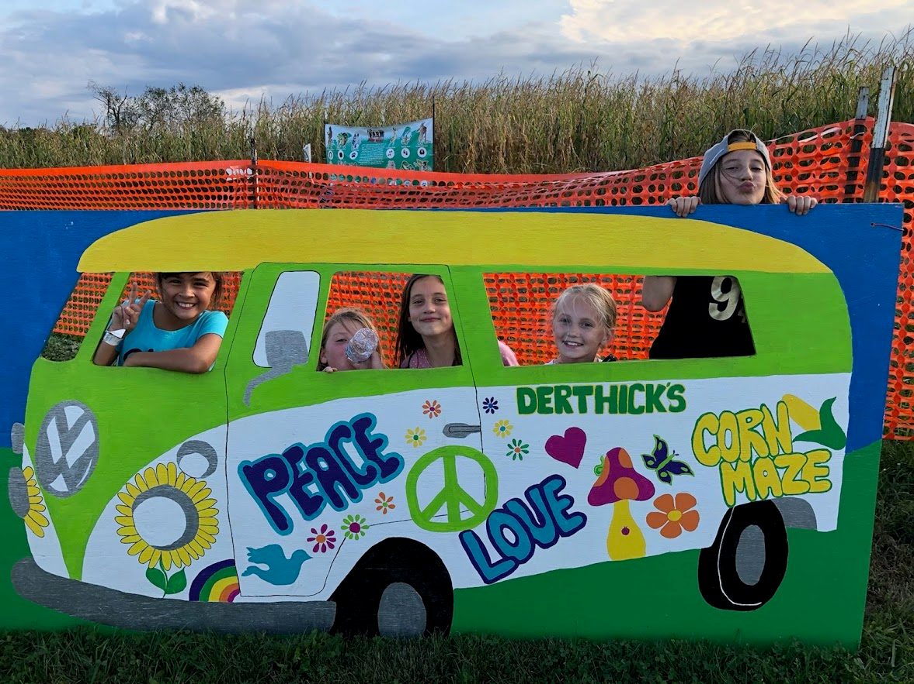
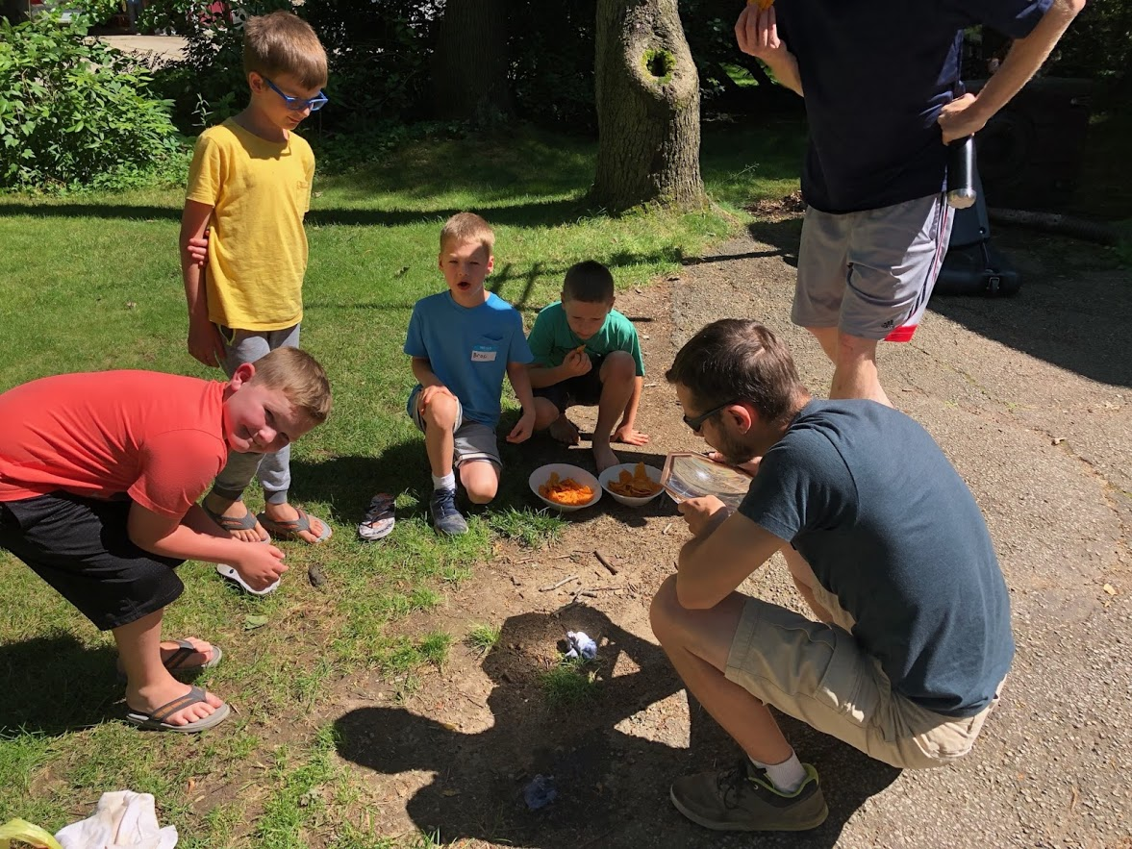

28 kids w/new babes
Christian Life Center
Elementary class
Kindergarten class
Preschool class
Nursery
New: guitar players!
New 5th Grade “BBS”
2 meetings, 6 kids so far

