Slide 1
Politics is contentious. We’re not going to shy away from that.
Notes:
People’s basic rights and well-being are at stake at politics.
Disagreement is fundamental to democracy
Not a class about policy, but policy is interwoven in politics

Slide 2
Two promises
I will treat you with respect
I will tell you the truth*
*to the best of my ability
Empathy is the next level above respect. I’ll try but will not always succeed.
Sometimes being told someone’s views can hurt. We can all think of examples. But it’s a sign of respect when done respectfully.

Slide 3
Normative vs Positive
In this class we are going to learn the difference between normative and positive
In a nutshell, “normative” is the realm of values and “positive” is the realm of facts
I am going to try to make you question your normative commitments
By making you question their positive underpinnings

Slide 4
You belong here.

Slide 5
What’s at stake in American Politics?
Many features of politics and media make it hard to know what’s really at stake. For example:
Politicians make tendentious implications
Parties exaggerate differences
Media profits off of controversy
However many facts are googleable if only we know to be skeptical, particularly of “our own” side!

Slide 6
Example 1: Republican split over Ukraine aid
Conservative Republicans argue that Ukraine aid "puts America last" and means that "we're ignoring our own people's problems".
They are expressing the view that we are spending too much on Ukraine. Fine!
However, one might think that we are spending a large part of the national budget on Ukraine.

Slide 7
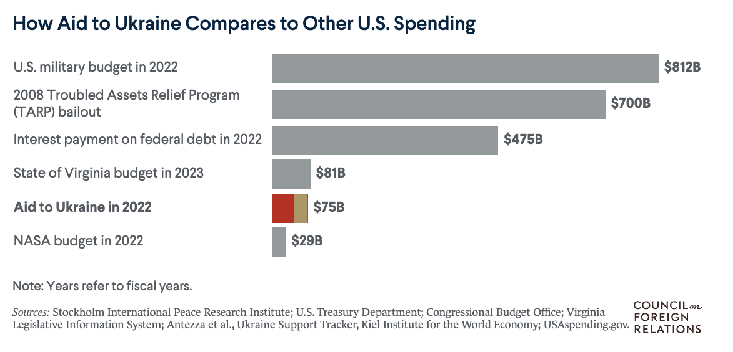
Example 1: Republican split over Ukraine aid
Much of this money is spent on domestic military production

Slide 8
Example 2: Democratic opposition to border wall
Senate Minority Leader Chuck Schumer said America's symbol "should be the Statute of Liberty, not a 30-foot wall.” (AP, January 9 2019)
In fact, many border security policies have been similar.
Biden Administration waived 26 federal regulations to construct additional border wall in fall of 2023

Slide 9
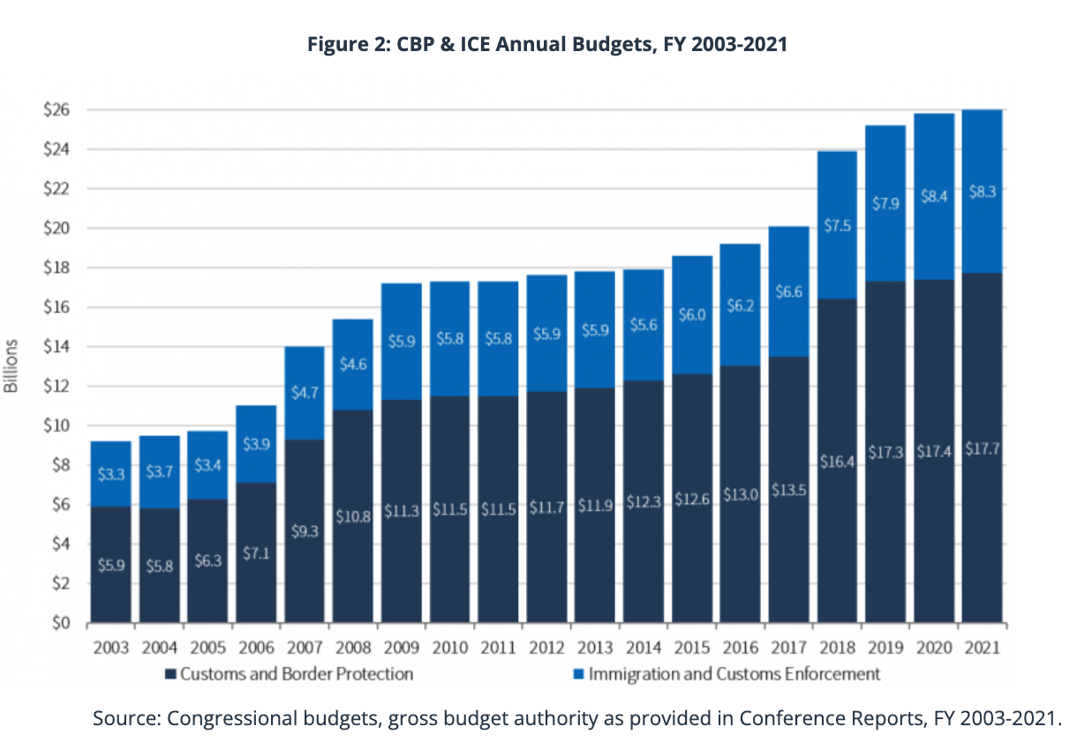

Slide 10
Some context: the Federal Budget
What policies are a big deal? Which are a small deal?
This is a hard and also subjective question.
But at least part of the answer has to be cost or expenditure.
Money quantifies our ability to do something else instead!

Slide 11

But isn’t the federal budget endlessly complicated?
There are many many many federal programs.
But mostly, federal government is just an insurance company with an army.

Slide 12
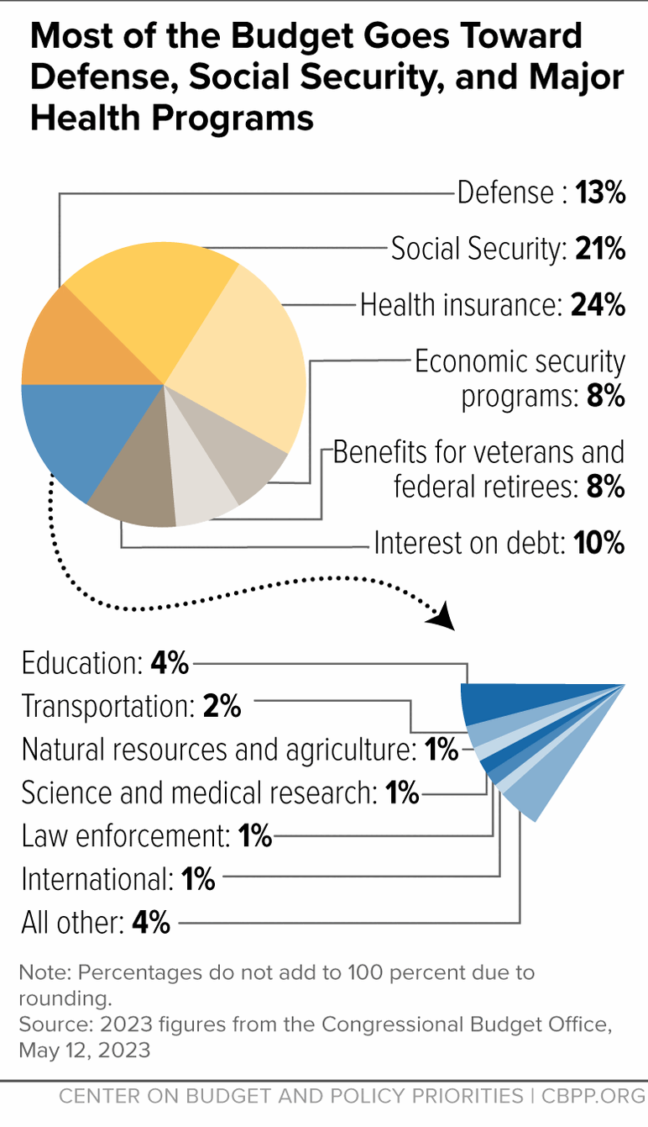
70%

Slide 13
Insurance
Insurance is pooling of risk
Everyone pays, benefits are received by victims of events both expected (old age) and unexpected (major health problems)
Social insurance is compulsory and paid for by taxes
Social security (~21%): risk of poverty in retirement
Medicare (~12%): risk of high health bills in retirement
Medicaid (~9%): risk of poverty/poor health
Notes:
Conservatives sometimes object to the notion of “social insurance” because they object to the idea that poverty, for instance, is really the product of bad luck.
However, the notion that different people can have different risks is inherent in all types of insurance.

Slide 14
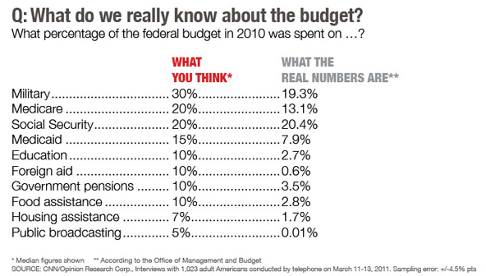
What people think it does

Slide 15
What people think it does

Slide 16
What are budget fights about? (In a nutshell)
Democrats sometimes want to create new social programs.
Republicans sometimes want big cuts to Medicaid.
Sometimes Republicans want lower taxes for “rich” people, and Democrats want higher taxes for “rich” people.
If you don’t understand the size of the tradeoffs, then you don’t understand much. But it’s not hard!

Slide 17
Back to government
This is not a class about policy! It’s a class about politics.
But it’s important to understand the stakes of politics.
This class will be concerned with how our politics and institutions generate different policy outcomes.

Slide 18
Next class: Government at the founding
No social insurance
Federal army had less than 1,000 men
Main expense: revolutionary war debt
Most revenue from tariffs
Exception of a few excise taxes, i.e. on whiskey
Notes:
Gov had land it would give to people

Slide 19
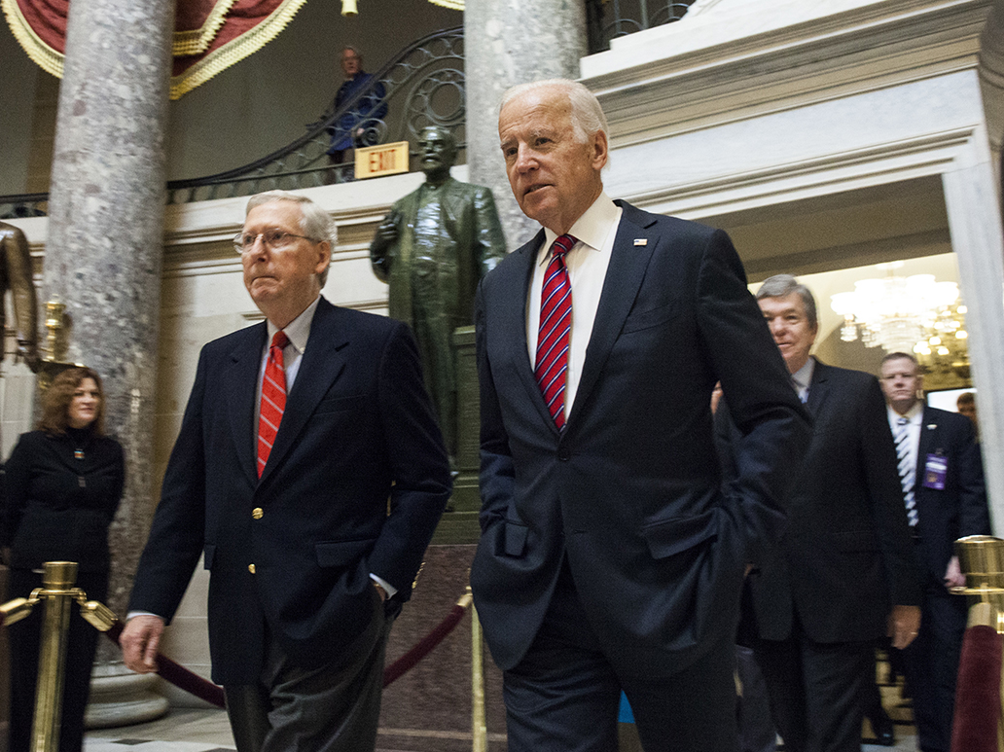
The Constitution
And yet, same rules that were made at that time structure conflict today

Slide 20
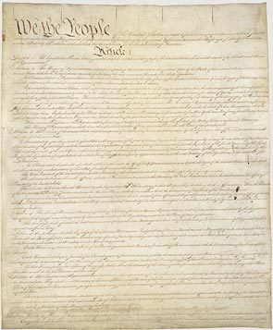
Why do we have the government we have?
Stay tuned

