Slide 1
Representation on Continuous Policies
Chris Tausanovitch and Connor Warshauer
UCLA
Notes:
30 minutes

Slide 2
Argument
To understand representation, we need to consider policy in a continuous space
We also need to measure intensity over that space
Evidence
I attempt this in the case of the minimum wage
My measures tell a different story than standard “congruence”

Slide 3
Policy incongruence is pervasive
Congruence = Policy aligns with public opinion majority
Policy in the states is congruent 60% of the time (Caughey and Warshaw 2022)
Lawmaking in Congress is congruent 55% of the time (Ansolabehere and Kuriwaki 2025)
Passes unpopular bills 38% of the time
Fails to pass popular bills 47% of the time

Slide 4
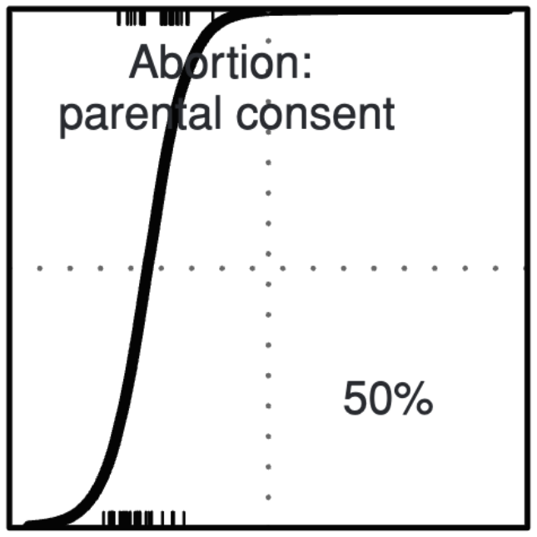
Measured congruence = almost always binary
Either a state has parental consent requirements for abortion or they don’t.
Lax and Phillips (2012)

Slide 5
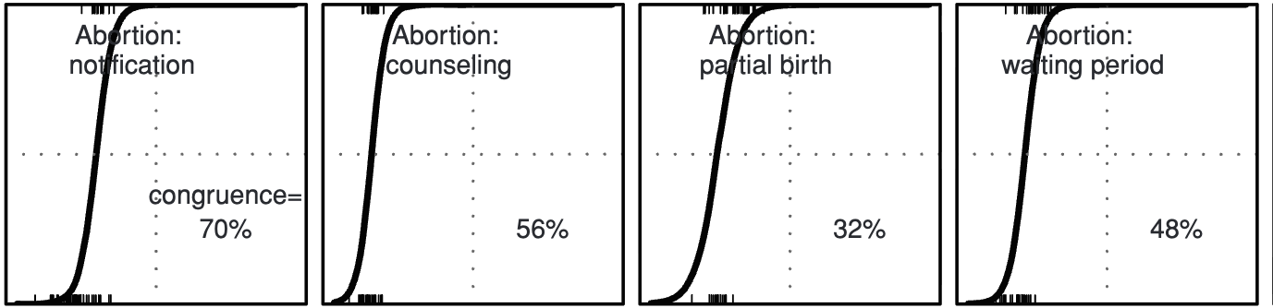
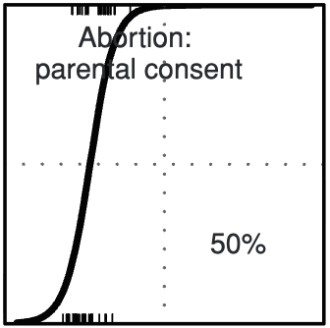
But policy is continuous

Slide 6
Congruence in continuous space is never perfect
Continuous congruence = distance between policy and median preference
Simonovitz and Payson (2023) find that state minimum wages are $2 less than voters prefer, on average
Is this a lot or a little?
Empirical question: what should we expect?

Slide 7
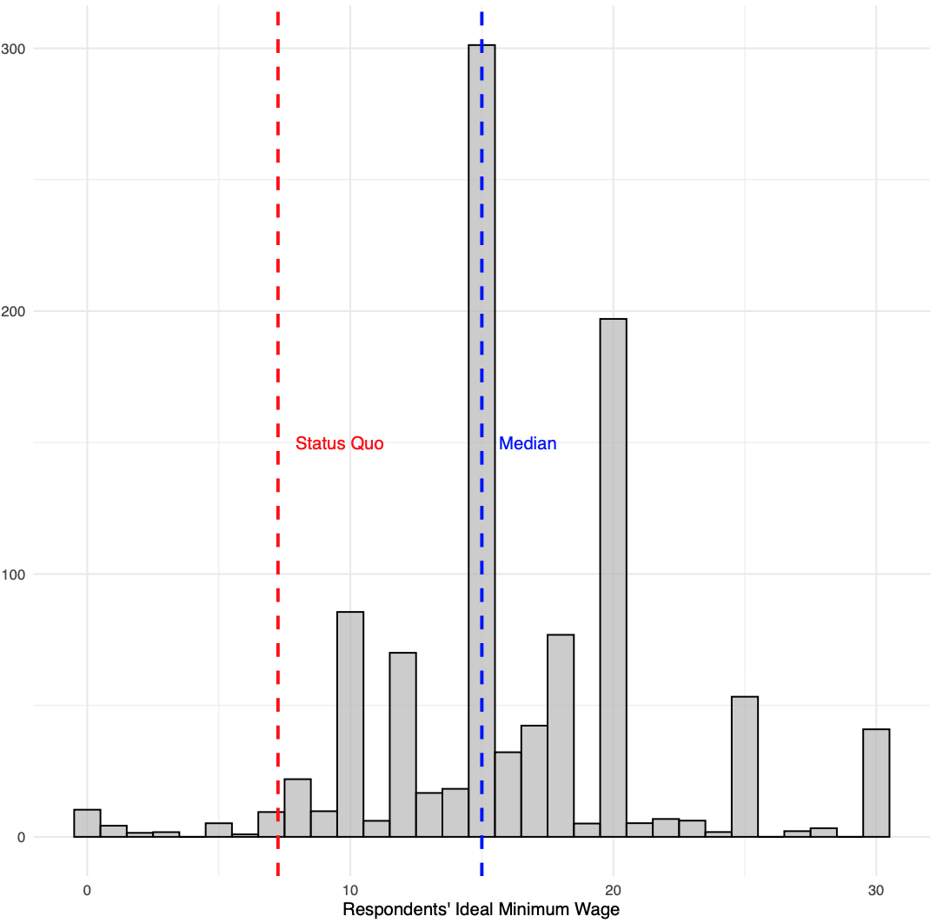

Slide 8
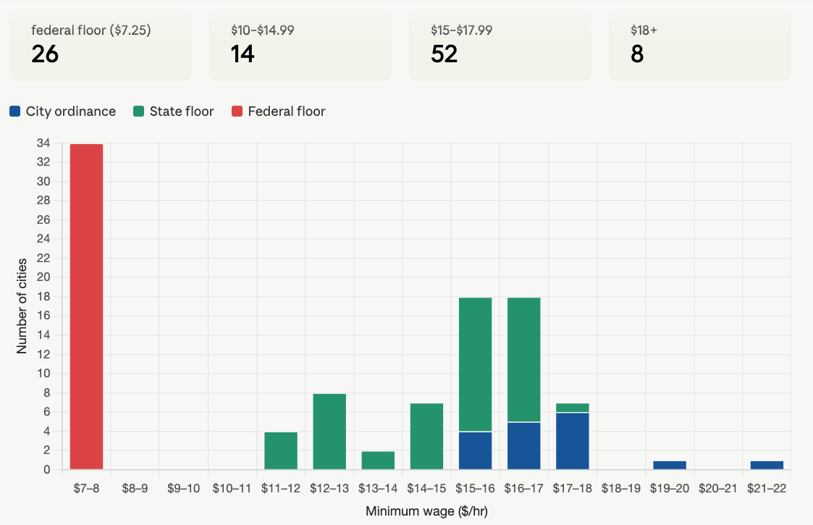
City-level minimum wages (100 largest cities)

Slide 9
How much incongruence should we expect?
In the simple two candidate spatial voting model: none
But IF
There are aggregate shocks to relative preference for candidates
Candidates are office-motivated and policy-motivated
THEN
The extent of policy incongruence may depend on the intensity of voter preferences

Slide 10
Measuring the elasticity of choice
Politicians need to know how their positions affect vote decisions
Measuring the elasticity of vote decisions:
We offer people bundles of policy positions that we vary experimentally
Estimate the effect of positions on choice
We include policy of current federal minimum wage ($7.25) and minimum wages varying from $0 to $30 in $1 increments.
Each respondent (N=1,050) reports their views on 10 binary issues + continuous minimum wage, and responds to 10 experiments

Slide 11
Experiment For Measuring Elasticity
Choice of one of two sets of policies, A or B
Four policies: Minimum wage plus 3 others randomly selected from list of 10, order randomized
For policies other than the minimum wage, affirmative version assigned to one set and negative version assigned to other
For minimum wage, $7.25 assigned to one set, $0 to $30 randomly chosen for the other

Slide 12
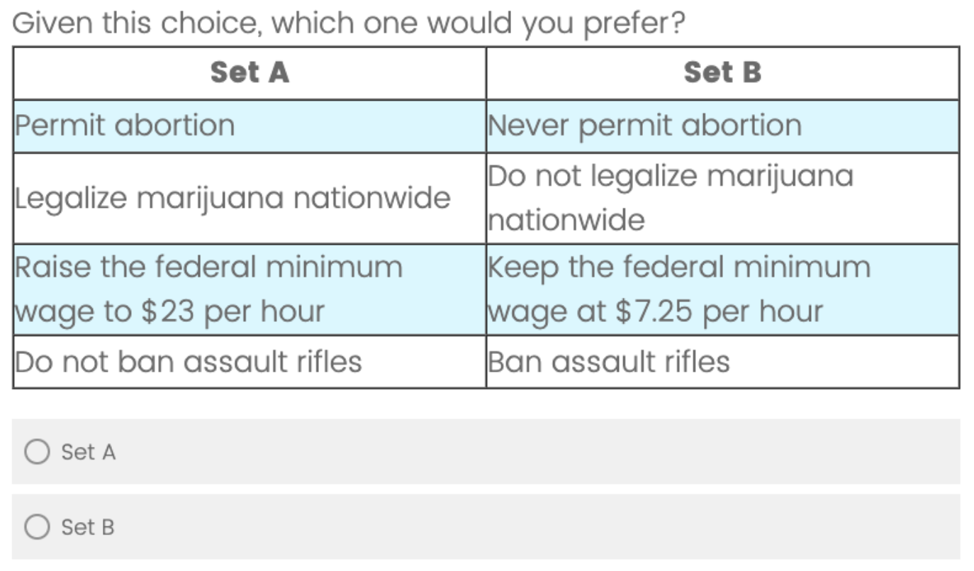

Slide 13
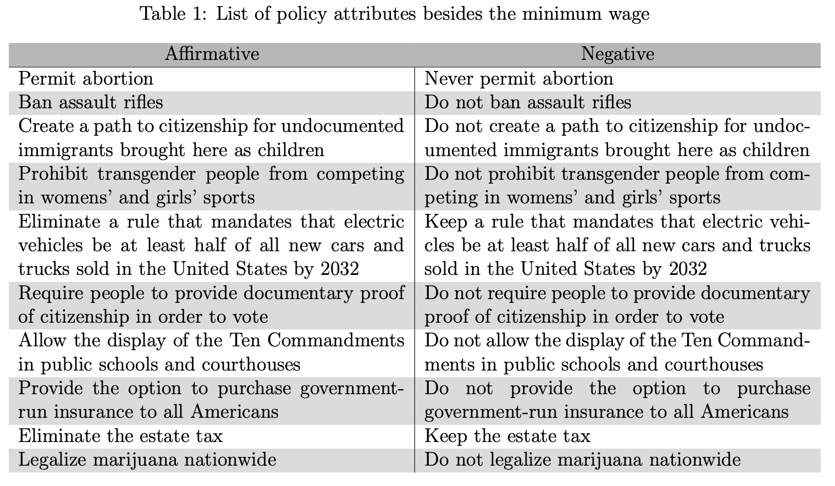

Slide 14
The Average Marginal Component Effect
This is just the regression coefficient of a 1,0,-1 dummy variable on choice of Set A
1 = affirmative version of the policy appears in set A
For minimum wage, values ranging from $0 to $30
-1= negative version appears in set A
For minimum wage, $7.25
0 = policy does not appear in either set
For minimum wage, that specific comparison
All effects estimated in one multiple regression, standard errors clustered by respondent

Slide 15
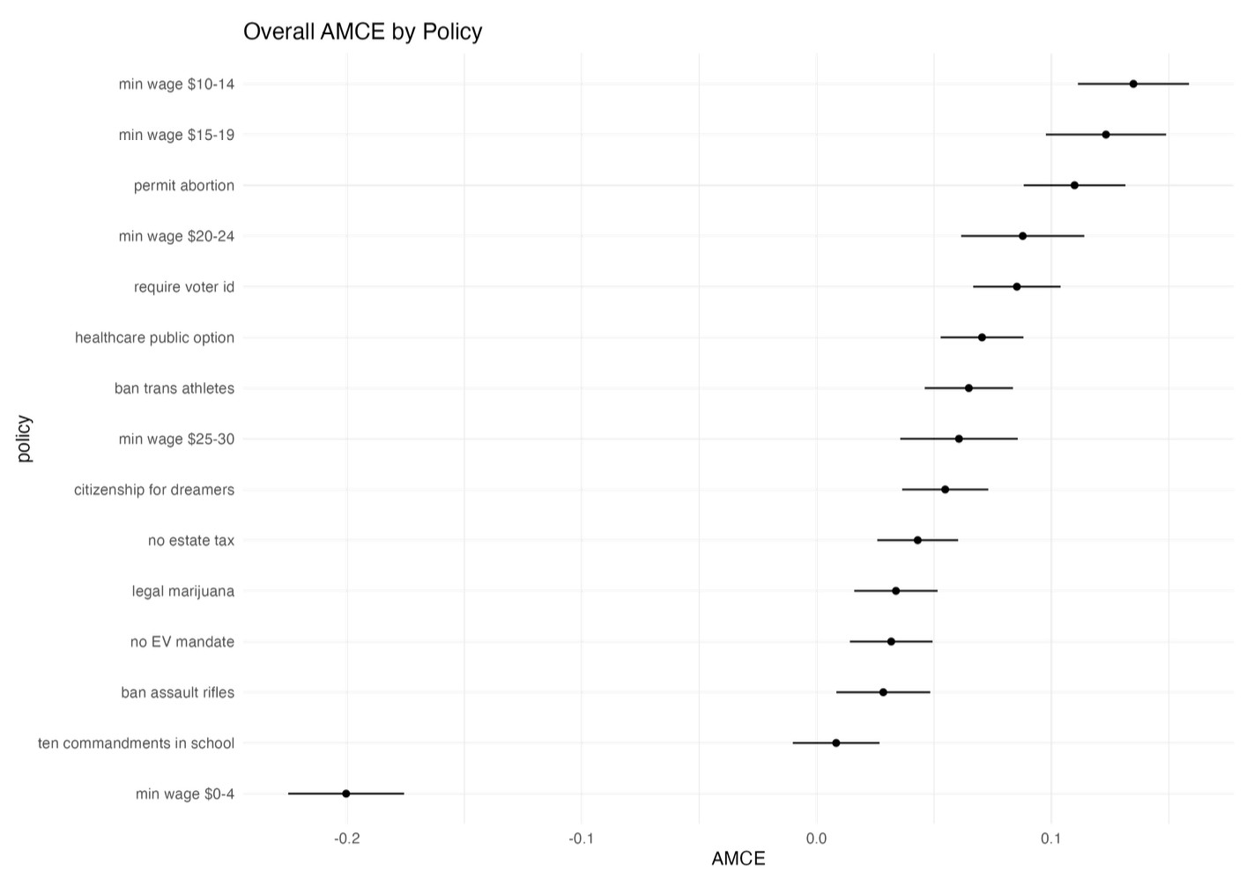

Slide 16
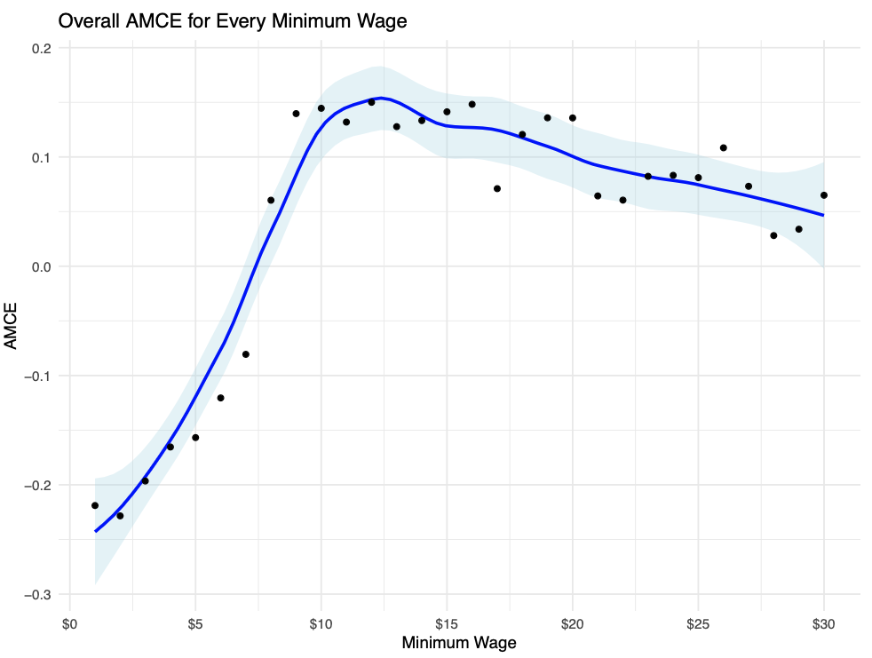
~0.1
From 65-35 to 55-45
~0.25
From 62-38 to 38-62

Slide 17
Indifference zone
Choices of alternatives to the status quo from $0 to $9 make a large difference in choice probabilities
Roughly .044 change in AMCE per $1
Choices of alternatives from $10 to $30 have about a tenth of the effect
Roughly .005 change in AMCE per $1

Slide 18
What are the political implications?
Overshooting preferred minimum wage is much less consequential for votes than undershooting
Is $10 a failure of democracy? $30?
Some forms of “incongruence” much more consequential!
Elections in the US are two-stage: what about the primary?

Slide 19
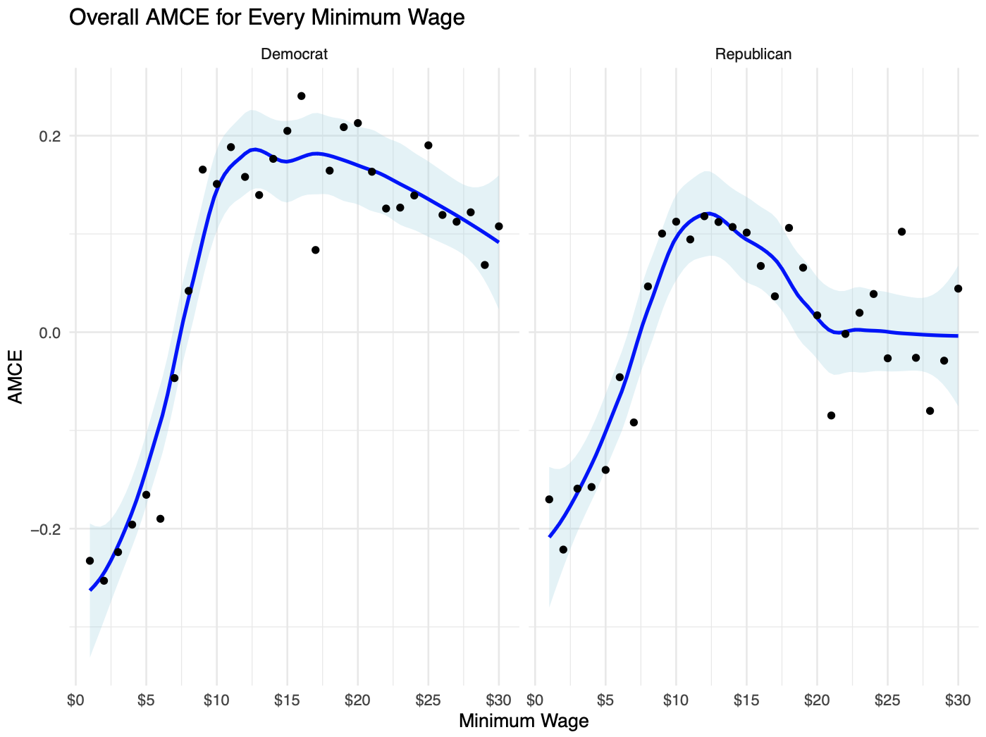

Slide 20
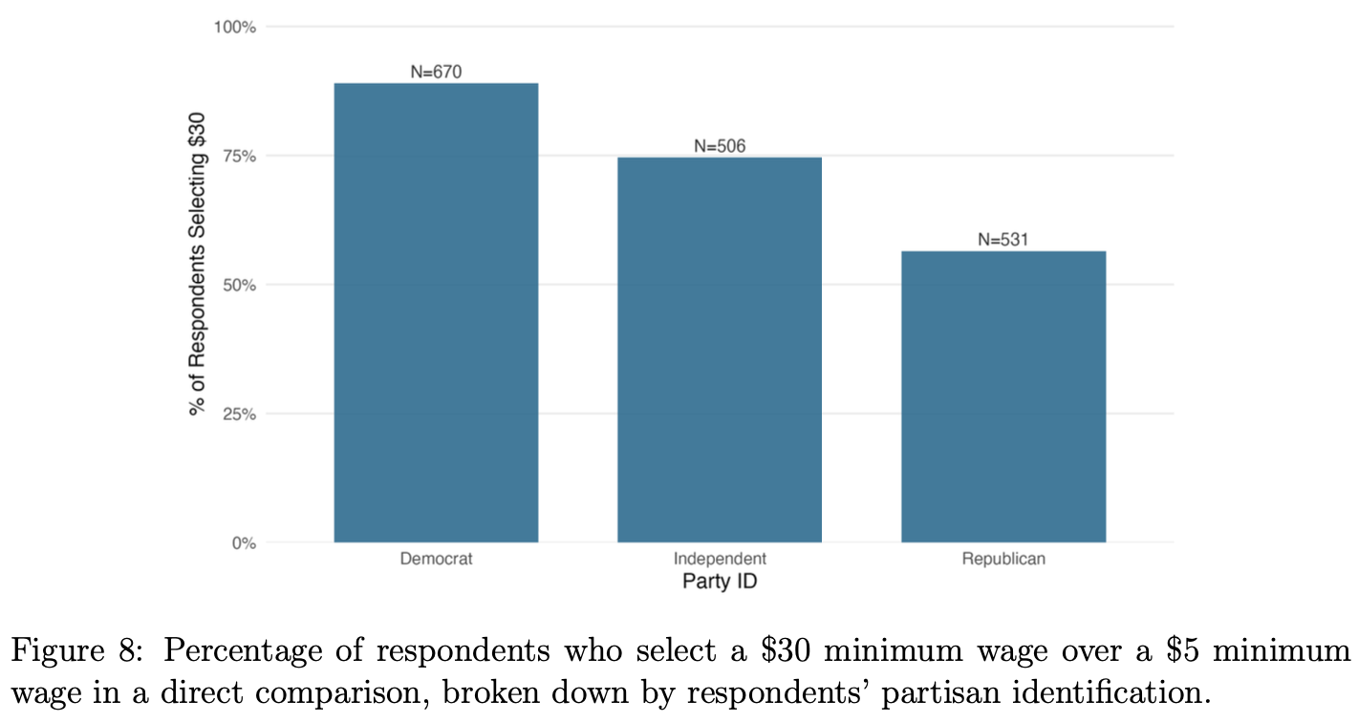
Reality check

Slide 21
Who accounts for the elasticity
“Churn” could be politically consequential
High individual elasticities could motivate more intensive forms of participation (e.g. issue publics)
But individual-level is hard to obtain
However, we can look at elasticity by most-preferred minimum wage
Indifference is widespread for large majority favoring increases

Slide 22
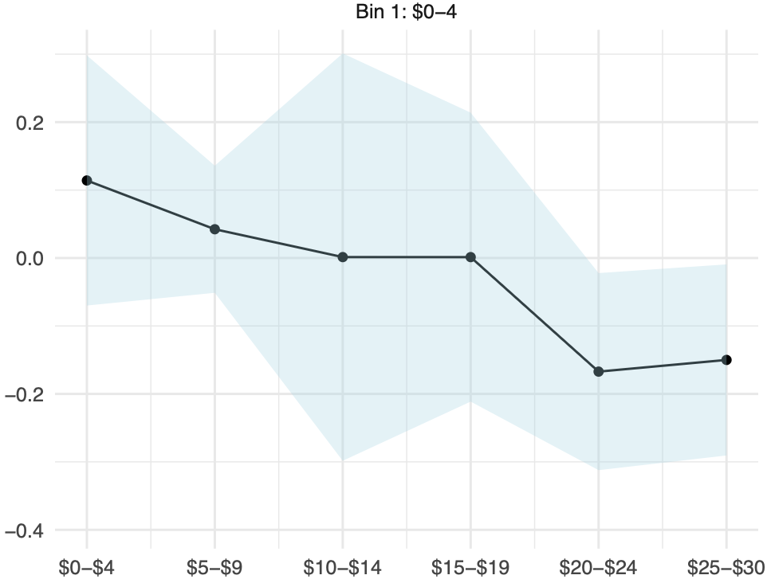

Slide 23
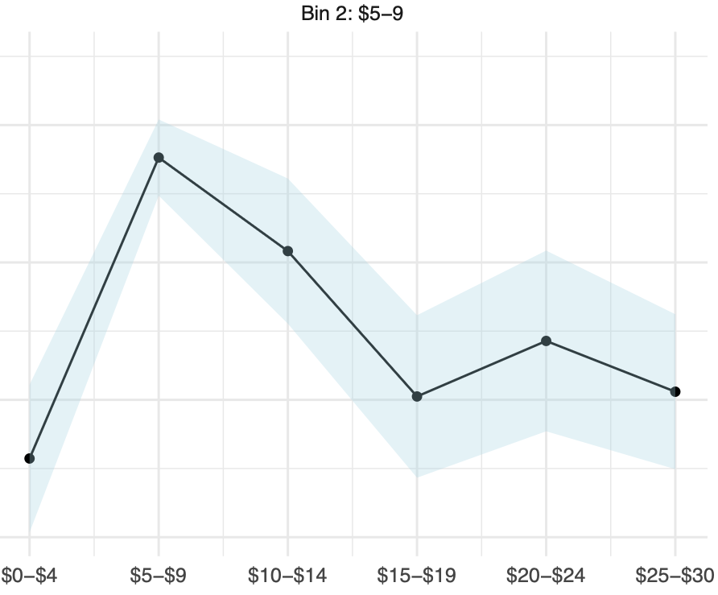

Slide 24
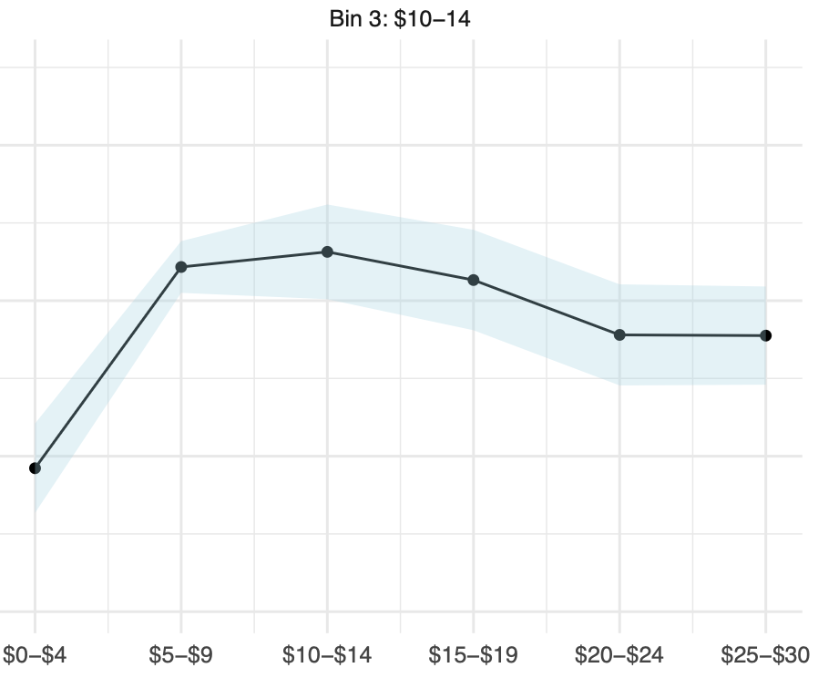

Slide 25
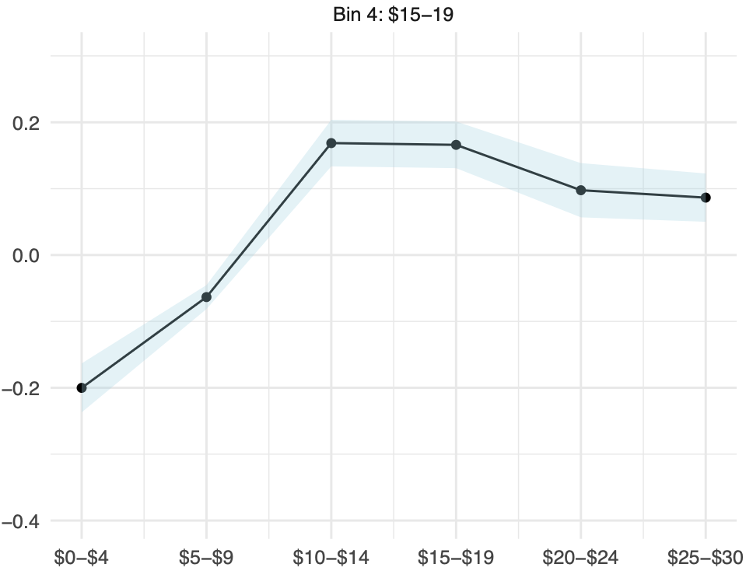

Slide 26
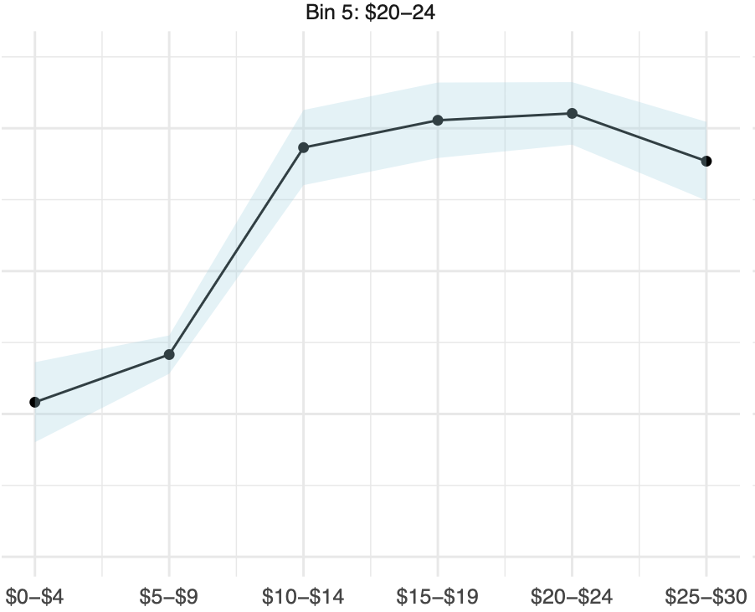

Slide 27
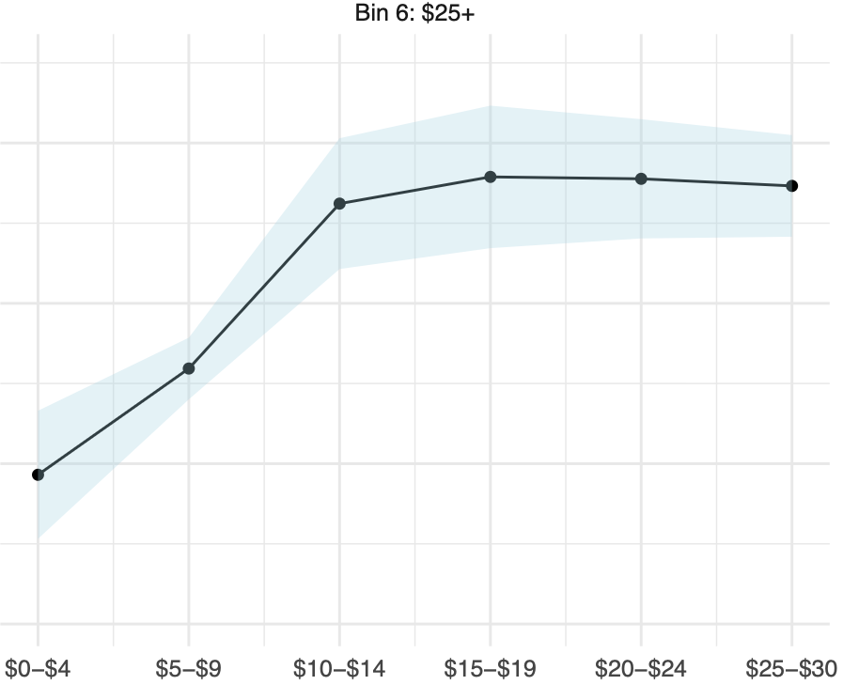

Slide 28
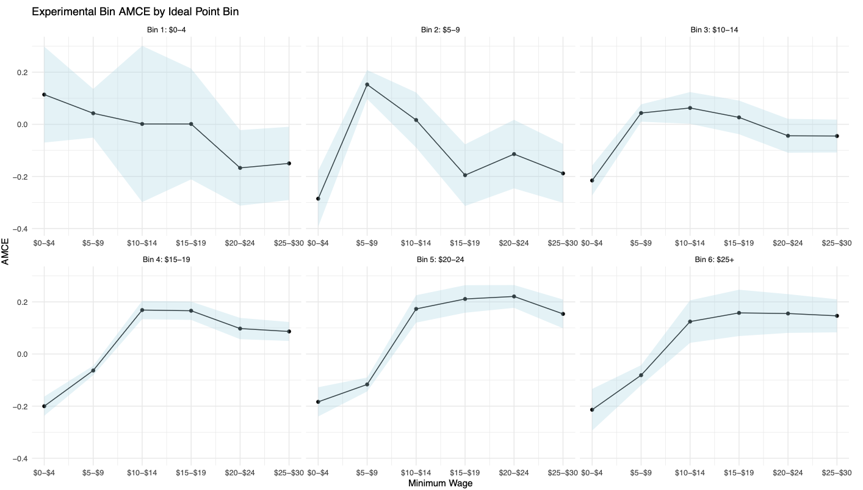

Slide 29
Summary: Findings
The public is close-to-indifferent over a wide range of values of the minimum wage
A priori, we should not expect politicians to lose substantial vote share from deviating from the most preferred minimum wage ($15)
With the exception that the public has an intense preference for higher-than-federal minimum wages

Slide 30
Takeaways
Almost all policies exist in a continuum of policy options
Our expectations about representation depend on our theory of accountability
If candidates are policy motivated and voting is probabilistic, then the elasticity of choice of the public over a continuum of options is fundamental in shaping electoral incentives
Ambivalence does not explain all gaps in representation – more research needed

Slide 31
Extra Slides

Slide 32
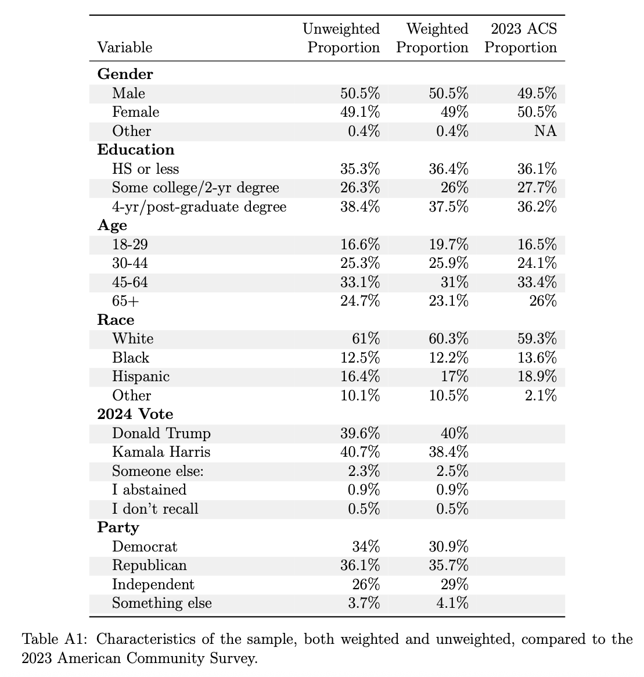

Slide 33
Congruence depends on item selection
Policy
Voter
Congruent cutlines
Incongruent cutlines
Congruent cutlines

Slide 34
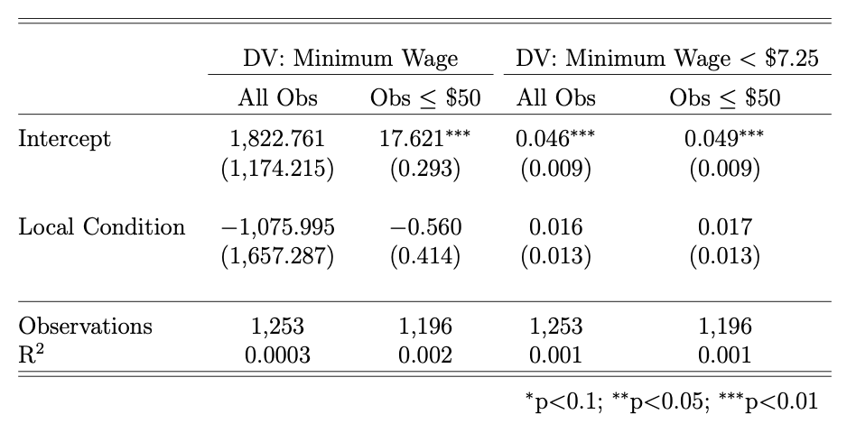
Question wording
National: “In your view, what should be the federal minimum hourly wage?”
Local: “In your view, what should be the minimum hourly wage in the town or city you currently live in, in dollars per hour?”

Slide 35
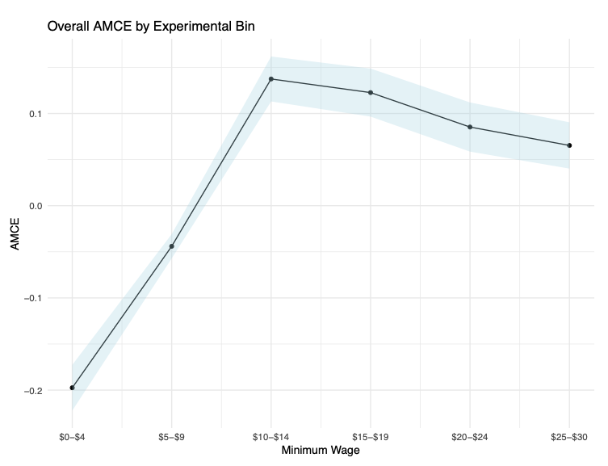
Binned Approach

Slide 36
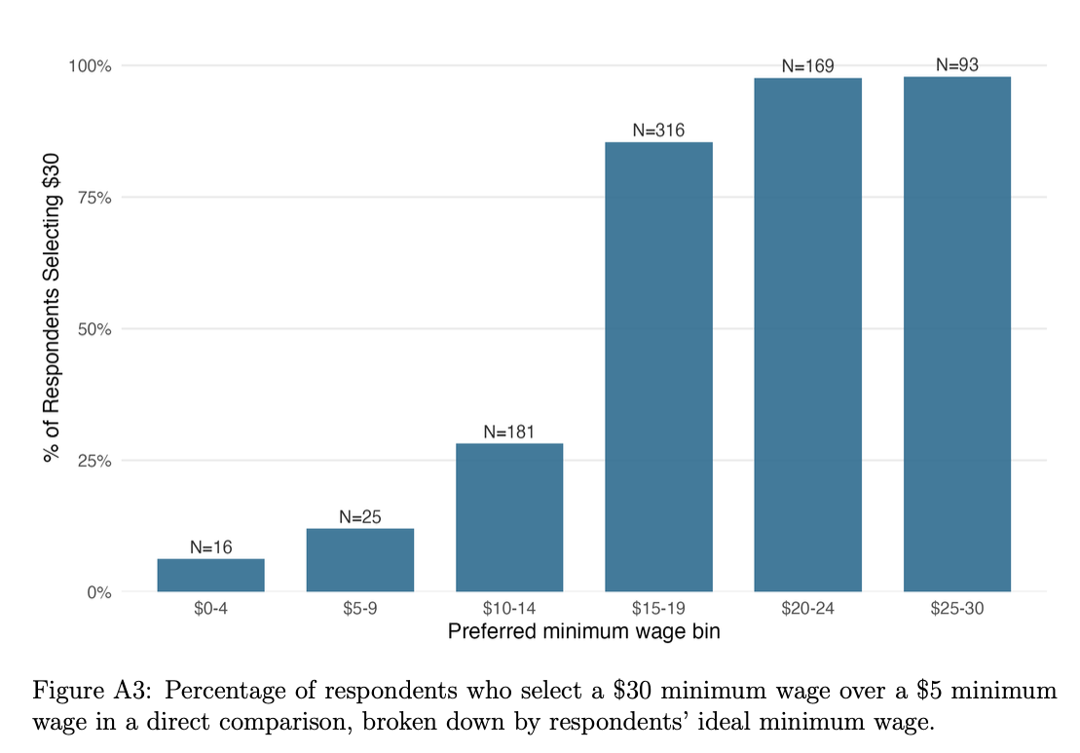

Slide 37
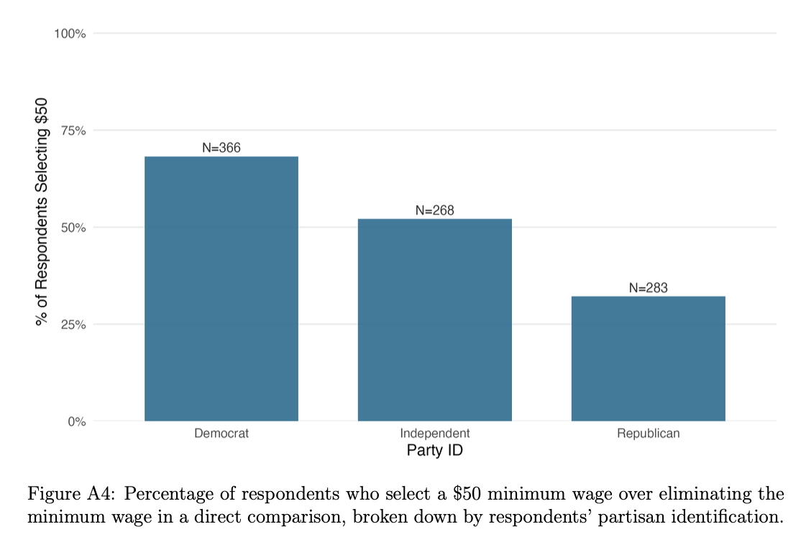

Slide 38
