Slide 1

2026 Midterms:
Electoral Tsunami,
Policy Ripple
Chris Tausanovitch
UCLA
Political Science

Slide 2
What are the consequences of 2026?
3 Graphs:
How big was the Tsunami?
Fundamental change or pendulum swing?
How has the composition of Congress changed?

Slide 3
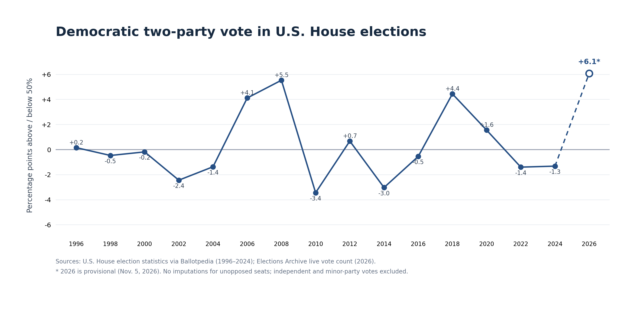
How big of a Tsunami?

Slide 4
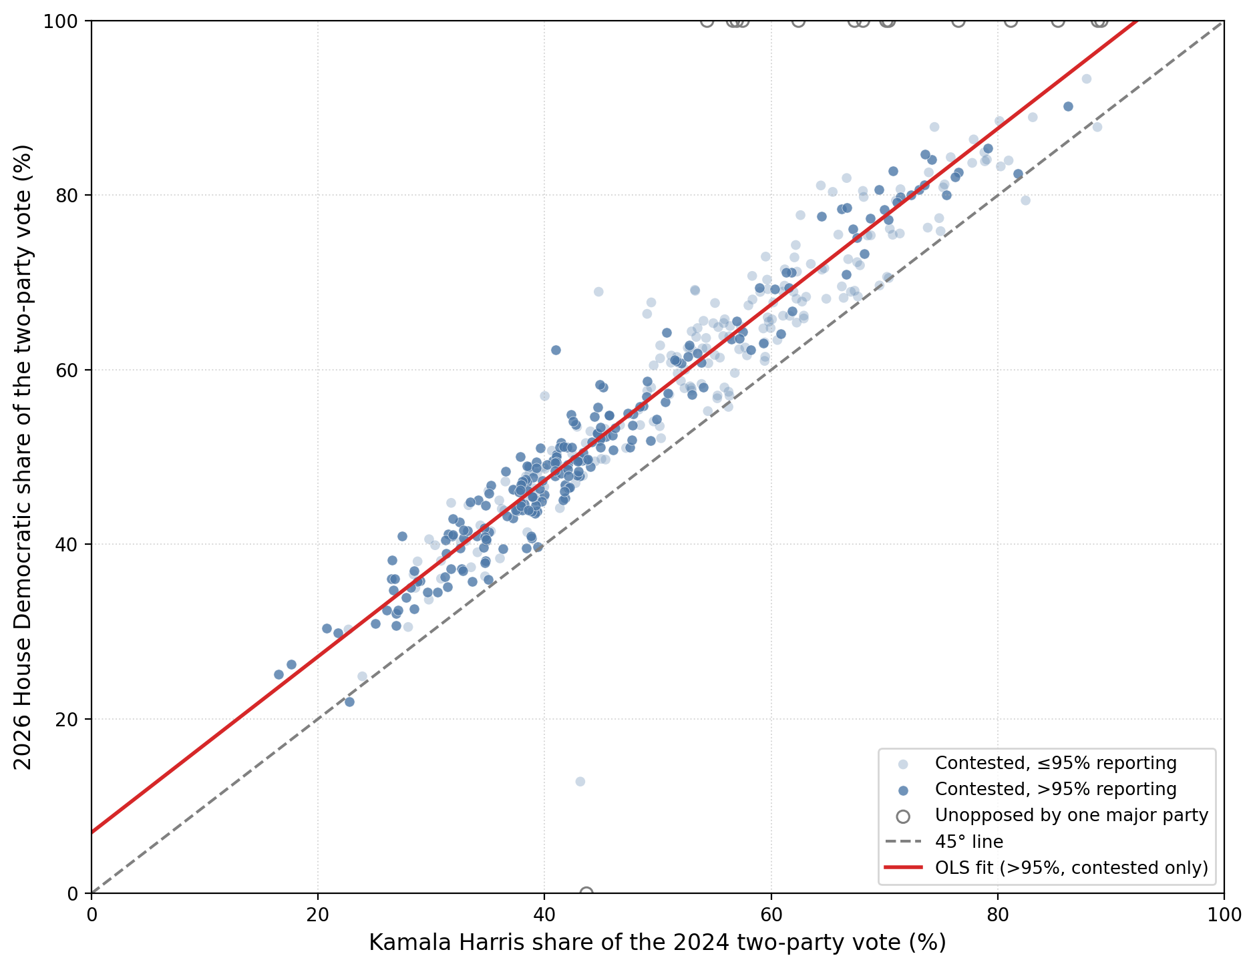
Where did people shift towards the Democrats?

Slide 5
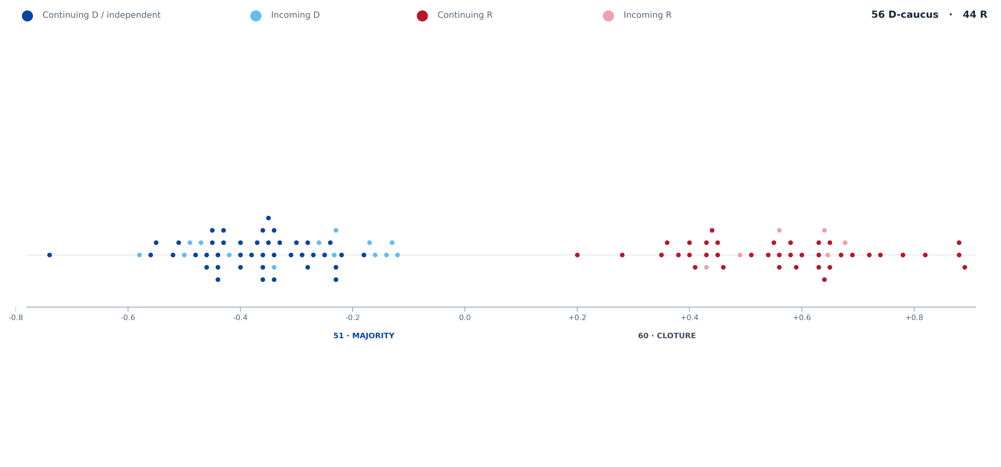
What will the Senate look like?

Slide 6
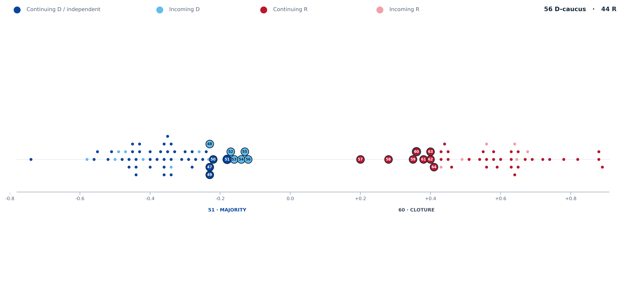
What will the Senate look like?

Slide 7
What will the Senate look like?

Slide 8
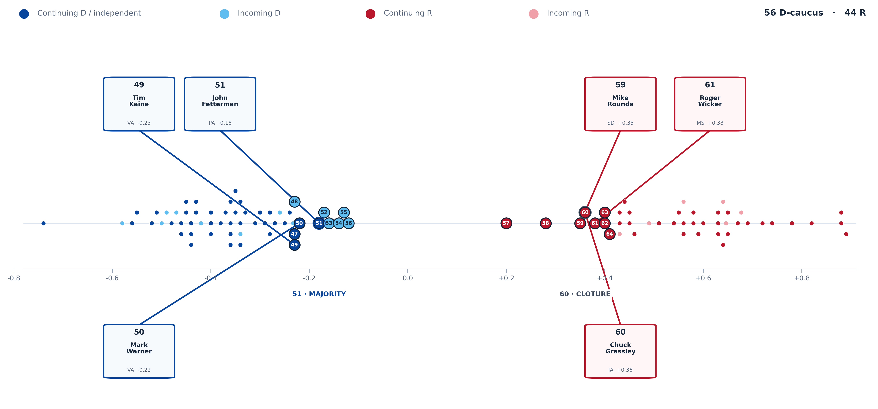
What will the Senate look like?

Slide 9
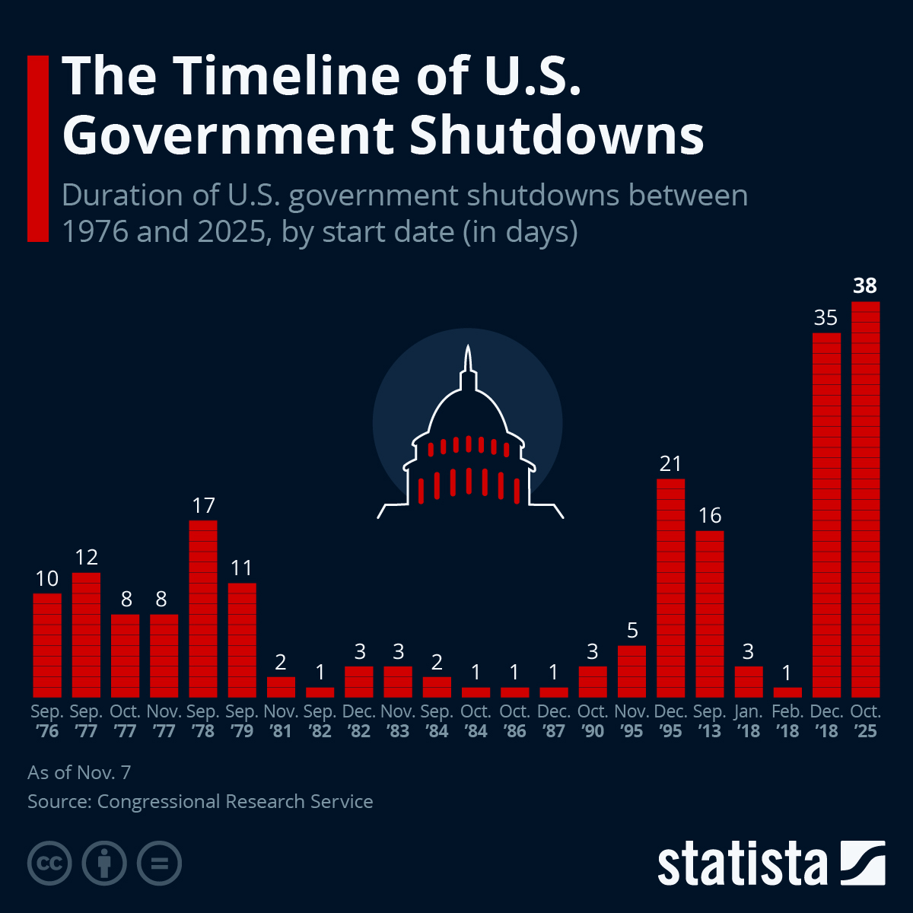
What should we expect?
Messaging legislation
Failed cloture votes
A little bipartisan legislation
A budget battle

Slide 11
Bipartisan Stuff?
Permitting reform
AI regulation + Data Centers
A Few Rs?
Ukraine Aid
Iran war limits
Tariffs
Minimum wage
Partisan Stuff?
Cut ICE/BP
Executive branch reform
Restore Medicaid
End tax cuts
Progressive Stuff?
Medicare-for-all
Punitive measures towards Israel
Impeachment

Slide 14
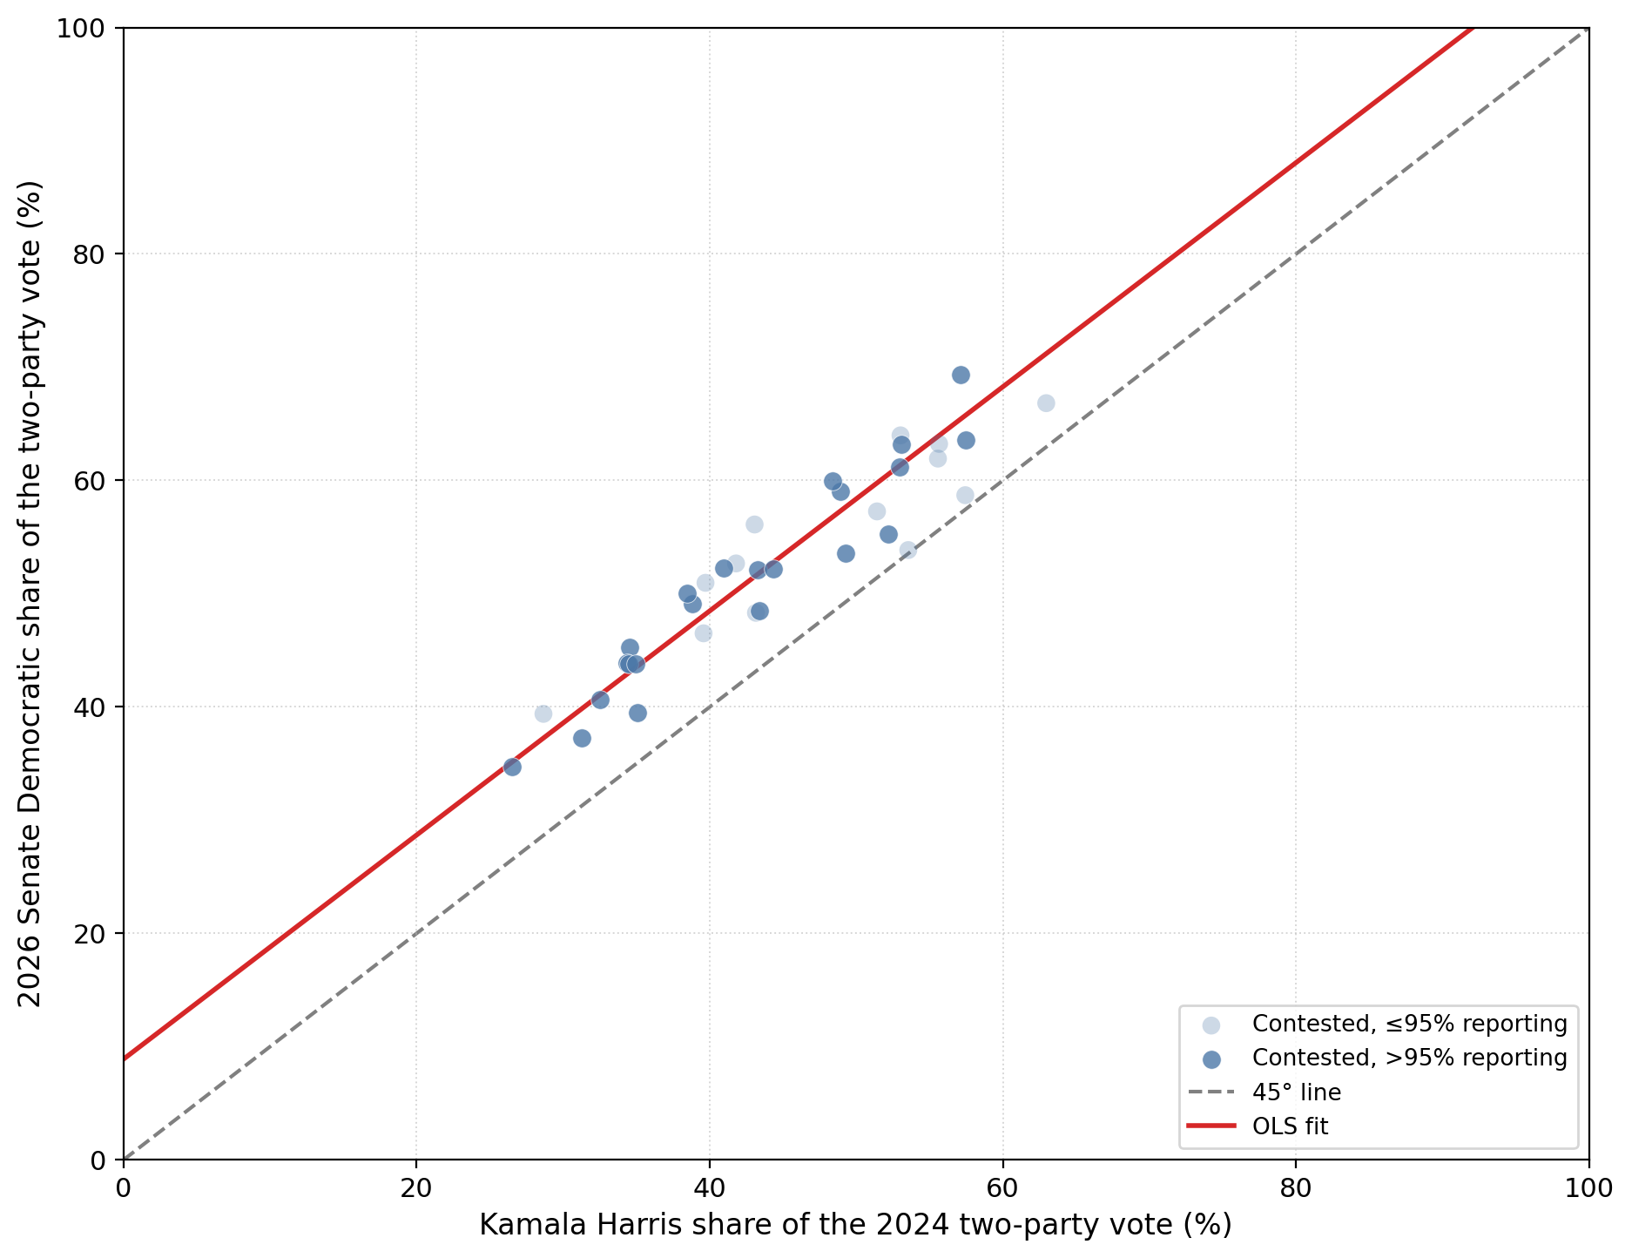
Notes:
+8.46% in the average state where there was a Senate race

Slide 15
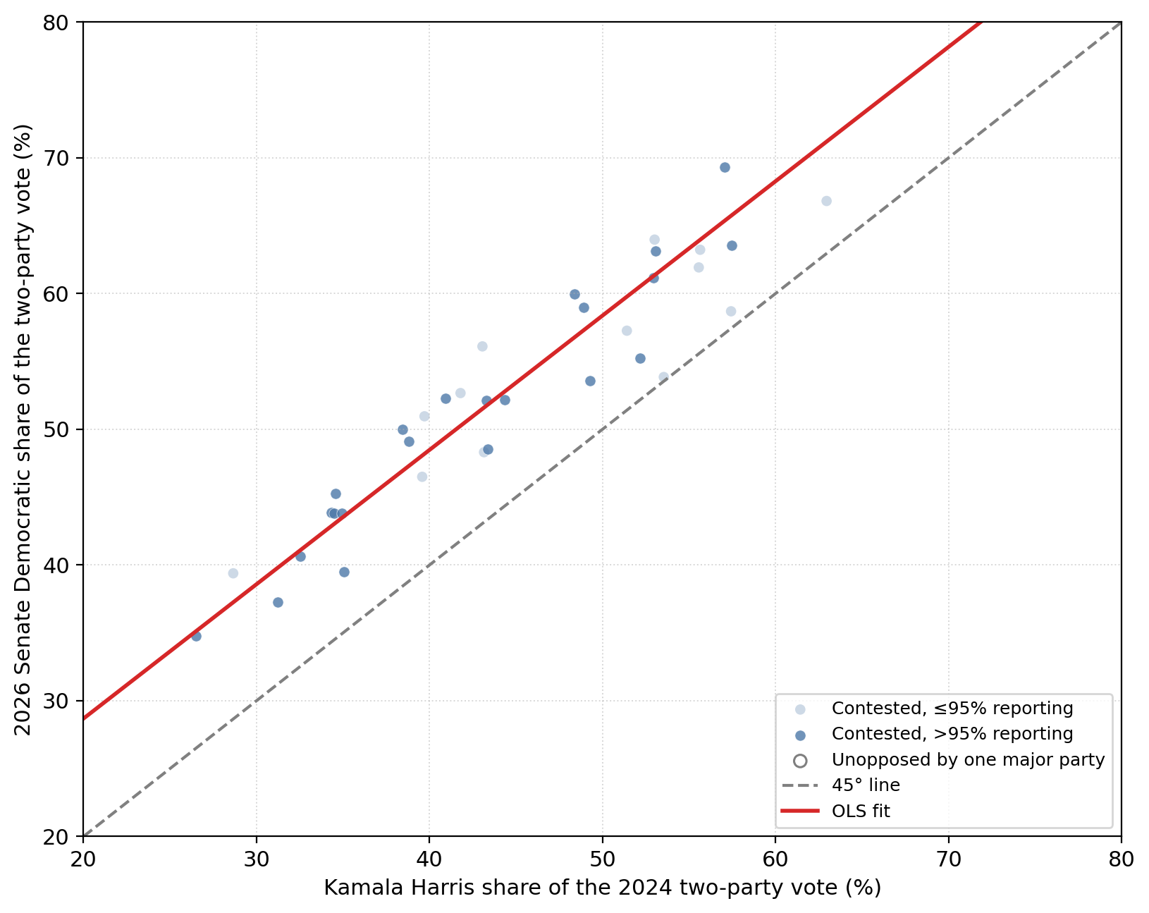

Slide 16


Slide 17


