Slide 1

(Thinking About) Introducing Agile Testing to the One Laptop Per Child Project
C. Titus Brown
Asst. Prof., Michigan State U.
titus@idyll.org
Notes:
Talk you’ve all been waiting for: the last one.
Asst prof, dev bio & bioinformatics; promise to give boring talk next year
Live demo, may fail. Net connectivity at PyCon is hard to manage.
May touch a bit on the “rough edges” that Ivan mentioned.

Slide 2
“Solving Social Problems, Technically”
Notes:
Joke, my usual approach.
Management is frequently the source of the problem.

Slide 3
Rough outline
Agility (agility?) and Software Development
Forensic code analysis
The OLPC and sugar-jhbuild

Slide 4
Agile methods hinge on… agility in software practices
Rapid iterations
Immediate feedback
Frequent releases
Test automation

Slide 5
Automated testing
A keystone of agile methods is automated testing.
Having good automated tests lets you refactor and re-engineer small parts of big code bases.
There are many other benefits, too.
Notes:
I am all about testing. Other benefits: get new people up to speed; portability; exploratory testing means you tested last week’s code, not this week’s code (“moving target”)
Not to the exclusion of exploratory testing…!

Slide 6
Forensic code analysis
Large software projects are living, breathing, evolving organisms.
We lack tools to study them.
CPython has some nice hooks for this purpose.

Slide 7
Watching your code execute with trace hooks
CPython’s sys.settrace lets you “bug” your code.
In particular, you can do simple things like code coverage analysis very easily.
Wouldn’t it be nice to be able to retrieve that information from long-running processes?
Notes:
…like Web servers and GUIs?

Slide 8
Back to the OLPC…
The OSS community is intolerant of projects that do not have version control or automated build systems.
Would that the same were true of automated tests...
(Guess where I’m going with this.)

Slide 9
The OLPC graphical interface has no automated tests.
The test plan is:
“have other people do it.”
Notes:
…and, even worse, it’s not actually working AFAICT

Slide 10
Why am I being such a jerk?
The “Testing Death Spiral”
Write a bunch of code & manually test it.
(Good so far.)
Start adding features over here;
Watch code over there break.
Rinse, lather, repeat.
(where do you think this ends?)
Notes:
90% or more of a successful software project’s energy is focused on maintenance. Apparently this 90% is “rough edges”

Slide 11
Cascade of Attention-Deficit Teenagers
“I report bugs; they go unread for a year, sometimes two; and then (surprise!) that module is rewritten from scratch -- and the new maintainer can't be bothered to check whether his new version has actually solved any of the known problems that existed in the previous version.”
(jwz; “CADT”)
Notes:
This is the future of OLPC Sugar

Slide 12
Actual quote
"It will always have bugs in it and it will never be perfect," Mr. Negroponte told them, adding that he has a "royal battle" with his Windows-based computer nearly every morning.
Notes:
This may be a cheap shot, but it seems like the wrong comparison to me. The first is certainly true. I hope the second isn’t the bar being set.

Slide 13
Continuous integration
‘sugar-jhbuild’ lets you build the Sugar graphical environment under Linux.
Depends on 51 distinct packages which are pulled in from various places on the ‘net.
Breaks frequently.
Notes:
Sugar is the OLPC graphical interface

Slide 14
Implementing continuous integration
Placing a buildbot on ‘sugar-jhbuild’ gives us a dashboard where we can look at build breakages.

Slide 16
Simple GUI automation
+
Watching Sugar run with figleaf & figserve
Notes:
OK, but that’s easy… THIS is hard.

Slide 18
Trivial twill extension for xmacro
extend_with twill_x
move 471 337
type_in titus
move 970 650
click
sleep 1
click

Slide 19
Watching Sugar (etc.) programs run with figserve

Slide 20
Concluding thoughts
Watch the buildbot go!
Runtime code tracing is just fun
GUI test automation is annoying
  GTK does not have good testing hooks
  OLPC accessibility layer is not dogtail-compatible
  Driving X is always going to work, but it doesn’t work at the right level of abstraction…

Slide 21
Concluding thoughts
Runtime code tracing can be applied to collaborative exploratory testing:
  Group of people with OLPCs
  Central server recording code execution
  Code coverage analysis then guides exploratory testing
Test automation is not a panacea, but it can really help stabilize a code base.

Slide 22
Future outlook
More effort needs to be applied to testing, especially GUI automation.
I am interested in helping (as a mentor).
Some opportunities:
  “Python testing tools” / OLPC GSoC student
  Disney Animation intern
Stop writing new stuff & make sure the old stuff works & stays working, eh?
Notes:
Kicking the family dog… lots of people have had negative personal experiences with the OLPC

Slide 23
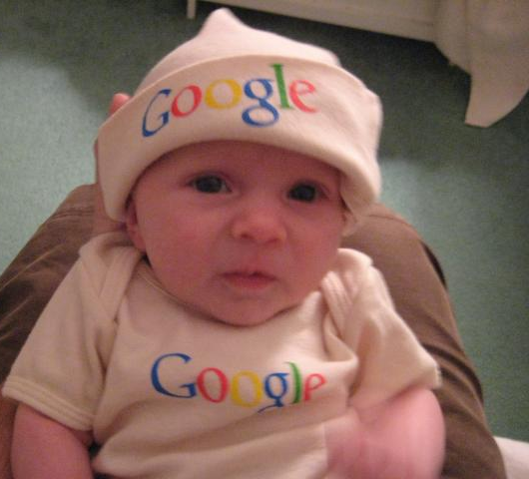
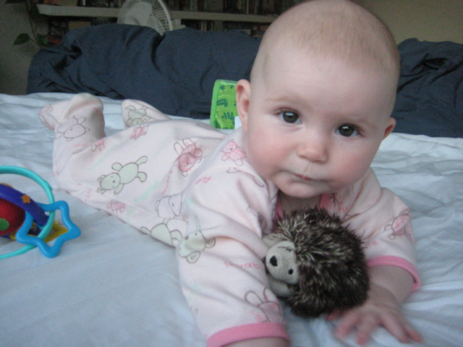

Slide 24
Future outlook
More effort needs to be applied to testing, especially GUI automation.
I am interested in helping (mentor).
Some opportunities:
  “Python testing tools” / OLPC GSoC student
  Disney Animation intern
Stop writing new stuff & make sure the old stuff works & stays working, eh?
Notes:
Kicking the family dog… lots of people have had negative personal experiences with the OLPC

Slide 25
Thanks!
I will upload a screencast of the cool stuff ASAP; bug me via e-mail.
If you’re interested in testing summer stuff (GSoC or Disney) please contact me:
titus@idyll.org

