Slide 1

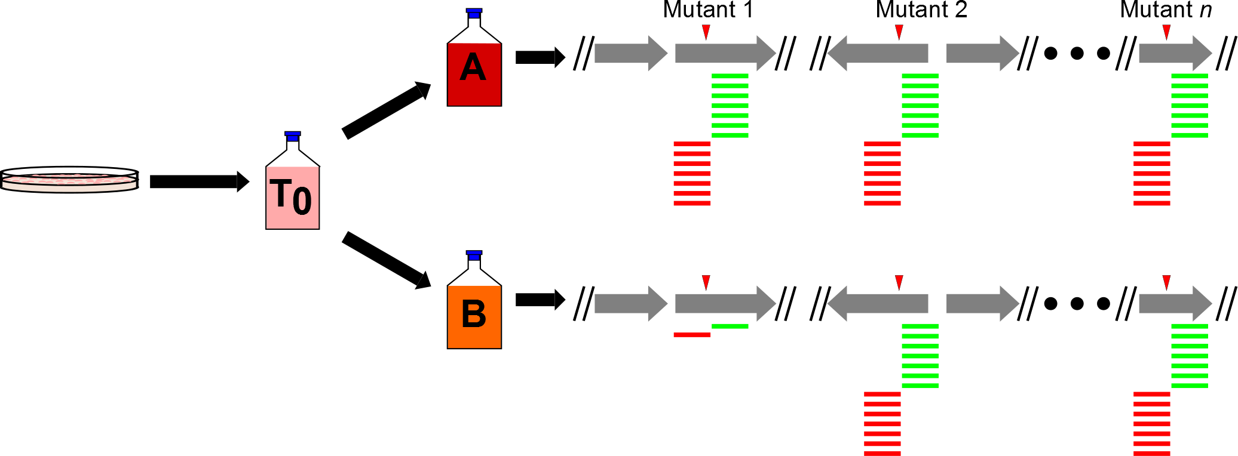
Tn-Seq- “Toothpicks and logic” meets next-gen sequencing
Saturated
library
with n
mutants
Outgrowth of parent
library (T₀) under
different conditions
(A and B)
DNA isolation, Mme1 digestion,
amplification, and deep
sequencing to compare outgrown
libraries with parent library

Slide 2
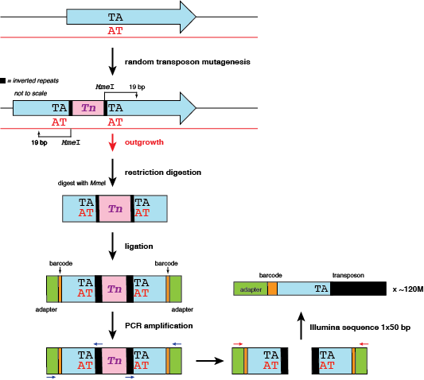

Slide 3
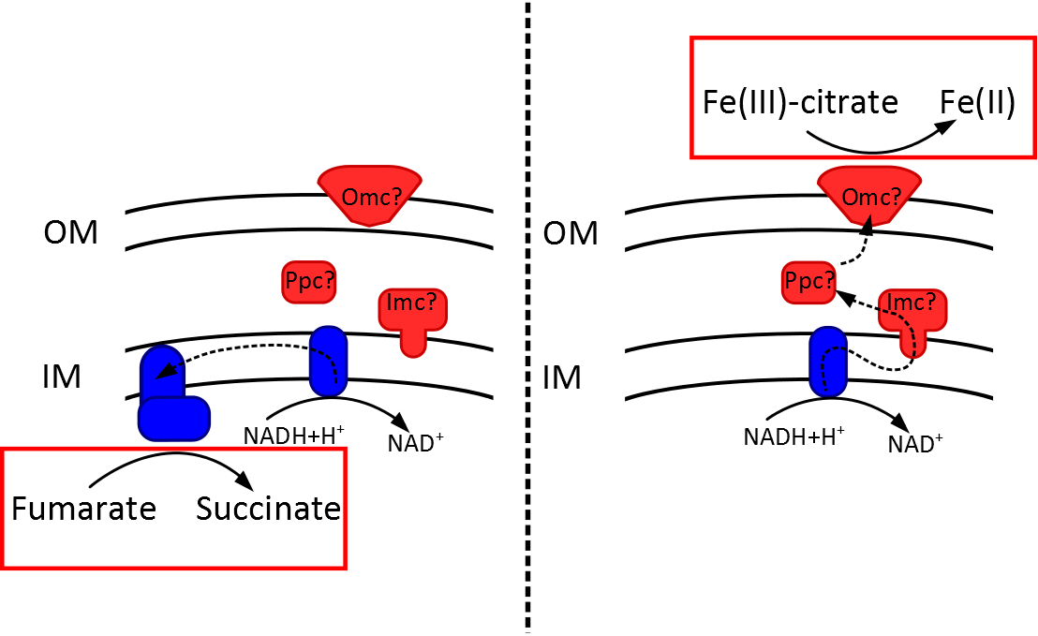
Condition A:
Fumarate reduction
Condition B:
Fe(III)-citrate reduction

Slide 4
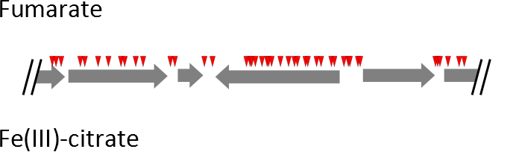
Tn-Seq in Geobacter
Notes:
So, most basically, when we look at data like these, a few things start to pop out. First, each of these red triangles represents a unique transposon insertion location that we identified in our parent library. So just based on the number of insertions present in our starting library, we seem to have a pretty good chance of identifying genes required for growth under these different conditions.

Slide 5
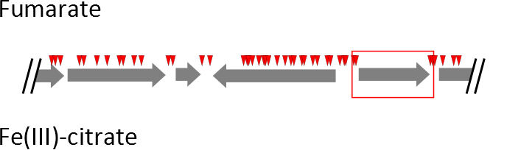
Tn-Seq in Geobacter
Notes:
Next, we see genes that don’t have any insertions, even though it may have the TA sites needed for transposon insertion. This likely indicates that this gene is required for growth under the conditions in which the parent library was generated, or perhaps was essential under all outgrowth conditions. Of course, the possibility exists that we were just extremely unlucky in that we didn’t get any Tn hits to the gene.

Slide 6
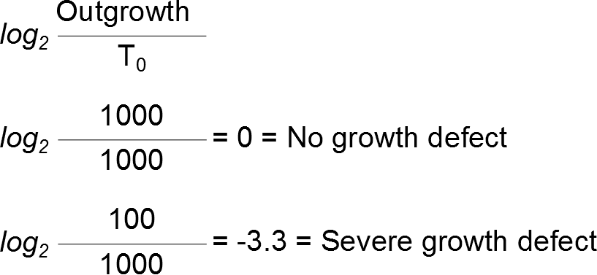
Log₂ ratios to identify genes of interest
Notes:
And finally, we can use the relative number of reads mapped to the flanking regions of each one of these transposon insertion sites to calculate some relative cost of each one of these insertions. The way we do that is by asking how many reads were mapped to these flanking regions in these two outgrowth conditions when compared to the total number of reads mapped to that same insertion in the parent library.

Slide 7
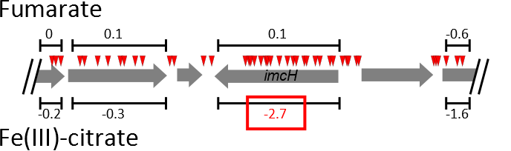
Log₂ ratios to identify genes of interest
Notes:
And finally, we can use the relative number of reads mapped to the flanking regions of each one of these transposon insertion sites to calculate some relative cost of each one of these insertions. The way we do that is by asking how many reads were mapped to these flanking regions in these two outgrowth conditions when compared to the total number of reads mapped to that same insertion in the parent library.
PHOSPHOSERINE AMINO TRANSFERASE

Slide 8
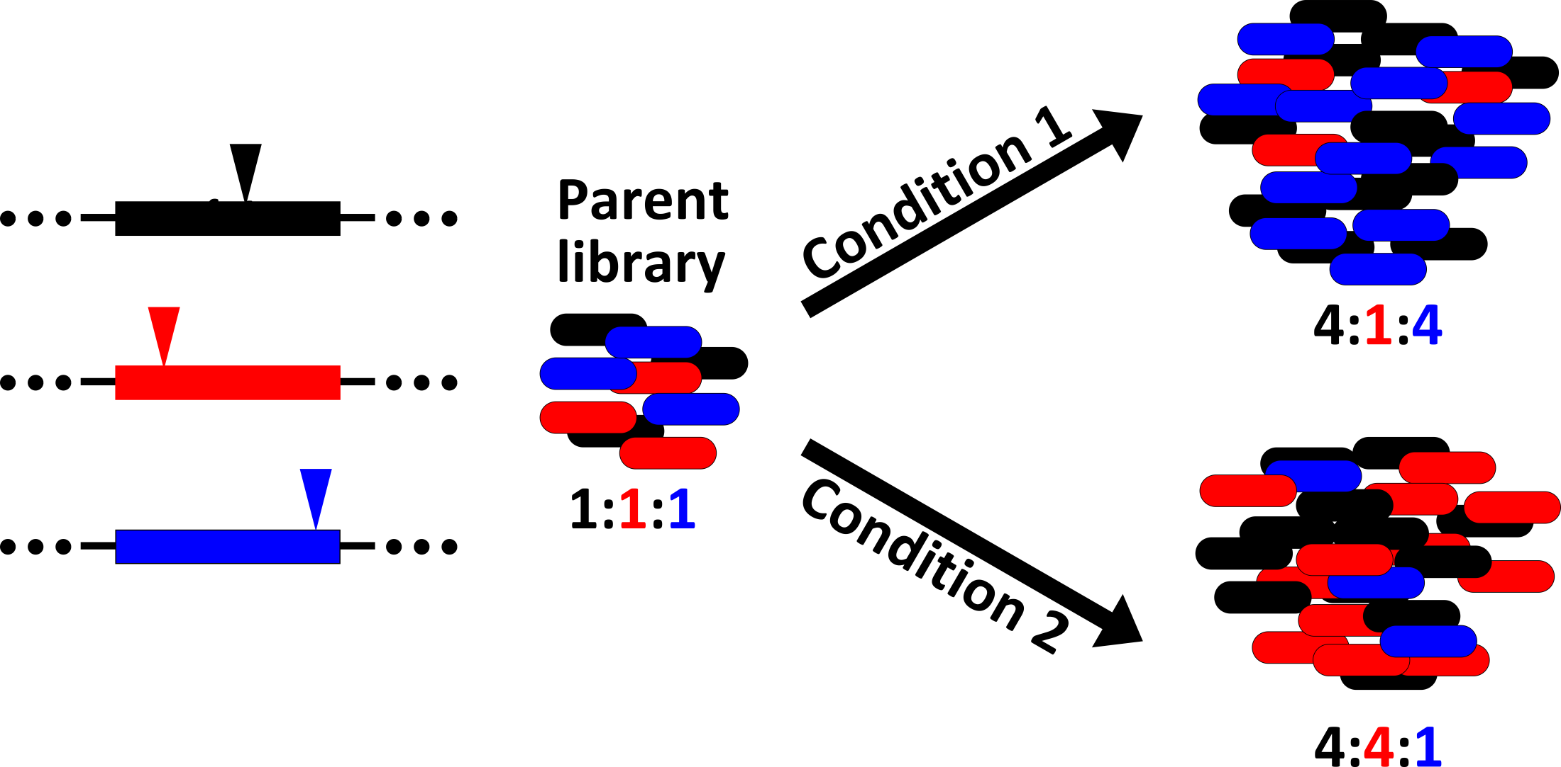
Tn-Seq: Test 44,000 mutants at once

Slide 9
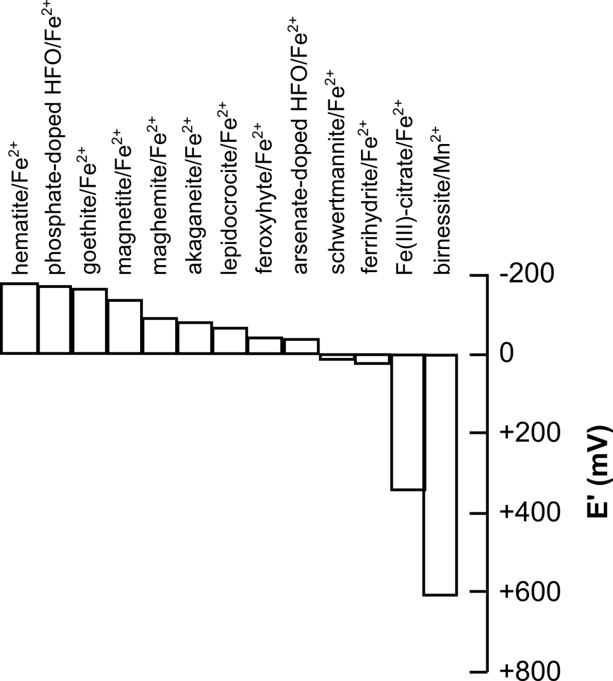
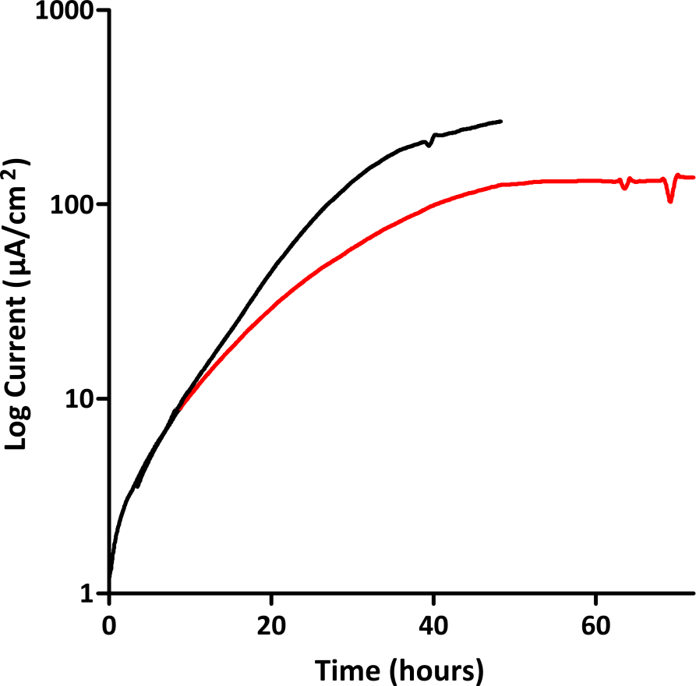
Tn-Seq using electrodes at different potentials
“Low”
-0.10 V vs SHE
“High”
+0.24 V vs SHE

Slide 10


Tn-Seq: Test 44,000 mutants at once

Slide 11
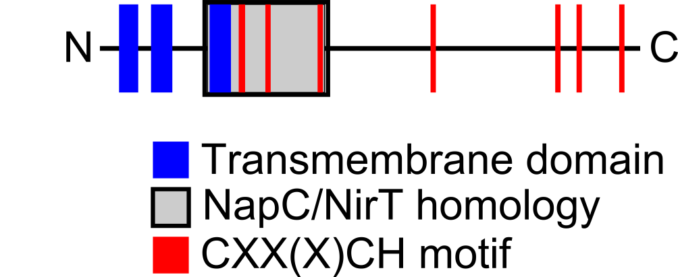
Potential dependent phenotypes

Slide 12
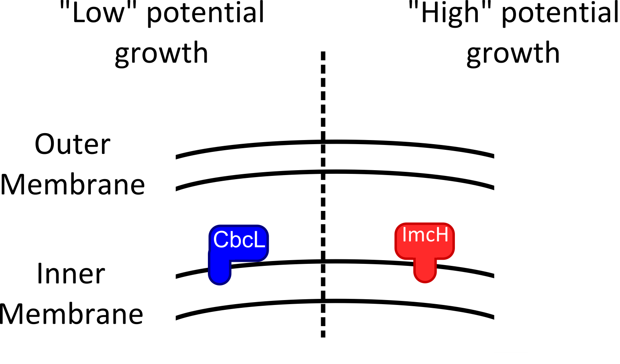

Respiration in response to redox potential

