Slide 1
Predicting Customer Churn?
Brayden Nicholl Shu Lee Krishna Dave Sasha Farzin-Nia Gurami Kavrelishvili Chris Bowne Airi Oye

Slide 2
Abstract
Clients of the bank have a certain likelihood of transitioning to a different bank, and client information such as gender, active membership, credit score and number of products with the bank can be used to predict this rate. The data, containing customer data from banks in France, Spain and Germany from year 2015, was used to demonstrate that the relationship between balance and number of products, age and active membership, and country of origin and number of products proved to be significant in predicting whether a client “churned” out of the bank.

Slide 3
Data Set Chosen
Question:
What factors correlate with customer “churn” (the act of a customer leaving the bank’s customer base)?
Training and Testing:
Set was split into 8000 observations for training and 2000 for testing.
Variables:
10000 observations of 11 variables
Categorical
CustomerId
Surname
Geography
Gender
HasCrCard
IsActiveMember
Exited
Numerical
CreditScore
Age
Tenure
Balance
NumofProducts
EstimatedSalary

Slide 4
Outcome variable EXITED
Exited is a binary categorical variable that measures whether or not a given customer has entirely stopped using the bank’s services and products.
0 - customer has not exited
1 - customer has exited
For a bank, securing new customers and retaining current customers is the goal. Of the two, it is much less expensive to retain current customers than it is to secure new ones. The goal of this study is to create a suitable model to predict whether an existing customer exits or not. Therefore, predicting Exited is the goal.

Slide 5
Predictor variables (before any transformations)
Age - customer age (quantitative)
Balance - customer checking account balance (€) (quantitative)
Gender - male / female (categorical)
Geography - France / Germany / Spain (categorical)
Is Active Member - proprietary internal bank metric whether or not customer meets criteria as an “active member” 0 (no) / 1 (yes) (categorical)
Number of Products - number of products (checking/loan/credit card/etc.) customer has with bank (quantitative)

Slide 6
Method of selecting Predictor variables
Individual customer identifiers Customer ID and Surname were eliminated
Exploratory data analysis suggested all other variables were viable as candidates for our model. Further, multicollinearity checks suggested viable interactions to account for.
Determination of the final model:
Backwards elimination of individual predictors. This included checking scenarios where quantitative variables were transformed to categorical
Once the model was reduced, we then explored the addition of interaction terms. Additional and removal of combinations of interaction terms were explored until AIC and residuals were minimized and coefficient significance was maximized.

Slide 7
Frequency Distributions of Categorical Variables

Slide 8
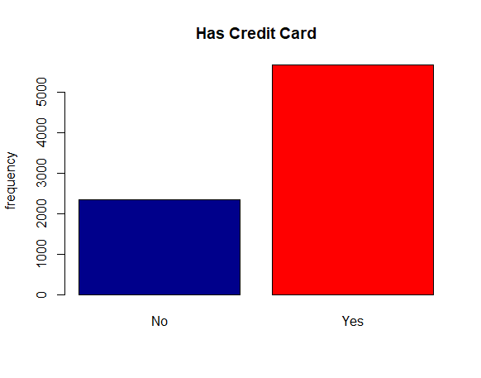
Frequency distribution for HasCrCard (Has Credit Card)

Slide 9
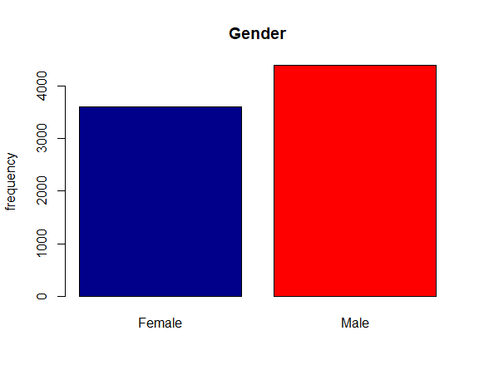
Frequency distribution for Gender

Slide 10
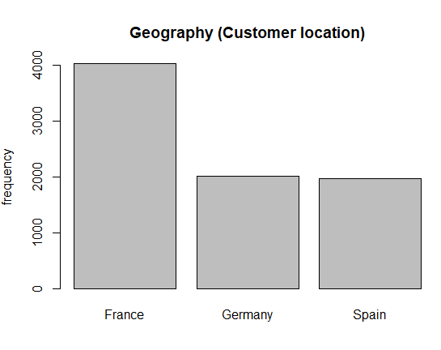
Frequency distribution for Geography
Notes:
We ended up using France as our base

Slide 11
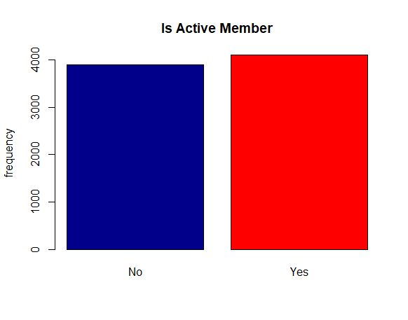
Frequency distribution for IsActiveMember

Slide 12
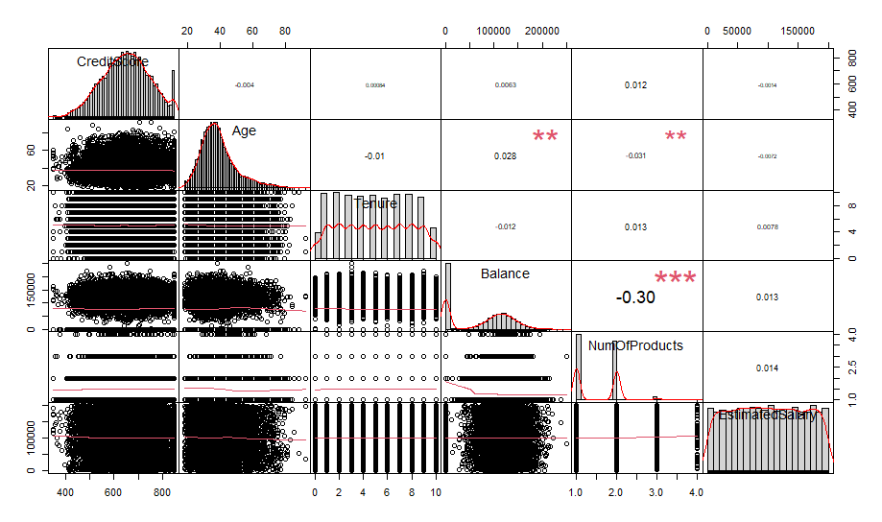
Distribution and Multicollinearity Checks of Quantitative Variables
Notes:
In this slide, we check the distribution and multicollinearity checks of quantitative variables and as we can see, we don not have an issue of multicollinearity, except for balance and num of products, where we have a significant covariance

Slide 13
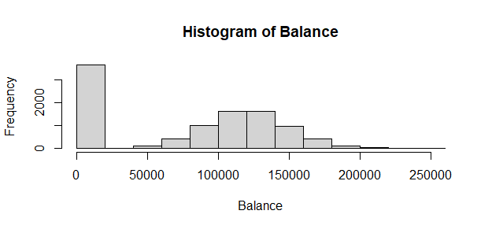
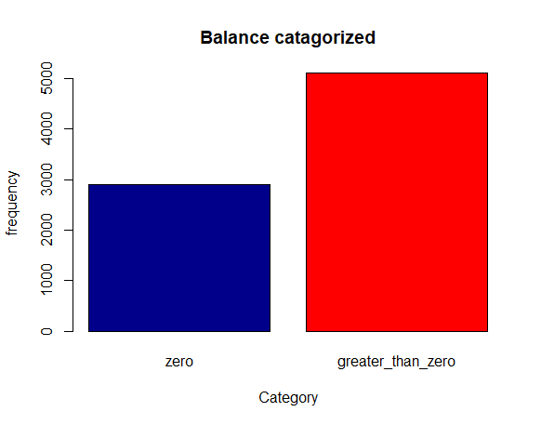
Categorization of Balance
Balance is significant, but one issue is the number of $0 balances.
Estimate 2.5 % 97.5 %
Balance 1.00 1.00 1.00
Odds of exiting are very close to zero.
Uncategorized Categorized
Notes:
Chris When the coefficient is exponentiated it suggest odds of exit per dollar change in balance is very close to zero. We could have changed the units from per dollar to per 10000 dollars. However, we felt it was best to factorized because the $0 balances hold additional information (that the customer did not have a checking account product. The following shows the split we used in Models 4-6:

Slide 14
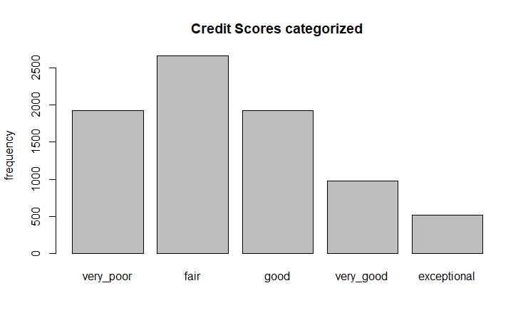
Categorization of Credit Score
CreditScore is weakly significant. The coefficient exponentials to odds of 1.
Estimate 2.5 % 97.5 %
1.00 1.00 1.00
Financial institutions recognize broad categories of scores and classify customers in meaningful ways. We propose categorizing CreditScore according to standard financially relevant categories (Experian.com):
Credit score range
very poor [300, 580)
fair [580, 670)
good [670, 740)
very good [740, 800)
exceptional [800, 850)
Notes:
Chris
Credit score is relatively meaningless in raw form. Odds of exiting a bank increasing or decreasing due to unit increases or decreases in Credit score are not practically significant.

Slide 15
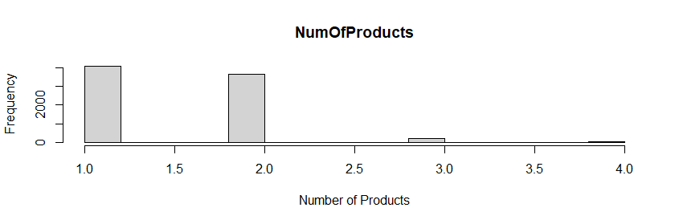
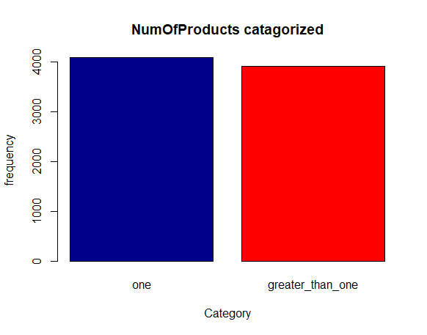
Categorization of Number of products
Number of Products was checked for compatibility with being categorized. The categorization is as follows:
AIC drops about 350 points from Model 4 to 5.
Uncategorized
Categorized
Notes:
Chris The number of products in our sample were from 1 to 4. Most were 1 or 2. There was some debate on whether to categorize, but in our training set

Slide 16
Normality Analysis
Of Variables

Slide 17
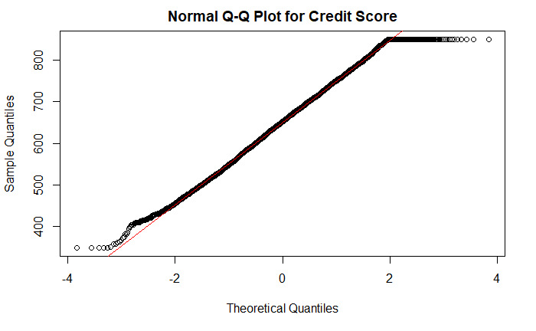
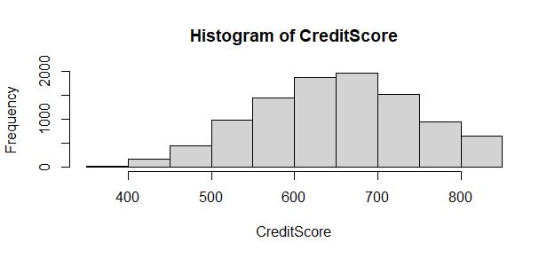
Testing Normality for Credit Score

Slide 18
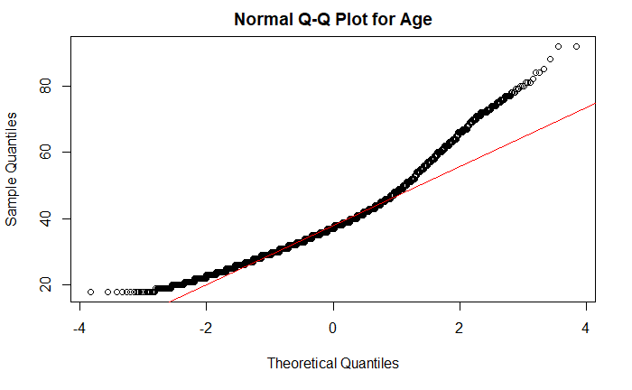
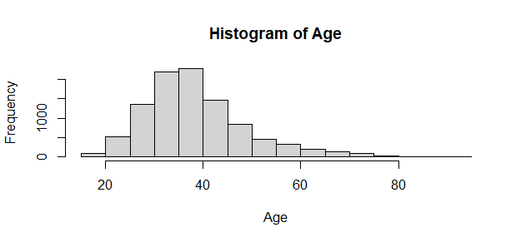
Testing Normality for Age

Slide 19
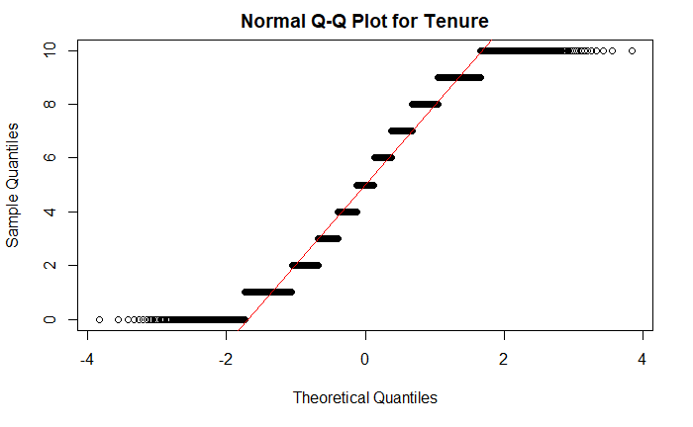
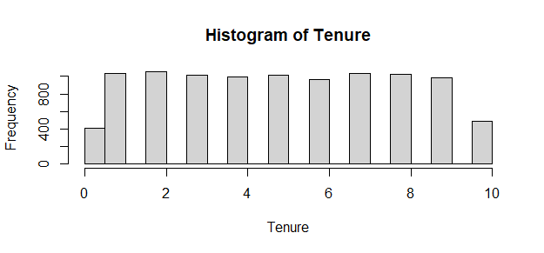
Testing Normality for Tenure

Slide 20
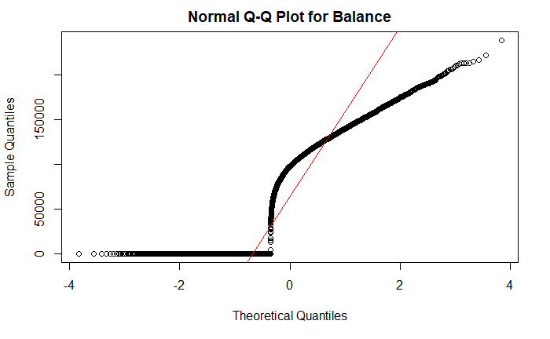
Testing Normality for Balance
Notes:
The QQ plot for Balance seems to fail due to the high frequency of zero balances. As we see later on in the project, we categorize the balance into non zero balance and zero balance

Slide 21
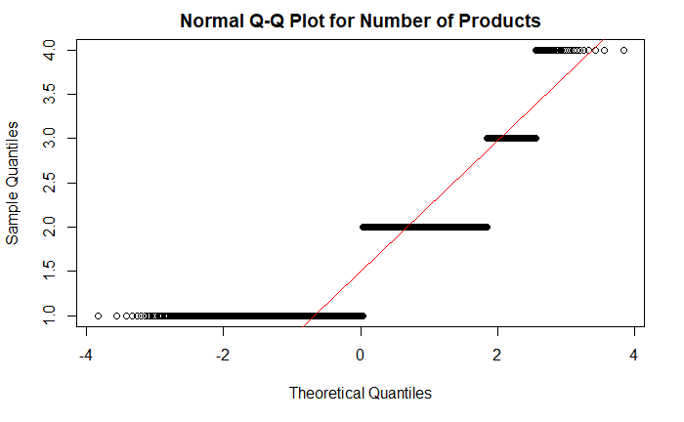
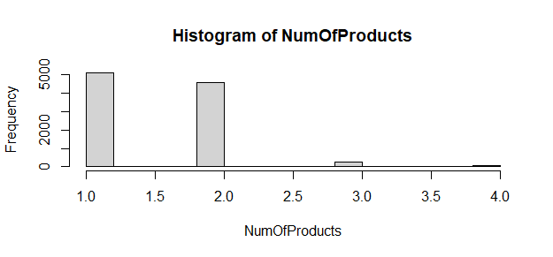
Testing Normality for Number of Products

Slide 22
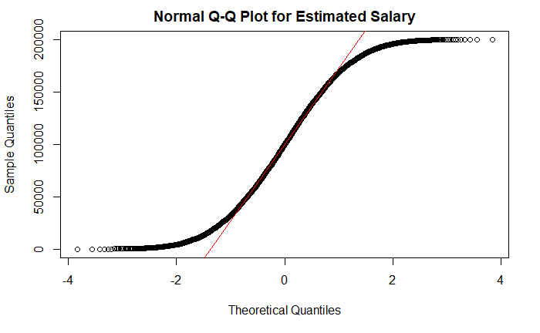
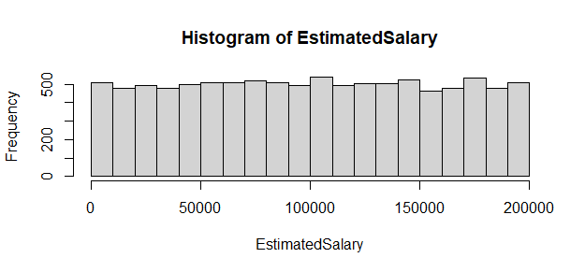
Testing Normality for Estimated Salary

Slide 23
Transformation Analysis
Notes:
We will quickly show the symbox diagrams, and we did not numerically transform anything, merely categorized

Slide 24
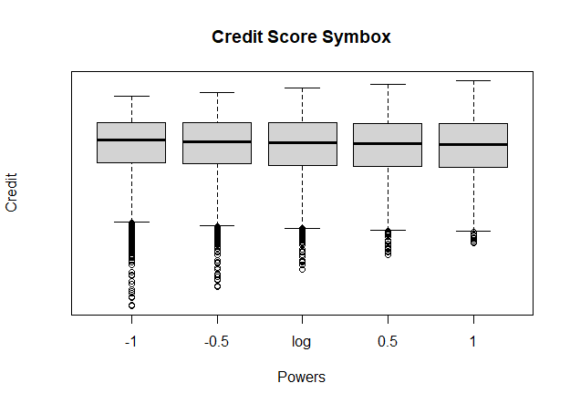
Transformation Analysis - Credit Score

Slide 25
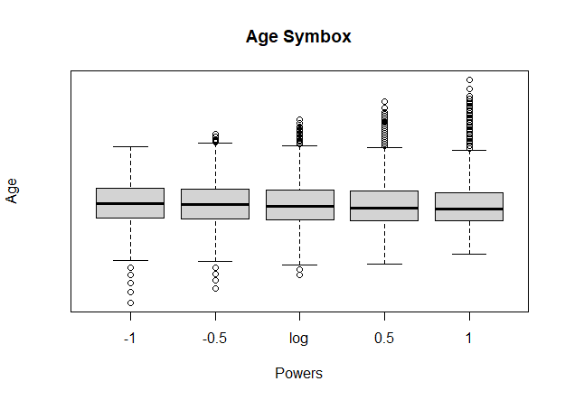
Transformation Analysis - Age

Slide 26
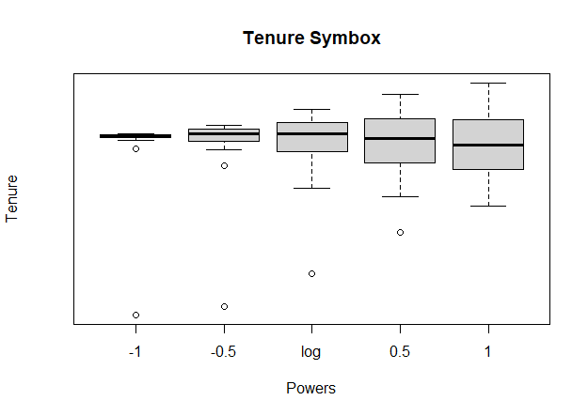
Transformation Analysis - Tenure

Slide 27
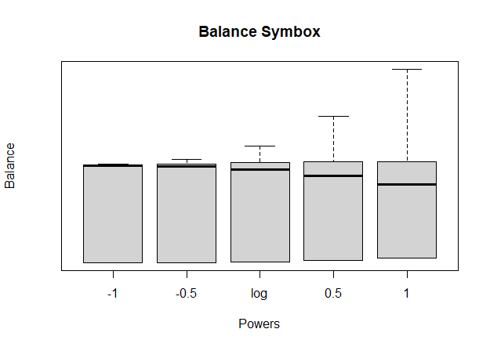
Transformation Analysis - Balance

Slide 28
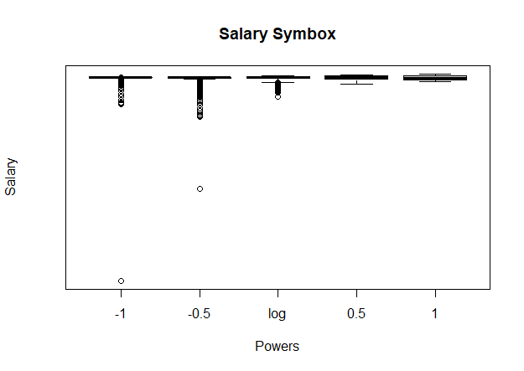
Transformation Analysis - Estimated Salary

Slide 29
Final Model

Slide 30
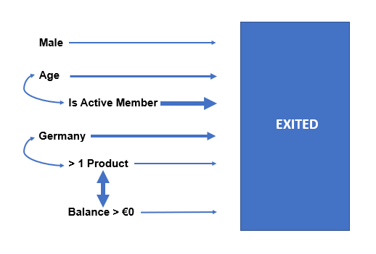
Observations on significant predictors in model
For our model, we determined some variables may be more interpretable as categories. In particular, variables categorized were
Balance
Credit Score
Number of Products
Variables with the greatest influence were whether customer was an active member or not, and the interaction between having more than one bank product or not and having a checking balance greater than zero or not.
mod <- glm(Exited ~
Balance_cat_greater_than_zero * NumOfProducts_cat_greater_than_on
+ Gender_Male
+ Age*IsActiveMember_1
+ NumOfProducts_cat_greater_than_one * Geography_Germany,
data = bankdata_train, family="binomial")

Slide 31
Variable \ Model | Coef (log odds) p value
Age | 0.127910 ***
Balance_cat: Greater_than_zero | -0.934327 ***
Number of Products_cat: Greater_than_one | -2.079681 ***
Geography: Germany (base France) | 1.274153 ***
Gender: Male | -0.446486 ***
Is Active Member: Yes | 2.642412 ***
Interactions
Balance_cat_greater_than_zero * NumOfProducts_cat_greater_than_one | 2.372363 ***
Age * IsActiveMember_1 | -0.088018 ***
NumOfProducts_cat_greater_than_one * Geography_Germany | -1.406858 ***
Residual Deviance | 6234.5
AIC | 6254.5

Slide 32
 | Estimate (odds) | 2.5% | 97.5%
Balance > €0 | 0.01 | 0.00 | 0.01
Male | 0.12 | 0.10 | 0.16
Age | 1.14 | 1.12 | 1.15
Is Active Member | 14.05 | 8.00 | 24.86
> 1 Product | 0.39 | 0.32 | 0.48
Germany | 3.58 | 2.99 | 4.28
Age * Is An Active Member | 0.92 | 0.90 | 0.93
(Balance > €0) * (> 1 Product) | 10.72 | 7.69 | 14.97
Germany * (> 1 Product) | 0.24 | 0.18 | 0.33
Interpretation of Odds Ratios with Confidence Intervals
Notes:
As you increase age by 1 year, then you are 14% more likely to exit the bank
Those who are active members of the bank are 14.05 times more likely to exit the bank than those who are inactive at the bank
Those who are from Germany are over 3 and a half times as likely to exit the bank than those who are from France

Slide 33
Interpretation of Odds Ratios
Those with a balance greater than €0 are 99% less likely to exit the bank than those with a €0 balance
Those that are of the Male gender are 88% less likely to ext the bank than those who are female
As you increase age by 1 year, then you are 14% more likely to exit the bank
Those who are active members of the bank are 14.05 times more likely to exit the bank than those who are inactive at the bank
Those who have more than one product are 61% less likely to exit the bank than those who have one or less
Those who are from Germany are 3.58 times as likely to exit the bank than those who are from France
A customer’s age tends to be 0.92 years older when they are active members, as opposed to when they aren’t.

Slide 34
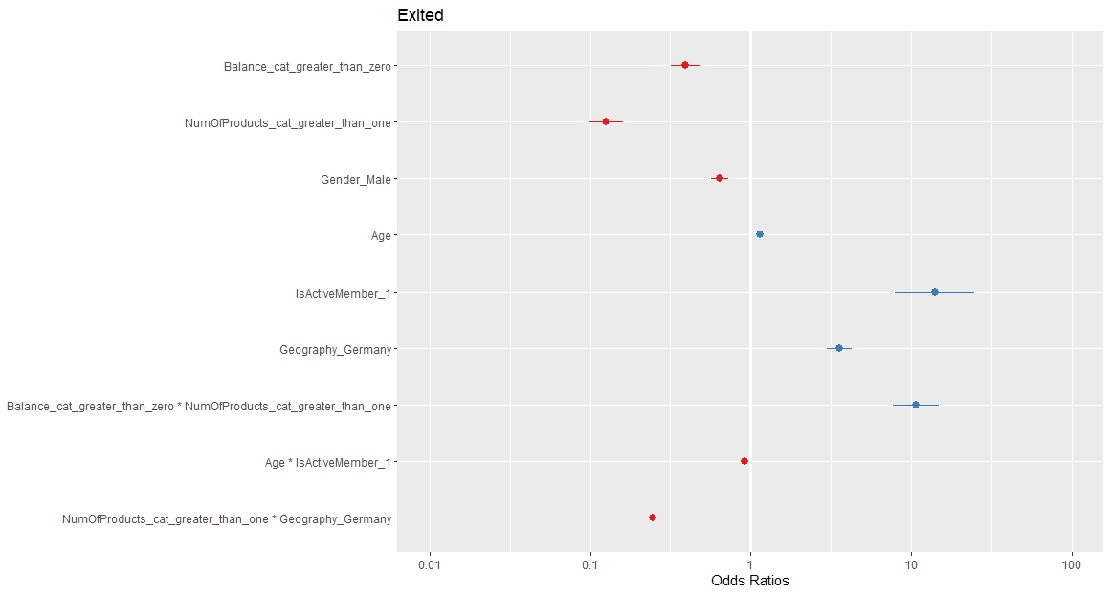
Odds Ratios plotted alongside each other
Notes:
Note that IsActiveMember has a large range for its interval

Slide 35
MMP plot, Pseudo R-Squared, Pearson’s Chi-squared test, and Influence Plot

Slide 36
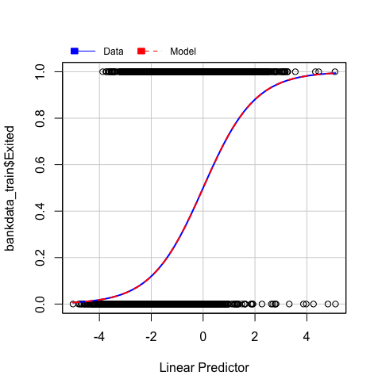
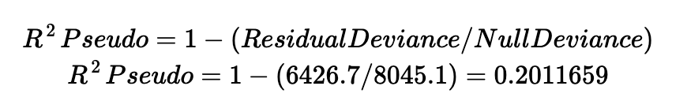
Null hypothesis: The logistic linear model is a good fit for the data.
Pearson Chi- Squared = 8481.656
Critical Q-chisq = 8198.047
8481.656 > 8198.047
Comparing Pearson Chi-Squared vs Critical Chi-squared value
Since the calculated value of Pearson Chi p-value was 6.528932x10⁻⁰⁵ , we reject the null hypothesis, and conclude that the logistic model is not a good fit for the data. However, the chi-square value is relatively close to the critical value, so cross-validation is suggested to check this.

Slide 37
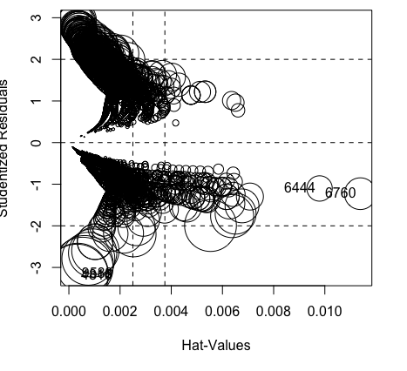
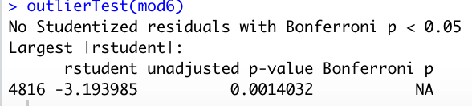
Data size = 8000
4/N = 0.0005
Our data size is large enough for us to glance over the Outlier test and not exclude this one outlier from our data.
Majority of points <3 and >-3 St.Resids
Most of our data points are <3 and >-3 for our studentized residuals so we are safe to move on without any high influential/leverage points.

Slide 38
Interaction Plots

Slide 39
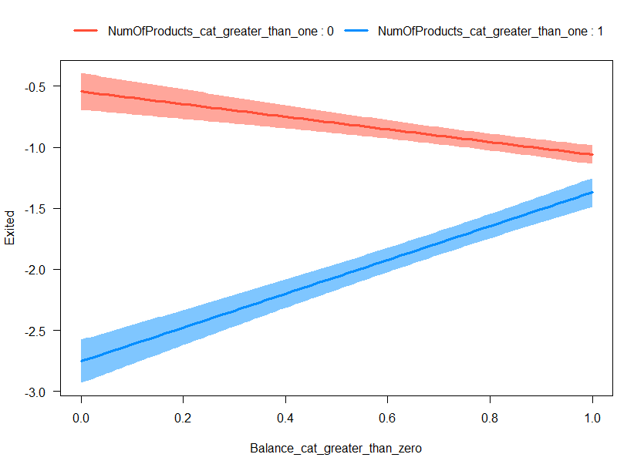
Interaction Plot - Balance_cat_greater_than_zero * NumOfProducts_cat_greater_than_one
Notes:
For customer whose Balance was zero the odds of exiting were much lower for those who had at least 1 Product with the bank vs those who only had 1 product with the bank. As balance was greater than zero, although the odds of exiting were lower for customers having number of products greater than one, the odds of exiting were much closer for Number of products being greater than 1, or being less than or equal to one.

Slide 40
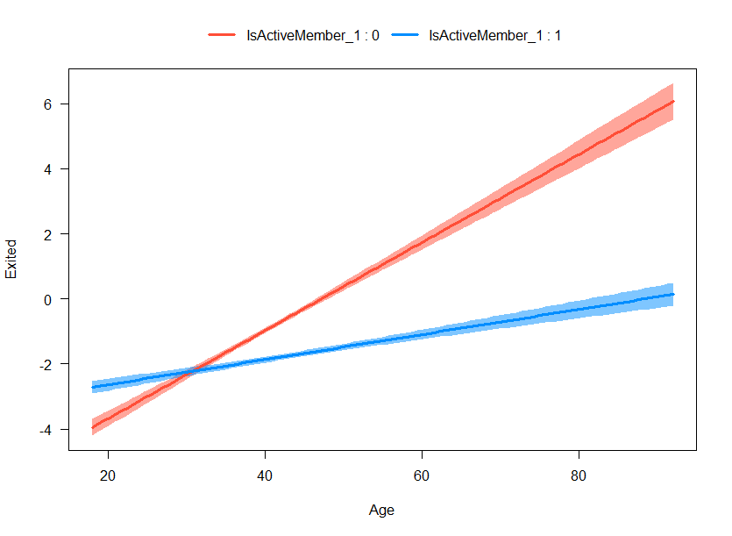
Interaction Plot - Age * IsActiveMember_1
Notes:
After the age of 30 as age increases the odds of exiting increases between Active Members and Non Active Members and even though both Non Active and Active members odds increase, the odds of a non-active member increase faster as age increases. It’s the exact opposite for age less than 30.

Slide 41
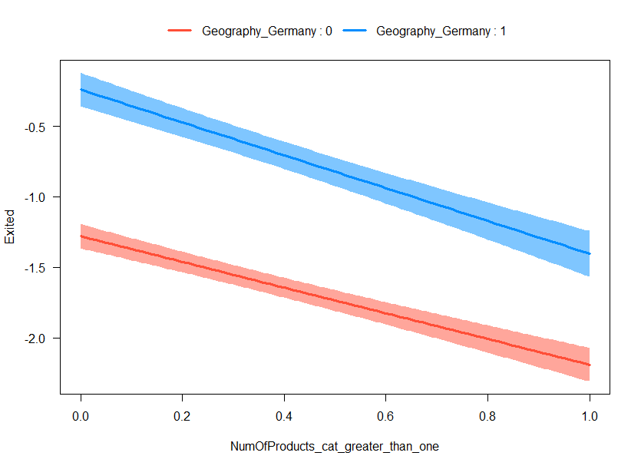
Interaction Plot - NumOfProducts_cat_greater_than_one * Geography_Germany
Notes:
Weak interaction
For both customers who do and do not live in Germany, the likelihood of the client exiting the bank is lower if their number of product with the bank is greater than one.

Slide 42
Interpretation of Interaction Plots
NumOfProducts_cat_greater_than_one interaction with Balance_greater_than_Zero variable
For customer whose Balance was zero, the odds of exiting were much lower for those who had at least 1 Product with the bank vs those who only had 1 product with the bank. If balance was greater than zero, although the odds of exiting were lower for customers having number of products greater than one, the odds of exiting were much closer for Number of products being greater than 1, or being less than or equal to one.
Age interaction with IsActiveMember variable
As age increases after the age of 30, the odds of exiting increases between Active Members and Non Active Members. However, even though both Non Active and Active members odds increase, the odds of a non-active member exiting increases faster as age increases. It’s the exact opposite for age less than 30.
NumOfProducts_cat_greater_than_one interaction with Geography_Germany
For both customers who do and do not live in Germany, the likelihood of the client exiting the bank is lower if their number of product with the bank is greater than one.

Slide 43
Contingency Table, Interpretation, and Cross Validation
Recall (Sensitivity): 143 / (280+143) = 0.3381
33.81% of people who exited were predicted correctly
Specificity: 1526 / (1526 + 51) = 0.9677
96.77% of people who did not exit were predicted correctly
Accuracy:
(1526 + 143) / (1526 + 51 + 280 + 143) = 0.8345
Overall, 83.45% of people in the dataset were predicted correctly
Conducted 5-Fold CV and obtained the same results as the contingency table
 | Predicted
Actual | No Exit | Exit
No Exit | 1526 | 51
Exit | 280 | 143
Notes:
Regarding cross validation, we also did not perform because we subsetted our data to training and testing sets so we did not find the need to perform an additional k-fold cross validation.

Slide 44
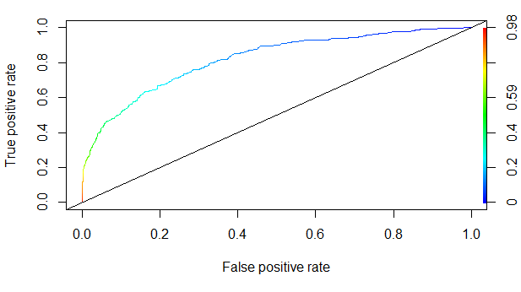
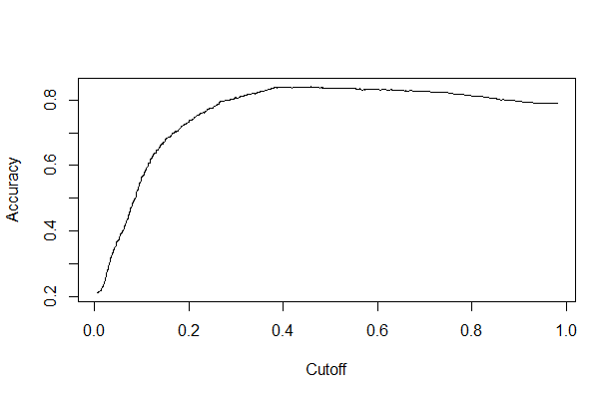
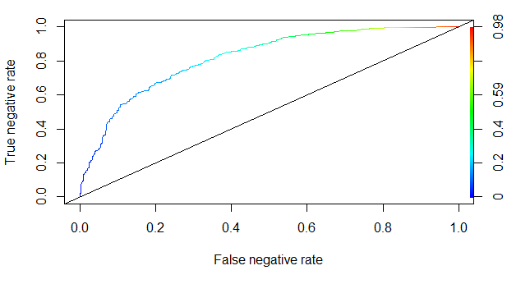
ROC Curves
Area under the curve: 0.8194133
Notes:
Here are our receiver operating characteristic curve or ROC curves, which displays the performance of our model at different thresholds.
Area under the AUC curve ranges from 0 to 1 and is close to 0.80. Based on guidelines for clarifying the accuracy of our model, the proposed model displays decent/good (Not excellent but good) accuracy for predicting likelihood of exiting the bank.
The graph on the top right plots the true positive rate in relation to the false positive rate for different cut off points of a parameter and the graph on the bottom similarly plots the true negative rate with the false negative rate.

Slide 45
Summary and Conclusions
Our results indicate that likelihood of a client exiting a bank is 99% less likely for clients with a balance higher than zero, 88% less likely for males, and 61% less likely for clients with more than one product. Meanwhile, exiting is 14% more likely as client age increases by one year, 14.05 times more likely for active members and 3.58 times more likely for those in Germany than those in France.
Interaction plots imply the likelihood of a client exiting a bank varies with the number of product and client’s balance. The likelihood also reverses after age 30 as clients age for active vs. non-active members. The model has an overall accuracy of 83%, with specificity of 97% and sensitivity of 34%.
The goal of this study was to predict customers that will exit. If these customers can be detected the bank can proactively reach out to them with special deals or free products to retain their business. Ultimately, for this scenario, sensitivity is the most important measure and the model performs poorly as it only correctly predicts exits 34% of the time.

Slide 46
Shortcomings
The shortcomings of our model include:
The model did not perform well in predicting customers who leave, with only a 34% success rate. This suggests other models should be looked at, such as random forest or deep learning models, though these do not offer the same interpretability a logistic model does.
Investigate on a deeper level what some of our predictor variables really mean, for example what an “active member” truly means and how it is determined. Another one to look at would be: what does it really mean when balance =0? Does it mean that this person doesn’t have a checking/savings account?
Recommendations
Given these results, we provide the following recommendations to the banks:
Collect more data on those above age 30
Collect more data in other countries if possible
Investigate cultural or financial differences, specifically in Germany, that may be causing higher exit rates than France
Investigate subsets of clients who have zero balance
Market research to strategize for new products and services
Notes:
Focus on sensitivity at the cost of specificity
Investigate what an “active member” truly means… how is it determined?

Slide 47
Thank You For a Great Quarter!

