Slide 1


Image-Based Model Drift Detection
using model inversion and membership inference attacks
Jupyter Notebook Link:
https://colab.research.google.com/drive/1AYklT_aDmMpNuHrKEYgtVfPKXPyoJxIo?usp=sharing
24 Aug 2023
CTC IRAD ML Lab

Slide 2
Outline
What is Model Drift?
Importance of Model Drift Detection
Overview of Our Approach
Gray Data Definition
Membership Inference Definition
Steps 1-2: Model Creation
Steps 3-4: Gray Data Generation
Steps 5-6: Membership Inference Attacks
Step 7: Model Drift Detection
Recent Results
Future Direction
…………………………………….……3
…………………………………….……4
…………………………………….……5
………………………………………….6
………………………………………….7
………………………………………….8
………………………………………….9
…………………………………………10
…………………………………………11
………………………………………….12
………………………………………….13
Click any header to navigate to the slide

Slide 3


What is Model Drift?
Model Drift occurs when the performance of a machine learning model worsens over time
Data Drift : occurs when the data changes from original dataset
Concept Drift : occurs when the model’s awareness of a certain feature changes
e.g., a model will be provided with entirely new data that it has not yet seen.
e.g., the data given to the model will be perturbed or manipulated in some way.
images from https://www.flaticon.com/free-icons

Slide 4




Why is this important?
New information is a constant in real-world applications
Knowing how a model fails leads to better solutions
Ensures a model’s performance long-term
images from https://mymodernmet.com/navid-baraty-nyc-intersections
and https://www.bing.com/images

Slide 5
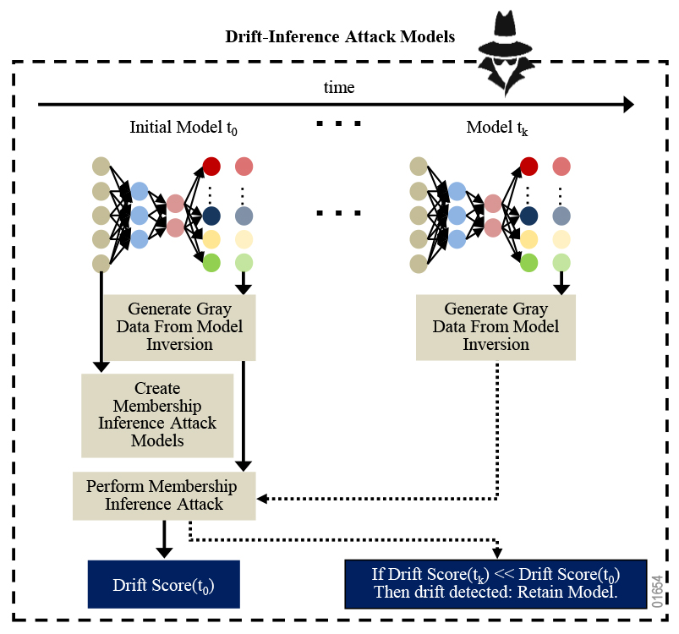









Our approach
Detecting concept drift in image data
7 steps to test the base model’s definition of the concepts (or classes) of image datasets:
#1-2 : create models on different portions of the dataset
#3-4 : create gray data for each model
#5-6 : infer membership of gray data within base model
#7 : check scores to detect drift
Generate base gray data
Generate production gray data
Create membership inference models
Perform membership inference attack
Drift Accuracy Score($t_{0}$)
Compare Drift Accuracy Score($t_{0}$) with Drift Accuracy Score($t_{k}$)

Slide 6
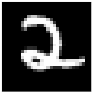
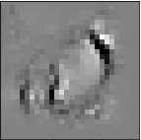

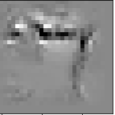

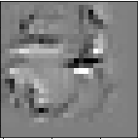
What is Gray Data?
Model inversion attacks use a classifier to attempt to recreate the training data given to a model as “gray data”
human-uninterpretable gray data extracted from the model to represent some MNIST training data
original MNIST training data given to the model
images from https://www.tensorflow.org/datasets/catalog/mnist
and https://www.tensorflow.org/datasets/catalog/mnist

Slide 7
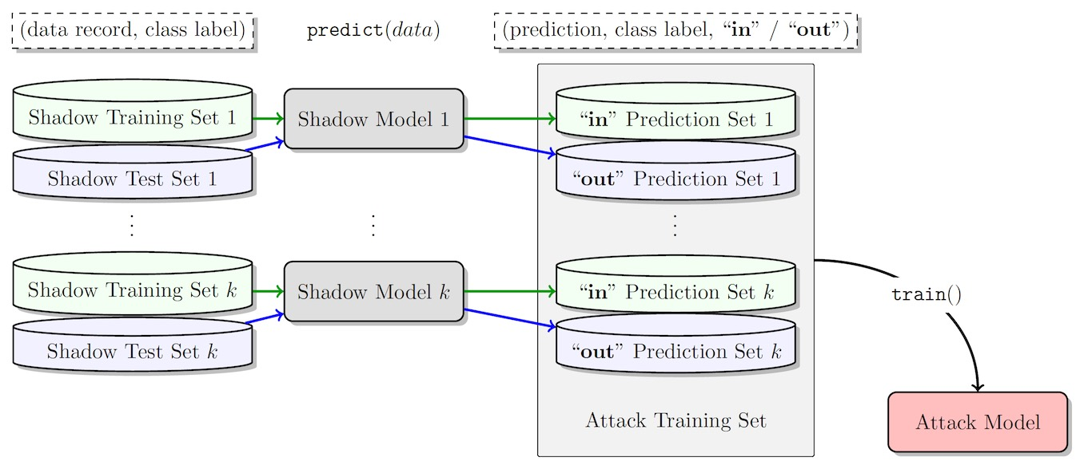
What is Membership Inference?
Membership inference attacks aim to predict if a specific instance of data was used in the training data for the model
shadow models created by feeding random examples the model to determine key features
final model can predict whether a data point was in the training data of a model
image from https://bdtechtalks.com/2021/04/23/machine-learning-membership-inference-attacks/

Slide 8




Model Creation
Generate base gray data
Generate production gray data
Split training data in original dataset into base data and production data, then…
Create membership inference models
Create base model from base data
Create production model from production data
Perform membership inference attack
Drift Score($t_{0}$)
Compare Drift Score($t_{0}$) with
Drift Score($t_{k}$)

Slide 9


Gray Data Generation
Generate base gray data
Generate production gray data
Create membership inference models
Run a model inversion attack on the base model to generate base gray data
determines the base model’s concept of the classes from the base data
Run a model inversion attack on the production model to generate production gray data
determines the production model’s concept of the classes from production data
Perform membership inference attack
Drift Score($t_{0}$)
Compare Drift Score($t_{0}$) with
Drift Score($t_{k}$)

Slide 10


Membership Inference Attacks
Run membership inference attack on base model with base gray data
base drift score determines whether the concept of a class has drifted
Generate base gray data
Generate production gray data
Run membership inference attack on base model with production gray data
production drift score determines whether the concept of a class has drifted
Create membership inference models
Perform membership inference attack
Drift Score($t_{0}$)
Compare Drift Score($t_{0}$) with
Drift Score($t_{k}$)

Slide 11



Model Drift Detection
If production drift accuracy score << base drift accuracy score, then concept drift confirmed
Generate base gray data
Generate production gray data
Create membership inference models
Perform membership inference attack
Drift Accuracy Score($t_{0}$)
Compare Drift Accuracy Score($t_{0}$) with Drift Accuracy Score($t_{k}$)

Slide 12


Does our approach work?
 | base model test accuracy | production model test accuracy
CIFAR-10 | 0.5738 | 0.5969
EMNIST | 0.8200 | 0.8246
**results collected using an average of three tests from our published Jupyter notebook**
no model drift is indicated

Slide 13


Does our approach work?
Rule-Based Membership Inference Attacks
Black-Box Membership Inference Attacks
**results using our published Jupyter notebook** | accuracy with base gray data | accuracy with production gray data | accuracy with base gray data | accuracy with production gray data
CIFAR-10 | 1.0 | 0.6666 | 1.0 | 0.3611
EMNIST | 1.0 | 0.5352 | 0.9516 | 0.1713
**results collected using an average of three tests from our published Jupyter notebook**
production drift acc << base drift acc
model drift detected

Slide 14

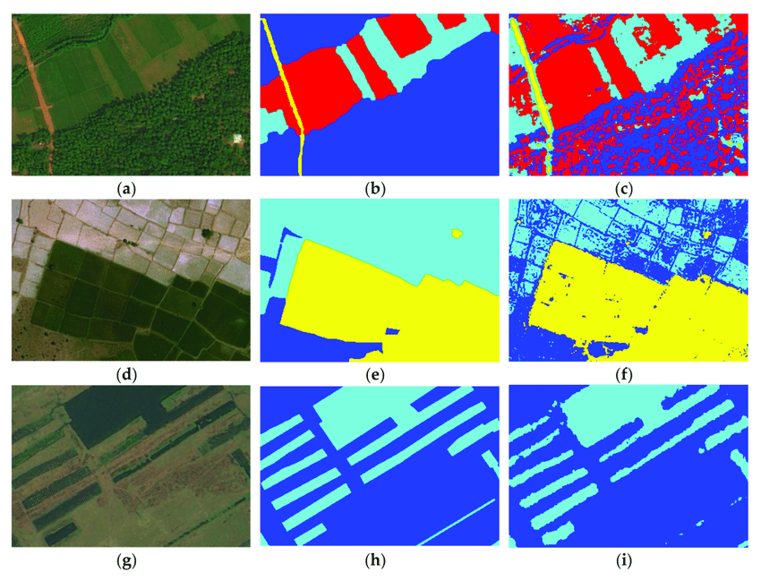
What is the future direction with this method?
Detection → Mitigation
detect drift in a model and recover from drift with an updated model
Overhead Imagery Datasets
detect drift in a model that operates on overhead imagery
images from https://www.researchgate.net/figure/Segmentation-results-for-satellite-images-from-our-dataset-part-1-23-different_fig2_347844387
and https://www.anolytics.ai/blog/how-to-improve-machine-learning-model-performance/

