Slide 1
CHECK M8 CAMBALIZA | CISNERO | DIONISIO

Slide 2
NEEDFINDING
1
Checking of attendance in a school

Slide 3
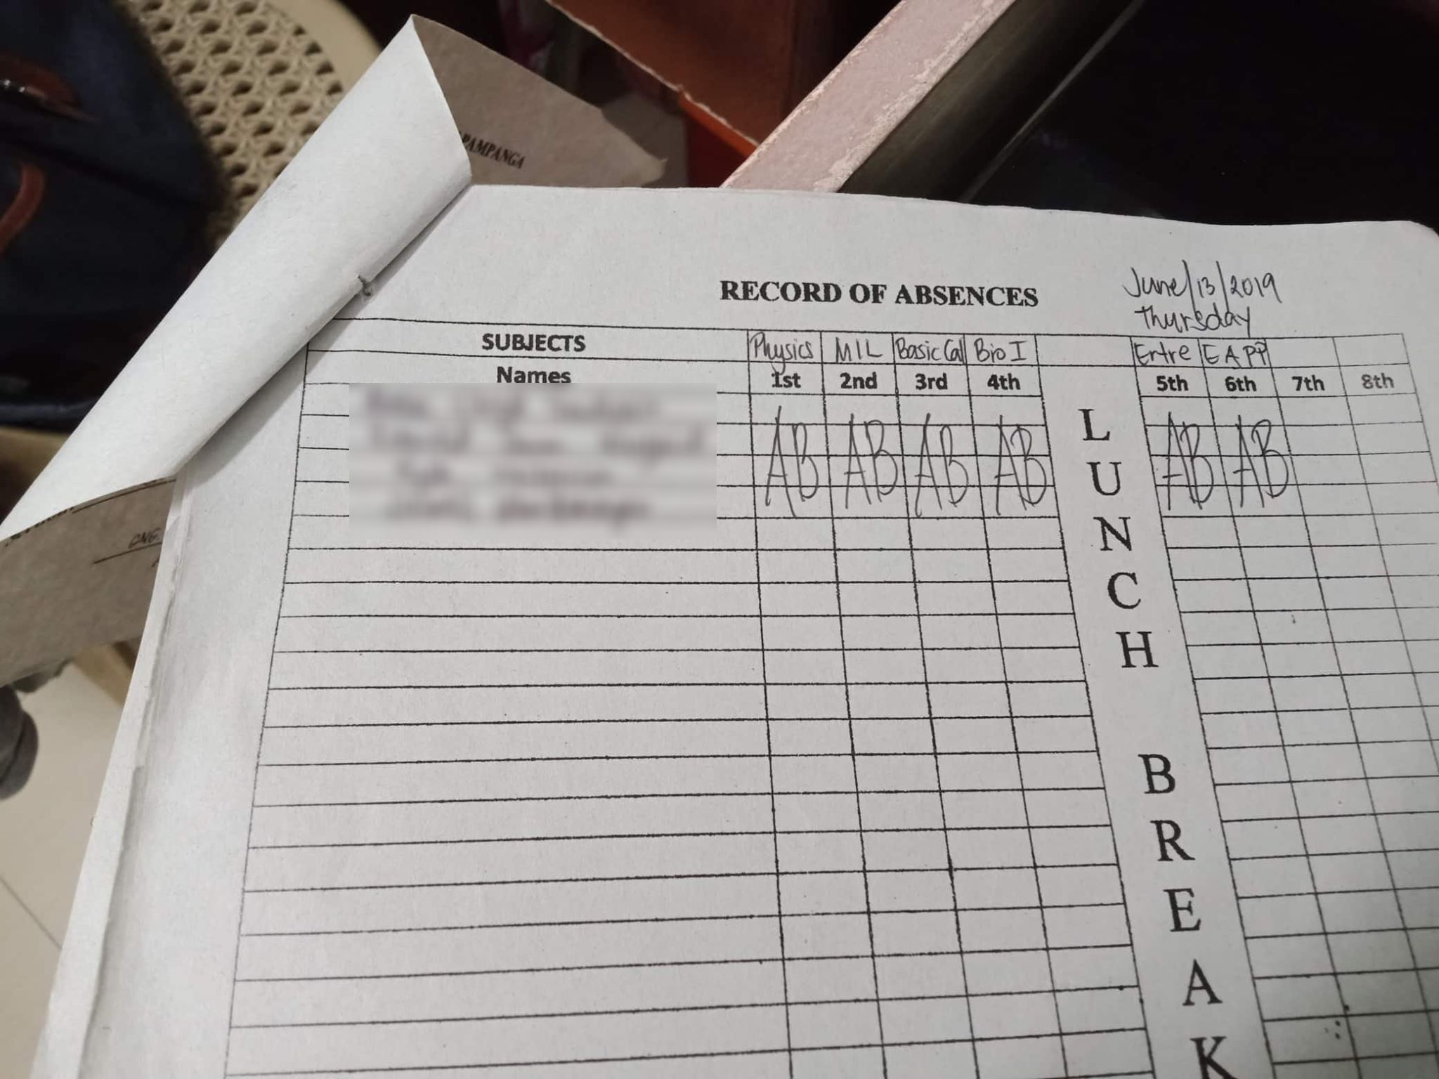
PROBLEM
The main problem is that some teachers are having a hard time in checking the attendance and some parents doesn’t know if their child's are really going to school.

Slide 4
INTERVIEWEES
We asked two (2) teachers and two (2) parent about their insights and experiences when it comes to their students and child's attendance.
Teachers:
Mr. Edzel Mangune
Ms. Russel Manuel
Parents:
Delia Lingad
Irish Camiring

Slide 5
INTERVIEW QUESTIONS AND ANSWERS
QUESTION 1 : Are you aware of your child’s/student’s attendance?
Teacher 1:
“Yes, I don’t often have complete attendance in my class. And some of my students go to class after they come without excuse letter.”
Teacher 2:
“I always keep it in my bag, and I am having a hard time when the time comes that I need to check the summary of their attendance.”
Parent 1
Before I’m not aware, then I knew my child does not go to school and goes somewhere. Then i said to myself that I need to accompany and pick him up from school so I’m sure that he goes to school.”
Parent 2
“Nalalaman ko nalang na umaabsent pala ang anak ko kapag nababasa ko sa likod ng card niya.”

Slide 6
INTERVIEW QUESTIONS AND ANSWERS
QUESTION 2: What do you think are the reasons why your child/students don’t attend to school and go somewhere else?
Teacher 1:
“I really have no idea; maybe they go to malls or friend’s house”
Teacher 2:
“I admit that my subject is quite hard and that leads them to just go somewhere else to escape in the hardships of schooling.”
Parent 1
“Yes, one time I caught my son playing in a computer shop.”
Parent 2
“Siguro dahil sa mga kaibigan nila na bigla silang yayain na umabsent nalang.”

Slide 7
INTERVIEW QUESTIONS AND ANSWERS
QUESTION 3: What solution do you think will help to prevent students from truancy and cutting classes?
Teacher 1:
“I think we need software or something that notifies parents that their children are in school.”
Teacher 2:
“Since we live in the 20th century, I think we need something high-tech that will help us in checking the attendance.
Parent 1
“I want something that will notify me and ensure me that my child is already in school.”
Parent 2
“Siguro kailangan namin ng bagay na palaging magpapaalam saamin kung pumasok ba anak namin.”

Slide 8
POINT OF VIEW AND USER NEEDS
POINT OF VIEW
The students now a day doesn’t attend class just to play or go somewhere else. An application will help the parents and teachers to monitor their child/student’s attendance will help to solve this problem.
USER NEEDS
The teacher needs an that can record the student’s attendance.
The parent needs an application that will notify them about the students if their children are really go to school.

Slide 9
STORYBOARD
2

Slide 10
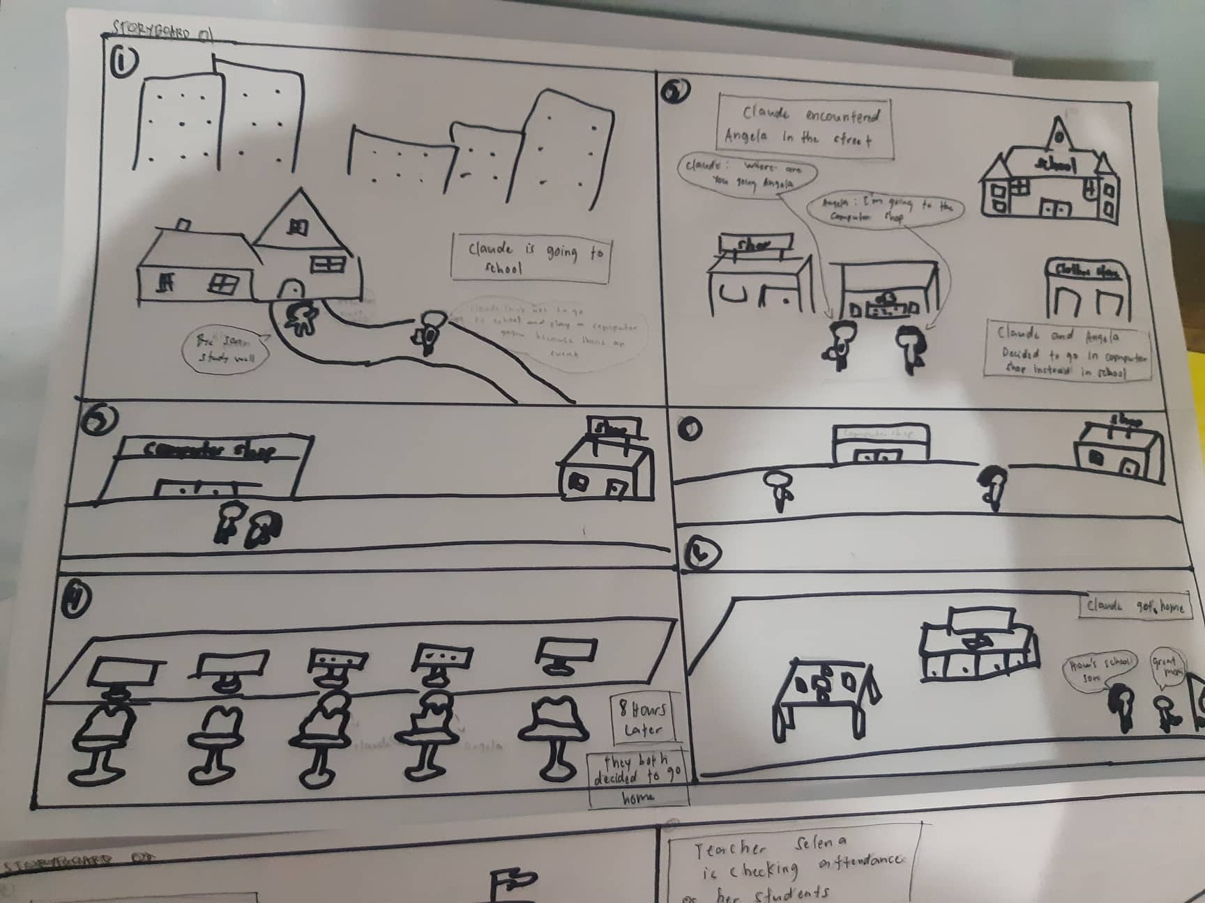
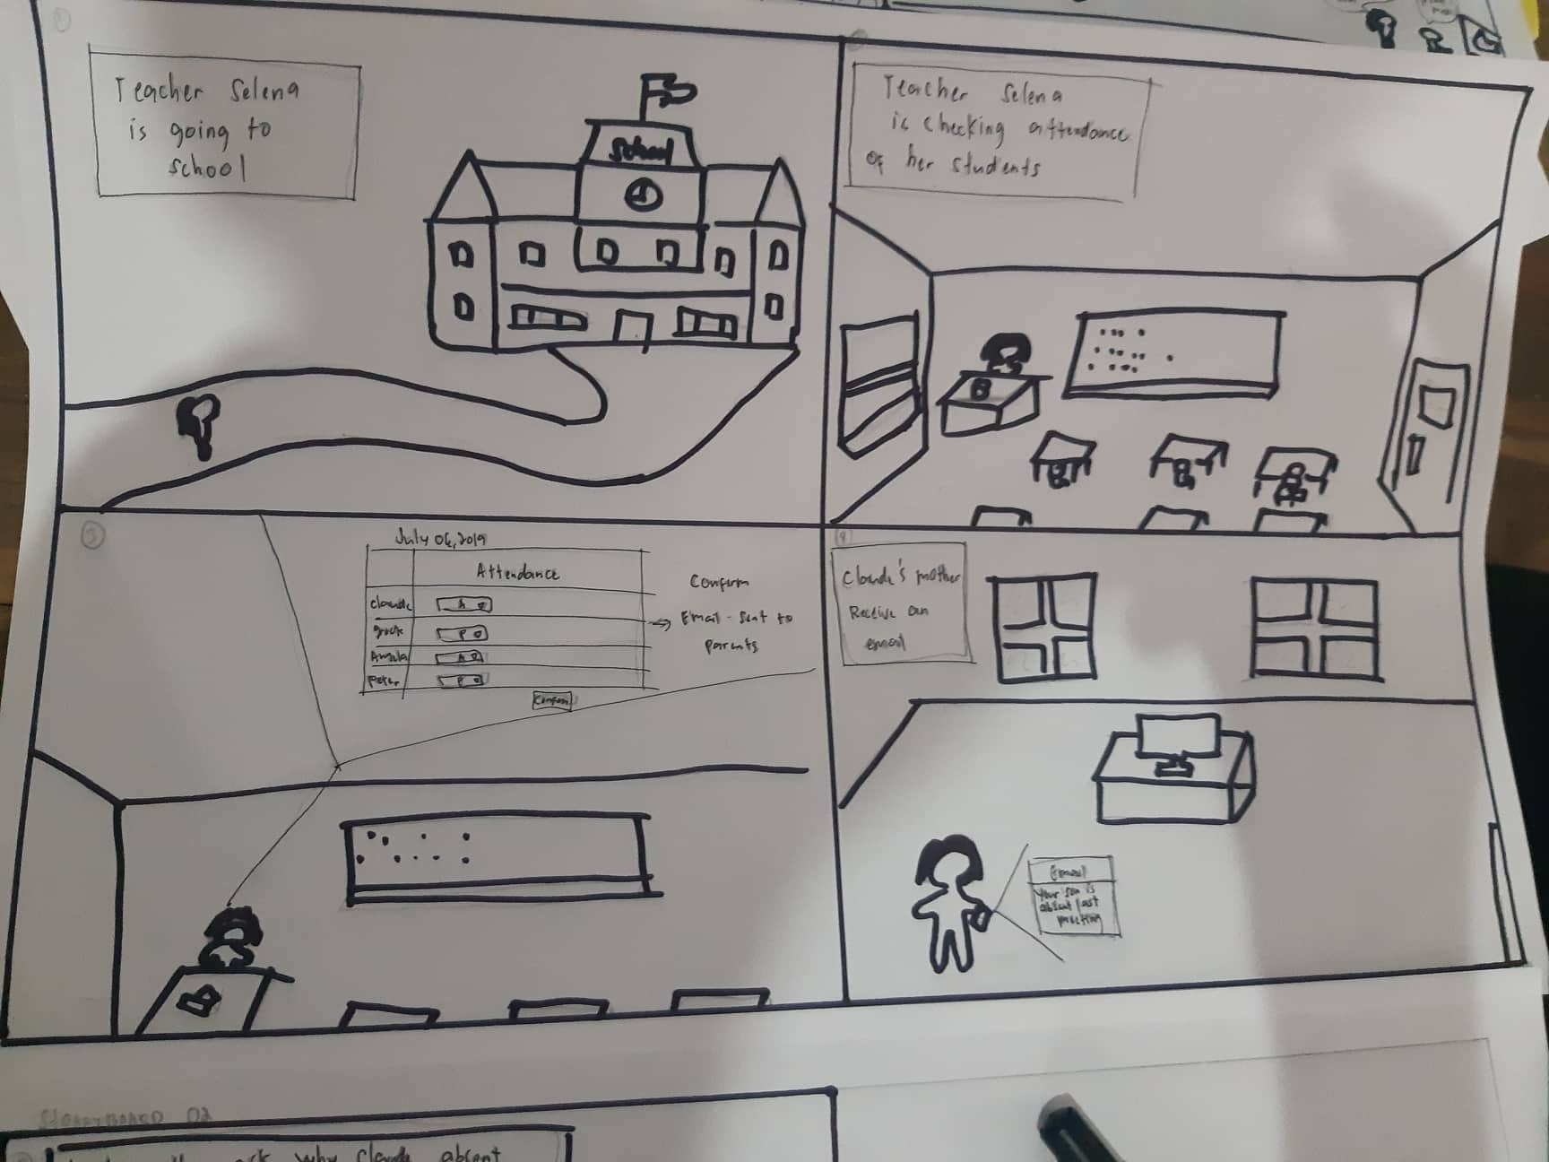
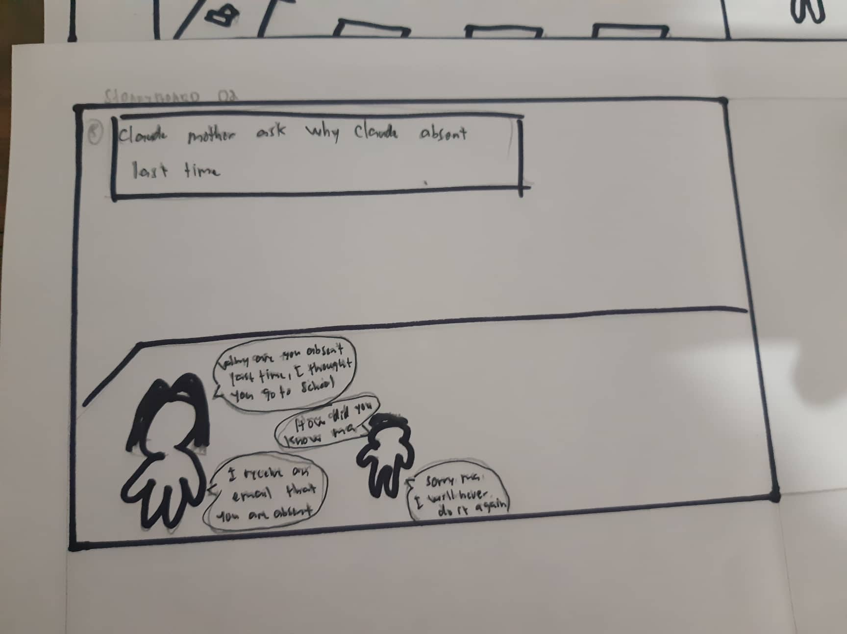
Quotations are commonly printed as a means of inspiration and to invoke philosophical thoughts from the reader.

Slide 12
Quotations are commonly printed as a means of inspiration and to invoke philosophical thoughts from the reader.

Slide 13
ITERATION COMMENTS

Slide 14
1st Iteration Comments for Parent
Parent 1:
“For college, if you could put remarks that i can see in which subjects he or she attended to or not. And make it real time so the parent will know the attendance of the child. If could also improve more the interface. Add remarks which subject the child is absent and the contact teacher of that subject the parent can communicate with.”
Parent 2:
“Regarding sa send message, meron sanang automatic message. Example, absent ang student sa isang subject, pag click ng send message may lalabas na make an appointment. When they click the make an appointment lalabas yung time and date ng schedule for the appointment. Number 2 yung send message is sana a free text message.”
Parent 3:
“Okay naman yung app, parang may kulang lang. Dapat may summary ng absent para mas madaling icheck.”
Parent 4:
“Maganda naman yung app kasi mababantayan ko talaga yung mga anak ko kung pumapasok ba o nagcucutting lang. I-susugest ko sana na pwedeng makapaglagay ng total absent para malaman ko agad kung gaano na karami yung absent nila.”
Parent 5:
“Mas maganda kung yung mga buttons ay same ng size. tapos yung sa part ng message dapat pag tapos kong mag send ng message tapos pagbalik ko andun parin yung ininput ko na student code, parang naka initial load pa rin yung screen kanina.”

Slide 15
1st Iteration Comments for Parent
PARENT 1: https://www.youtube.com/watch?v=skR6X0a28Q4&feature=youtu.be
PARENT 2: https://www.youtube.com/watch?v=KweeTv7tQug&feature=youtu.be
PARENT 3: https://www.youtube.com/watch?v=HQMSewctC3s&feature=youtu.be
PARENT 4: https://youtu.be/LORnD3Vyo54
PARENT 5: https://youtu.be/IGYO_cmypS4
PARENT 6: https://youtu.be/S_v1cxgwAag

Slide 16
LINKS FOR PARENT ITERATION 1
PARENT 1 https://www.youtube.com/watch?v=skR6X0a28Q4&feature=youtu.be
PARENT 2 https://www.youtube.com/watch?v=KweeTv7tQug&feature=youtu.be
PARENT 3 https://www.youtube.com/watch?v=HQMSewctC3s&feature=youtu.be
PARENT 4 https://youtu.be/LORnD3Vyo54
PARENT 5 https://youtu.be/IGYO_cmypS4
PARENT 6 https://youtu.be/S_v1cxgwAag

Slide 17
1st Iteration Comments
Teacher 1:
Sana kapag naglo-login ako, pinapakita yung username ko sa home page. Sana automatic din na nakalagay yung date kung sakaling di nakapaglagay yung teacher tapos mas maganda siguro kung may date din sa review records.
Teacher 2:
maayos naman ang app pero suggestion lang, sana may nakalagay na pangalan ng teacher kung sino nag check, kung si adviser teacher ba or yung subject teacher ba para atleast alam ng parent kung sino yung nag check ng attendance ng kanilang mga anak.
Teacher 3:
“Sana kapag nag review ako ng records hindi lang section ang ilagay niyo, pati na rin ang date. Ayun lang okay naman yung app, kaya lang lakihan niyo onti yung mga buttons.”
Teacher 4:
“Siguro pag mag rereview sana may option for date. Okay naman siya, ibahin niyo nalang yung kulay nung present at absent, yung parang red kapag absent, para lang malaman agad kung sino yung absent.”
Teacher #5 :
“Para sakin yung kulang nalang is yung pagkakaiba-iba ng mga kulay para sa present/absent/late. Para lang hindi mahirap hanapin yung mga absent. “

Slide 18
LINKS FOR TEACHER ITERATION #1
TEACHER 1 https://youtu.be/qUGO84j8hSc
TEACHER 2 https://youtu.be/HPGztryQWkg
TEACHER 3 https://youtu.be/UwW5rCnjVA0
TEACHER 4 https://youtu.be/ZiSQZPia788

Slide 19
2nd Iteration Comment
Parent 6:
“Maganda naman yung application kasi makakatulong yun sa aming mga parents para ma monitor namin kung nakapasok ba o pumasok ba at anong oras pumasok ang mga anak namin. Suggest ko lang na lagyan ng section.”
LINK FOR PARENT 6: https://youtu.be/S_v1cxgwAag
Teacher 5
“Kapag sa messages sana kita, naka thread view pa rin siya.”

Slide 20
THANK YOU!

