Slide 1
Simulation of light scattering and propagation
# HW2
陳政霆 (Leon)
Biomedical electronics and Bioinformatics

Slide 2
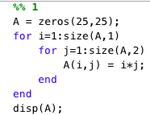
Display a 25-by-25 multiplication table
Figure 1. Solution of problem 1

Slide 3
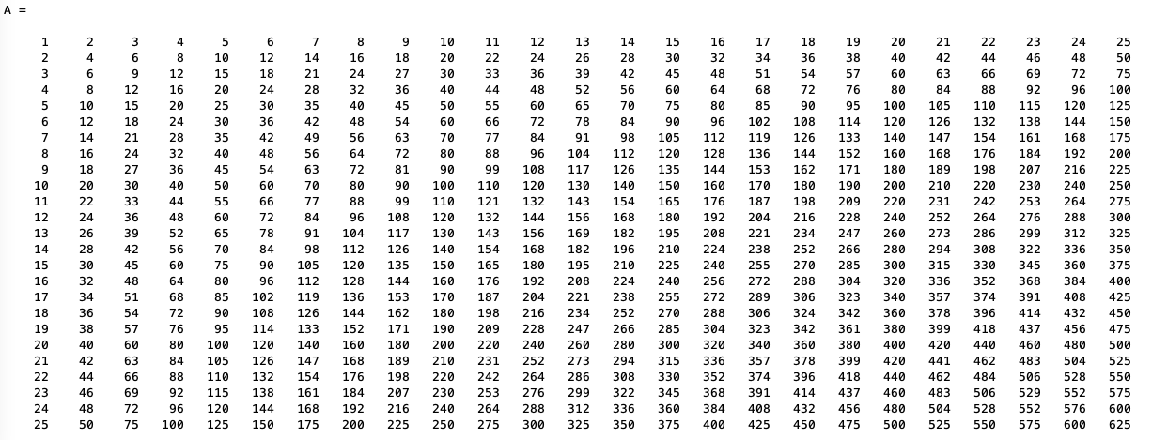
Display a 25-by-25 multiplication table
Figure 2. Answer of problem 1

Slide 4
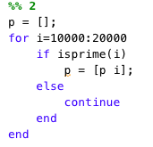
Show all prime numbers between 10000 and 20000
Figure 3. Solution of problem 2

Slide 5
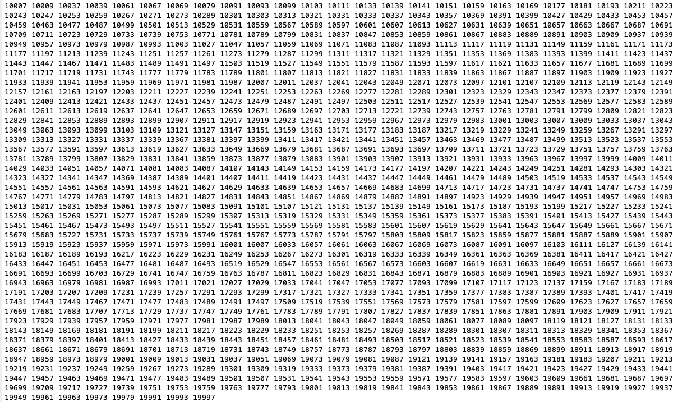
Show all prime numbers between 10000 and 20000
Figure 4. Answer of problem 2
Notes:
1033 prime numbers totally

Slide 6
Draw a sketch of yourself
Ellipse
Interp1 to make curve line
Polyshape to make polygon

Slide 7
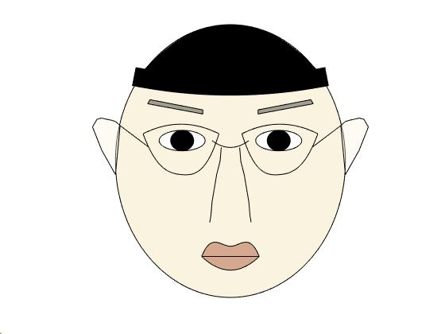
Draw a sketch of yourself
Figure 5. Answer of problem 3

Slide 8
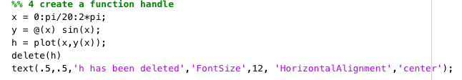
Create an function handle
Figure 6. Solution of problem 4

Slide 9
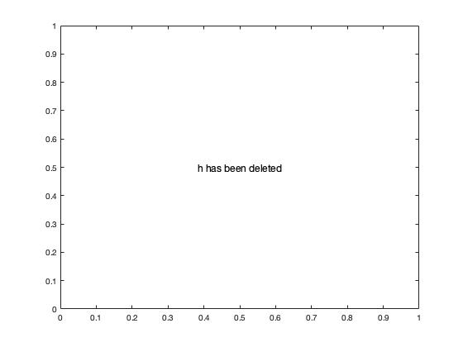
Create an function handle
Figure 7. Answer of problem 4

