Slide 1
Simulation of Light Scattering and Propagation HW 5 Presentation 2022/10/17
Professor: Dr. Snow H. Tseng
Group 6
Members:
吳天予(Tammy)、陳政霆(Leon)、Deepali、潘如麟

Slide 2
Outline
HW5.1 Question
HW5.2 Question
HW5.3 Question
HW5.4 Question

Slide 3
HW5.3 Can iterative finite difference method (static field) be used to simulate the phenomenon of electromagnetic waves? reflection, refraction, etc.
No, it can’t.
Electromagnetic waves is time-varying, not static field, which reverse their direction at a regular frequency, are produced by appliances using alternating current (AC) as well as by cellular telephone antennas, microwaves, etc.
In this case, the electric and magnetic fields are interrelated and are both associated with a specific frequency.
Notes:
Code with simplicity and efficiency.
Consistent with physical principles. such as gravity or Maxwell's equations.
Simulation in the correct scale, e.g. when simulating electric fields, the size of the sample may affect the results.
Ignore unnecessary trivial factors.
Physical parameters that can be quantified and observed .

Slide 4
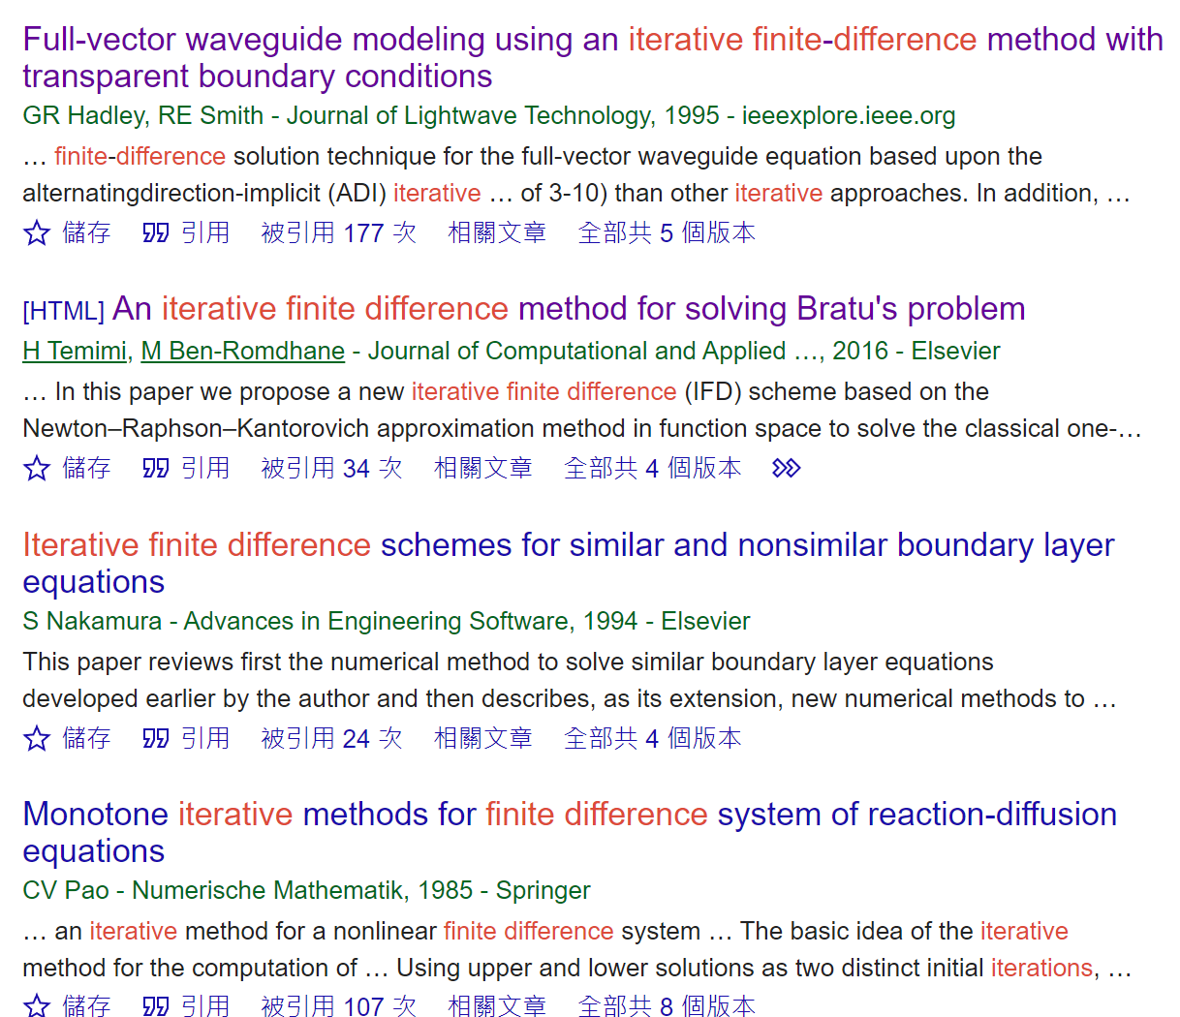
HW5.4 The applications of iterative finite difference?
Full-vector waveguide modeling
finite-difference frequency-domain (FDFD) simulation of materials with negative permittivity
solving Bratu's problem
reaction-diffusion equations
linearized waveform inversion in the frequency domain
analyzing fluid flow in porous media
heat transport equation
Riemann-Liouville tempered fractional derivative equation
.
..
...

Slide 5
HW5.4 The applications of iterative finite difference?
Iterative finite difference
Generate a sequence of improving approximate solutions according to previous approximation.
Notes:
General idea of iterative finite difference

Slide 6
HW5.4 The applications of iterative finite difference?
•Walking path prediction of pet.
Reasons:
1. They walks the same path each time based on my observation.
(Based on this idea, if he walks to point A, we give it a weight. Then next time he will have a
larger probability to point A)
2.Predict future path is doable because walking

Slide 7


