Slide 1
Doctor Engagement and Retention Report
Prepared for: Karen (Finance Department)

Slide 2
Objective & Main Questions
Objective: Analyze doctor behavior across platform
Main Questions:
1. Who is satisfied and who is not?
2. How do early joiners compare to new joiners?
3. Are there signals before churn?
4. Which groups churn more often?

Slide 3
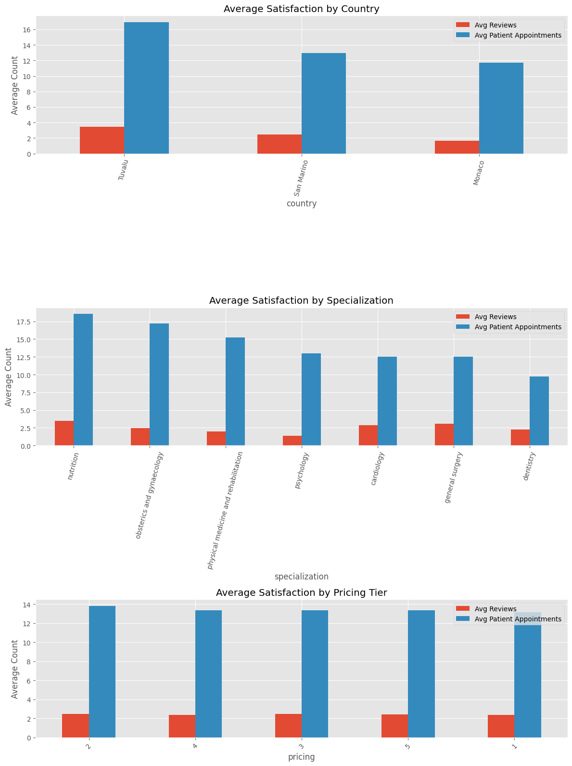
Satisfaction Overview
Notes:
Satisfaction of doctors
Measure: Doctors with enough opinions (Reviews) and user bookings (patient appointments).

Slide 4
Satisfaction
Country:
conclusion: Tuvalu doctors lead in both reviews and patient appointments
Conclusion: Monaco lags - fewer reviews and bookings → may need more support or visibility
Specialization:
Conclusion: nutrition and OB-GYN specialists are top performers
Conclusion: Dentists have the lowest average bookings - attention
Pricing:
Conclusion: very little difference across pricing
Tier-levels: little difference
Conclusion: suggests pricing isn't a barrier to patient engagement

Slide 5
Early vs. New Joiners
Metric | Early | New
Reviews | 2.02 | 3.13
Appointments | 13.7 | 13.1
Notes:
2. Comparing Early vs. new joiners

Slide 6
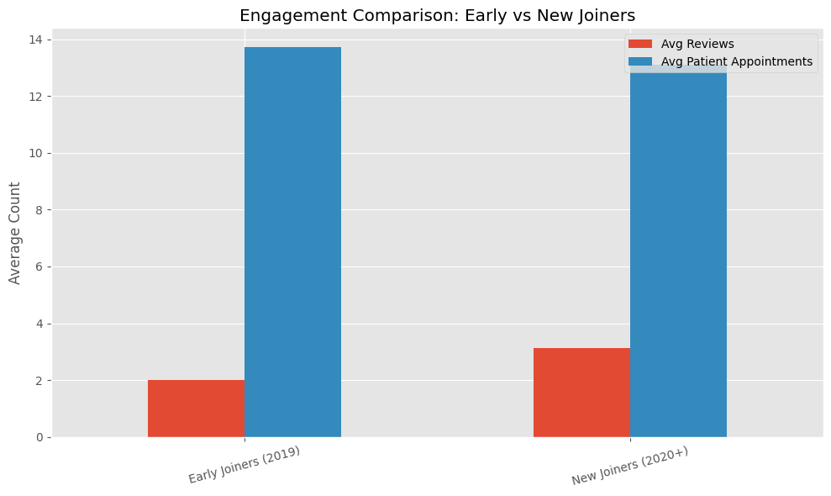
Notes:
early joiners vs. new joiners

Slide 7
Early vs. New Joiners
Conclusion:
New joiners leave more reviews on average (3.13 vs. 2.02) → possibly more engaged or actively asking for feedback.
Early joiners have slightly more patient appointments, but the difference is small.

Slide 8
Signals Before Churn
Metric | Pre-Churn | Retained
Reviews | 0.85 | 2.86
Appointments | 6.20 | 15.58
Notes:
3. signals before churn

Slide 9
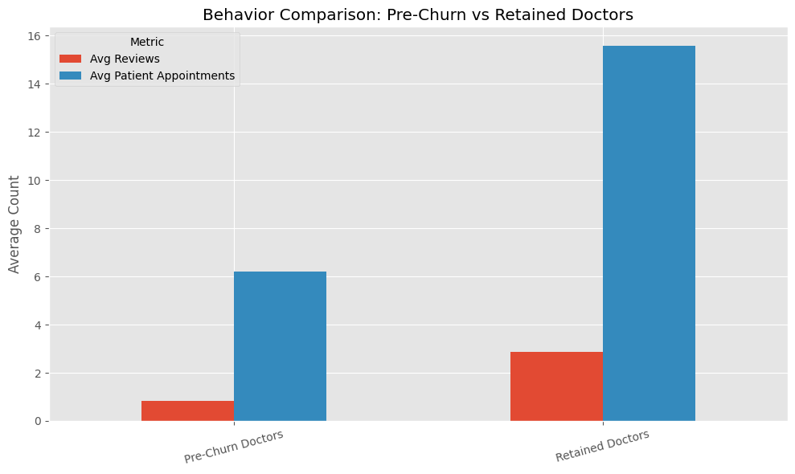
Pre-Churn vs. Retained

Slide 10
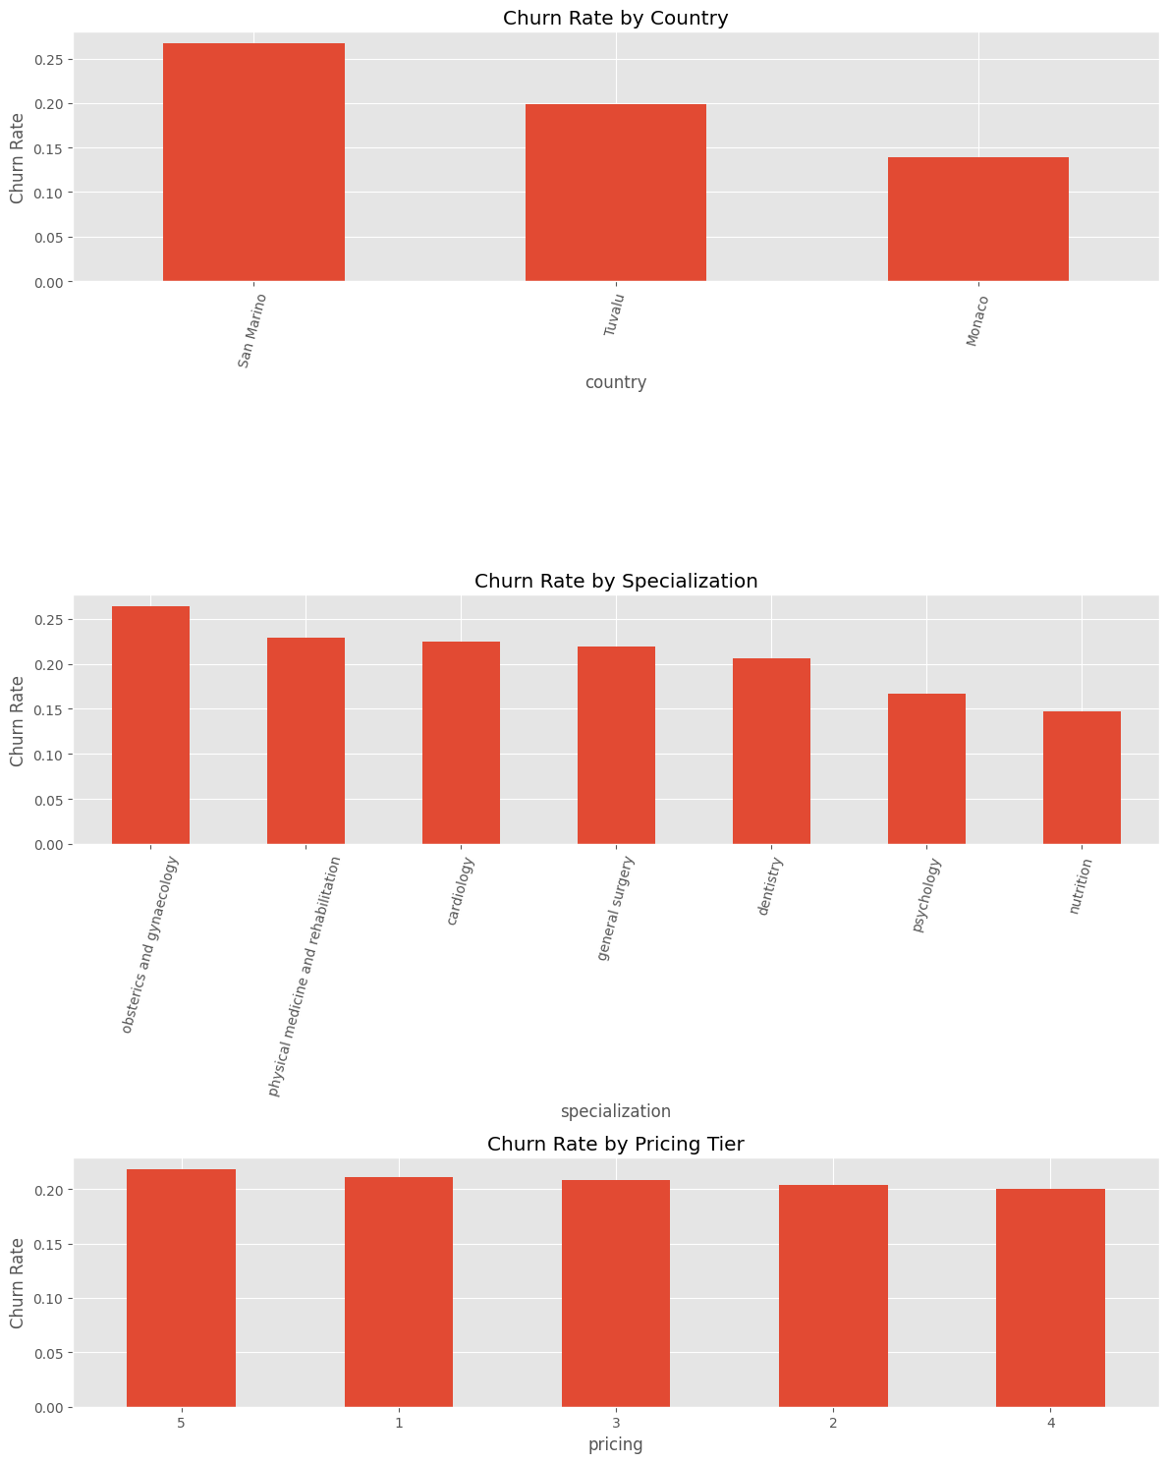
Notes:
3. Groups that Churn More

Slide 11
Groups That Churn More
Country: San Marino highest (26.7%), Tuvalu (20%) Monaco lowest (13.9%)
Specialization: OB-GYN (26.4%), physical medicine and rehabilitation (23%) vs. Nutrition (lowest - 15%)
Pricing: Tier 5 highest churn (21.8%), Tier 1, Tier 3, Tier 2, Tier 4 lowest (20.0%)

Slide 12
Final Recommendations
Support low-engagement doctors (Monaco, Dentistry)
Nurture and retain new joiners
Use booking/review drops as churn signals
Investigate high churn in premium doctors ( = OB-GYN, Tier 5)

Slide 13
Questions & Next Steps
Would you like deeper segmentation?
Can we align onboarding with churn signals?
Ready to prototype churn alerts?

