Slide 1
Quarterly Sales Forecasting
CoCoPep Drinks
Business Intelligence with SARIMA & Gradio Interface

Slide 2
Business Challenge
• Difficult to predict revenue
• Struggles with ARIMA model
• Need for more precise method
Notes:
• Difficult to predict future revenue across sales channels. (4 - Distributor, On-line, Wholesale, In-store)
• Post-pandemic, the previous ARIMA (Auto-Regressive integrated Moving Average) model with limited features have struggled to capture increased complexities in social/economic factors
• Stakeholders needed a more precise method to visualize and explore forecasts.

Slide 3
Pipeline Strategy
1. Historical US region sales data (2018–2021)
2. Aggregate by order date, sales chanel, and net revenue (monthly)
3. SARIMA model
(Seasonal Auto-Regressive Integrated Moving Average)
4. Forecasting UI with Gradio
Notes:
1. Import historical US region sales data (2018–2021)
2. Aggregate by order date, sales chanel, and net revenue (monthly)
3. Use SARIMA model to forecast sales trends
(Seasonal Auto-Regressive Integrated Moving Average)
4. Deploy interactive forecasting UI with Gradio

Slide 4
SARIMA (Seasonal Auto-Regressive Integrated Moving Average)
an extension of ARIMA (AutoRegressive Integrated Moving Average)
incorporates seasonality
Advantages:
Handles seasonality effectively
Suitable for long-term forecasting
Limitations/Considerations:
More complex than ARIMA
Requires careful tuning
Notes:
an extension of the ARIMA (AutoRegressive Integrated Moving Average)
incorporates seasonality in addition to the non-seasonal components
Advantages:
Handles seasonality effectively, which ARIMA cannot.
Suitable for long-term forecasting where seasonal patterns are present.
Limitations:
More complex than ARIMA due to additional seasonal components.
Requires careful tuning of both seasonal and non-seasonal parameters.

Slide 5
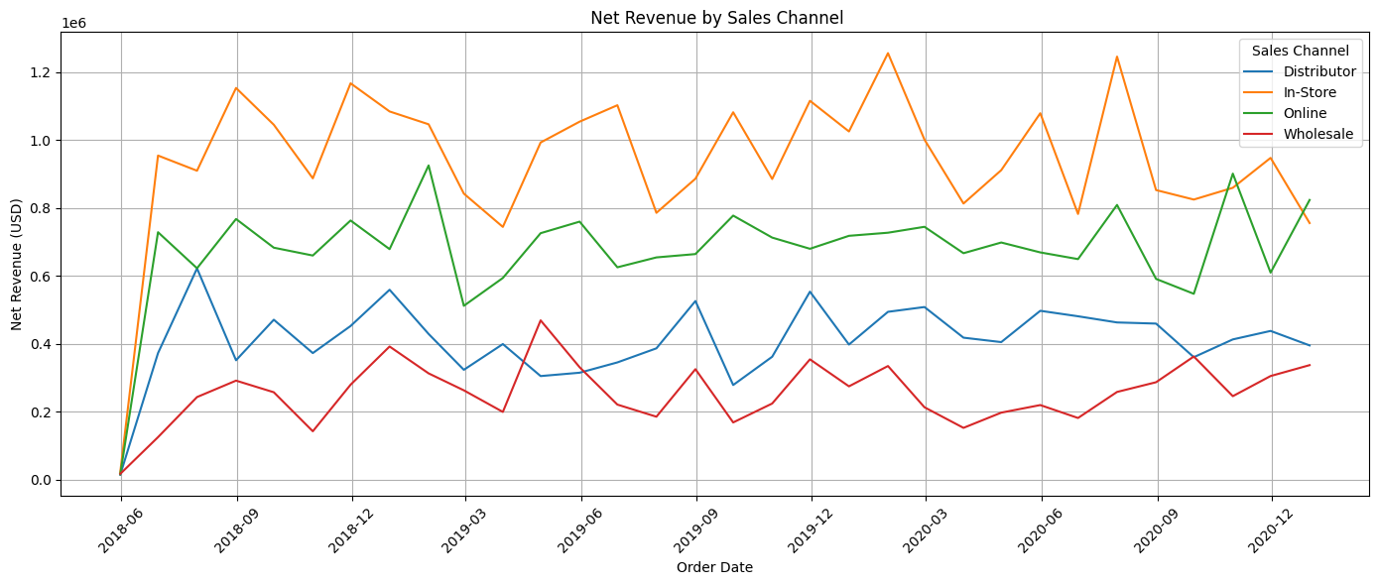
Quarterly Revenue by Sales Channel (2018-2021)
Notes:
Brown = In-store
Green = On-line
Blue = Distributor
Red = Wholesale

Slide 6
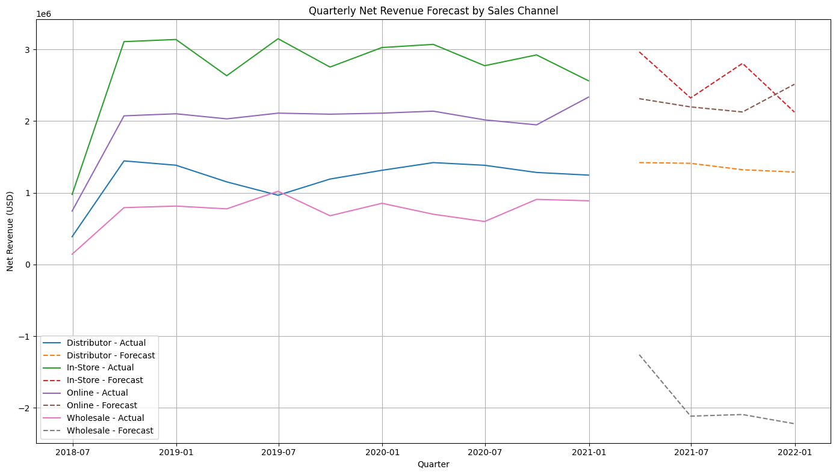
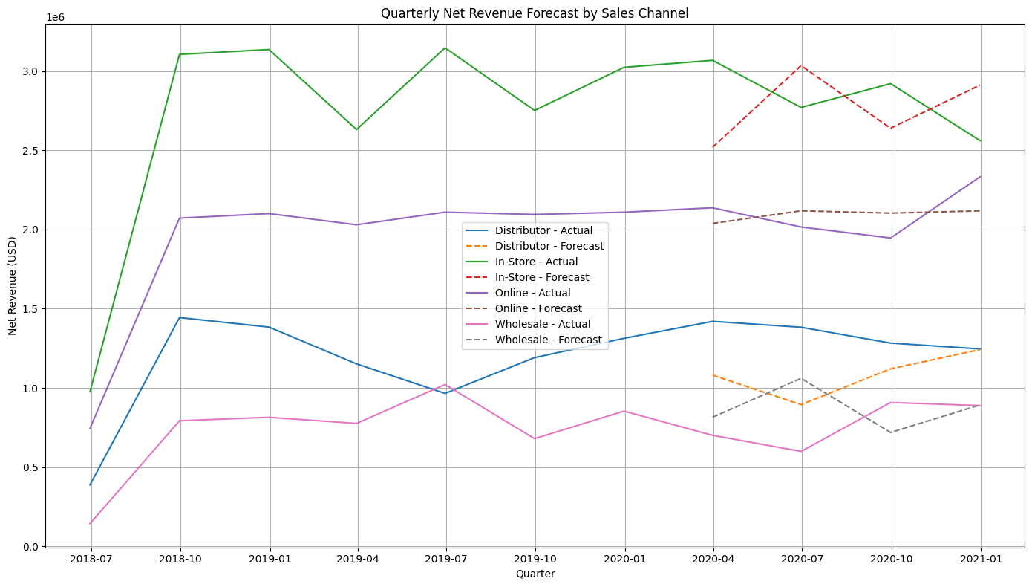
SARIMA - Test
Notes:
Comparison of Model Predictions with Actual Data
-some discrepancy due to lack of aggregation of promotional-seasonality data
-Brown dashed-line dip (Distributor Forecasting) mirrors previous dip in Distributor Actual data
-showing that the model learned well
-83.5% Accuracy

Slide 7
Interactive Forecasting Interface
• Built with Gradio
• select sales channel & forecast horizon (quarters)
• Forecasts visualized
• public shareable link
https://80b2b6b9d9d7ea6ea8.gradio.live/
Notes:
• Built with Gradio (Python UI framework)
• Users select sales channel & forecast horizon (quarters)
• Forecasts visualized instantly using matplotlib
• Hosted via Google Colab with public shareable link
https://80b2b6b9d9d7ea6ea8.gradio.live/

Slide 8
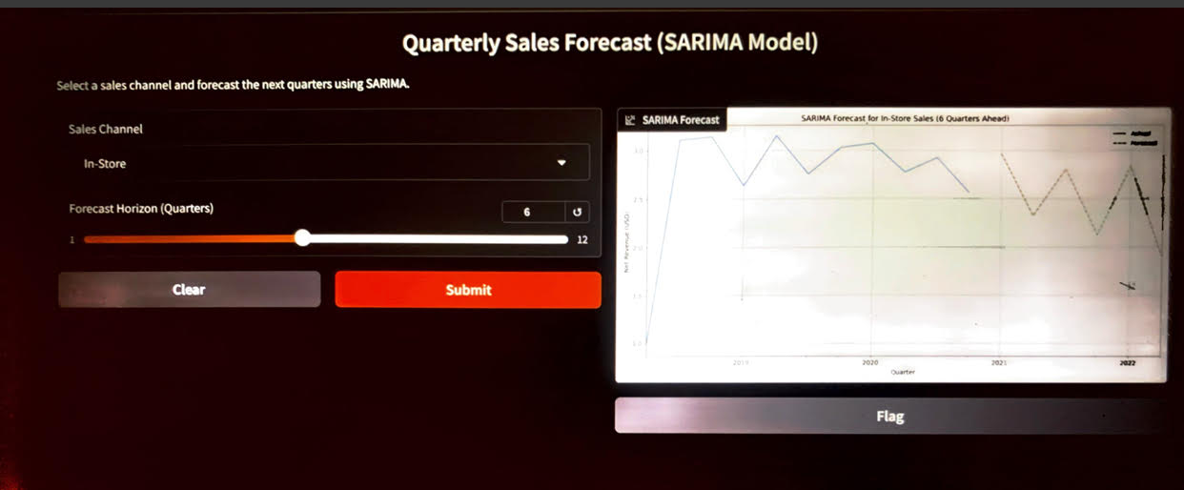
Live Prototype: Gradio Interface
Notes:
Here is how the Gradio Interface Looks like
-dropdown widget to choose the Sales Channel
-slider allows predictions for the next 12 quarters/3 years
-click submit to see the forecast

Slide 9
Business Impact
• quarterly trends per sales channel
• Data-driven support
• SARIMA model
• Stakeholders can interact directly via. Gradio interface
Notes:
• Clear visibility into quarterly trends per sales channel
• Data-driven support for marketing and budget planning
• SARIMA models deliver consistent, interpretable forecasts
• Stakeholders can interact directly with sales forecast data vis. Gradio interface

Slide 10
Next Steps
monthly
promotion and discount features
Test Prophet and ML-based models
Export forecasts to Excel
BI dashboards
Notes:
Monthly instead of quarterly - for even more stable predictions
• Add promotion and discount features
• Test Prophet and ML-based models
Prophet: Automated handling of seasonality, trends, and holidays.
• Export forecasts to Excel
integrate with BI dashboards

Slide 11
THANK YOU – QUESTIONS & DISCUSSION

