Slide 1
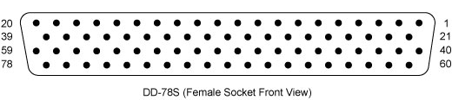
Mirror Board Testing
DSUB 1
DSUB 2

