Slide 1


Analysis of USGS Earthquake Data - 25 Aug to 24 Sept 2023
Presented by Tidiane Diallo
29 Sept 2023

Slide 2
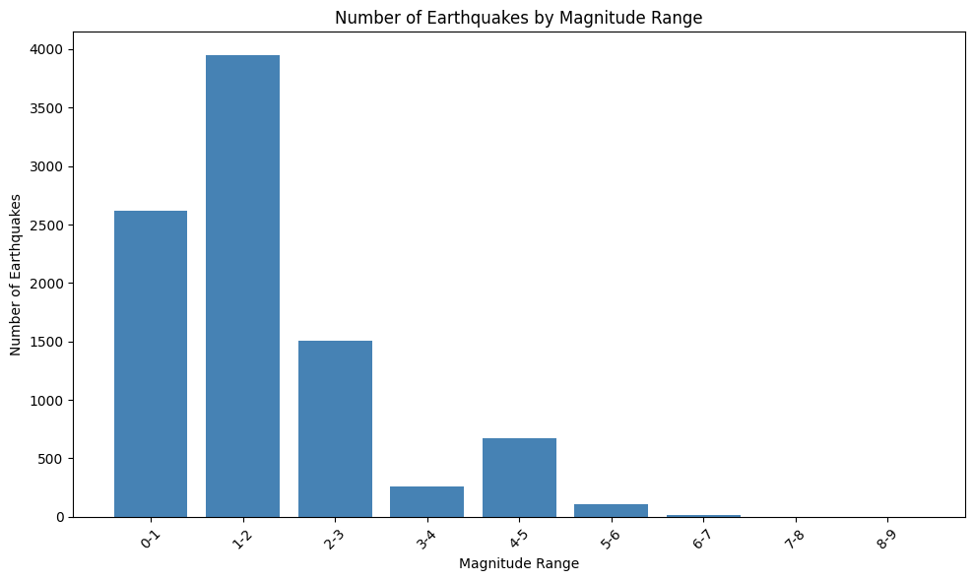
The magnitude “1-2”, has the highest number of earthquakes. As magnitude increases, the number of earthquakes decreases
3953 observations

Slide 3
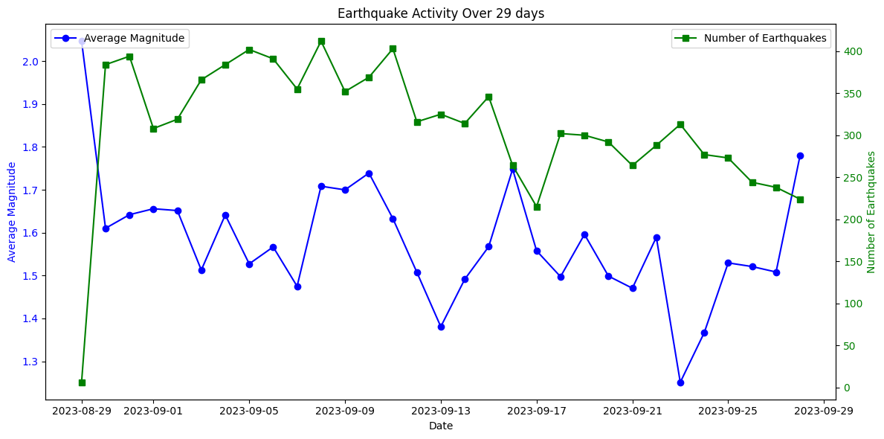
Noticeable fluctuation in earthquake magnitude over time. Number of earthquakes reveals occasional spikes and periods of increased seismic activity

Slide 4
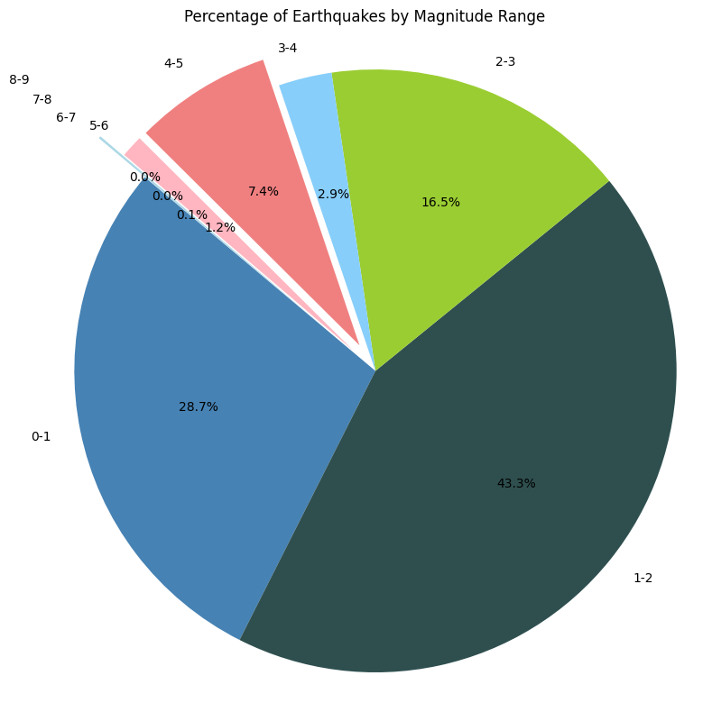
Majority of earthquakes fall in the magnitude range "1-2," representing the largest share of seismic events

Slide 5
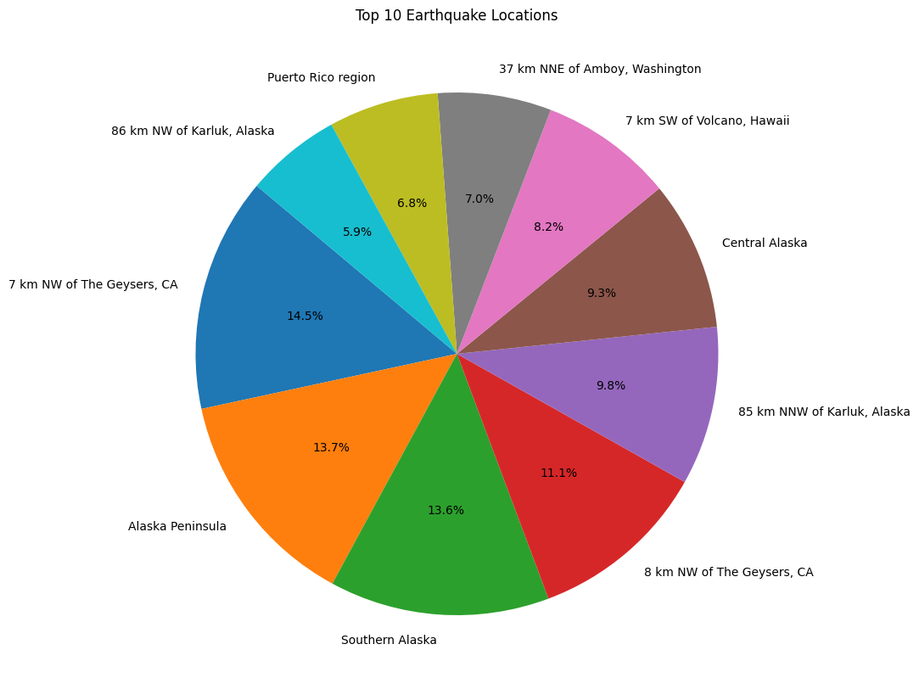
A few areas in the United States experience a higher concentration of seismic events, totalling ~88.8% of readings

Slide 6
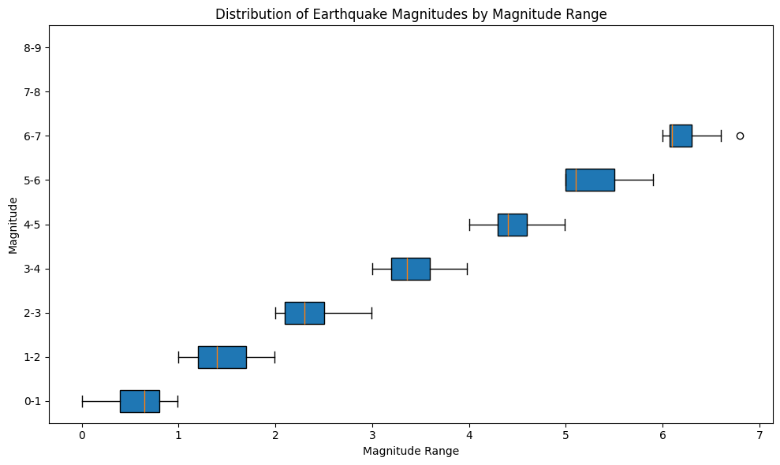
Less severe magnitude ranges have wide distributions, while higher mag ranges are more tightly grouped. Outlier in “6-7” mag range allowed to capture Al Haouz earthquake (6.8 magnitude)
Al Haouz earthquake

Slide 7
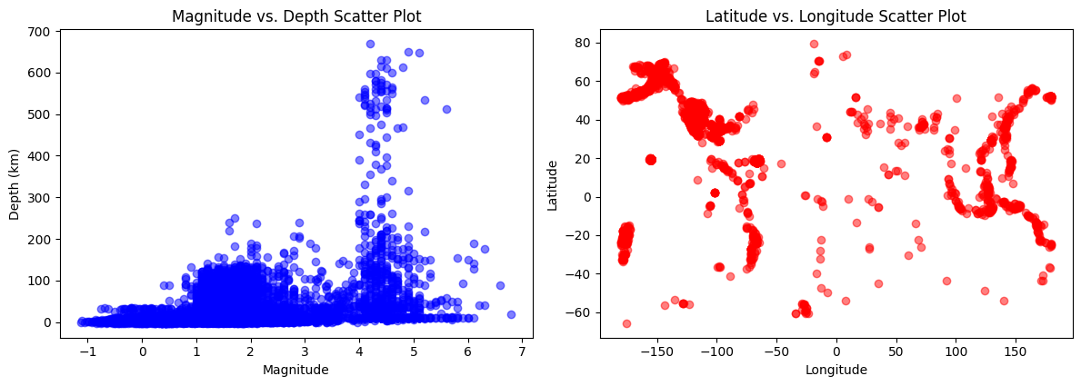
Most earthquakes occurred at depths between 0 and 200 km The 2nd plot provides a spatial perspective on earthquake occurrence

Slide 8
Insights
The majority of earthquakes in the dataset fall in the "1-2" magnitude range, indicating that smaller earthquakes are more common than larger ones.
Clusters of earthquakes are observed in specific regions, aligning with known tectonic plate boundaries.

Slide 9
Thank you for listening!

Slide 10
Glossary
time: Time when the earthquake event occurred. latitude: The geographic latitude coordinate of the earthquake's epicenter.
longitude: The geographic longitude coordinate of the earthquake's epicenter.
depth: The depth at which the earthquake occurred below the Earth's surface, usually measured in kilometers.
mag: The magnitude of the earthquake, which quantifies the energy released by the earthquake. It is a numerical value.
magType: The type of magnitude measurement used, such as "mb" (Body-wave magnitude) or "ml" (Local magnitude).
nst: The total number of reporting seismic stations for this earthquake.
gap: The largest azimuthal gap (in degrees) among all the seismic stations used to determine the earthquake's location and magnitude.
dmin: The minimum distance to the earthquake in degrees. This can be thought of as the closest station to the epicenter.
rms: The root mean square (RMS) of the amplitude spectrum of the earthquake's seismogram.
net: The network or data source identifier. id: A unique identifier for the earthquake event. updated: The time when the earthquake information was last updated.
place: A description of the location where the earthquake occurred, typically including the nearest populated place or geographic feature.
type: The type of earthquake event, such as "earthquake," "explosion," or "quarry blast."
locationSource: The source or agency responsible for providing the earthquake location information.
magSource: The source or agency responsible for determining the earthquake magnitude.
horizontalError: The horizontal error in kilometers associated with the earthquake's location.
depthError: The error in kilometers associated with the earthquake's depth measurement. magError: The error associated with the earthquake magnitude measurement.
magNst: The number of reporting seismic stations used to compute the magnitude.
status: The status of the earthquake event, which can be "automatic" or "reviewed" based on the level of human review and verification.

Slide 11
Disclaimer
The views expressed in this document are solely those of the student and do not represent the official views or opinions of the United States Geological Survey (USGS). The USGS does not endorse or take responsibility for any conclusions or recommendations presented herein.

