Slide 1
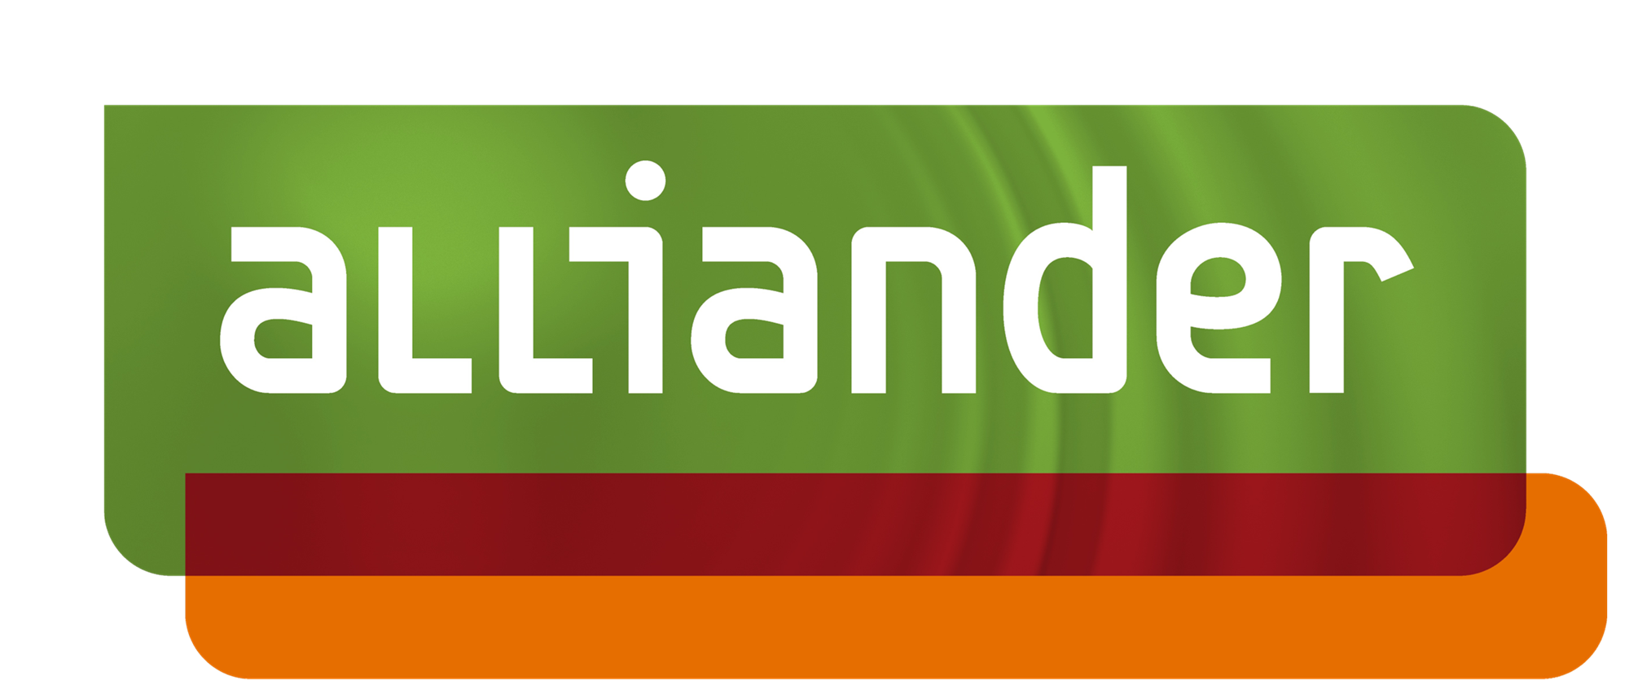
AInstein: ArchiMate
Model Generation
Pipeline
Findings, Challenges, and the Road to YAML
Cagri Tekinay l ESA l AI-DSO / AIon l March 2026

Slide 2
AInstein generates
ArchiMate models from
architectural decisions & review/improve existing models
The generation pipeline: turning ADRs and source documents into validated ArchiMate Exchange XML
2

Slide 3
Agenda
What AInstein does today
What’s coming next: the Read Pipeline
Implementation choice: Skills vs MCP vs Custom Agent
Model capability findings: why small models fail
Validation and sanitization struggles
Skill philosophy: no regex soup
Follow-up refinement: iterating without full XML
The YAML pivot: stop generating XML
Format analysis: TOON vs YAML
The final numbers: 90% token reduction!
What’s next
3

Slide 4
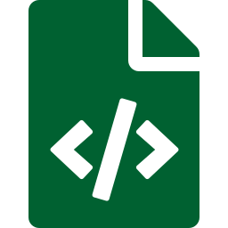




What AInstein Does Today
Generation Pipeline — Producing Architecture Models
Ingest
→
Generate
→
Validate
→
Repair
→
Refine
ADRs, specs,
source docs
ArchiMate
Exchange XML
ArchiMate 3.2
schema rules
View refs,
missing nodes
User-guided
improvements
Purpose: Produce ArchiMate Open Exchange XML models from architectural decisions — not consume them.
4

Slide 5


What’s Coming Next
Read Pipeline — Giving AInstein Eyes on Existing Models
Exposed Tools
Use Cases
SearchViews — find views by name or content
GetViewDetails — full element/relationship data
SearchElements — query elements across models
GetElementDetails — properties, relationships
Generate documentation from live models
Threat modeling from architecture views
Provide architectural context to other LLMs
Read from GitHub, local repos, model repos
Open question: Return model content as YAML, TOON, or Markdown for LLM consumption? (Analysis on slides 12201314, results on slides 15201318)
5

Slide 6
Implementation Choice
Why Claude Skills over MCP Servers or Custom Agentic Frameworks
Dimension | Skills | MCP Server | Custom Agent
Token efficiency | Lazy loading (only active skills) | All tool defs upfront | Full prompt per call
Context loading | Progressive (~500 vs ~25K tokens) | Static tool schemas | Manual management
Execution | Claude sandbox (local, secure) | Remote server (network hops) | Self-hosted (ops burden)
Portability | .skill zip file works anywhere | Server deploy per environment | Custom deploy per setup
Data sovereignty | All local (critical for DSO) | Data traverses network | Depends on implementation
Iteration speed | Edit SKILL.md instant reload | Redeploy server | Redeploy agent
Our skills: archimate-viewer (visualization), archimate-generator (XML from ADRs), repo-housekeeping (docs)
6

Slide 7
Model Capability Findings
Why Smaller and Local Models Cannot Generate ArchiMate XML
Small Models (3B–20B)
Local Ollama (M3 Pro, 36 GB)
Cannot maintain valid XML across 50+ elements
Lose track of element IDs in relationship refs
Hallucinate xsi:type values not in ArchiMate 3.2
gpt-oss:20b (MoE, 3.6B active): plausible but structurally broken
smollm3 (3.1B): completely unable to produce valid XML
gpt-oss:20b on Metal: 15–25 tok/s
131K default context eats 17 GB of 36 GB RAM
ArchiMate XML = 10K+ output tokens = 7–10 min
Chain-of-thought reasoning adds overhead
Acceptable for Q&A but impractical for generation
Conclusion: Structured XML generation requires frontier models (Claude Sonnet 4+). Local models are viable for RAG, not generation.
7

Slide 8
Validation & Sanitization
Taming the Stochastic Output of LLM-Generated XML
XML Escaping
View Repair
Stochasticity
Problem:
Problem:
Problem:
LLMs produce & instead of &amp;,
< in names, unescaped quotes
Views reference elements that
don’t exist, missing nodes
Same prompt → different structures.
Hallucinated types, swapped IDs
Mitigation:
Mitigation:
Mitigation:
Deterministic sanitizer catches
all XML-illegal characters
Post-generation repair pass:
scan views, add missing nodes
Schema validation + retry loop.
Still not fully solved → YAML pivot
8

Slide 9


Skill Philosophy
Gradual Improvement Without Rigid Logic or Regex Soup
LLM routes per intent
No regex or keyword routing. Ainstein persona classifies intent using an LLM and orchestrates an execution paths. Adaptive as capabilities grow.
Progressive skill loading
Skill descriptions = ~500 tokens. Only 2–3 relevant skills fully loaded per query, saving 93% on input tokens.
Skills, not hardcoded pipelines
archimate-viewer, archimate-generator, repo-housekeeping — each a .skill zip with SKILL.md + reference code.
Deterministic validation, not LLM repair
XML schema validation, escaping, and view generation are code — not another LLM call. Eliminates 10K+ token repair.
9

Slide 10
Follow-Up Refinement
Iterating on Models Without Resending the Full XML
Before: Full Model Round-Trip
After: Instruction-Based Edits
User: "Add a Technology layer"
LLM receives full XML (10K+ tokens input)
LLM regenerates entire model (10K+ output)
View repair needed (10K+ tokens)
Validation retry (14K tokens if failed)
Total: up to 34,500 tokens per change
User: "Add a Technology layer"
LLM generates only the change instruction
Deterministic code applies the delta
No full-model regeneration needed
View updates computed, not guessed
Target: ~3,500 tokens per change
→
Architects iterate naturally — "now add a firewall between zones" — without XML overhead.
10

Slide 11
The YAML Pivot
Stop Having LLMs Generate XML — Let Them Think Instead
Key insight: The LLM spends most completion tokens on XML boilerplate — namespace declarations, xsi:type=, xml:lang="en", identifier attributes, <views> coordinates. That’s structural repetition, not architectural reasoning.
LLM outputs only decisions (YAML):
Deterministic code handles the rest:
elements:
- id: m1
type: Driver
name: "Secure access"
relationships:
- type: Realization
source: a1 | target: a5
Expand short IDs to full ArchiMate identifiers
Map type strings to xsi:type attributes
Wrap in XML namespaces, tags, escaping
Generate view with grid layout per layer
Compute all view connections automatically
11

Slide 12
Format Analysis: TOON vs YAML
Is the Newest Format the Best Fit for ArchiMate Generation?
Factor | YAML ✅ | TOON | Raw XML
Token savings vs JSON | ~35–40% | ~40–60% (tabular data) | Baseline (most verbose)
Savings on our structure | ~35–40% | ~35–45% (marginal gain) | 0%
LLM output reliability | Excellent — trained on millions of files | Risky — too new for training data | Good but verbose/fragile
Parsing ecosystem | Mature libraries in every language | Young — TS/Python SDKs only | Mature but complex
Verdict: TOON is promising for input (feeding data to LLMs) but too immature for output. As of March 2026, LLMs have not been trained on TOON. YAML gives 90% of the benefit with near-zero risk.
12

Slide 13
Implementation Complexity
What It Takes to Build Each Pipeline
Dimension | XML (current) | JSON | YAML ✅ | TOON
Converter to Exchange XML | N/A (direct output) | Medium JSON→XML mapping | Medium YAML→XML mapping | Medium-High TOON→JSON→XML
Converter dev effort | 0 days | 3–4 days | 3–4 days | 5–7 days
View generation dev effort | 0 (repair: 10K tok) | 1–2 days | 1–2 days | 1–2 days
Validation dev effort | Already built (2–3 days) | 2 days | 1–2 days | 3–4 days
Total new dev effort | 0 (status quo) | 5–6 days | 4–6 days | 9–13 days
LLM generation success rate | ~85% (view always broken) | ~92% | ~95% | ~60–70% (not in training data)
Prompt engineering effort | Low | Low | Low | High (full spec + examples)
YAML: 4–6 days to implement with ~95% LLM success rate. TOON: 9–13 days with ~65% success rate. Double the effort, half the reliability.
15

Slide 14
Cost per Model Generation
Token Costs at Claude Sonnet 4.5 Pricing ($3 Input / $15 Output per MTok)
Cost Driver | XML (current) | JSON | YAML ✅ | TOON
LLM completion tokens | ~10,000 | ~7,000 | ~3,500 | ~3,000
View repair LLM call | ~10,500 (100% trigger) | ~10,500 (same problem) | 0 (deterministic) | 0 (deterministic)
Validation retry LLM call | ~14,000 (when triggered) | ~8,000 (when triggered) | 0 (valid by construction) | 0 (valid by construction)
Worst case total tokens | ~34,500 | ~25,500 | ~3,500 | ~3,000
Cost per model ($15/MTok output) | $0.52 | $0.38 | $0.053 | $0.045
Annual cost (20 models/day) | $3,780 | $2,774 | $383 | $328
Generation time | 90–230s + repair 30–60s | 60–120s + <1s convert | 30–50s + <1s convert | 25–45s + <1s convert
TOON saves $0.008/model over YAML ($55/year). TOON costs 5–7 extra dev-days. The ROI on TOON is negative for generation — use it for input only.
14

Slide 15
What We Built
YAML Pipeline: From Spec to Production in One Session
yaml_to_xml.py
SKILL.md
generation.py
test_yaml_to_xml.py
248 lines
Single public function
4 internal stages
172 lines
YAML schema + rules
No XML instructions
5 edit points
YAML detect → convert
Retry + fallback
21 tests
All passing
Roundtrip validated
✅ Single file Follows CLAUDE.md thin-layers rule. Constants reused from archimate.py.
✅ Graceful fallback No YAML detected? Falls through to legacy XML path. Zero downtime risk.
✅ Deterministic rel IDs id-rel-{source}-{target} — collision-free, merge-safe for refinement.
✅ YAML companion Stored alongside XML artifact. Refinement operates on YAML, never on XML.
✅ One targeted retry ~500 tokens on validation error. Not an infinite loop.
✅ Pipeline telemetry pipeline_info dict in COMPLETE log: path taken, tokens, retry status, convert time.
15

Slide 16
Expected vs Achieved
Spec Predictions vs First Production Run (ADR-29 Model)
Metric | Spec Predicted | Actually Achieved | Verdict
Completion tokens | ~3,500 | 4,856 | ✅ +39% but richer model
Total tokens (worst case) | ~3,500 | 8,900 | ✅ 65% reduction from 25,737
View repair | 0 tokens | 0 tokens | ✅ Eliminated
Validation retry | 0 tokens | 0 tokens | ✅ Eliminated
Generation time | 30–50s | 47s | ✅ On target
Conversion time | <1s | 31ms | ✅ Negligible
YAML success rate | ~95% first try | 100% first try | ✅ Better than expected
Elements generated | 53 (baseline) | 74 | ⬆ +21% richer model
Relationships generated | 61 (baseline) | 92 | ⬆ +48% richer model
Key insight: The LLM spent freed tokens on architectural reasoning — 74 elements vs 53, 92 relationships vs 61. Better models at lower cost.
16

Slide 17
The Proof
Actual COMPLETE Log Line from First Production Run
pipeline=yaml, yaml_valid=True, yaml_retry=False, convert_ms=31,
prompt=4044tok, completion=4856tok, elements=74, relationships=92
pipeline=yaml
YAML path taken, not XML fallback
yaml_valid=True
Validated first attempt. No retry needed.
yaml_retry=False
Zero post-generation LLM calls. Valid by construction.
convert_ms=31
Deterministic conversion in 31 milliseconds.
completion=4856tok
vs 34,500 worst case with XML pipeline. 86% reduction.
YAML companion saved (16,950 chars). Ready for refinement path.
17

Slide 18
Before & After
XML Pipeline vs YAML Pipeline — Same ADR, Same Model, Real Numbers
BEFORE: XML Pipeline
AFTER: YAML Pipeline
Completion tokens
10,628
Completion tokens
4,856
View repair
10,514 tokens (43s)
View repair
0 (deterministic)
Validation retry
14,168 tokens (89s)
Validation retry
0 (valid by construction)
Total tokens
25,737
Total tokens
8,900
Total time
227 seconds
Total time
47 seconds
Elements
61
Elements
74 (↑ +21%)
Relationships
62
Relationships
92 (↑ +48%)
-65% Total Tokens
-79% Generation Time
+21% Model Richness
0 Post-Gen LLM Calls
18

Slide 19

What’s Next
SHIPPED
IN PROGRESS
PLANNED
YAML Converter
Refinement via YAML
Read Pipeline
DONE. 248 lines, 21 tests, all passing. Deterministic XML + grid views. YAML companion stored for refinement.
NEXT. Load YAML companion (~2,500 tokens) → LLM modifies → converter produces XML. ~80% reduction vs XML refinement.
PLANNED. Parse existing ArchiMate files. Expose SearchViews, GetElementDetails. Return YAML for LLM consumption.
Validated principle: LLMs do the thinking. Deterministic code does the formatting. 65% fewer tokens. 79% faster. 21% richer models.
19

