Slide 1
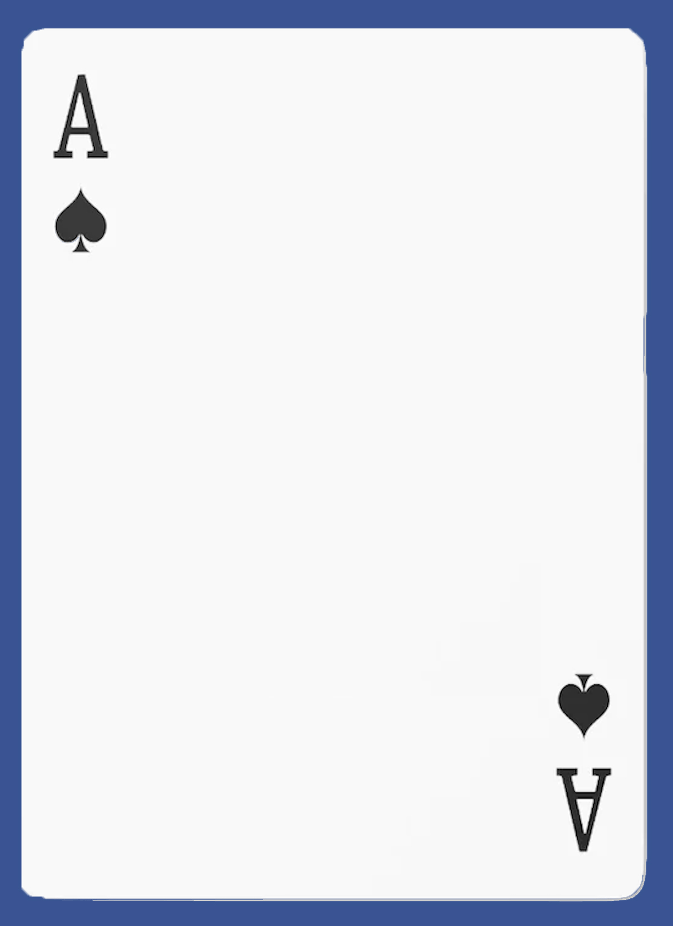

CMU
Blackjack
Society
Learn / Practice
Basic strategy &
Card counting
Master the skills
& Beat the casino!

Slide 2
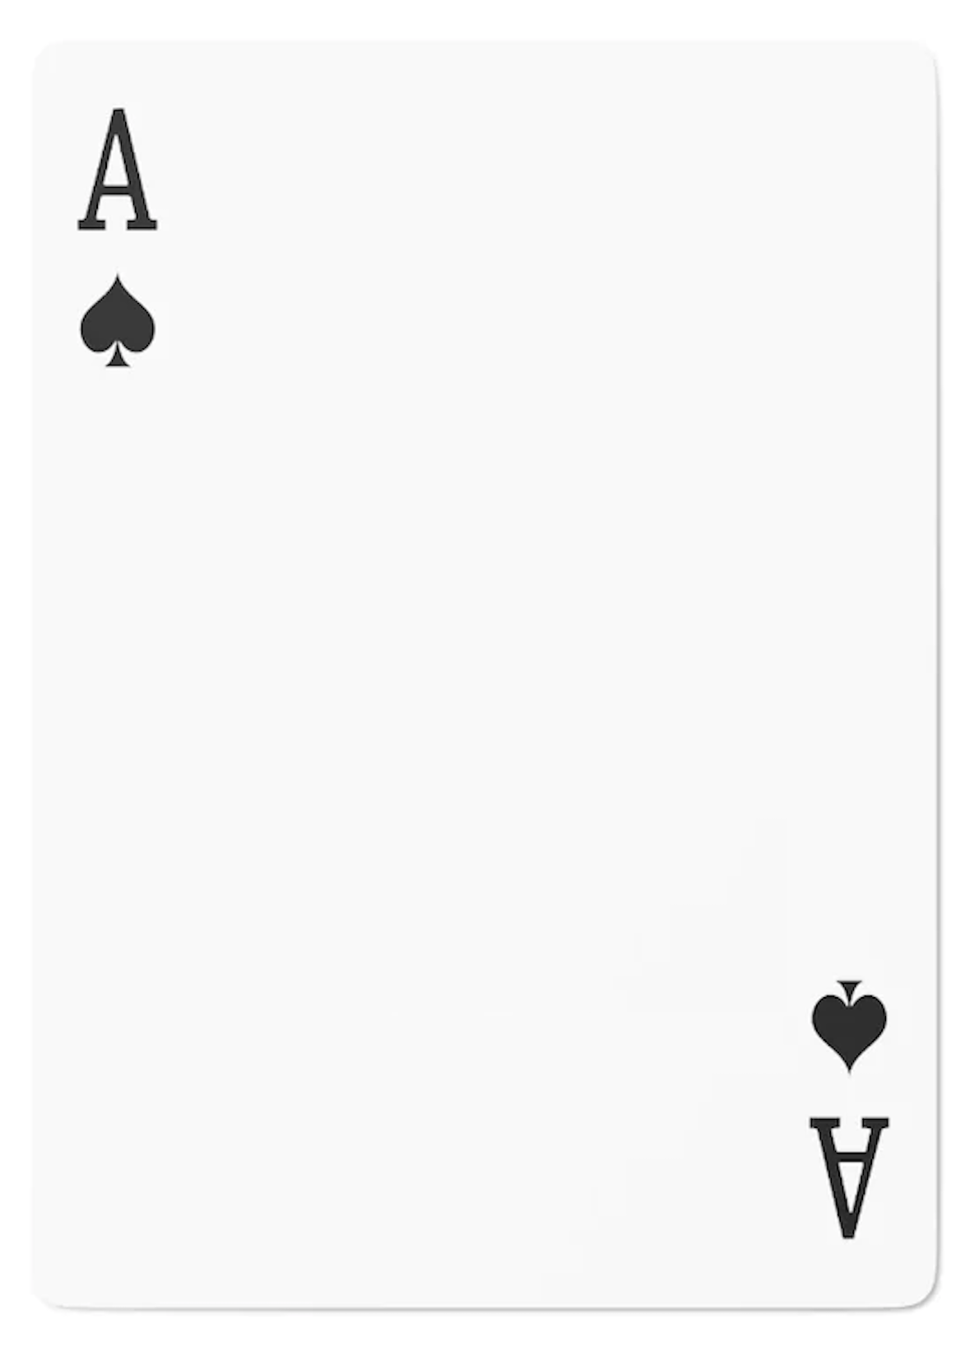
CMU
Blackjack
Society
Learn / Practice
Basic strategy &
Card counting
Master the skills
& Beat the casino!

Slide 3
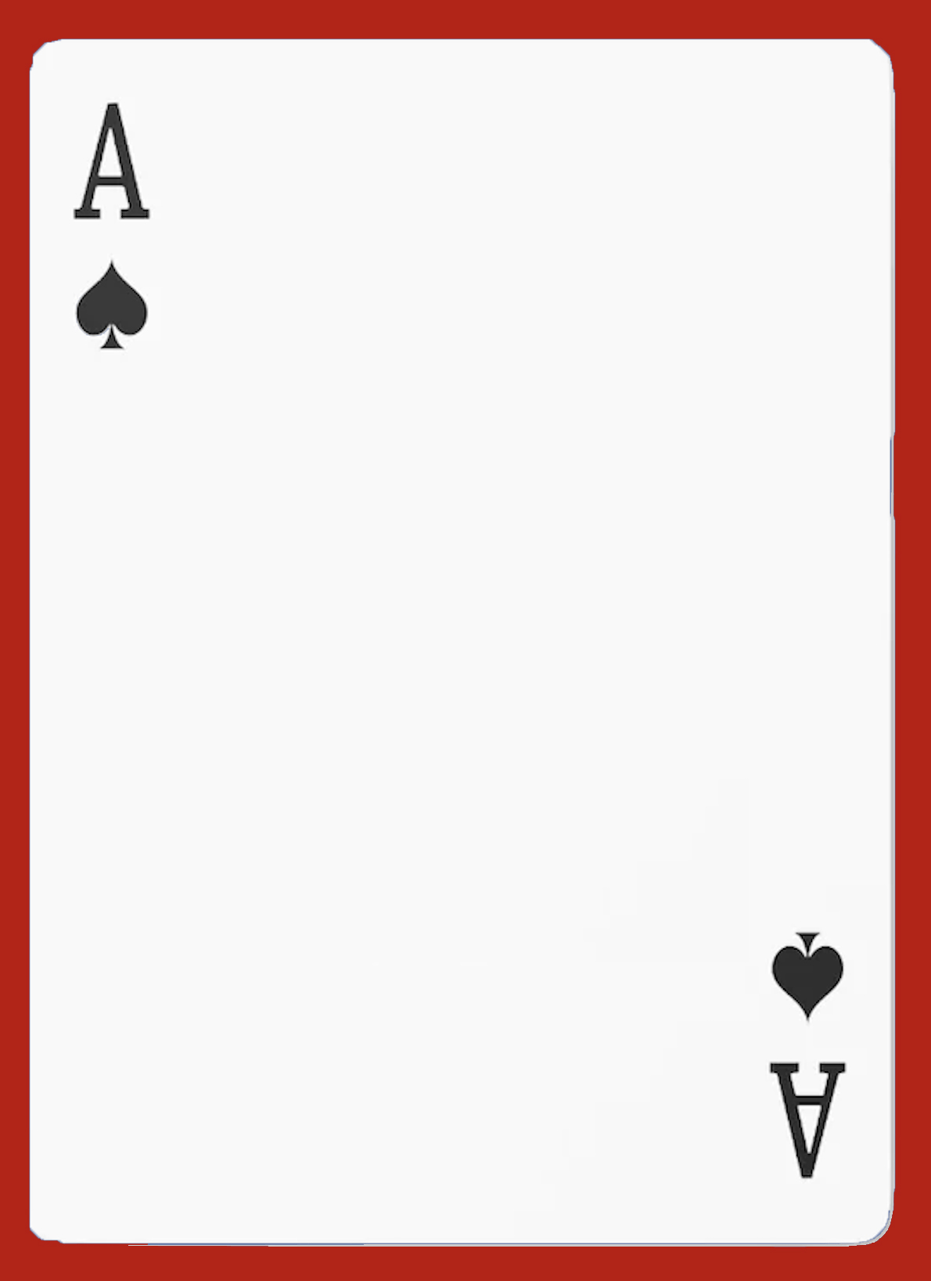
CMU
Blackjack
Society
Learn / Practice
Basic strategy &
Card counting
Master the skills
& Beat the casino!

