Slide 1
Creating an RPKI Cache Queried by IRRd
Corey Tessler
2011/12/06

Slide 2
About the Project
Organization
Merit Network
http://www.merit.edu
Mentor
Manish Karir
Goal
To extend IRRd with RPKI information when servicing a WHOIS request for a network block.
Notes:
"This project was sponsored by Manish Karir at Merit Network. Merit, has and continues to be an important voice in shaping the internet."
"One of the tools that Merit freely provides is IRRd. The Internet Routing Registry Daemon. For this project IRRd was extended to provide new information from the Resource Public Key Infrastructure, RPKI."archy of a
"

Slide 3
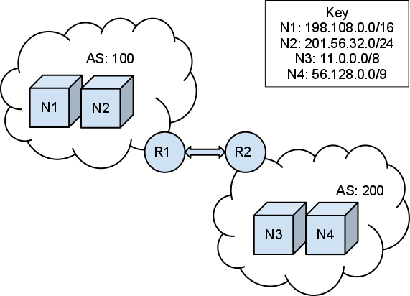
Simplified Internet Architecture
Notes:
To understand the goal of this project a little background information is required.
This is a very simplistic view of the current internet architecture.
The smallest unit is the network block (the cubes labeled with the letter N.) Each device that is connected to the internet has an address that is within one of these network blocks.
Network blocks are owned by Autonomous Systems (ASes.) An AS is an entity, such as a school, or an internet service provided.
For devices on the internet to reach each other, ASes must communicate their network blocks to each other. This is typically done through BGP routers labelled with an R in the diagram.
What is important to notice in this diagram is that all of the network blocks, and the AS numbers are unique. There can be only one device on the internet with a particular address. Only one entity can claim ownership of a specific AS number. If either of these rules are broken routing on the internet ceases.

Slide 4
Assigning & Finding Resources
IANA
Assigns resources to entities (ISPs, schools, etc.)
Such as domain names, AS numbers and network blocks.
WHOIS
Asks the question:
"WHO IS the owner of this resource?"
(As assigned by IANA)
IRRd
A WHOIS daemon.
Authored by Merit.
Notes:
To maintain the uniqueness of internet resources, such AS numbers DNS entries, and network blocks the Internet Assigned Numbers Authority (IANA) was created.
When a person wants to find the owner of a resource they submit a WHOIS query to a WHOIS server. A WHOIS query asks the question "WHO IS the owner of this internet resource?"
IRRd is an implementation of a WHOIS server. Freely available to download, build, modify, and run. WHOIS servers provide answers from their local databases. IRRd requires those underlying databases to be downloaded.

Slide 5
Lack of Resource Validation
Resource Public Key Infrastructure
A proposed architecture for validating resources assigned by IANA.
Mimics the hierarchy of IANA assignments with a hierarchy of X.509 certificates.
For our purposes we will consider network blocks and AS numbers only.
Notes:
Since WHOIS responses are generated from local databases. It is possible that they are inaccurate. Either by accident, or subversion by a malicious party.
The Resource Public Key Infrastructure (RPKI) is a proposed architecture for validating resources that are assigned by IANA.
IANA assigns more than network blocks and AS numbers. For this project they were not considered. The focus is on these objects only.
The architecture applies and extends existing standards. Most noteably X.509 certificates, and Cryptographic Message Syntax (CMS) ASN.1 objects.

Slide 6
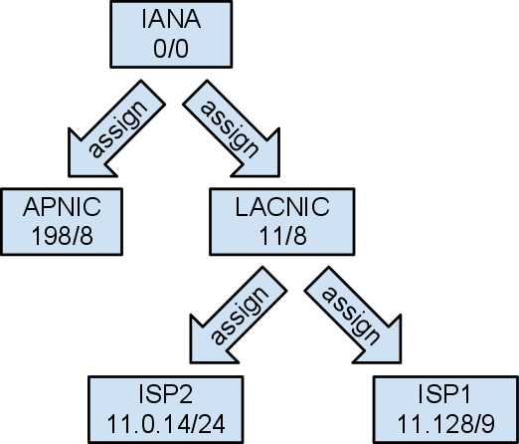
Network Block & AS Number Hierarchy
Notes:
IANA does not assign resources, such as network blocks directly. It assigns subsets to other entities which in turn assign subsets to other entities.
In this abbreviated, and incorrect example, IANA has assigned 11/8 to LACNIC which has divided some of it's assignments between two ISPs.
AS numbers are assigned in an identical fashion.

Slide 7
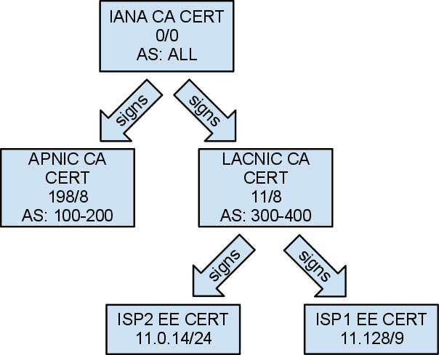
RPKI Mimicry
Notes:
The RPKI replicates the IANA hierarchy with X.509 certificates.
An X.509 certificate is a container that is signed with an encryption key.
Each certificate contains it's own public key. When assigning a resource to another certificate, the child certificate is signed using the private key of the parent.
The signature of the child certificate can be verified by using the public key from the parent.
Utilizing this property of X.509 certificates, the RPKI includes more data within them. Namely the network blocks, and AS numbers being assigned.
By checking the signatures of certificates starting at ISP1, the assignment of 11.128/9 can be traced back to IANA. And is considered valid.
There are two types of certificates in the architecture. Certificate Authority (CA), and End Entity (EE) certificates. CA certificates allow the holder of the certificate to assign their resources to others.
EE certificates authorize the holder a limited use of the resources, in our case the authority to create Route Origin Authorization (ROA). ROAs are the authority to announce a route to the network block.

Slide 8
Restating the Goal
To modify IRRd's response to WHOIS queries.
To include ROA information from the RPKI
Validity, Source, AS Number, Duration
Notes:
We've covered this much background so that we can understand what the goal of the project is.
That is to include the RPKI information in an IRRd response to a WHOIS query for a network block.
The specific information is:
The matching ROAs for the supplied network block.
For each ROA:
The source of the ROA
The validity of the ROA
The AS which are included in the ROAs.
The duration of the ROA

Slide 9
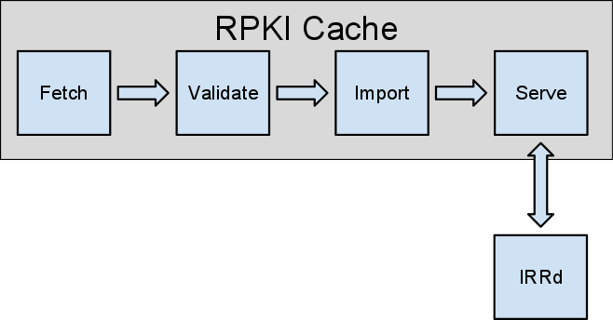
Components of the Solution
Notes:
To reach the goal there are two basic components.
The first is to construct a cache of the RPKI information.
The second is to modify IRRd.

Slide 10
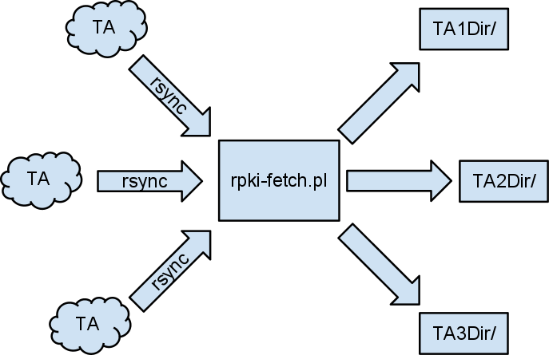
Fetch
Notes:
RPKI information is published in multiple locations. These publication points are called Trust Anchors (TAs).
They serve the signed objects that comprise the RPKI via the rsync protocol. Publishing certificates, CA, and EE. As well as ROAs.
To collect these objects a new script was written called rpki-fetch.pl. It is invoked by cron nightly and incrementally updates the file system with the contents of the TAs.
The TAs are specified in rpki-fetch.pl's configuration file.
After the TA contents have been fetched rpki-fetch.pl produces a configuration file that is used in the next stage of the cache.

Slide 11
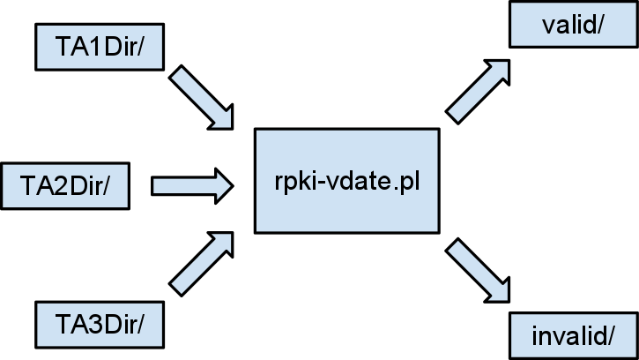
Validate
Notes:
After the rpki-fetch.pl script has completed, the cron entry starts the rpki-vdate.pl script.
The purpose of this script is to determine which of the objects from the TAs are valid, and invalid. Valid objects go into the vaild subdirectory. Invalid objects into the invalid.

Slide 12
Validation Problems
OpenSSL Stack Depth
When validating a stack of X.509 certificates OpenSSL cannot validate as stack with a depth greater than two.
Solution
Modified OpenSSL's verify utility to take an arbitrary depth when validating X.509 certificate stacks.
Route Origin Authorizations
A relatively new object, which has yet to be standardized.
They contain the final EE certificates. Which must be extracted to validate the entire certificate chain.
Solution
Modify the print_roa utility from rcynic to extract EEs.

Slide 13
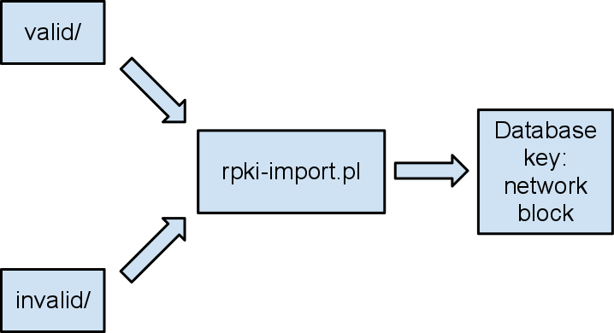
Import
Notes:
After the validation step is completed. The ROAs, and only the ROAs are imported into the postgres database.
rpki-import.pl walks through the valid and invalid directories. Finds the ROAs, and extracts from them their EE certificates, network blocks, and AS numbers. This information is then placed in the database indexed by the network blocks.

Slide 14
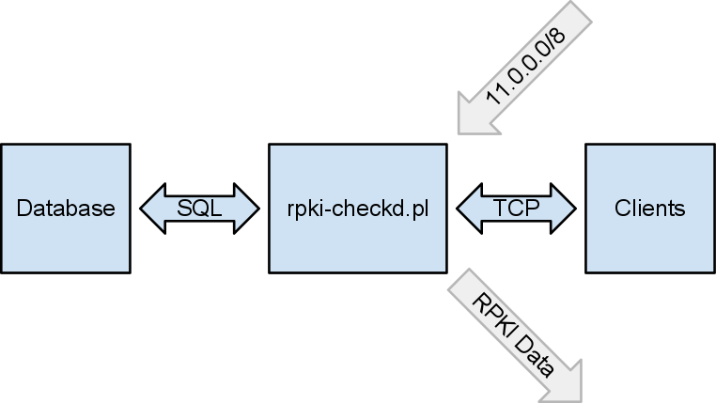
Serve
Notes:
The last portion of the RPKI cache is the server. Implemented as rpki-checkd.pl
It's a small select server that forks for each accepted TCP connection.
There is no interface, only a simple CLI that exchanges ASCII text.
The server accepts one type of query, a network block. And returns the RPKI data. validity, source, as number, and duration.

Slide 15
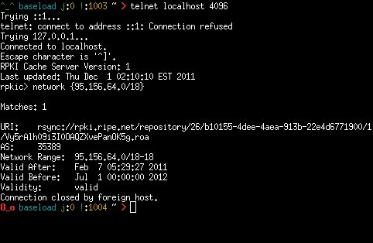
Cache Query Example

Slide 16
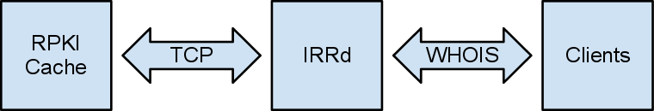
IRRd Modification
Clear Path
Understand how the WHOIS response is generated.
Thankfully WHOIS is a loose ASCII protocol.
After the WHOIS ownership information is presented insert the RPKI Cache information.
Insert the output of rpki-checkd.pl into the WHOIS response.

Slide 17
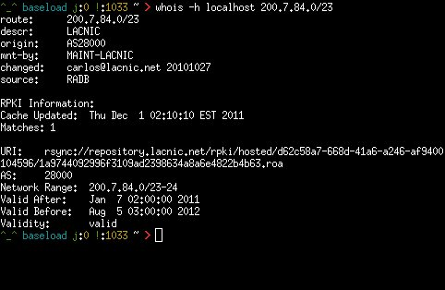
Success!

Slide 18
Gratitude
Notes:
I would like to thank
Manish Karir, for creating this project and his guidance.
Kyle Creyts for his responsive technical assistance
Andy Rosenzweig for introducing me to Manish.
Dr. Zeiger for his academic guidance.
The class for their feedback and questions.

Slide 19
Questions

Slide 20
Demo
Notes:
200.7.84.0/23

