Slide 1
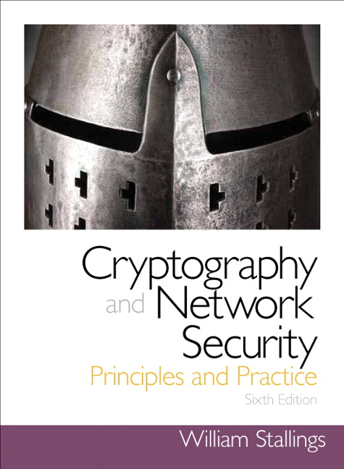
Cryptography and Network Security
Sixth Edition
by William Stallings
Notes:
Lecture slides prepared for “Cryptography and Network Security”, 6/e, by William Stallings, Chapter 5 – “Advanced Encryption Standard”.

Slide 2
Chapter 5
Advanced Encryption Standard
Notes:
The Advanced Encryption Standard (AES) was published by the National Institute
of Standards and Technology (NIST) in 2001. AES is a symmetric block cipher that
is intended to replace DES as the approved standard for a wide range of applications.
Compared to public-key ciphers such as RSA, the structure of AES and most symmetric
ciphers is quite complex and cannot be explained as easily as many other cryptographic
algorithms. Accordingly, the reader may wish to begin with a simplified version
of AES, which is described in Appendix 5B. This version allows the reader to perform
encryption and decryption by hand and gain a good understanding of the working of
the algorithm details. Classroom experience indicates that a study of this simplified
version enhances understanding of AES. One possible approach is to read the chapter
first, then carefully read Appendix 5B, and then re-read the main body of the chapter.

Slide 3
Advance Encryption Standard

Slide 4
Topics
Origin of AES
Basic AES
Inside Algorithm
Final Notes

Slide 5
Origins
A replacement for DES was needed
Key size is too small
Can use Triple-DES – but slow, small block
US NIST issued call for ciphers in 1997
15 candidates accepted in Jun 98
5 were shortlisted in Aug 99
Notes:
The Advanced Encryption Standard (AES) was published by NIST (National Institute of Standards and Technology) in 2001. AES is a symmetric block cipher that is intended to replace DES as the approved standard for a wide range of applications. The AES cipher (& other candidates) form the latest generation of block ciphers, and now we see a significant increase in the block size - from the old standard of 64-bits up to 128-bits; and keys from 128 to 256-bits. In part this has been driven by the public demonstrations of exhaustive key searches of DES. Whilst triple-DES is regarded as secure and well understood, it is slow, especially in s/w. In a first round of evaluation, 15 proposed algorithms were accepted. A second round narrowed the field to 5 algorithms. NIST completed its evaluation process and published a final standard (FIPS PUB 197) in November of 2001. NIST selected Rijndael as the proposed AES algorithm. The two researchers who developed and submitted Rijndael for the AES are both cryptographers from Belgium: Dr. Joan Daemen and Dr.Vincent Rijmen.

Slide 6
AES Competition Requirements
Private key symmetric block cipher
128-bit data, 128/192/256-bit keys
Stronger & faster than Triple-DES
Provide full specification & design details
Both C & Java implementations
Notes:
Listed above are NIST’s requirements for the AES candidate submissions. These criteria span the range of concerns for the practical application of modern symmetric block ciphers.

Slide 7
AES Evaluation Criteria
initial criteria:
security – effort for practical cryptanalysis
cost – in terms of computational efficiency
algorithm & implementation characteristics
final criteria
general security
ease of software & hardware implementation
implementation attacks
flexibility (in en/decrypt, keying, other factors)
Notes:
In fact, two set of criteria evolved. When NIST issued its original request for candidate algorithm nominations in 1997, the request stated that candidate algorithms would be compared based on the factors shown in Stallings Table5.1, which were used to evaluate field of 15 candidates to select shortlist of 5. These had categories of security, cost, and algorithm & implementation characteristics.
The final criteria evolved during the evaluation process, and were used to select Rijndael from that short-list, and more details are given in Stallings Table 5.2, with categories of: general security, ease of software & hardware implementation, implementation attacks, & flexibility (in en/decrypt, keying, other factors).

Slide 8
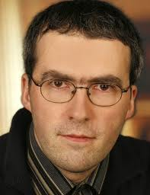

The AES Cipher - Rijndael
Rijndael was selected as the AES in Oct-2000
Designed by Vincent Rijmen and Joan Daemen in Belgium
Issued as FIPS PUB 197 standard in Nov-2001
An iterative rather than Feistel cipher
processes data as block of 4 columns of 4 bytes (128 bits)
operates on entire data block in every round
Rijndael design:
simplicity
has 128/192/256 bit keys, 128 bits data
resistant against known attacks
speed and code compactness on many CPUs
V. Rijmen
J. Daemen
Notes:
The Rijndael proposal for AES defined a cipher in which the block length and the key length can be independently specified to be 128,192,or 256 bits. The AES specification uses the same three key size alternatives but limits the block length to 128 bits. Rijndael is an academic submission, based on the earlier Square cipher, from Belgium academics Dr Joan Daemen and Dr Vincent Rijmen. It is an iterative cipher (operates on entire data block in every round) rather than feistel (operate on halves at a time), and was designed to have characteristics of: Resistance against all known attacks, Speed and code compactness on a wide range of platforms, & Design simplicity.

Slide 9
Topics
Origin of AES
Basic AES
Inside Algorithm
Final Notes

Slide 10
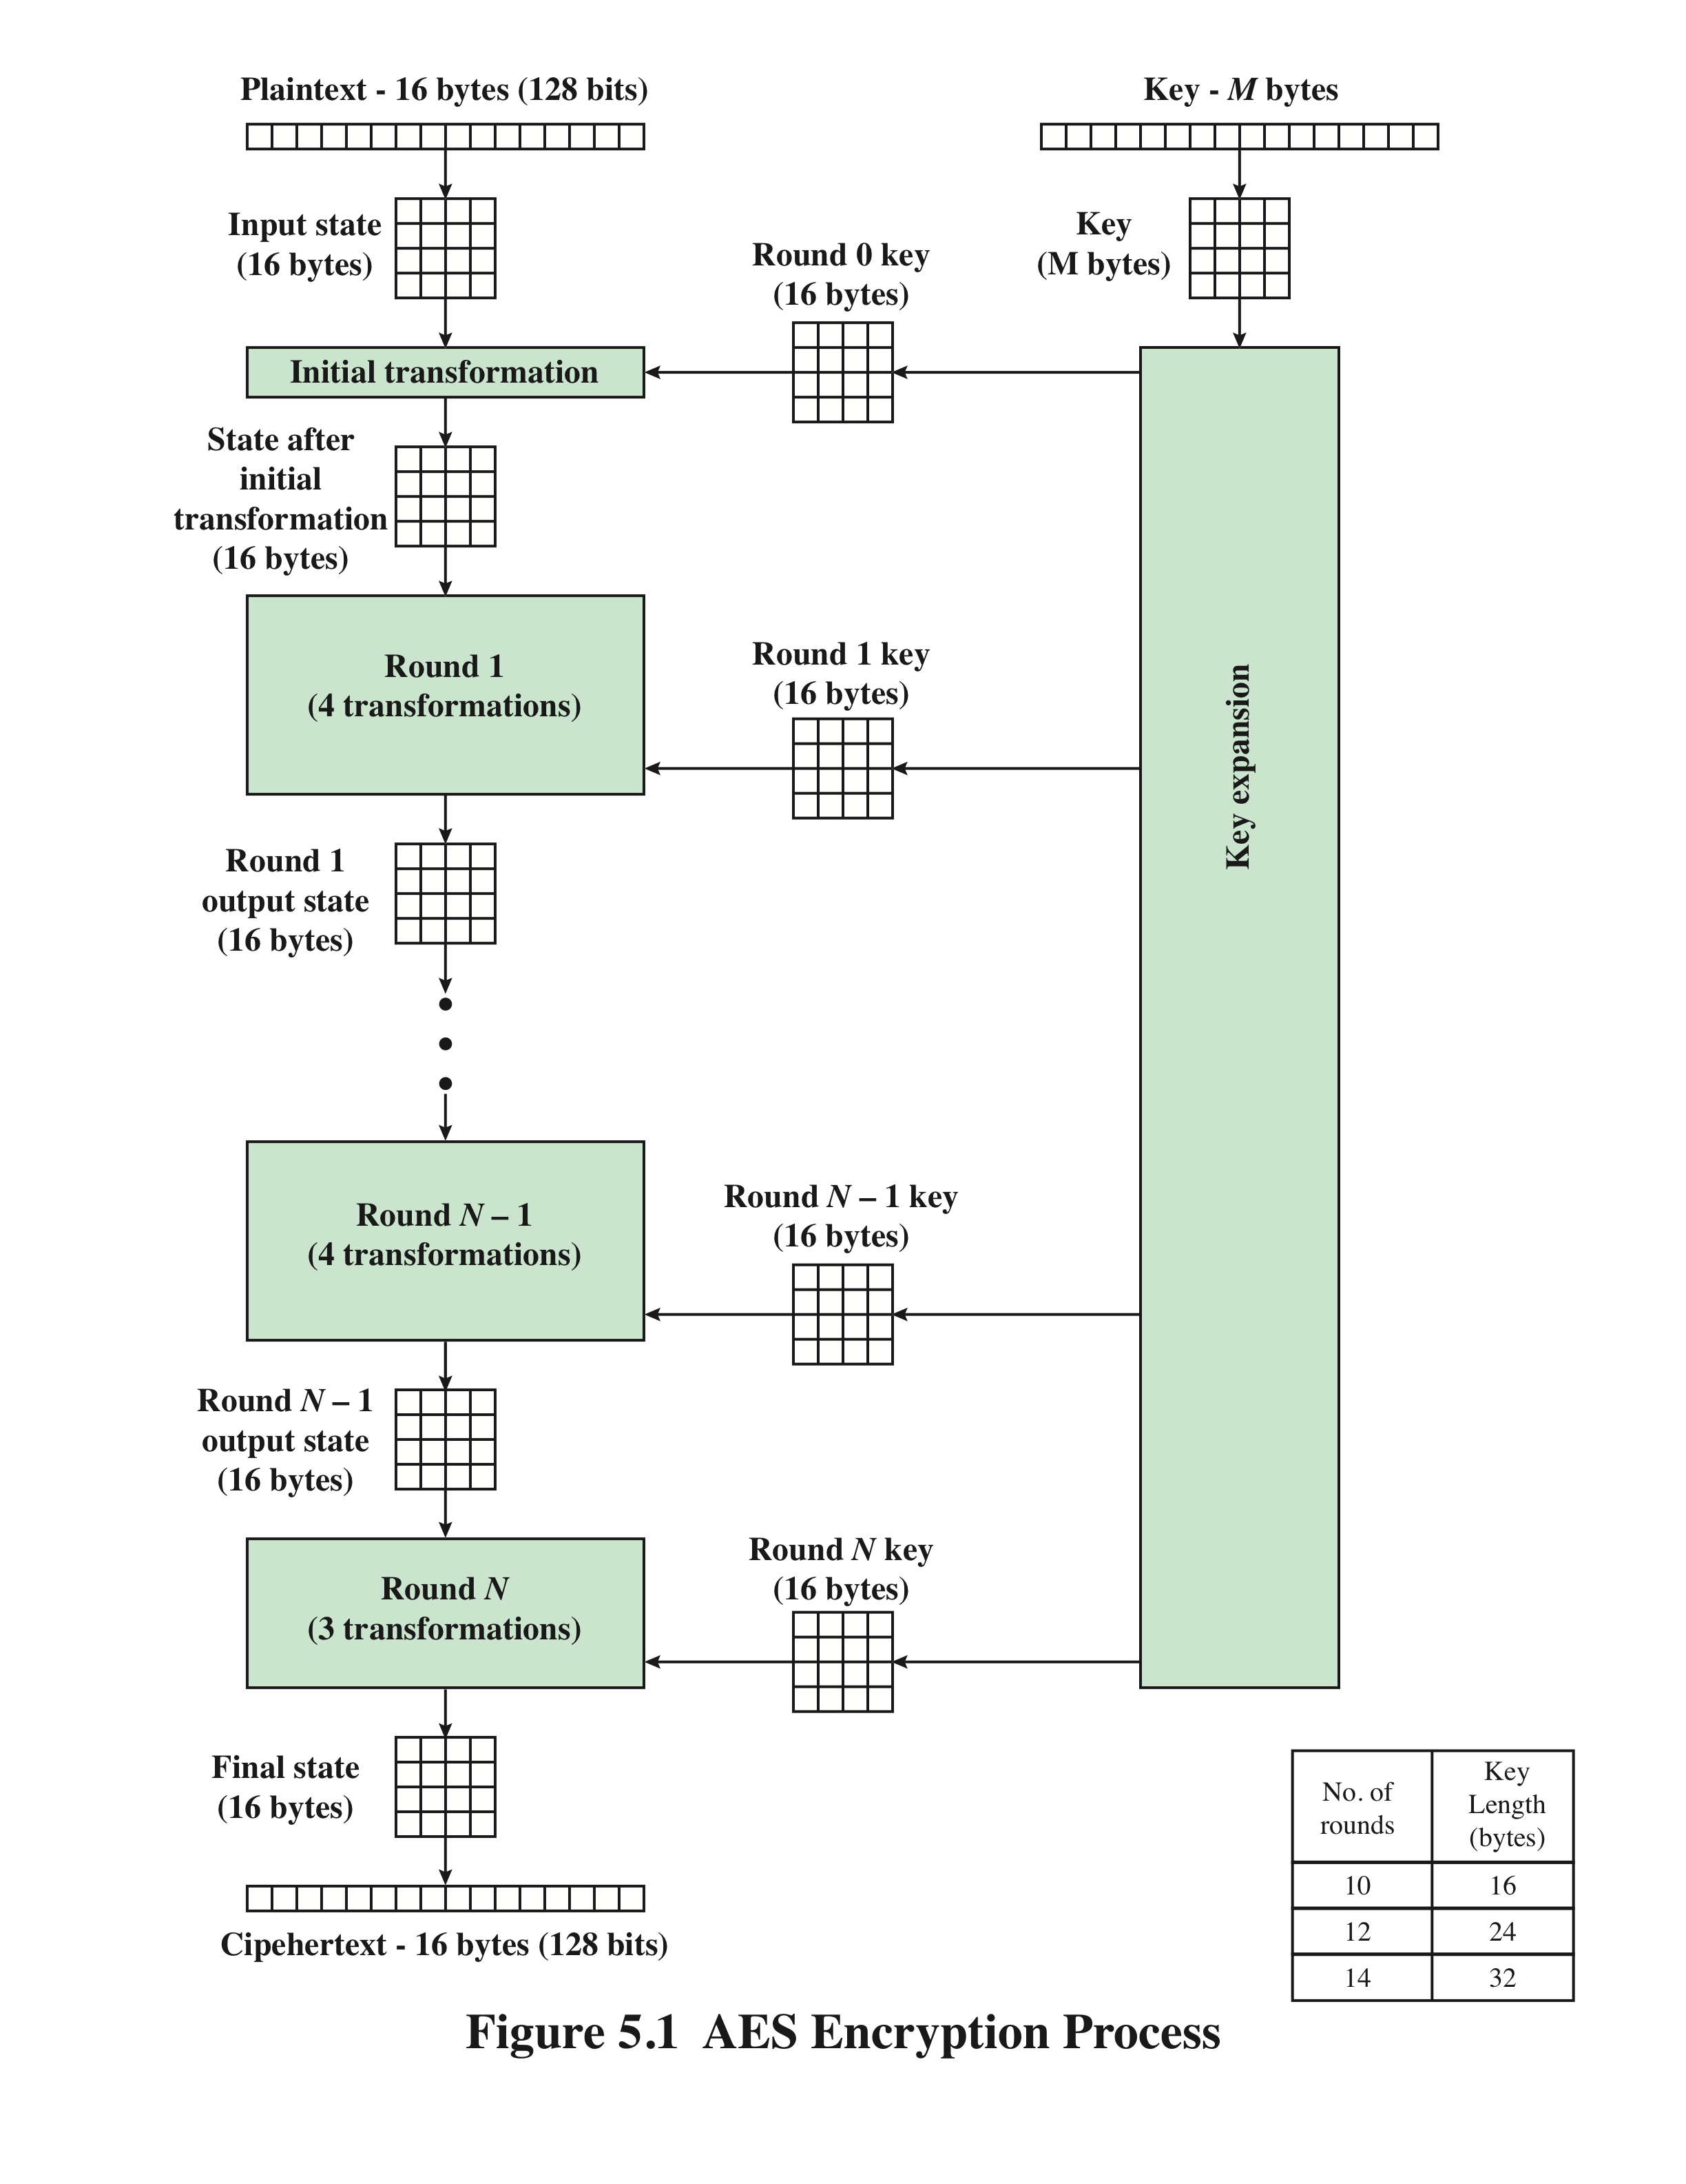
AES Encryption Process
Notes:
Figure 5.1 shows the overall structure of the AES encryption process. The cipher
takes a plaintext block size of 128 bits, or 16 bytes. The key length can be 16, 24, or
32 bytes (128, 192, or 256 bits). The algorithm is referred to as AES-128, AES-192, or
AES-256, depending on the key length.

Slide 11
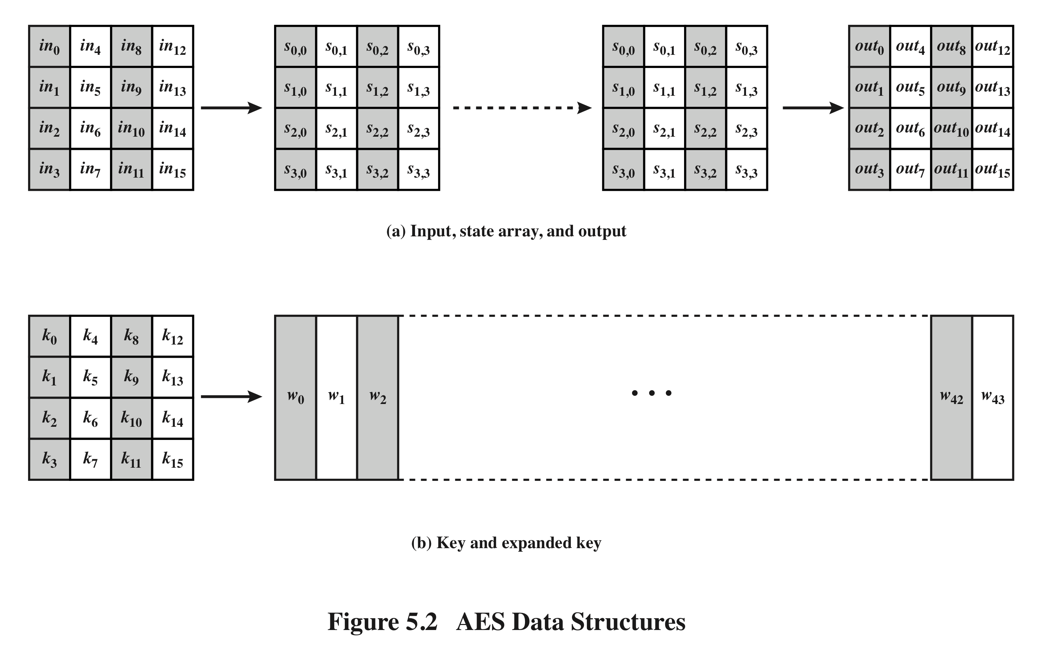
AES Data Structures
Notes:
The input to the encryption and decryption algorithms is a single 128-bit block.
In FIPS PUB 197, this block is depicted as a 4 * 4 square matrix of bytes. This
block is copied into the State array, which is modified at each stage of encryption or
decryption. After the final stage, State is copied to an output matrix. These operations
are depicted in Figure 5.2a. Similarly, the key is depicted as a square matrix of bytes.
This key is then expanded into an array of key schedule words. Figure 5.2b shows the
expansion for the 128-bit key. Each word is four bytes, and the total key schedule
is 44 words for the 128-bit key. Note that the ordering of bytes within a matrix is by
column. So, for example, the first four bytes of a 128-bit plaintext input to the encryption
cipher occupy the first column of the in matrix, the second four bytes occupy the
second column, and so on. Similarly, the first four bytes of the expanded key, which
form a word, occupy the first column of the w matrix.

Slide 12
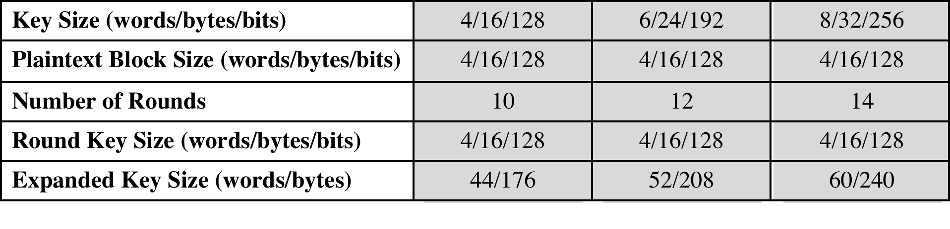
Table 5.1 AES Parameters
Notes:
The cipher consists of N rounds, where the number of rounds depends on the
key length: 10 rounds for a 16-byte key, 12 rounds for a 24-byte key, and 14 rounds
for a 32-byte key (Table 5.1). The first N - 1 rounds consist of four distinct transformation
functions: SubBytes, ShiftRows, MixColumns, and AddRoundKey, which are
described subsequently. The final round contains only three transformations, and
there is a initial single transformation (AddRoundKey) before the first round, which
can be considered Round 0. Each transformation takes one or more 4 * 4 matrices
as input and produces a 4 * 4 matrix as output. Figure 5.1 shows that the output of
each round is a 4 * 4 matrix, with the output of the final round being the ciphertext.
Also, the key expansion function generates N + 1 round keys, each of which is a distinct
4 * 4 matrix. Each round key serves as one of the inputs to the AddRoundKey
transformation in each round.

Slide 13
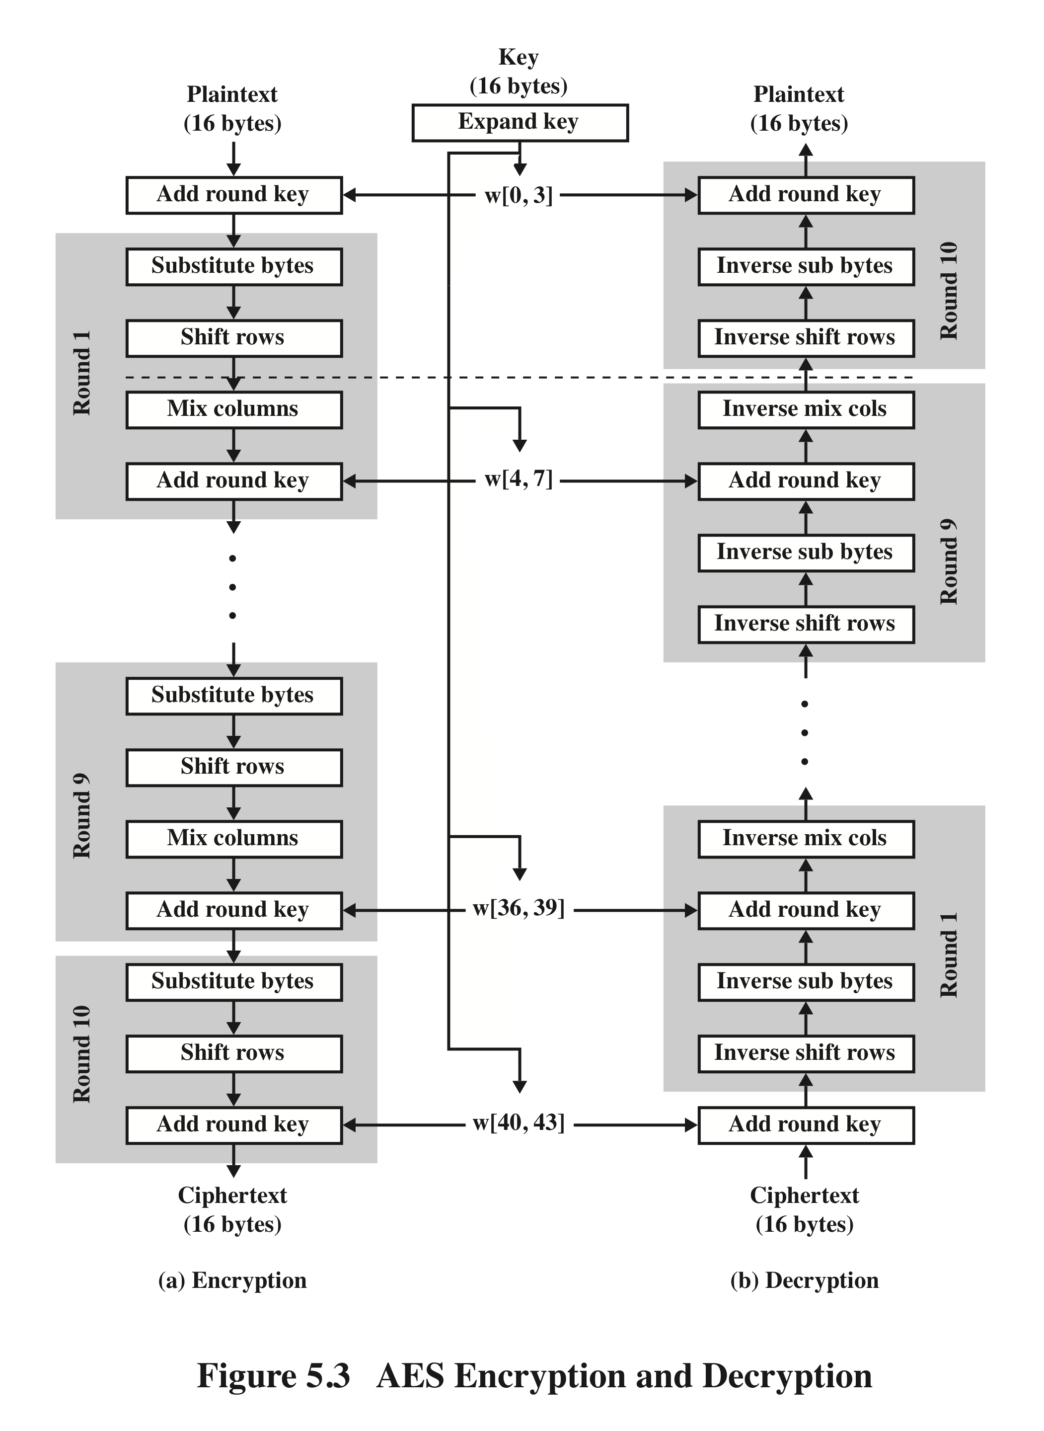
AES Encryption and Decryption
Notes:
Figure 5.3 shows the AES cipher in more detail, indicating the sequence of transformations
in each round and showing the corresponding decryption function. As was
done in Chapter 3, we show encryption proceeding down the page and decryption
proceeding up the page.

Slide 14
AES Conceptual Scheme
Plaintext (128 bits)
AES
Key (128-256 bits)
Ciphertext (128 bits)

Slide 15
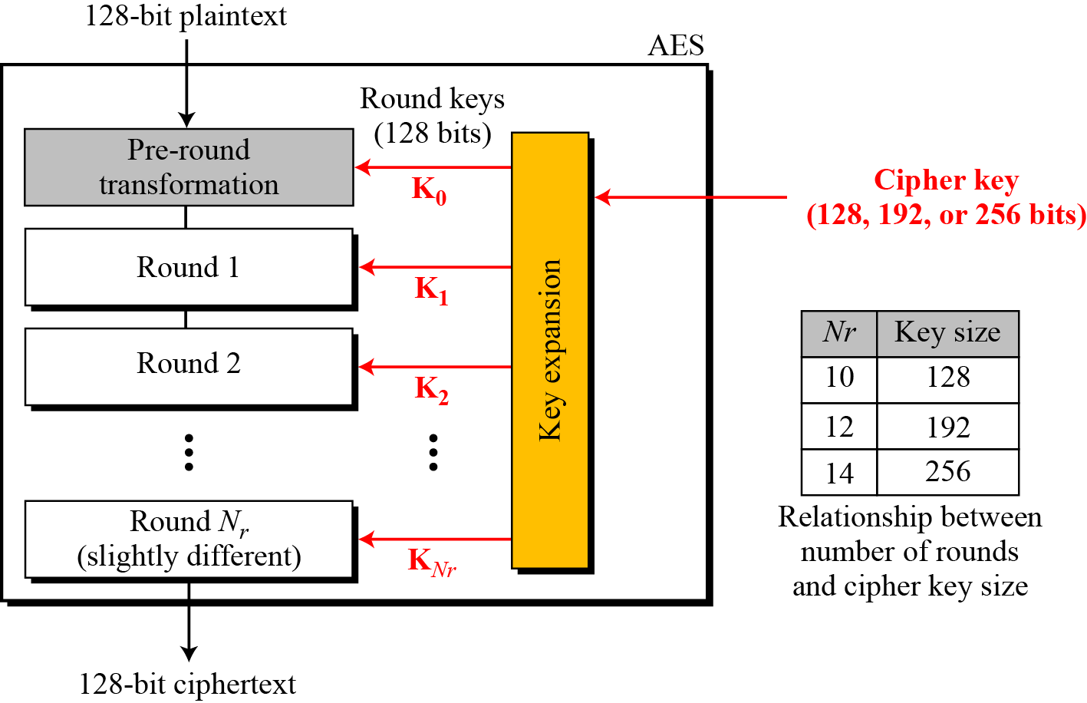
Multiple rounds
Rounds are (almost) identical
First and last round are a little different
Notes:
The input to the AES encryption and decryption algorithms is a single 128-bit block, depicted in FIPS PUB 197, as a square matrix of bytes .This block is copied into the State array, which is modified at each stage of encryption or decryption. After the final stage, State is copied to an output.
The key is expanded into 44/52/60 lots of 32-bit words (see later), with 4 used in each round.
The data computation then consists of an “add round key” step, then 9/11/13 rounds with all 4 steps, and a final 10th/12th/14th step of byte subs + mix cols + add round key. This can be viewed as alternating XOR key & scramble data bytes operations. All of the steps are easily reversed, and can be efficiently implemented using XOR’s & table lookups.

Slide 16
High Level Description
Key Expansion
Round keys are derived from the cipher key using Rijndael's key schedule
Initial Round
AddRoundKey : Each byte of the state is combined with the round key using bitwise xor
Rounds
SubBytes : non-linear substitution step
ShiftRows : transposition step
MixColumns : mixing operation of each column.
AddRoundKey
Final Round
SubBytes
ShiftRows
AddRoundKey
No MixColumns
Notes:
The input to the AES encryption and decryption algorithms is a single 128-bit block, depicted in FIPS PUB 197, as a square matrix of bytes .This block is copied into the State array, which is modified at each stage of encryption or decryption. After the final stage, State is copied to an output.
The key is expanded into 44/52/60 lots of 32-bit words (see later), with 4 used in each round.
The data computation then consists of an “add round key” step, then 9/11/13 rounds with all 4 steps, and a final 10th/12th/14th step of byte subs + mix cols + add round key. This can be viewed as alternating XOR key & scramble data bytes operations. All of the steps are easily reversed, and can be efficiently implemented using XOR’s & table lookups.

Slide 17
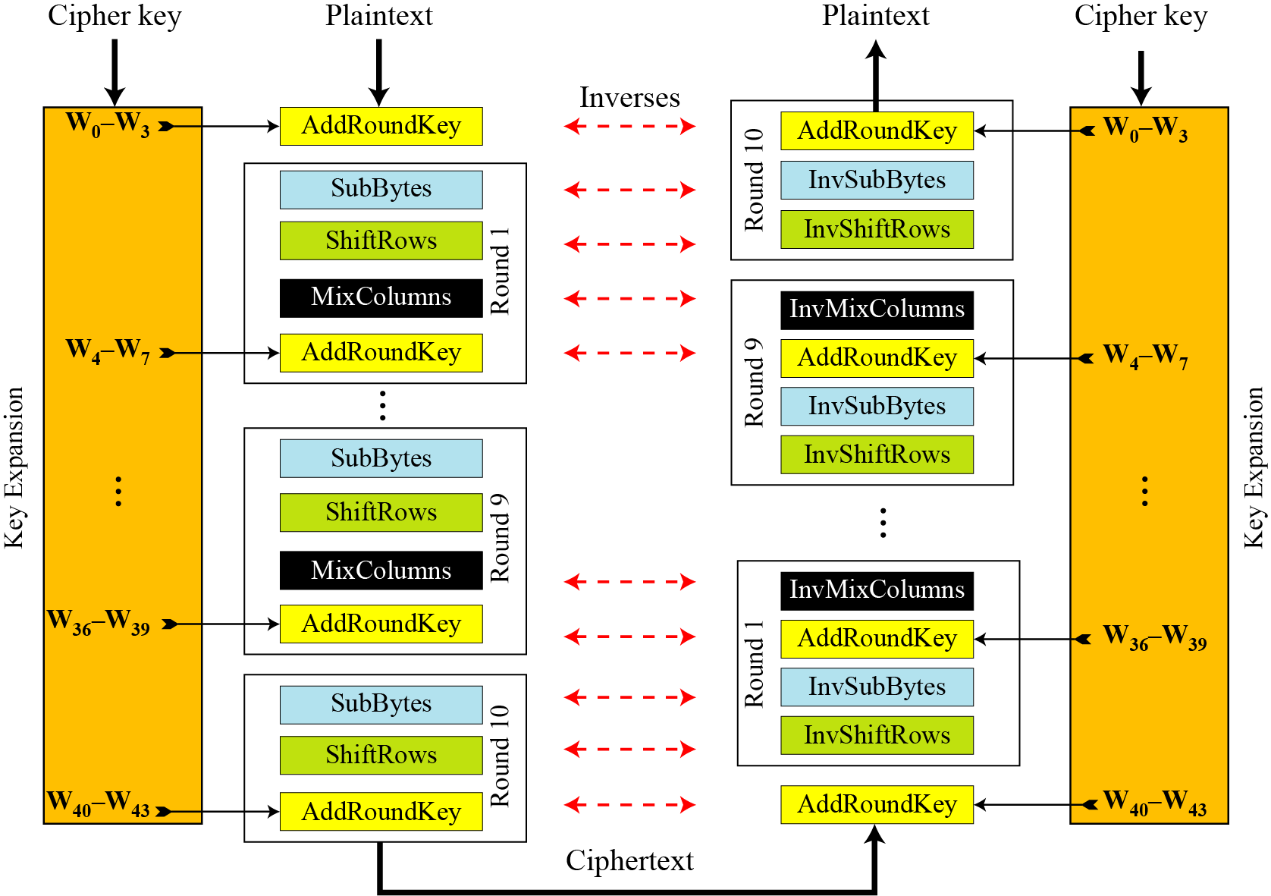
Overall Structure
Notes:
Stallings Figure 5.1 shows the overall structure of AES, as detailed on the previous slide.

Slide 18
128-bit values
Data block viewed as 4-by-4 table of bytes
Represented as 4 by 4 matrix of 8-bit bytes.
Key is expanded to array of 32 bits words
1 byte

Slide 19
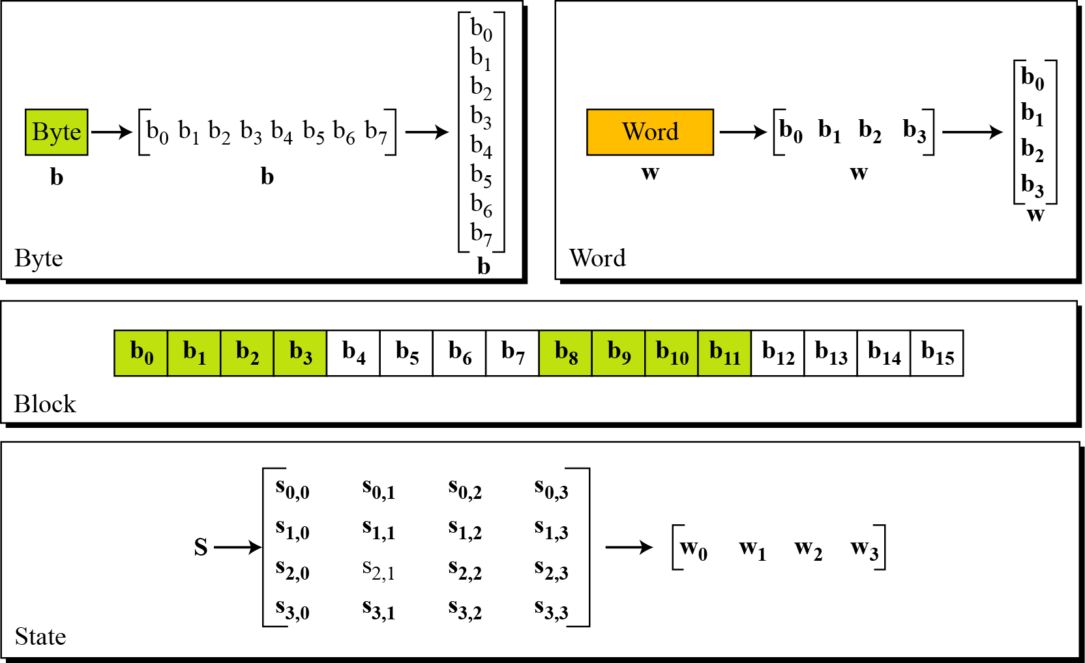
Data Unit

Slide 20
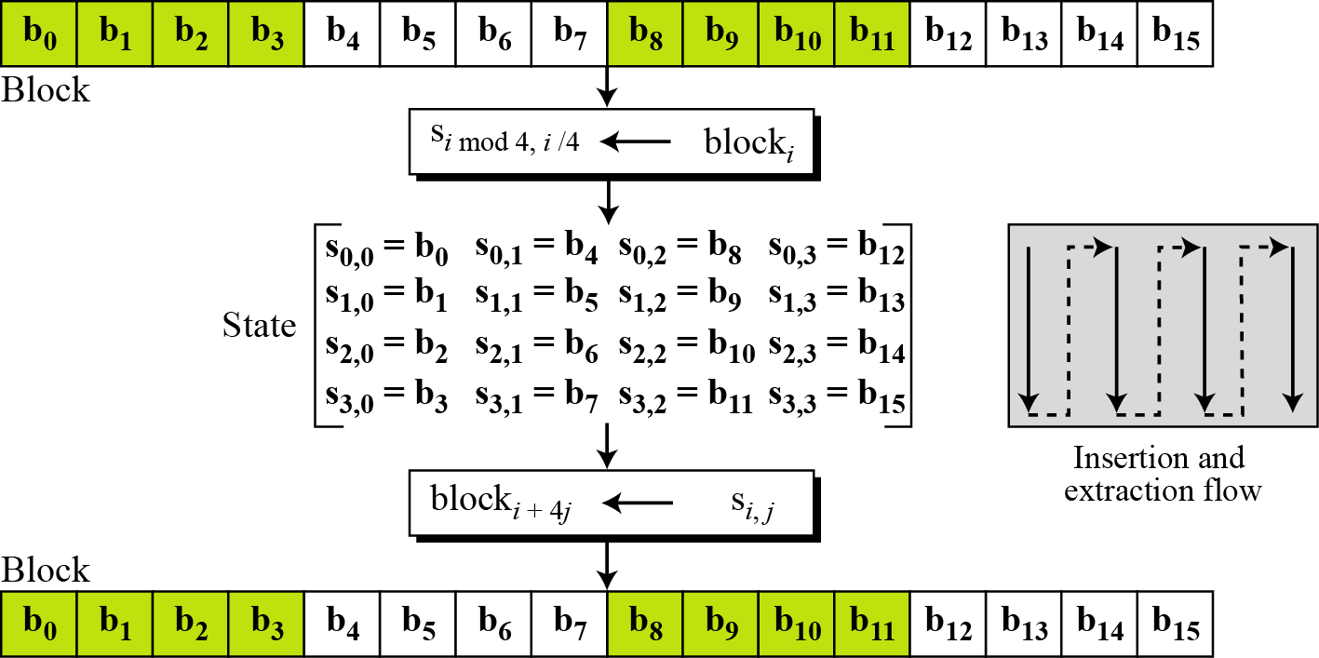
Unit Transformation

Slide 21
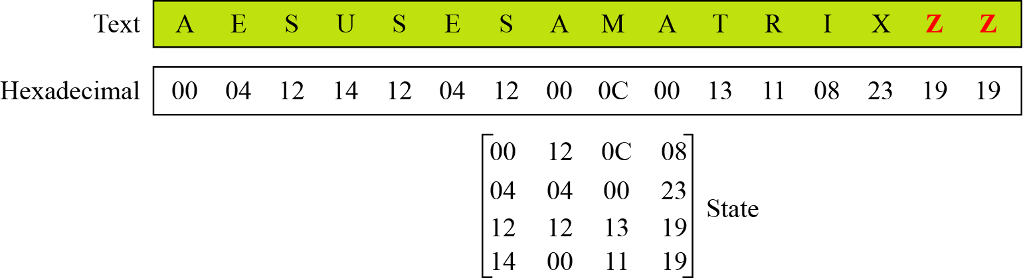
Changing Plaintext to State

Slide 22
Topics
Origin of AES
Basic AES
Inside Algorithm
Final Notes

Slide 23
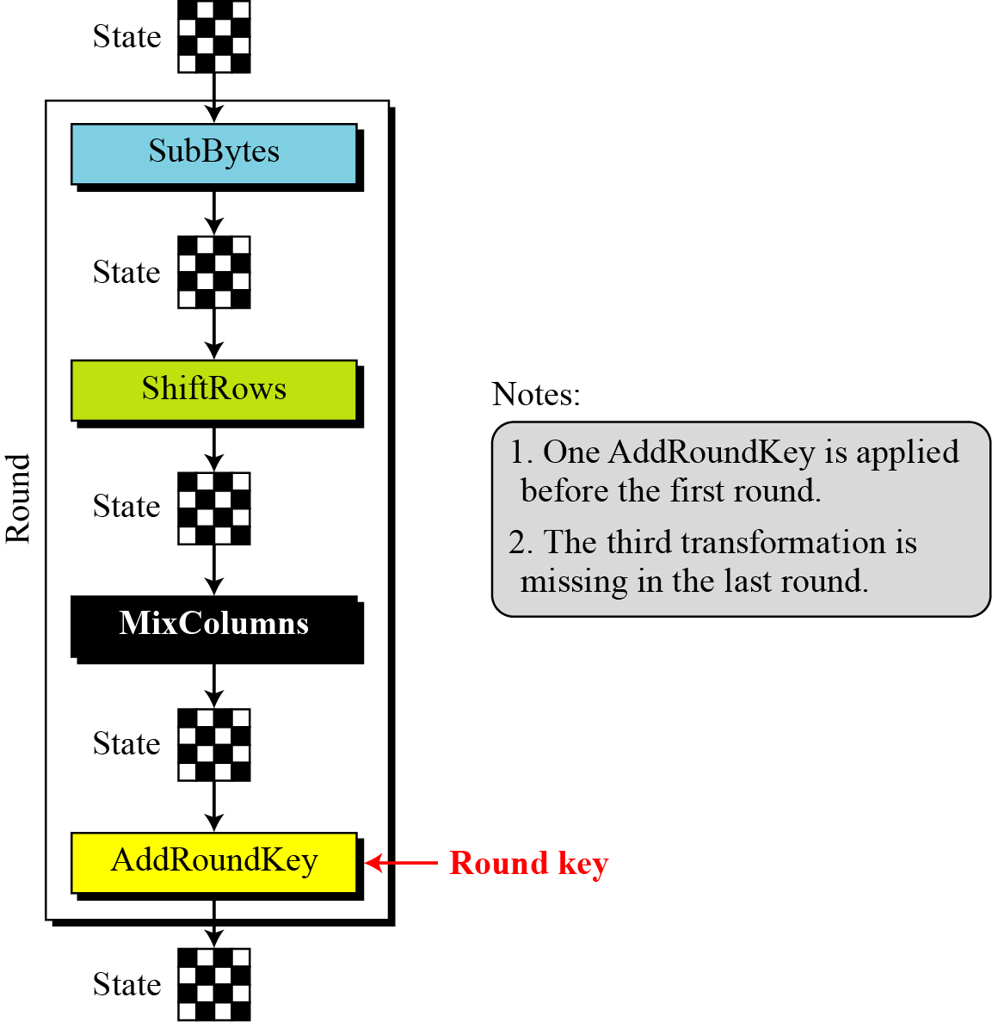
Details of Each Round

Slide 24
SubBytes: Byte Substitution
A simple substitution of each byte
provide a confusion
Uses one S-box of 16x16 bytes containing a permutation of all 256 8-bit values
Each byte of state is replaced by byte indexed by row (left 4-bits) & column (right 4-bits)
eg. byte {95} is replaced by byte in row 9 column 5
which has value {2A}
S-box constructed using defined transformation of values in Galois Field- GF(2⁸)
Galois : pronounce “Gal-Wa”
Notes:
Now discuss each of the four stages used in AES. The Substitute bytes stage uses an S-box to perform a byte-by-byte substitution of the block. There is a single 8-bit wide S-box used on every byte. This S-box is a permutation of all 256 8-bit values, constructed using a transformation which treats the values as polynomials in GF(2⁸) – however it is fixed, so really only need to know the table when implementing. Decryption requires the inverse of the table. These tables are given in Stallings Table 4.5.
The table was designed to be resistant to known cryptanalytic attacks. Specifically, the Rijndael developers sought a design that has a low correlation between input bits and output bits, with the property that the output cannot be described as a simple mathematical function of the input, with no fixed points and no “opposite fixed points”.

Slide 25
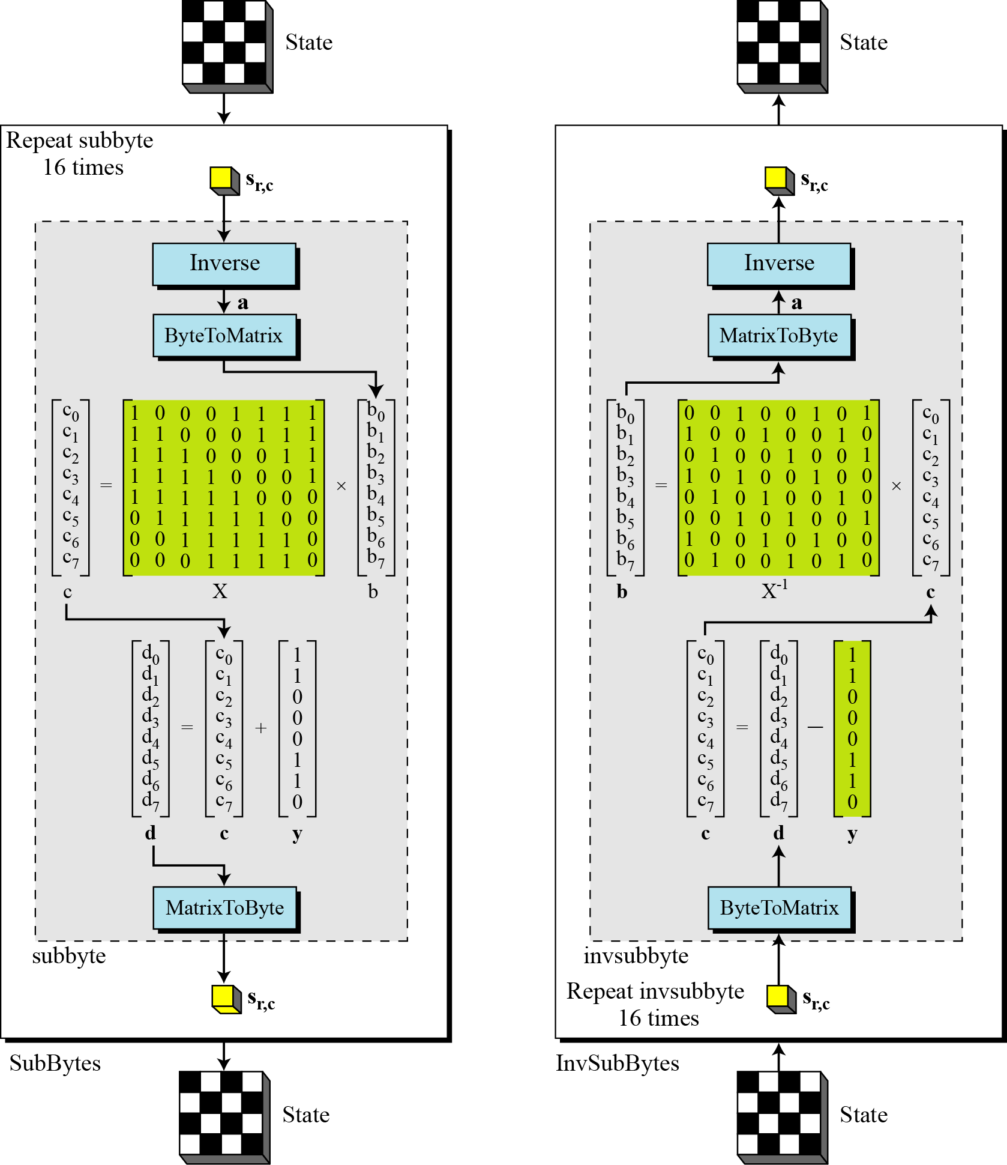
SubBytes and InvSubBytes

Slide 26
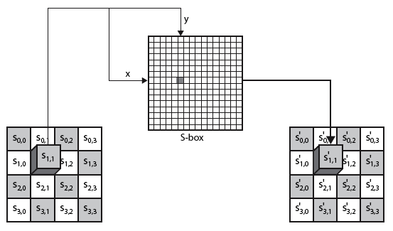
SubBytes Operation
The SubBytes operation involves 16 independent byte-to-byte transformations.
Interpret the byte as two hexadecimal digits xy
SW implementation, use row (x) and column (y) as lookup pointer
S_{1,1} = xy₁₆
x’y’₁₆

Slide 27
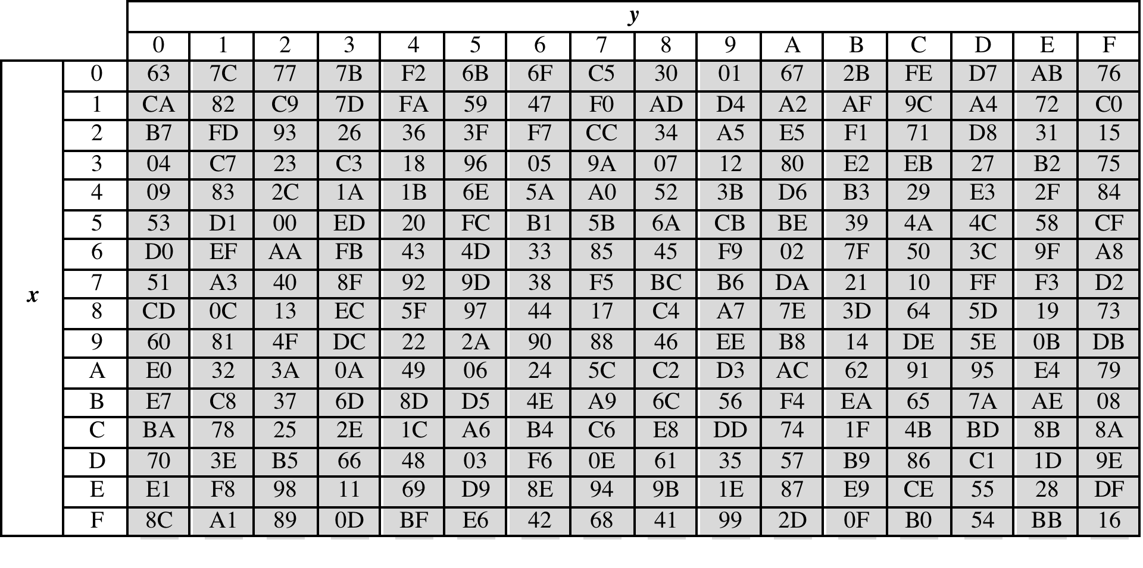
SubBytes Table
Implement by Table Lookup (S-box):

Slide 28
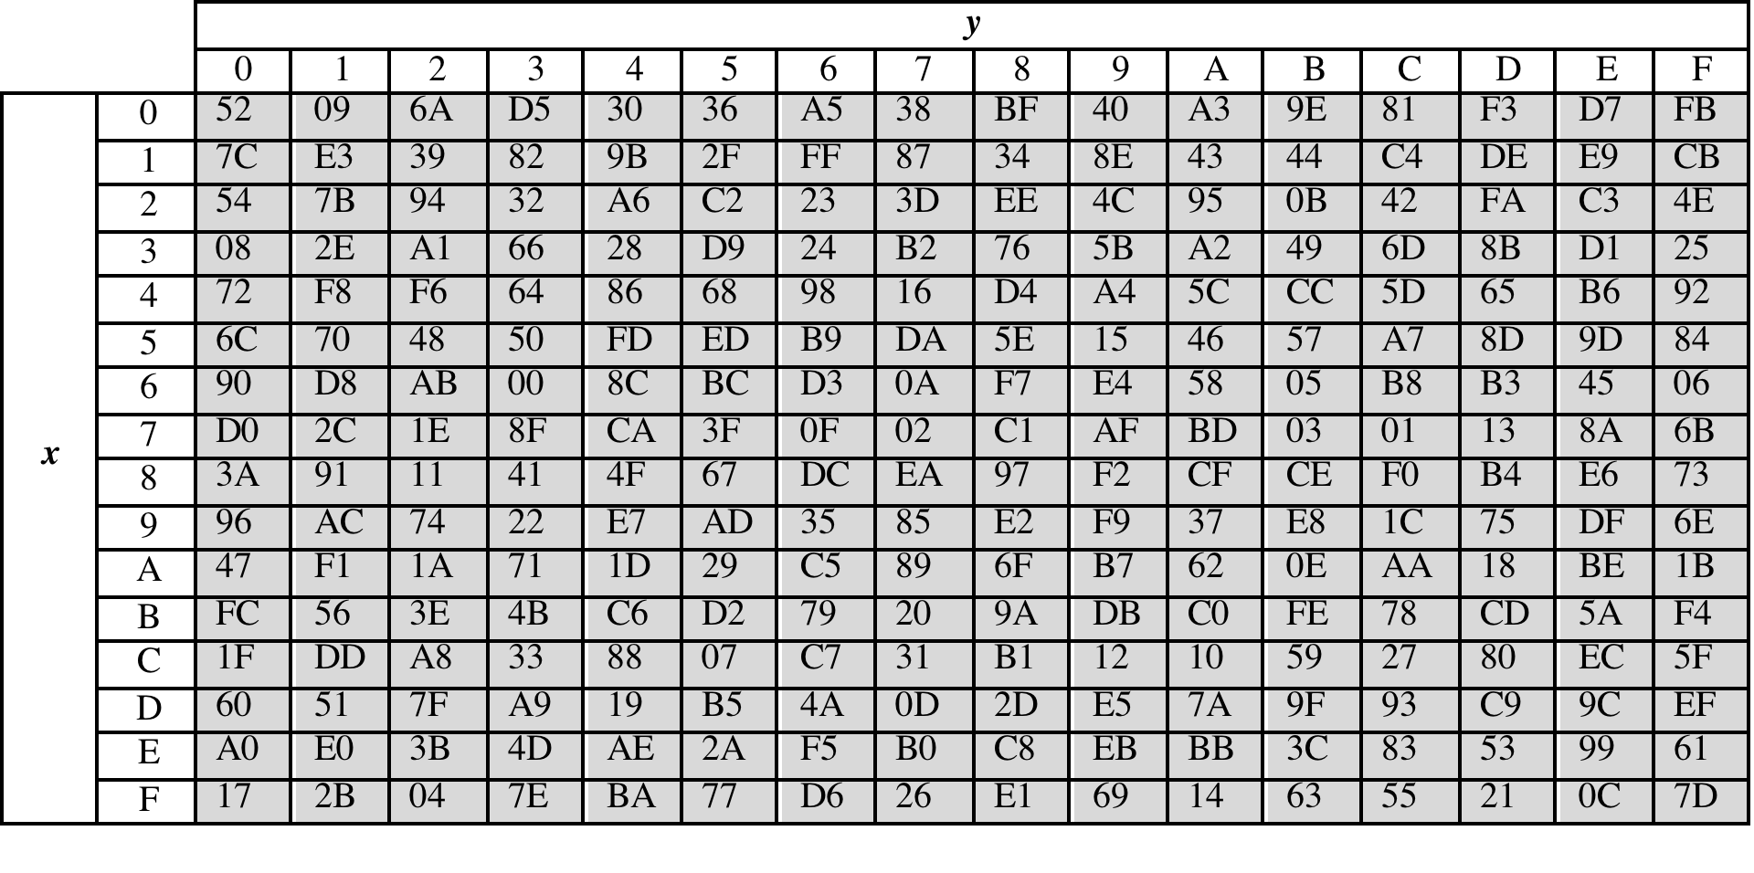
InvSubBytes Table (Inverse S-box ):

Slide 29
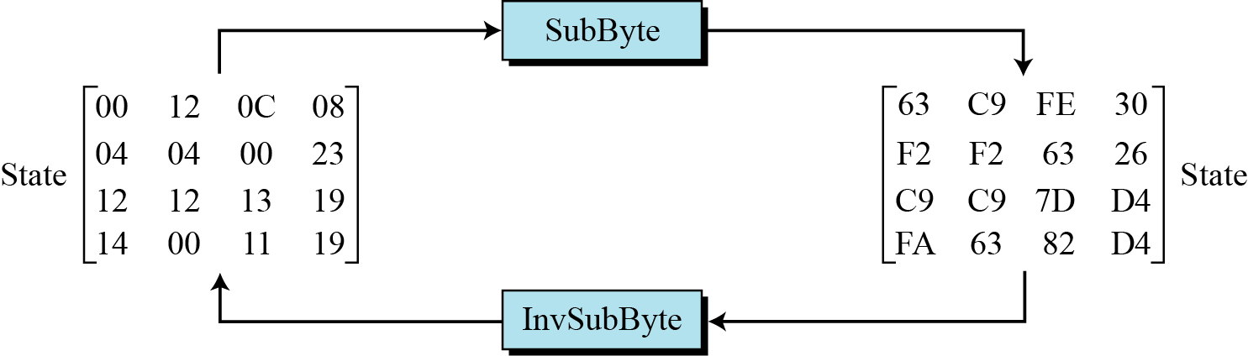
Sample SubByte Transformation
The SubBytes and InvSubBytes transformations are inverses of each other.

Slide 30
ShiftRows
Shifting, which permutes the bytes.
A circular byte shift in each each
1st row is unchanged
2nd row does 1 byte circular shift to left
3rd row does 2 byte circular shift to left
4th row does 3 byte circular shift to left
In the encryption, the transformation is called ShiftRows
In the decryption, the transformation is called InvShiftRows and the shifting is to the right
Notes:
The ShiftRows stage provides a simple “permutation” of the data, whereas the other steps involve substitutions. Further, since the state is treated as a block of columns, it is this step which provides for diffusion of values between columns. It performs a circular rotate on each row of 0, 1, 2 & 3 places for respective rows. When decrypting it performs the circular shifts in the opposite direction for each row. This row shift moves an individual byte from one column to another, which is a linear distance of a multiple of 4 bytes, and ensures that the 4 bytes of one column are spread out to four different columns.

Slide 31
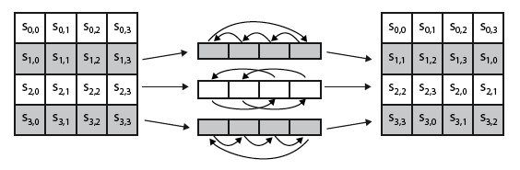
ShiftRows Scheme
Notes:
Stalling Figure 5.5a illustrates the Shift Rows permutation.

Slide 32
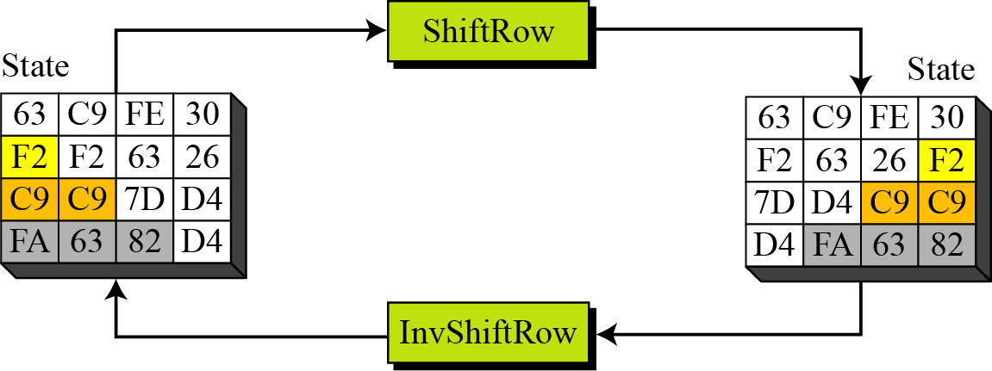
ShiftRows and InvShiftRows

Slide 33
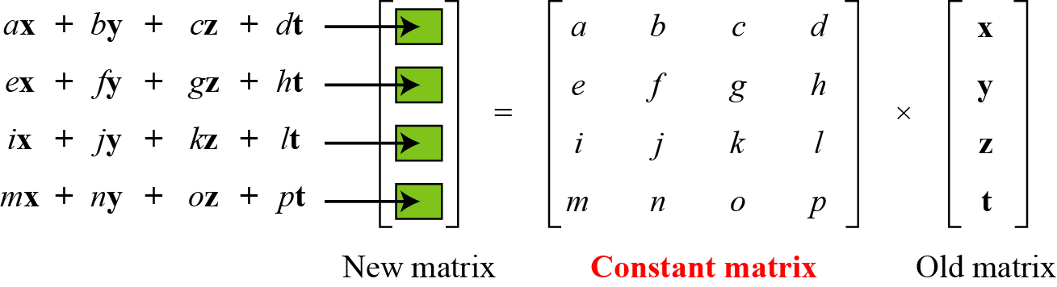
MixColumns
ShiftRows and MixColumns provide diffusion to the cipher
Each column is processed separately
Each byte is replaced by a value dependent on all 4 bytes in the column
Effectively a matrix multiplication in GF(2⁸) using prime poly m(x) =x⁸+x⁴+x³+x+1
Notes:
The MixColumns stage is a substitution that makes use of arithmetic over GF(2^8). Each byte of a column is mapped into a new value that is a function of all four bytes in that column. It is designed as a matrix multiplication where each byte is treated as a polynomial in GF(2⁸). The inverse used for decryption involves a different set of constants.
The constants used are based on a linear code with maximal distance between code words – this gives good mixing of the bytes within each column. Combined with the “shift rows” step provides good avalanche, so that within a few rounds, all output bits depend on all input bits.

Slide 34
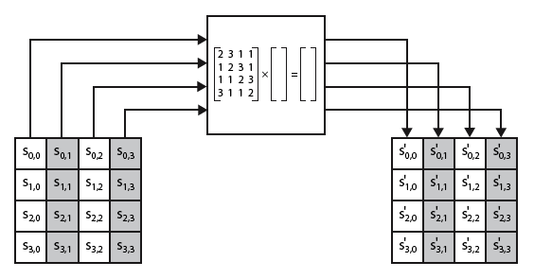
MixClumns Scheme
The MixColumns transformation operates at the column level; it transforms each column of the state to a new column.
Notes:
Stalling Figure 5.5b illustrates the Mix Columns transformation.
In practise, you implement Mix Columns by expressing the transformation on each column as 4 equations (Stallings equation 5.4) to compute the new bytes for that column. This computation only involves shifts, XORs & conditional XORs (for the modulo reduction).
The decryption computation requires the use of the inverse of the matrix, which has larger coefficients, and is thus potentially a little harder & slower to implement.
The designers & the AES standard provide an alternate characterisation of Mix Columns, which treats each column of State to be a four-term polynomial with coefficients in GF(2⁸). Each column is multiplied by a fixed polynomial a(x) given in Stallings eqn 5.7. Whilst this is useful for analysis of the stage, the matrix description is all that’s required for implementation.

Slide 35
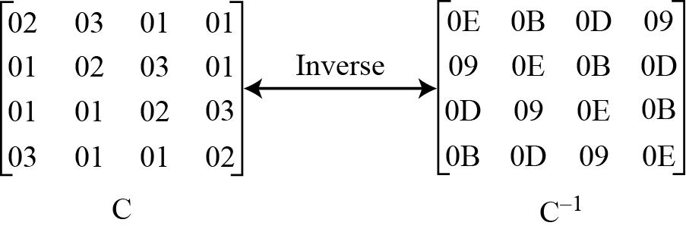
MixColumn and InvMixColumn

Slide 36
AddRoundKey
XOR state with 128-bits of the round key
AddRoundKey proceeds one column at a time.
adds a round key word with each state column matrix
the operation is matrix addition
Inverse for decryption identical
since XOR own inverse, with reversed keys
Designed to be as simple as possible
Notes:
Lastly is the Add Round Key stage which is a simple bitwise XOR of the current block with a portion of the expanded key. Note this is the only step which makes use of the key and obscures the result, hence MUST be used at start and end of each round, since otherwise could undo effect of other steps. But the other steps provide confusion/diffusion/non-linearity. That us you can look at the cipher as a series of XOR with key then scramble/permute block repeated. This is efficient and highly secure it is believed.

Slide 37
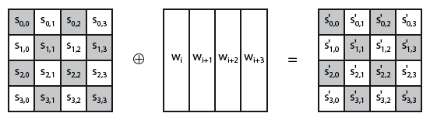
AddRoundKey Scheme
Notes:
Stallings Figure 5.4b illustrates the Add Round Key stage, which like Byte Substitution, operates on each byte of state independently.

Slide 38
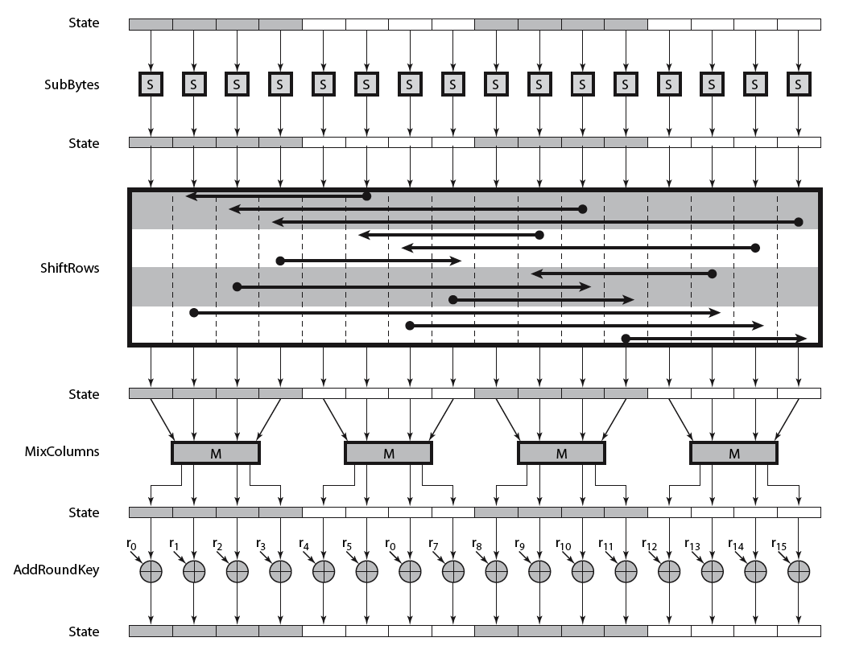
AES Round
Notes:
Can thus now view all the internal details of the AES round, showing how each byte of the state is manipulated, as shown in Stallings Figure 5.3.

Slide 39
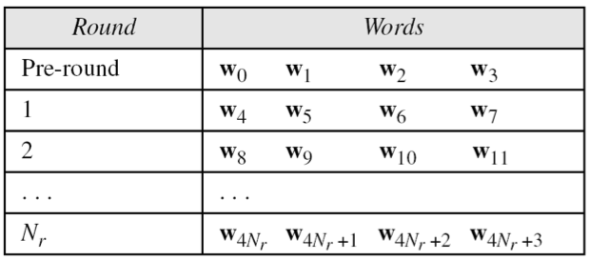
AES Key Scheduling
takes 128-bits (16-bytes) key and expands into array of 44 32-bit words
Notes:
The AES key expansion algorithm takes as input a 4-word (16-byte) key and produces a linear array of words, providing a 4-word round key for the initial AddRoundKey stage and each of the 10/12/14 rounds of the cipher. It involves copying the key into the first group of 4 words, and then constructing subsequent groups of 4 based on the values of the previous & 4th back words. The first word in each group of 4 gets “special treatment” with rotate + S-box + XOR constant on the previous word before XOR’ing the one from 4 back. In the 256-bit key/14 round version, there’s also an extra step on the middle word.

Slide 40
Key Expansion
The specific criteria that were used are:
Knowledge of a part of the cipher key or round key does not enable calculation of many other round-key bits
An invertible transformation
Speed on a wide range of processors
Usage of round constants to eliminate symmetries
Diffusion of cipher key differences into the round keys
Enough nonlinearity to prohibit the full determination of round key differences from cipher key differences only
Simplicity of description
The Rijndael developers designed the expansion key algorithm to be resistant to known cryptanalytic attacks
Inclusion of a round-dependent round constant eliminates the symmetry between the ways in which round keys are generated in different rounds
Notes:
The Rijndael developers designed the expansion key algorithm to be resistant to
known cryptanalytic attacks. The inclusion of a round-dependent round constant
eliminates the symmetry, or similarity, between the ways in which round keys are
generated in different rounds. The specific criteria that were used are [DAEM99]
• Knowledge of a part of the cipher key or round key does not enable calculation
of many other round-key bits.
• An invertible transformation [i.e., knowledge of any Nk consecutive words of
the expanded key enables regeneration of the entire expanded key (Nk = key
size in words)].
• Speed on a wide range of processors.
• Usage of round constants to eliminate symmetries.
• Diffusion of cipher key differences into the round keys; that is, each key bit
affects many round key bits.
• Enough nonlinearity to prohibit the full determination of round key differences
from cipher key differences only.
• Simplicity of description.
he authors do not quantify the first point on the preceding list, but the idea
is that if you know less than Nk consecutive words of either the cipher key or one of
the round keys, then it is difficult to reconstruct the remaining unknown bits. The
fewer bits one knows, the more difficult it is to do the reconstruction or to determine
other bits in the key expansion.

Slide 41
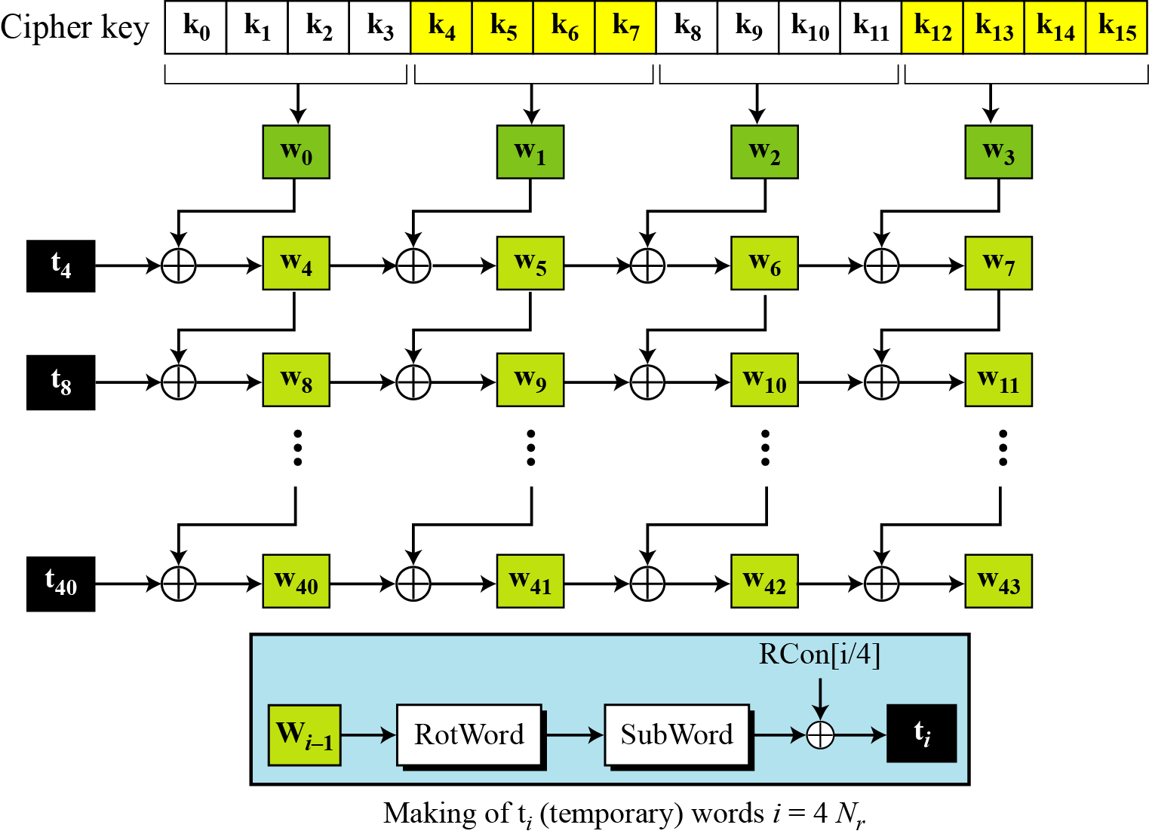
Key Expansion Scheme

Slide 42
Key Expansion submodule
RotWord performs a one byte circular left shift on a word For example:
RotWord[b0,b1,b2,b3] = [b1,b2,b3,b0]
SubWord performs a byte substitution on each byte of input word using the S-box
SubWord(RotWord(temp)) is XORed with RCon[j] – the round constant

Slide 43
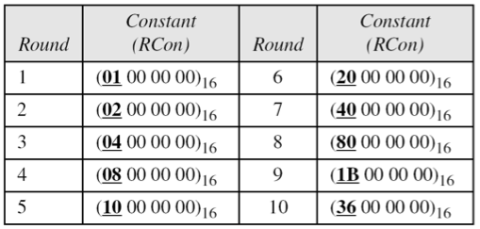
Round Constant (RCon)
RCON is a word in which the three rightmost bytes are zero
It is different for each round and defined as:
RCon[j] = (RCon[j],0,0,0)
where RCon[1] =1 , RCon[j] = 2 * RCon[j-1]
Multiplication is defined over GF(2^8) but can be implement in Table Lookup

Slide 44
Key Expansion Example (1st Round)
Example of expansion of a 128-bit cipher key
Cipher key = 2b7e151628aed2a6abf7158809cf4f3c
w0=2b7e1516 w1=28aed2a6 w2=abf71588 w3=09cf4f3c
i | w_{i-1} | RotWord | SubWord | Rcon[i/4] | t_{i} | w[i-4] | w_{i}
4 | 09cf4f3c | cf4f3c09 | 8a84eb01 | 01000000 | 8b84eb01 | 2b7e1516 | a0fafe17
5 | a0fafe17 | - | - | - | - | 28aed2a6 | 88542cb1
6 | 88542cb1 | - | - | - | - | Abf71588 | 23a33939
7 | 23a33939 | - | - | - | - | 09cf4f3c | 2a6c7605

Slide 45
Topics
Origin of AES
Basic AES
Inside Algorithm
Final Notes

Slide 46
Equivalent Inverse Cipher
AES decryption cipher is not identical to the encryption cipher
The sequence of transformations differs although the form of the key schedules is the same
Has the disadvantage that two separate software or firmware modules are needed for applications that require both encryption and decryption
Two separate changes are needed to bring the decryption structure in line with the encryption structure
The first two stages of the decryption round need to be interchanged
The second two stages of the decryption round need to be interchanged
Notes:
As was mentioned, the AES decryption cipher is not identical to the encryption
cipher (Figure 5.3). That is, the sequence of transformations for decryption differs
from that for encryption, although the form of the key schedules for encryption
and decryption is the same. This has the disadvantage that two separate software
or firmware modules are needed for applications that require both encryption and
decryption. There is, however, an equivalent version of the decryption algorithm
that has the same structure as the encryption algorithm. The equivalent version has
the same sequence of transformations as the encryption algorithm (with transformations
replaced by their inverses). To achieve this equivalence, a change in key
schedule is needed.
Two separate changes are needed to bring the decryption structure in line
with the encryption structure. As illustrated in Figure 5.3, an encryption round has
the structure SubBytes, ShiftRows, MixColumns, AddRoundKey. The standard
decryption round has the structure InvShiftRows, InvSubBytes, AddRoundKey,
InvMixColumns. Thus, the first two stages of the decryption round need to
be interchanged, and the second two stages of the decryption round need to be
interchanged.

Slide 48
AES Security
AES was designed after DES.
Most of the known attacks on DES were already tested on AES.
Brute-Force Attack
AES is definitely more secure than DES due to the larger-size key.
Statistical Attacks
Numerous tests have failed to do statistical analysis of the ciphertext
Differential and Linear Attacks
There are no differential and linear attacks on AES as yet.

Slide 49
Implementation Aspects
The algorithms used in AES are so simple that they can be easily implemented using cheap processors and a minimum amount of memory.
Very efficient
Implementation was a key factor in its selection as the AES cipher
AES animation:
http://www.cs.bc.edu/~straubin/cs381-05/blockciphers/rijndael_ingles2004.swf
Notes:
AES can also be very efficiently implemented on an 32-bit processor, by rewriting the stage transformation to use 4 table lookups & 4 XOR’s per column of state. These tables can be computed in advance using the formulae shown in the text, and need 4Kb to store.
The developers of Rijndael believe that this compact, efficient implementation was probably one of the most important factors in the selection of Rijndael for AES.

