Slide 1

SLIMS Java API Training
Customization Training Series
Manon REIST
SLIMS Technical Lead
February 23rd – March 2nd 2026

Slide 2
Agenda
Introduction
Architecture and technology
Set up your local environment
Demo of SLIMS Java API
Try yourself
Best practices

Slide 3



SLIMS Architecture
SLIMS Client
Lab Network
On prem deployments
Printers
HL7
Sequencer
Mail
FTP
SLIMS GUI Plugins (Vaadin)
Requester portal
Bench UI
Python-API
Frontend
Frontend
Hazelcast Cluster
SLIMS Server
Requester portal
SLIMS-R
SLIMS Rest
(Rest-API)
SLIMS GATE Plugins
(Apache, Camel, Java API)
Backend
Platform-API
Dependency
Communication
Database
File Storage
Notes:
This is an overview of our architecture.
SLIMS client (SLIMS web application) runs as a Tomcat web application on the SLIMS Server.
SLIMS Rest runs on the SLIMS server, also as a Tomcat web application.
SLIMS GATE service runs on the SLIMS Server as a separate java application. The code of the plugins are loaded in SLIMS GATE.
This is the connection to the outside world.
A Hazelcast cluster is running that connects SLIMS, SLIMS GATE, and SLIMS-R
Every action, whether it’s a view or fetch or update in SLIMS, or when using the Java or Rest API, it all goes through the platform API (for validation and access rights) before sending commands to the Database or file repository.

Slide 4
SLIMS Architecture
SLIMS Client
Lab Network
Cloud deployments
Printers
HL7
Sequencer
Mail
FTP
SLIMS GUI Plugins (Vaadin)
Requester portal
Bench UI
Python-API
SLIMS Remote
(for cloud deployments)
Frontend
Frontend
Hazelcast Cluster
SLIMS Server
Requester portal
SLIMS-R
SLIMS Rest
(Rest-API)
SLIMS GATE Plugins
(Apache, Camel, Java API)
Backend
Platform-API
Dependency
Communication
Database
File Storage
Notes:
The main difference for Cloud deployments is how to communicate with the Lab Network, where SLIMS Remote is needed.
SLIMS Remote will then communicate with SLIMS Rest and SLIMS Gate plugins can then be started (with usage “Remote”, more details on later slides)

Slide 5
SLIMS Rest API
SLIMS Client
Lab Network
Address: https://cglu-test.fra.slims.agilent.com/slims/slimsrest/v1/swagger-ui/index.html
Connect to REST API using same credentials as for SLIMS.
Simple calls: Create, Read, Update, Delete (CRUD)
Extended calls: Mix contents, Upload attachments
Documentation & Try it out feature available at: https://cglu-test.fra.slims.agilent.com/slims/slimsrest/v1/swagger-ui/index.html
Printers
HL7
Sequencer
Mail
FTP
SLIMS GUI Plugins (Vaadin)
Requester portal
Bench UI
Python-API
Frontend
Frontend
Hazelcast Cluster
SLIMS Server
Requester portal
SLIMS-R
SLIMS Rest
(Rest-API)
SLIMS GATE Plugins
(Apache, Camel, Java API)
Backend
Platform-API
Database
File Storage
Notes:
The REST API is running on the SLIMS server and accessible via the SLIMS REST URL.
This slide is FYI since this presentation is only about our JAVA API (or perhaps remove this slide and make a small Rest API presentation).

Slide 6
SLIMS Python API
SLIMS Client
Lab Network
Python connects through SLIMS Rest API.
Facilitates existing SLIMS Rest API calls.
Simple installation with SLIMS-Python package:
pip install slims-python-api
Source code and cookbook examples:
https://github.com/genohm/slims-python-api
Documentation:
https://readthedocs.org/projects/slims-python-api
Printers
HL7
Sequencer
Mail
FTP
SLIMS GUI Plugins (Vaadin)
Requester portal
Bench UI
Python-API
Frontend
Frontend
Hazelcast Cluster
SLIMS Server
Requester portal
SLIMS-R
SLIMS Rest
(Rest-API)
SLIMS GATE Plugins
(Apache, Camel, Java API)
Backend
Platform-API
Database
File Storage
Notes:
The REST API is running on the SLIMS server and accessible via the SLIMS REST URL.
This slide is FYI since this presentation is only about our JAVA API (or perhaps remove this slide and make a small Rest API presentation).

Slide 7
SLIMS GATE – Java API
Enterprise Integration Patterns
SLIMS Client
Lab Network
Relies heavily on Apache Camel.
Supports a great variety of transports and APIs:
Files
FTP
E-mail …
Easy to use Domain Specific Language
https://camel.apache.org/components/4.x/index.html
Dependency injection via Spring: https://spring.io/
Printers
HL7
Sequencer
Mail
FTP
SLIMS GUI Plugins (Vaadin)
Requester portal
Bench UI
Python-API
Frontend
Frontend
Hazelcast Cluster
SLIMS Server
Requester portal
SLIMS-R
SLIMS Rest
(Rest-API)
SLIMS GATE Plugins
(Apache, Camel, Java API)
Backend
Platform-API
Database
File Storage
Notes:
Camel is a framework that helps us to do all the “dirty” stuff.
Picks up files
Sends emails
FTP
And the language is very nice and easy to use
SLIMS 7.2 uses version 4.x. The link will take you to a “page not found” page from camel, pick a specific 4.x version on the bottom left

Slide 8
SLIMS GATE – Java API
Main Programmable Customization Layer
SLIMS Client
Lab Network
SLIMS GATE is close to the heart of SLIMS. Main purposes:
Instrument connections
Connections to “external systems”
Extra business logic
APIs that allow manipulating the data model:
Transactional
Logging
Business logic
More https://github.com/genohm/slims-api
Can use SLIMS REST API to initiate the plugins.
Printers
HL7
Sequencer
Mail
FTP
SLIMS GUI Plugins (Vaadin)
Requester portal
Bench UI
Python-API
Frontend
Frontend
Hazelcast Cluster
SLIMS Server
Requester portal
SLIMS-R
SLIMS Rest
(Rest-API)
SLIMS GATE Plugins
(Apache, Camel, Java API)
Backend
Platform-API
Database
File Storage
Notes:
Main programmable customization layer, main purposes:
Instrument connections
Connection to external systems
SLIMS GATE is close to the heart of SLIMS, advantages of the Java API (vs Rest API)
- Wide range of API services
- Code will execute must faster
- You have control over the scope of database transactions, compared to the Rest API where every single call (POST/GET/…) is a single separate transaction.
- Main tool used by Application Engineers

Slide 9



SLIMS GATE - Plugin
This is the public API part of SLIMS GATE.
Plugin structure in the UI to upload a plugin that is run by SLIMS GATE.
Configurable and manageable via the SLIMS application.
Independent from each other
Examples of plugins:
Handle the connection to a specific instrument
Add an extra piece of business logic
SLIMS/SLIMSGATE
PLUGIN
PLUGIN
PLUGIN
Notes:
Independent -> Plugins are running independently; they are unaffected by each other. You can start or stop them individually.
Parameter configuration can be done in the Plugins module and a plugin can be restarted after some alterations.
If the customer knows about the old school SLIMS GATE -> everything was running in 1 system with 1 camel context. Impossible to stop or start one SLIMS GATE flow individually.

Slide 10
0. Set up the environment
Download github repository
Add gradle.properties in ~/.gradle/gradle.properties
Set java home
Build the project
# Eclipse ./gradlew eclipse # IntelliJ ./gradlew idea
Import plugin projects in IDE
Notes:
Download repo: github -> Code -> download zip
Set java home (!) Java 21 (!) :
$ export JAVA_HOME=/c/Program\ Files/Java/openjdk-21.0.6+7/openlogic-openjdk-21.0.6+7-windows-x64
Build project
Import: open IntelliJ, then “Open” and select the slims-api-master (or equivalent)

Slide 11
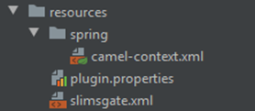
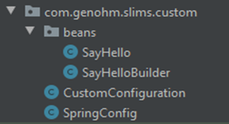

Demonstration: Say Hello Example
Notes:
Example of the files that are used in the SLIMS GATE template plugin.

Slide 12
settings.gradle
Defines which projects should be included in the build.
Newly created plugin projects need to be added:
include ‘templates:slimsgate-template’
include ‘templates:slims-vaadin-template’
include ‘templates:library-template’
include ‘templates:dto-template’
File pictured in Intellij
Notes:
After including a new plugin in this file, you will need to rebuild so that IDE project files are created.
Use ./gradlew idea or ./gradlew eclipse

Slide 13

build.gradle
List of Library Dependencies
Disclaimer! Don’t pull in too many dependencies because they need to be packaged inside the fatjar.
Use maven repository to find the right external dependency: https://mvnrepository.com/
When this file changes, you need to run:
./gradlew idea (or ./gradlew eclipse) to apply changes to your IDE.
Example of dependencies in build.gradle

Slide 14
plugin.properties and CustomConfiguration
Vocabulary
Plugin properties file: Choose the type of plugin from SLIMSGATE, REMOTE, or LIBRARY.
CustomConfiguration file: Contains the details of the default and configurable values of the plugin.

Slide 15

Set the plugin.properties
Type can be:
SLIMSGATE: SLIMSGate plugin – create your own custom instrument interface or automation.
LIBRARY: No plugin – create you own library of common functions on which other plugins can depend.
REMOTE: Remote plugin – SLIMS engineers can create plugins that talk to a local daemon.
apiVersion should match your current main SLIMS version.
config-class
Example of properties
Notes:
SLIMS GATE: SLIMS GATE plugins, machine integrations
LIBRARY: common (reusable) code for other plugins (which will be added as a dependency when needed)
REMOTE: remote plugins for SLIMS Cloud, balances integration /!\ written by SLIMS engineers /!\
SLIMS: Vaadin plugins, custom UI /!\ not part of the slide, as not encouraged /!\

Slide 16
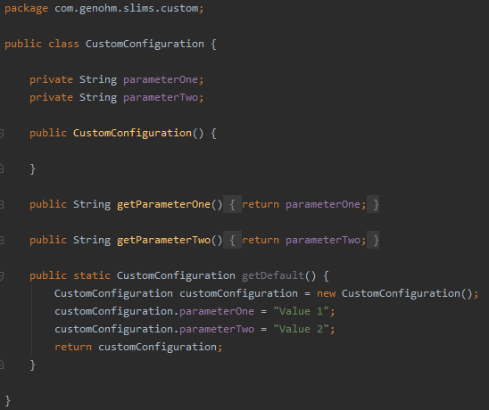
Set the CustomConfiguration
CustomConfiguration.java contains the details of the default and configurable values of the plugin.
Default values can be given to the parameters which will be visible in the Plugin module in the UI of SLIMS.
Example: Useful to indicate what kind of data should be contained in this parameter or enter a value that you already know.
Parameter details example

Slide 17
plugin.properties
Important Takeaways
plugin.properties within templates/slimsgate-template/src/main/resources
config-class=com.genohm.slims.custom.CustomConfiguration
type=SLIMSGATE
apiVersion=7.2.0
config-class CustomConfiguration.java contains the details of the default and configurable values of the plugin.
Type can be:
SLIMSGATE: SLIMS GATE plugin – create your own custom instrument interface or automation.
LIBRARY: No plugin – create your own library of common functions on which other plugins can depend.
REMOTE: Remote plugin – SLIMS engineers can create plugins that talk to a local daemon.
apiVersion needs to match your current main SLIMS version.
Notes:
If the config class changes, CustomConfiguration needs to be changed to the name of the configuration bean to match
Types which are available but not presented in the training. Note that Remote is still in the list, but it’s mentioned they are done by SLIMS engineers
SLIMS: Vaadin plugin – create your own custom UI forms in SLIMS.

Slide 18
Say Hello Example
Anatomy
camel-context.xml
<routeBuilder ref=“sayHelloBuilder”>
CustomConfiguration.java
SayHello.java
@Component
Public class SayHello{
@Autowired private CustomConfiguration customConfiguration
}
SayHelloBuilder.java
.to(“bean:sayHello”)
.routeId(“sayHello”)
slimsgate.xml
<route>sayHello</route>
Notes:
SpringConfig (class that will never change) defines to load:
all classes in a certain package with @Component
camel-context.xml
Camel-context.xml defines to load:
sayHelloBuilder
SayHelloBuilder defines the routes with specific beans:
sayHello
SayHello bean can use CustomConfiguration which is loaded via plugin.properties config-class
SLIMS web application loads the SLIMS GATE flows from
slimsgate.xml
SLIMS GATE flows start a camel route with routeId sayHello

Slide 19
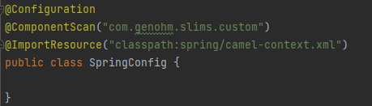
SpringConfig.java
Will never change.
Notes:
SpringConfig (class that will never change) defines to load:
all classes in a certain package with @Component
camel-context.xml

Slide 20
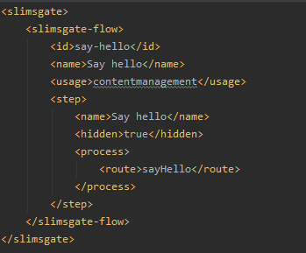
slimsgate.xml
Defines what input is required from the user. Can be selection of a record (content, order, attachment) or a manual input.
Zoom of slimsgate.xml file content
Notes:
Note: slimsgate.xml gives you some control of the UI. It is information that can change for every execution.

Slide 21
slimsgate.xml - Parameters
id: The unique id
name: The display name in SLIMS
usage: Which part of SLIMS it is displayed in:
contentmanagement → At the top of the Content module
eln → To be selected within a protocol step (from the ELN or a Workflow)
elntree → On the left of the ELN module
ordermanagement → At the top of the Orders module
attachment → In the Attachments module
macro → Within a step of type SLIMS GATE → ⚠suitable for plugin with only one step
dashboard → As a widget in the Dashboard module
simplified → At the top of a simplified protocol run
workflow → At the top of the Workflows module
resultmeasurement → Needs to be specified at the test level
internal → Won’t appear in SLIMS, more advanced, start non-direct route defined with camel
Step: List of parameters (on the next slide)
Notes:
Internal: routeBuilder definition -> watch directories, cron job, rest, … https://camel.apache.org/components/3.16.x/index.html
From 6.7.2, possible to start plugin via REST call -> not needed to have a slimsgate.xml. If still add on, use internal usage

Slide 22
slimsgate.xml – Step Parameters
name: Name of step displayed on top of the input window
hidden: True/false, controls whether the input window is displayed or not
input: List of input parameters
process: Contains route parameter that redirects to the route
(routeId is used within the Builder in the example SayHelloBuilder.java)
output: List of output parameters

Slide 23
slimsgate.xml – Input Parameters
label: The display name in the window
name: The name used in the bean to get the value
type: String, Text, RichText, Feedback, Integer, Float, Boolean, Date, DateTime, Time, StringArray, ValueMap, SingleChoice, MultipleChoice, Configuration, File, Table, Attachment, MultipleChoiceGrid, SingleChoiceGrid and some others
required: Controls whether the value is mandatory or not
defaultValue: A default value that will be filled
persistent: Whether this parameter will be passed to all the following steps
width: The width of the parameter
height: The height of the parameter
sameRowAsPrevious: True/false, controls whether this parameter will be display on the same line as previous parameter

Slide 24
slimsgate.xml – Output Parameters
Output parameters are used to transfer the output of a computation/fetch to the following step to be able to use it as an input.
name: The name of the parameter
type: ValueMap (the only possible value)
dataSource: (use when needed, refers to one table)
Example: You fetch the contents that are ready to be processed and then let the user choose which ones to actually process.

Slide 25
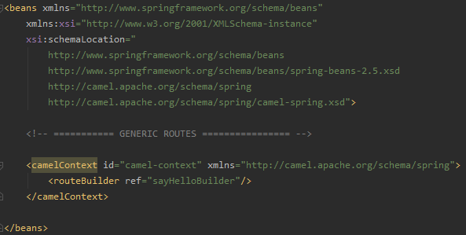
Camel-context.xml
Reference to the different routes
List the routeBuilder beans
Remember: use lowerCamelCase.
Zoom of camel-context.xml file‘s content
Notes:
Mention the lower case routeBuilder reference; i.e., the default id of an available injected bean/class is lowerCamelCase.

Slide 26
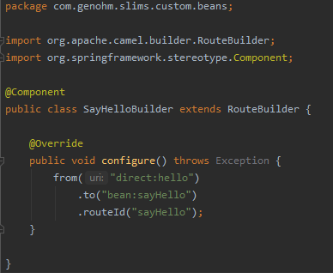
SayHelloBuilder.xml
from: ‘Direct’ most of the time, sometimes from camel components
to: path to the bean
routeId: from slimsgate.xml
Zoom of SayHelloBuilder
Notes:
Maybe important and interesting to mention that here you can “Autowired” the CustomConfiguration class and then use the configurations here.
Example -> name of a folder that you want to watch: from(“…”+variable +” …”, parameterFromConfiguation).to(…)
Concrete example: (passing value of watchFolders from customConfiguration into the builder and looping over the values : watchFolder in watchFolders)
In RouteBuilder class:
@Autowired
private CustomConfiguration customConfiguration;
@Override
public void configure() throws Exception {
for(String watchFolder: customConfiguration.getWatchFolders()){
fromF("file:/%s/?noop=true&recursive=true&fileName=CopyComplete.txt&idempotentKey=${file:modified}", watchFolder)
.to("bean:novaseqSequencedContents");
}
}
In CustomConfiguration class:
private String[] watchFolders;
public static CustomConfiguration getDefault() {
CustomConfiguration customConfiguration = new CustomConfiguration();
customConfiguration.watchFolders = new String[]{"Z:", "Z:/Sheet"};
}

Slide 27
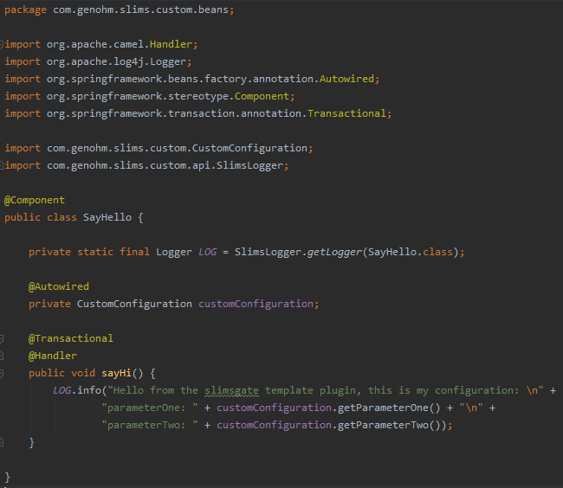
SayHello.java
The core of the code with methods.
Executing action required.
It is possible to fetch, add/update, and connect to external instruments.
Default values are defined in CustomConfiguration.java and input parameters are defined in slimsgate.xml.
Zoom of SayHello file

Slide 28
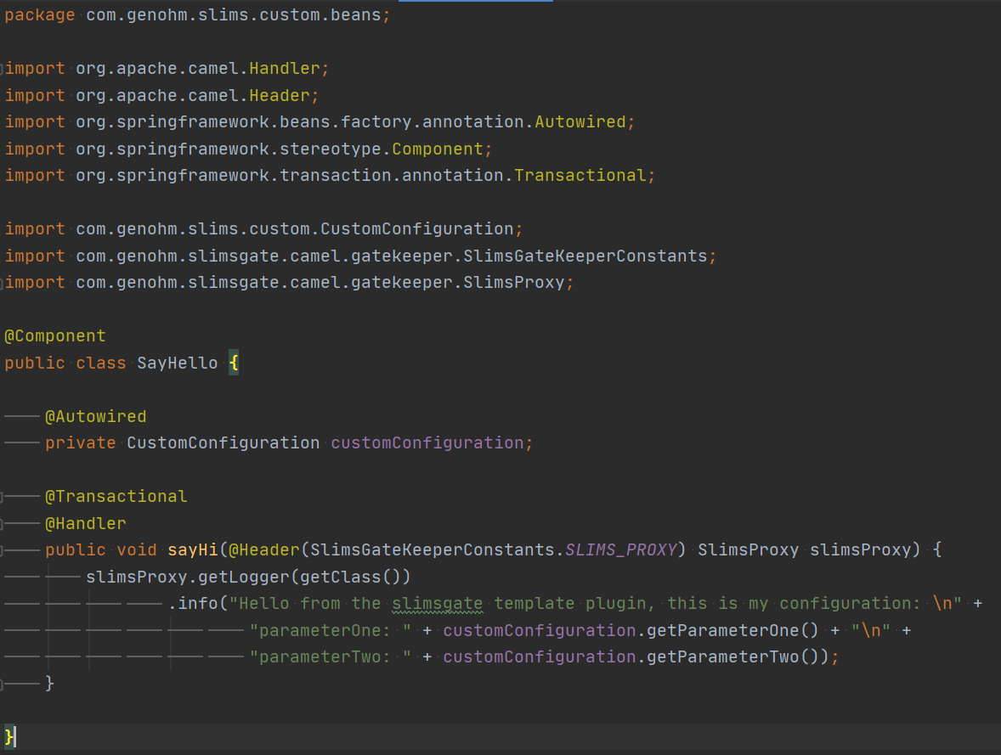
SayHello.java
Import
Definition of class
Core of Code
Notes:
Note: If you use a quartz scheduler – you need to use SlimsLogger as no slimsProxy is available.
Private static final Logger LOG = SlimsLogger.getLogger(SayHello.class)

Slide 29
1. Test the Example
Manually add the plugin in SLIMS.
Run the command in the plugin folder:
./gradlew templates:slimsgate-template:fatjar
From the SLIMS Plugins module, create a new plugin with the file that ends with *-fat.jar in the folder templates/slimsgate-template/build/libs.
Alternatively, run this command within the plugin folder to automatically add the plugin to SLIMS:
./gradlew templates:slimsgate-template:uploadToSlims
Test your plugin in SLIMS:
Use the SLIMS GATE flow button that is created by the plugin.
Check the SLIMS GATE logs within the UI.
Optional: Check the logs within the server to be sure you captured everything.
Notes:
Here I would start by showing how to do it directly in SLIMS (module: Plugin introduction -> like this you can also show the Configurations that can be changed and saved).
Then you say that you can also use a command to directly load the fatJAR in SLIMS using Rest call.

Slide 30
2. Create Your Own Example
Have a look at the file in slimsgate-template called:
HowToUseThisTemplate.md
Follow the guidelines in this file, including:
Copying the slimsgate-template folder
Renaming the folder
Adding a new line in settings.gradle with the new name.
Hint: Be cautious about capitalization, especially in the routeId, to, and routeBuilder definition. The first letter is in small case.
Important: You must have an @Handler method (Camel will search for one).
Notes:
Note: @Handler method is the method that Camel will call -> so it is your “main” method for the plugin. You MUST have one to avoid side-effect.
- Camel will look for a @Handler method if no method is specified in the camel route

Slide 31
3. Logging and Errors
Logging to UI via SlimsProxy
Error catching – always good practice:
Catch unhandled exceptions. Treat them and throw them again as a specific exception with a clearly stated message.
Exercise:
Add logging to the sayHi example.
Throw a new SlimsGateExceptionError every time.

Slide 32
4. Database Queries
<Table>RecordQueries – returns List of maps (key-value pairs) of the <Table> records
<Table>Queries – returns List of <Table>’s objects
NOTE: Only <Table>RecordQueries include custom fields.
@Autowired
private ContentRecordQueries contentRecordQueries;
Optional<Object> can be accessed with .get() if .isPresent() is true
Exercise:
Query the total number of contents and log it to the UI.
Query the custom field volume for each content and print it to the UI.
Tip: Both queries need to be Autowired.
Notes:
If querying for a ‘default’ value, <Table>Queries are suitable and faster than <Table>RecordQueries, because it loads less data.
Change a dao entity to a map using DaoUtil.getFilteredValues(entity) from the import com.genohm.slims.server.dao.util.DaoUtil;
Some remarks: <Table>RecordQueries are complete with custom fields and access restrictions, <Table>Queries not.

Slide 33
5. Updating/Adding Records
Records are created/removed/updated using Daos (Data Access Objects).
@Autowired
private Dao<Content> contentDao;
Exercise:
Create a new content record and log its barcode.
Edit the newly created content’s volume. Log its barcode and volume.
Remove previously created content and log its barcode.
For each exercise, verify whether the content and its values exist or not in the UI.
Tip: A Dao must be @Autowired.

Slide 34
6. Use SLIMS Services
PublicApi.java lists all available services that conduct internal SLIMS business logic.
Services need to be @Autowired.
@Autowired
private AttachmentStore attachmentStore;
Exercise:
Create a new attachment record and link it to an existing content.
Verify in the UI whether the attachment and its values exist or not.
Hint: Shortcut for opening types/files.
Eclipse: Ctrl or command + Shift + T
Intellij: Ctrl or command + Shift + O
Hint: Use a basic text file.
new ByteArrayInputStream(“this is a file”.getBytes());
Notes:
Tip: propose a basic String as a file: try(InputStream attachmentInputStream = new ByteArrayInputStream("this is a file".getBytes())) {
// Add attachment
}

Slide 35
7. Use Input Parameter
Input parameters can be used from the InputParameterValue map.
Add following parameter to the SayHi method:
@Header(SlimsGateKeeperConstants.SLIMS_WORKFLOW_INIT_PARAMETER)
SlimsFlowInitParam init Param
Exercise:
Edit slimsgate.xml to add an input parameter and log it in the UI.
Edit slimsgate.xml to add a second input parameter (of a different type) and log it in the UI + use it to edit a content.

Slide 36
8. Use Custom Configuration
Custom configuration can be used by using:
@Autowired private CustomConfiguration customConfiguration;
And then calling the call to the right parameter:
customConfiguration.getParameterOne();
Exercise:
Edit CustomConfiguration.java to add a configuration parameter and log it in the UI.
Edit CustomConfiguration.java to add a second configuration parameter (of a different type) and log it in the UI + use it to edit a content.

Slide 37
Best practices
Overall
Use existing services if available: check the publicApi
Can access the list in dev manual
Don’t hardcode Strings: either as configuration, or final static variables
don’t declare non-final variables in @Component classes
In case of working with a huge plugin or complex logic, don’t hesitate to reach out to us so that we can guide in the best direction and prevent performance issues

Slide 38
Best practices
Performances
Don’t fetch in loops
Don’t fetch custom fields if not needed -> Queries and not RecordQueries
Define which fields are needed to be fetch to not fetch them all
FetchRequest myFetchRequest = new FetchRequestImpl()
.setCriterion(slimsRestriction) // restriction to fetch the entries you want
.setAddDisplayFields(false) // don’t fetch the display fields of custom fields
.setLimitedCustomFields(Optional.of(List.of(field1, field2, …)));
List<Map<String,Object>> contents = contentDao.fetch(myFetchRequest).getResultList();
Only fetch what you plan to use (only the x more recent)
See the example in DeleteSomeContents.java of the cookbook
Prefer to have good restrictions/criteria in your fetch than fetch everything and then loop on the results to filter what you want
Prefer to use count method and not fetch if you’re only interested in the number of entries

Slide 39
Useful services
Util classes from com.genohm.slims.server.util
StringUtil
MapUtil
SetUtil
…
DaoUtil
DaoConstant
…Meta

Slide 40
Useful services
InteractiveImportApi
Parse a CSV / Excel file for record data and build a CellsDetailTable
CellDetailsTable parseCsv(byte[] file) throws InteractiveImportException;
CellDetailsTable parseExcel(byte[] file) throws InteractiveImportException;
CellDetailsTable cellDetails = interactiveImportApi.parseCsv(fileBytes);
List<Map<String, Object>> records = cellDetails.getAsRecordList();
Import records into SLIMS from a parsed data file
List<Map<String, Object>> importRecords( CellDetailsTable cellDetailTable, String[] importKeyFields, String table, Feedback feedback, User user) throws InteractiveImportException;

Slide 41
Useful services
ConvertRecordService - Display to PK
Converts
an entity in the display format (i. e. with fields having display values)
to an entity in the internal SLIMS format (i. e. with fields having the right internal value).
Map<String, Object> convertToInternalFormat(Map<String, Object> external, String table);
convertRecordService.convertToInternalFormat(record, DaoConstants.CONTENT);

Slide 42

Questions?

