Slide 1
Let’s GO!
Go Go

Slide 2
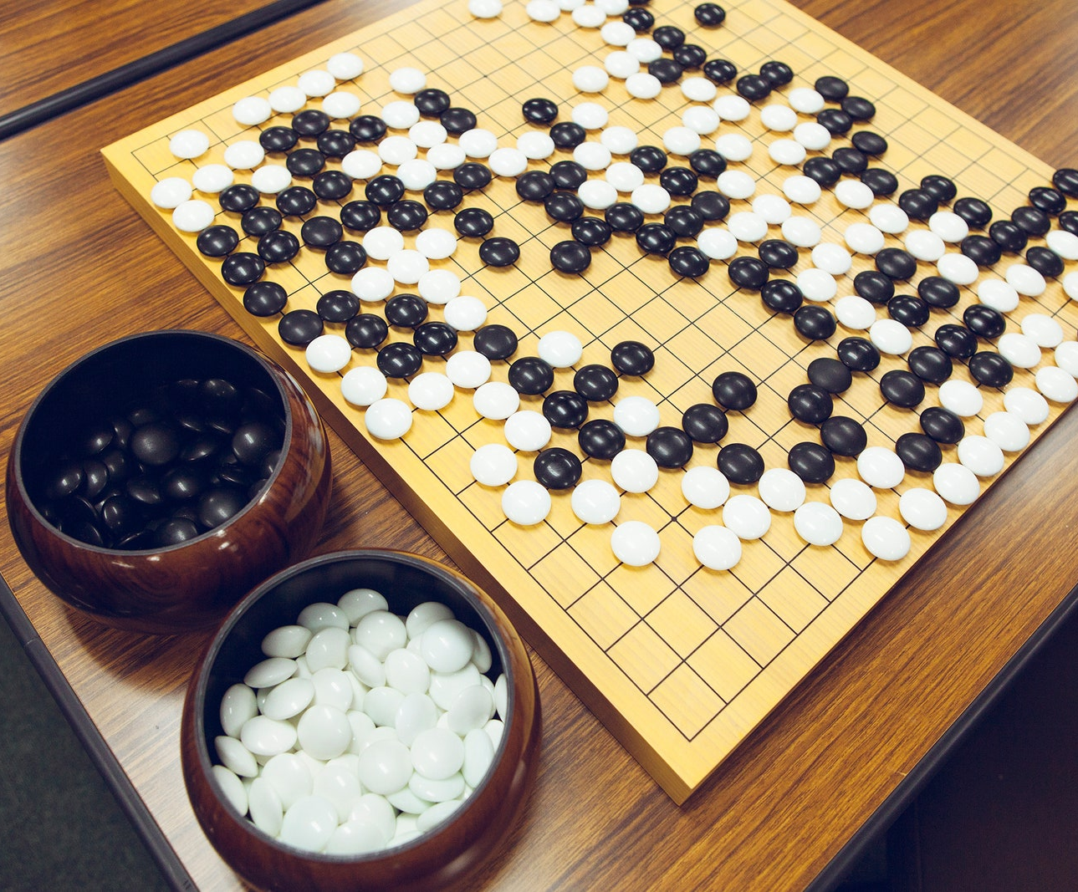

What was our GOal?
Step 1: Learn GO fundamentals
Step 2: Create the game Go in Go
Step 3: Rush presentation

Slide 3
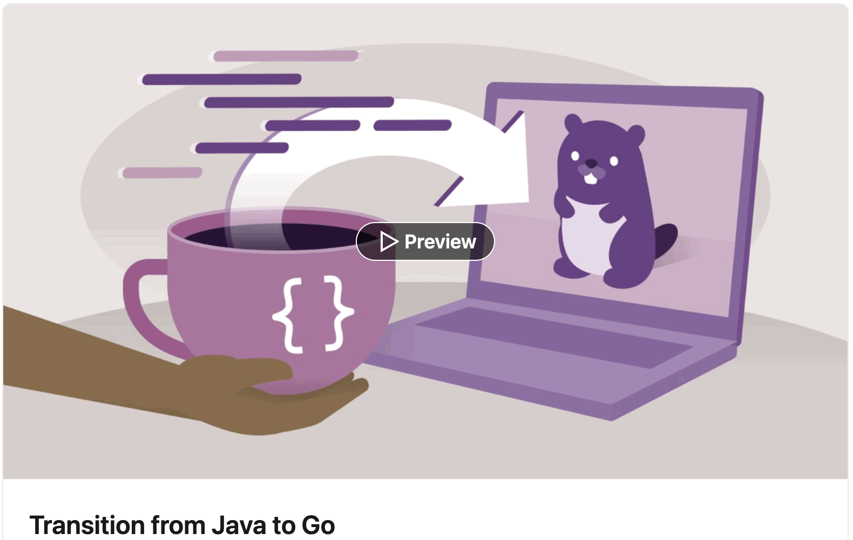
Step 1: Learn GO fundamentals
Go docs
Transition from Java to Go

Slide 4
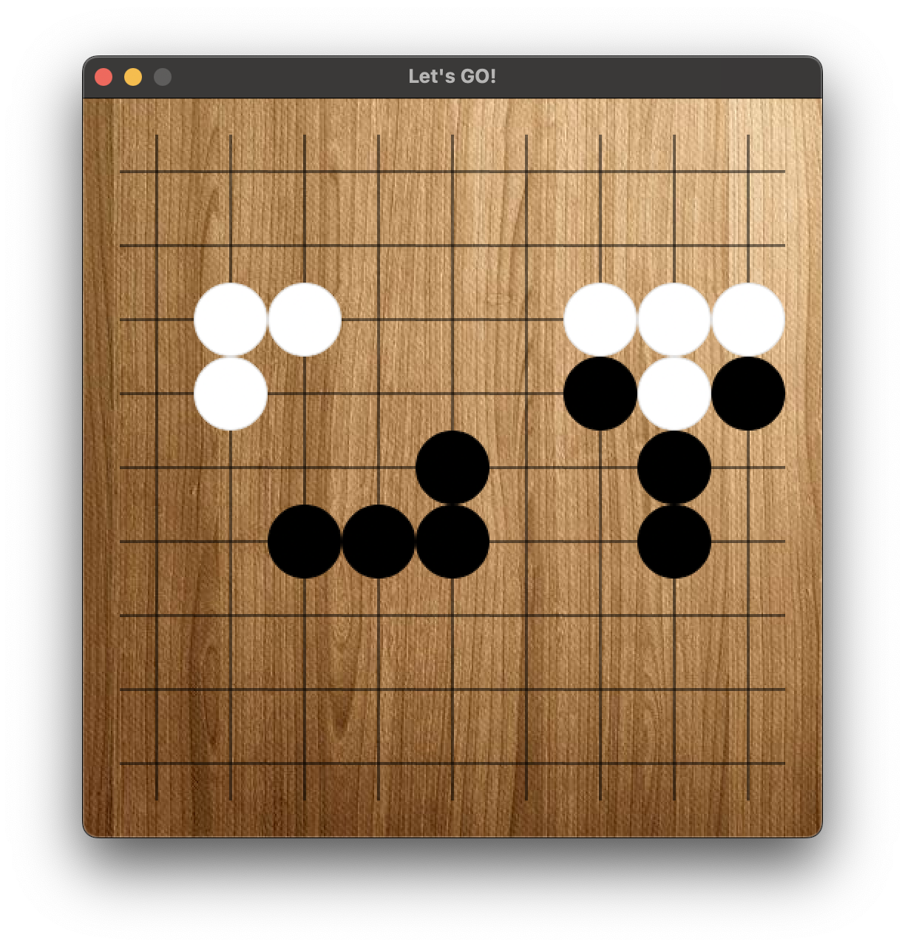
Step 2: Create the game Go in Go

Slide 5
Step 3: Rush presentation

Slide 6
Lessons learned
Mob programming
The game Go
The language Go
No ternary operator ?
Inverted typing as opposed to Java ☕️
Fun

Slide 7
Lessons learned
Mob programming
The game Go
The language Go
No ternary operator ?
Inverted typing as opposed to Java ☕️
Fun

