Slide 1


BarkBasics
By: Catherine Thaureaux
CSIT 355 Human-Computer Interaction

Slide 2

Proposal & Target Users
Purpose: iOS Mobile application that helps new and veteran dog owners keep track of their dog’s schedule with reminders and event logs, as well as track their dog’s training progress.
Target Users:
Dog owners of all ages

Slide 3
Interviews
Interviewed 3 different kinds of dog owners
All agreed that they need a centralized app to keep track of daily tasks for their pet

Slide 4
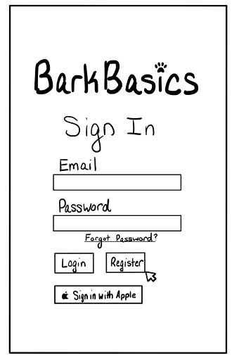
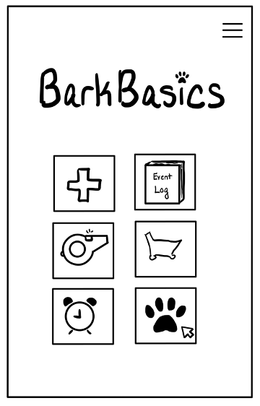
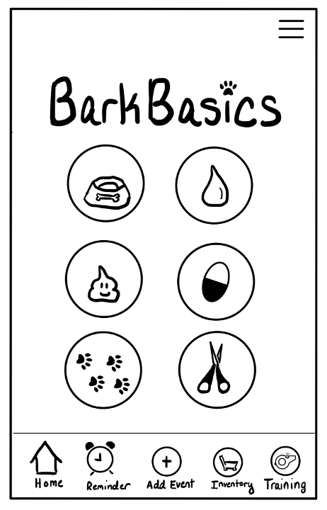
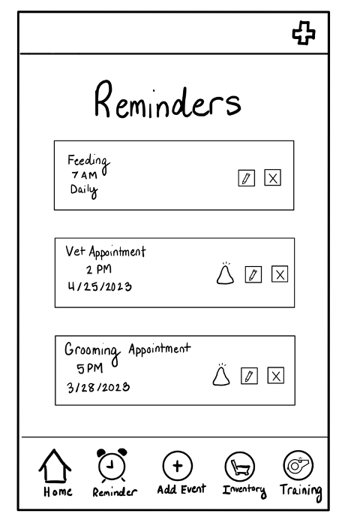
Low Fidelity Prototypes

Slide 5
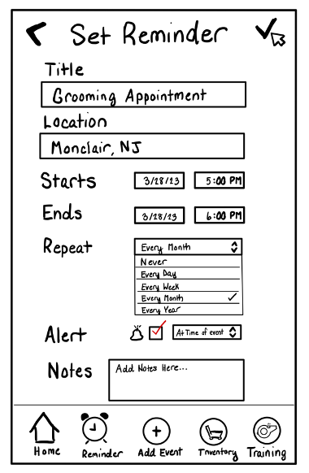
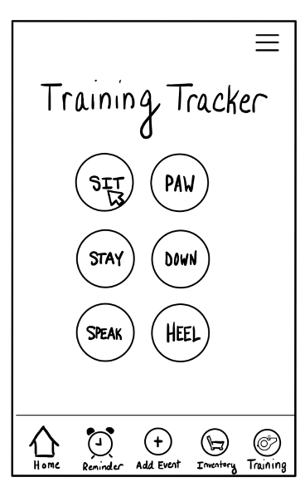
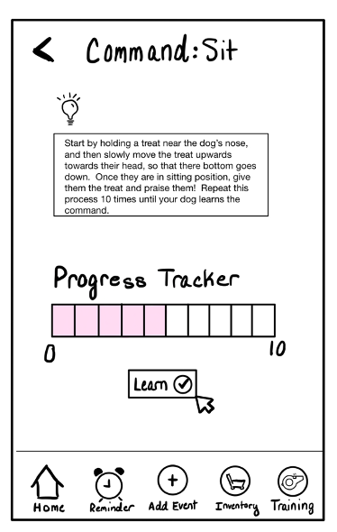
Low Fidelity Prototypes

Slide 6


Digital Prototype Demo

Slide 7
Future Implementations
Social
Add a social media/community element to allow “dogs” to add friends and view a fyp feed. Friends can view each other's profiles.
UI/UX
Add more color into the design of the app such as adding a colored title bar to all pages. Add video demonstrations to the training tracker pages.
Supply List
Finish the inventory/supplies list functionality of the application so dog owner’s can keep track of their pet’s supplies.

Slide 8


Thank you
for watching!

