Slide 1
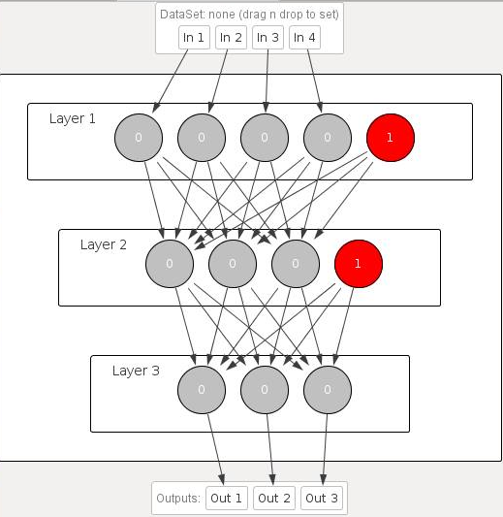
Trained Neural Net with 1 Hidden Layer

Slide 2
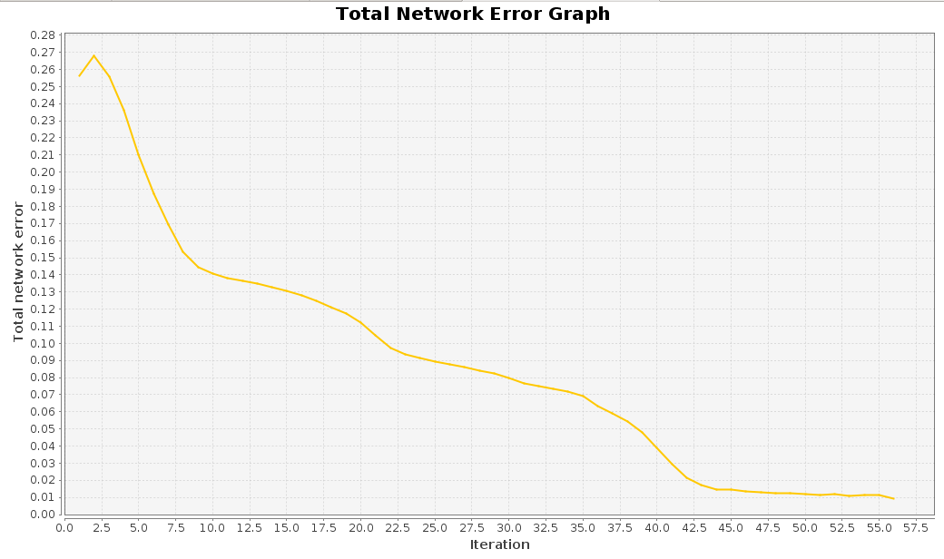
Single Hidden Layer Error Graph

Slide 3
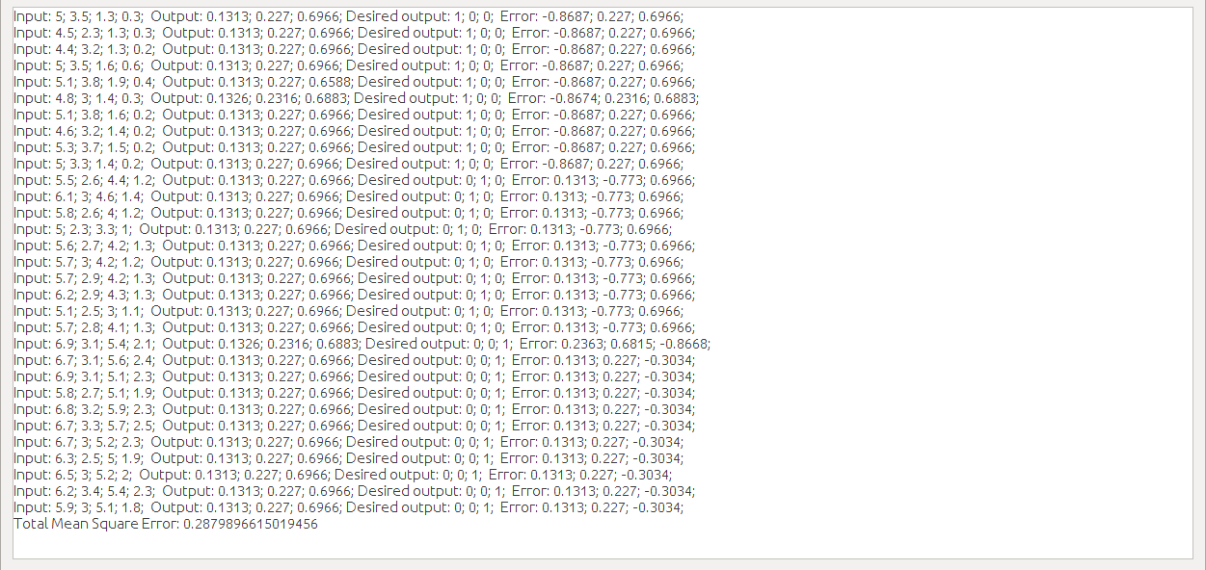
1 Hidden Layer Test Results

Slide 4
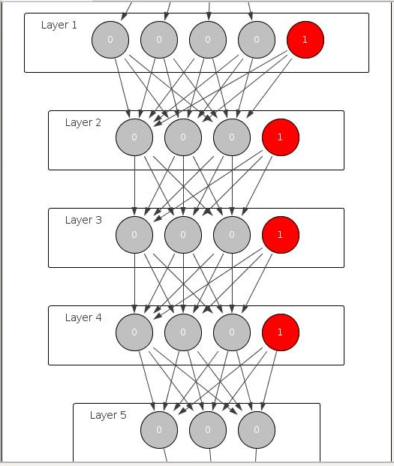
Trained Neural Net with 3 Hidden Layers

Slide 5
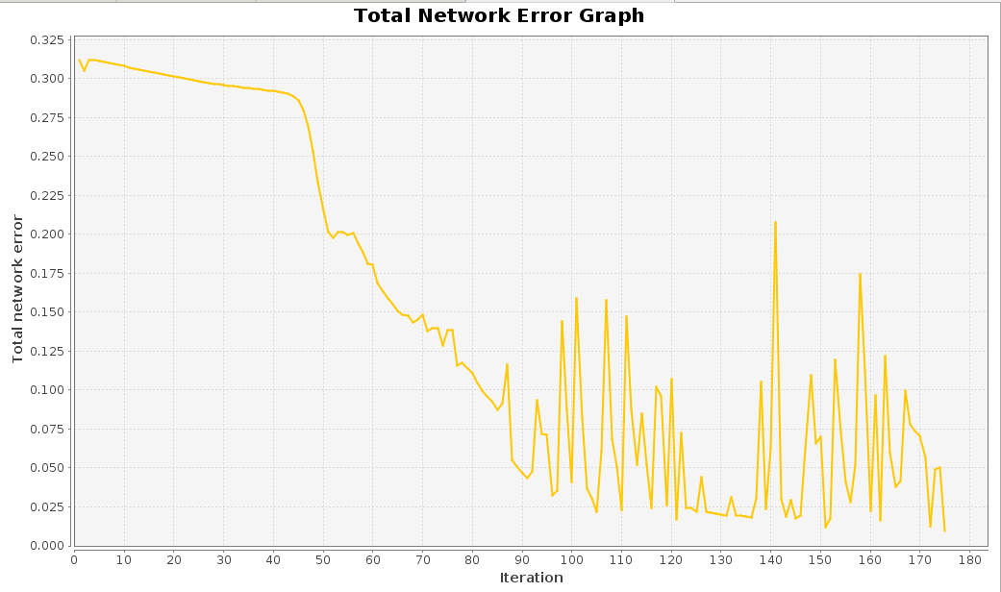
3 Hidden Layer Error Graph

Slide 6
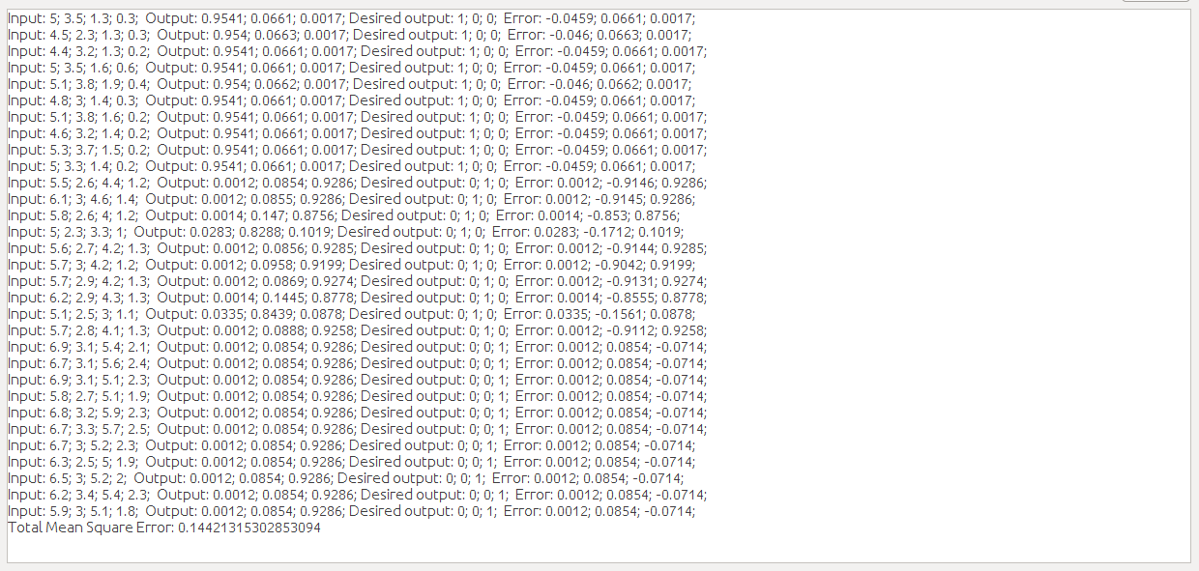
3 Hidden Layer Test Results

