Slide 1
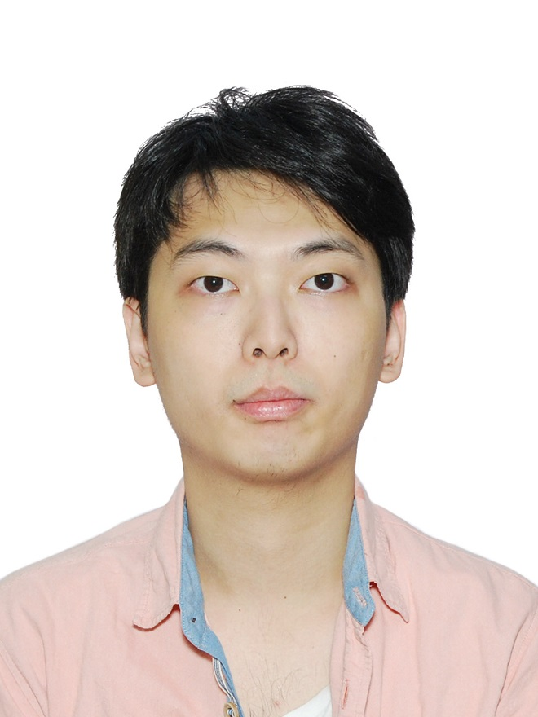
Name: Ting Hin CHUNG
Student ID: 301287013
Course code: 3422
Course name: Artificial Intelligence – Software Engineering Technology
Assignment 1: Portfolio
Detail: A simple portfolio site using NodeJS and Express.

