Slide 1
Digital court case management
NAME : CHALAPATI THEJASWINI
REGISTER NUMBER : 43110117
DEPARTMENT: BE CSE

Slide 2
ABSTRACT
The Digital Court Case Management System is an innovative approach to digitizing and automating the judicial process. It replaces traditional paper-based methods with a secure, efficient, and user-friendly platform that manages court cases digitally. The system allows seamless case filing, document management, scheduling, and status tracking. It enhances transparency, reduces delays, and ensures quick access to case information for judges, lawyers, and litigants. By integrating technology with the judicial system, this project aims to make justice delivery faster, smarter, and more accessible to all.

Slide 3
Existing system
The Digital Court Case Management System is designed to modernize and automate the entire court management process using technology.
This system allows courts, judges, advocates, and litigants to manage case information digitally from case filing to judgment. It helps track the progress of cases, store documents securely, and generate reports quickly. The use of Java for backend development and MySQL Workbench for database management ensures high performance, scalability, and data reliability

Slide 4
PROPOSED SYSTEM
The Digital Court Case Management System is designed to overcome the limitations of the traditional manual system by introducing a secure, efficient, and automated digital platform for handling court cases. The proposed system is developed using Java for backend logic and MySQL Workbench for database management. It provides an easy-to-use interface for court administrators and authorized users to manage case details digitally — including adding new cases, updating existing information, editing case records, and deleting outdated or closed cases.
This system centralizes all case-related data, ensuring that information is securely stored and easily retrievable. Each case record includes essential details such as case ID, title, parties involved, lawyer information, case status, and hearing dates. The admin users have full control to manage these records effectively through CRUD (Create, Read, Update, Delete) operations. This not only saves time but also ensures accuracy and consistency in maintaining judicial data.

Slide 5
ADVANTAGES
Automation of Manual Work
Efficient Case Management
Improved Data Accuracy and Consistency
Quick Search and Retrieval
Enhanced Security
Paperless Environment
Time and Cost Savings
Scalability and Integration
Transparency and Accountability

Slide 6
DISADVANTAGES
Initial Setup Cost
Technical Knowledge Requirement
Data Security Risks
System Maintenance
Data Loss Possibility
Resistance to Change
Limited Accessibility in Remote Areas

Slide 7
HARDWARE REQUIREMENTS
Processor (CPU): Executes all program instructions and
handles data processing.
RAM: Provides temporary storage for fast execution of Java
and SQL operations.
Hard Disk / SSD: Stores system files, case records, and data
base data permanently.
Monitor: Displays the system interface and user dashboards
clearly.
Keyboard: Used for entering and editing case information.
External Storage Device: Used for periodic data backup and
recovery.

Slide 8
SOFTWARE REQUIREMENTS
Operating System: Windows 10 or higher for running Java and
MySQL smoothly.
Programming Language: Java (JDK 8 or above) for backend
development.
Database: MySQL Workbench for creating and managing court
case data.
Connector: JDBC (Java Database Connectivity) for linking Java
with MySQL.
IDE (Integrated Development Environment): NetBeans or Eclipse
for coding and debugging.
Web Browser: Google Chrome or Edge for testing any web interface
(if applicable).

Slide 9
MODULES
User Authentication Module
Admin Management Module
Case Management Module
Database Management Module
System Security Module

Slide 10
MODULE DESCRIPTION
1. Case Management Module
It supports CRUD operations — Add, View, Update, and Delete case records.
Admins can assign or modify case details as needed.
It helps in maintaining a structured digital record of every case and ensures easy retrieval when required.
This module simplifies case tracking and ensures that no case information is misplaced or duplicated.
2. User Management Module
It stores user details like name, email, role, and login credentials.
Handles registration and authentication processes.
Ensures that every user interacts only with the sections relevant to their authority (for example, only admins can delete cases).

Slide 11
MODULE DESCRIPTION
3. Admin Management Module
Admins have full access to all case records and user activities.
They can add, edit, update, or delete case information.
The module allows admins to monitor system performance and data accuracy.
4. Database Management Module
Built using MYSQL Workbench,it maintains tables for users,cases,hearings and documents.
Handles relationships between tables.
Ensures data consistency, reliability,and Integrity during operations

Slide 12
MODULE DESCRIPTION
5. System Security Module
Implements login authentication and password encryption for user accounts
Restricts access based on user roles (admin, judge, lawyer)
Prevents unauthorized modifications or data breaches through validation checks
Includes database-level security such as restricted permissions and secure SQL queries

Slide 13
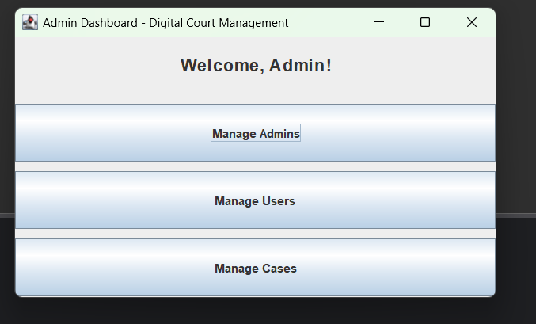
SAMPLE OUTPUT

Slide 14
CONCLUSION
The Digital Court Case Management System effectively modernizes the traditional court workflow by automating case management and reducing reliance on manual processes. It ensures efficient case tracking, quick access to records, and timely updates for all stakeholders, including judges, lawyers, and administrators. By digitizing court operations, the system minimizes errors, saves time, and enhances overall productivity and transparency. Moreover, it supports better data organization and retrieval, which aids in informed decision-making and case monitoring. This project lays a strong foundation for future upgrades, such as online case filing, real-time notifications, and integration with other judicial services, contributing to a more accessible, reliable, and smart judiciary

Slide 15
THANK YOU

