Slide 1

Demo Day #Batch 1203 Chloé Therreau

Slide 2
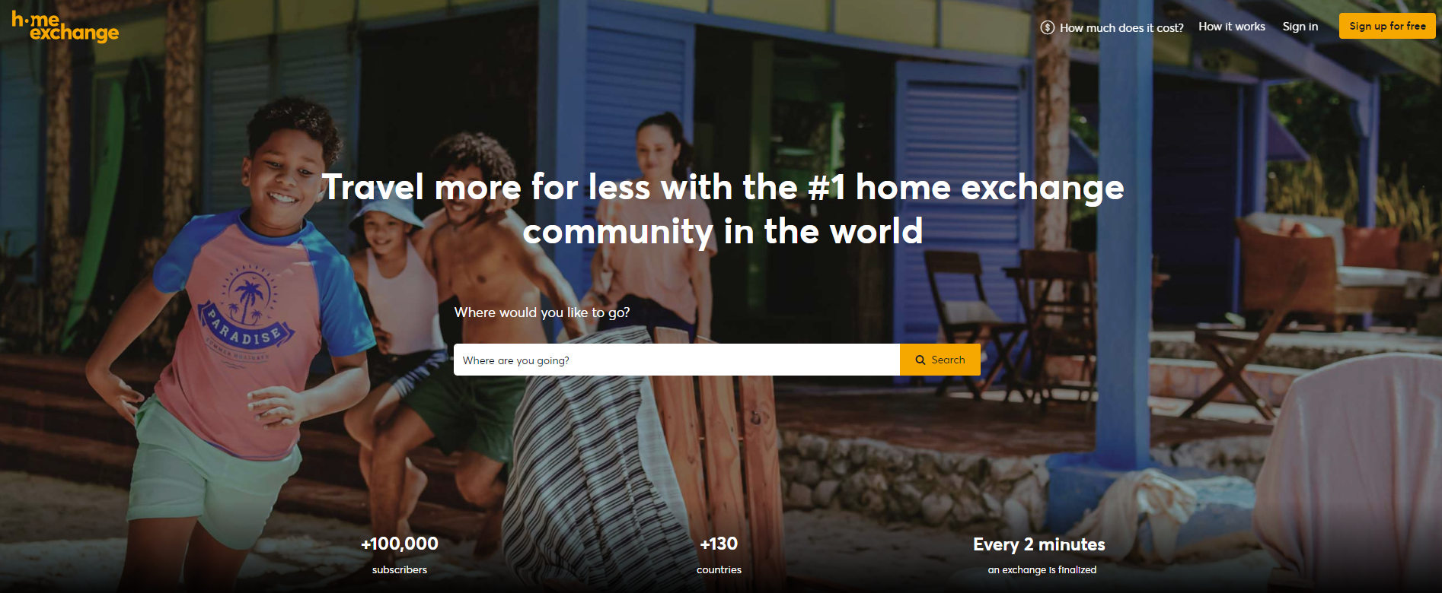
HomeExchange

Slide 3
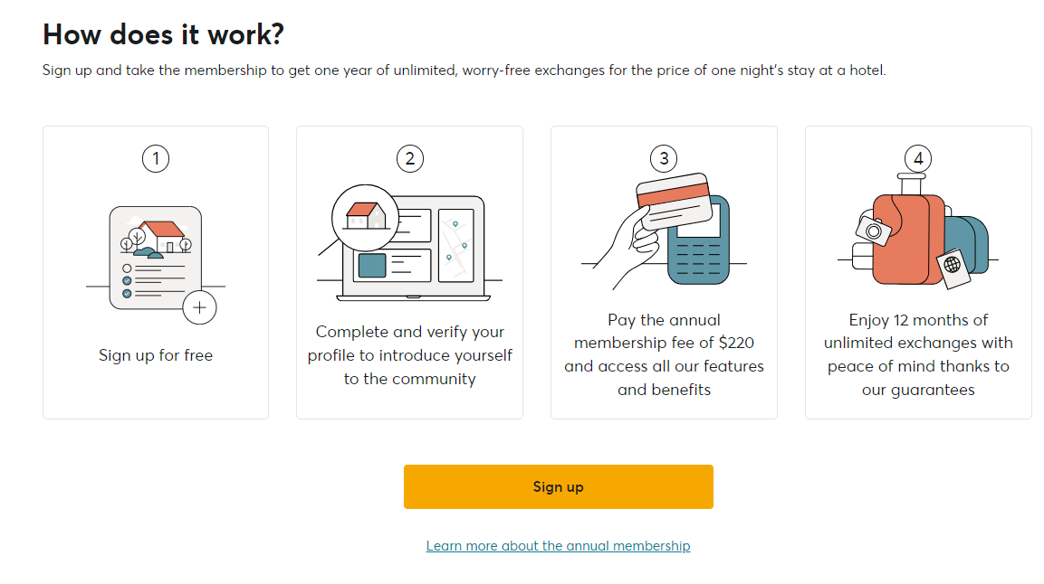


Presentation
2 ways of travels :
Reciprocal : you come to my house; I go to yours
Not reciprocal : you come to my house; in exchange I win GuestPoints that I can use to stay in another user house.
Annual subscription give access to GuestPoints :
500 GP for the first subscription
250 GP for the other one

Slide 4
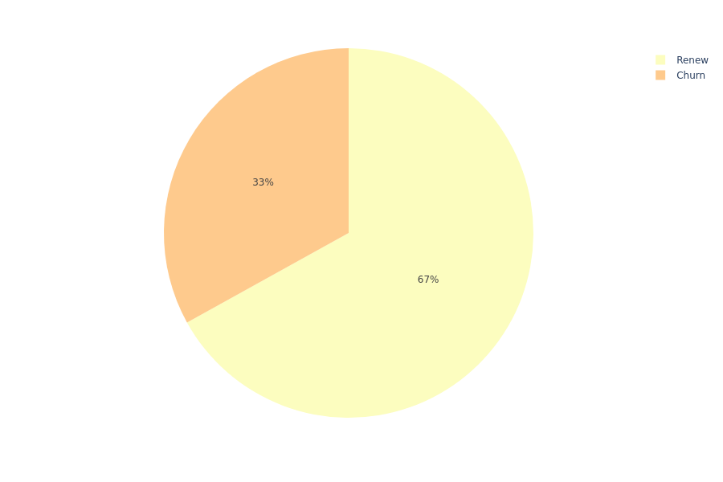
Why some user leave HomeExchange ?
3 years of data :
Subscriptions from 01-2019 to 10-2021
Exchanges from 01-2019 to 10-2022
Churn rate as a function of :
Date of subscription
Number of subscriptions for each user
The use or not of promotion and referral
Country
Number of exchange done by the user (as host, guest, both or none)

Slide 5
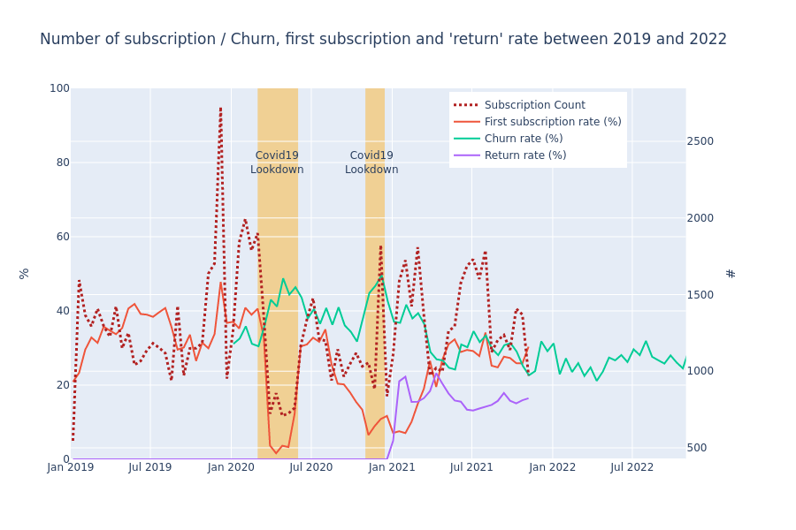
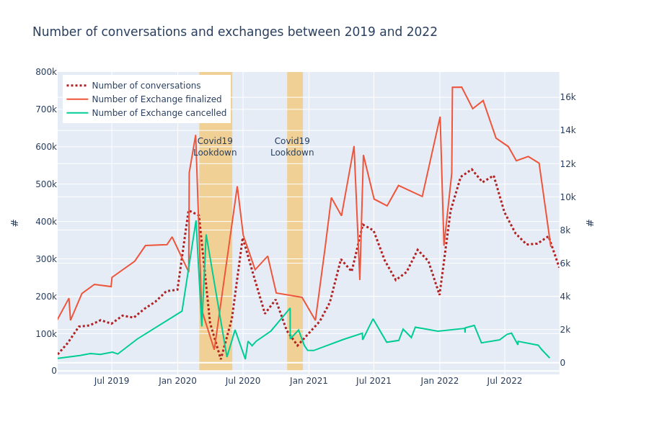
Timing & COVID
~ 1.5 times more subscriptions in June 2021 compared to June 2019
~ 3 times more exchanges finalized in June 2021 compared to June 2019
Notes:
People travel more, that means that those users should be happier with the solution and could be the best ambassador for Home Exchange. It could be interesting to increase reward for users that recommended the solution to friends..

Slide 6
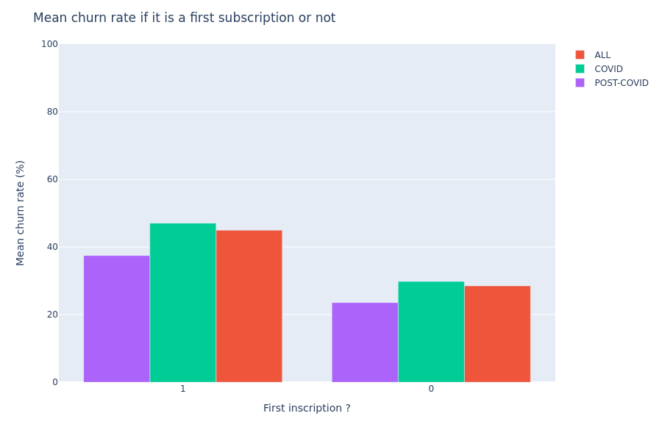
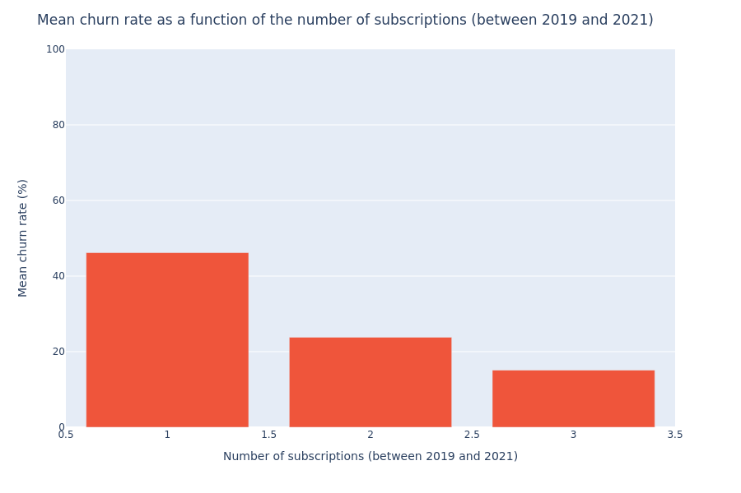
Number of subscriptions
2+

Slide 7
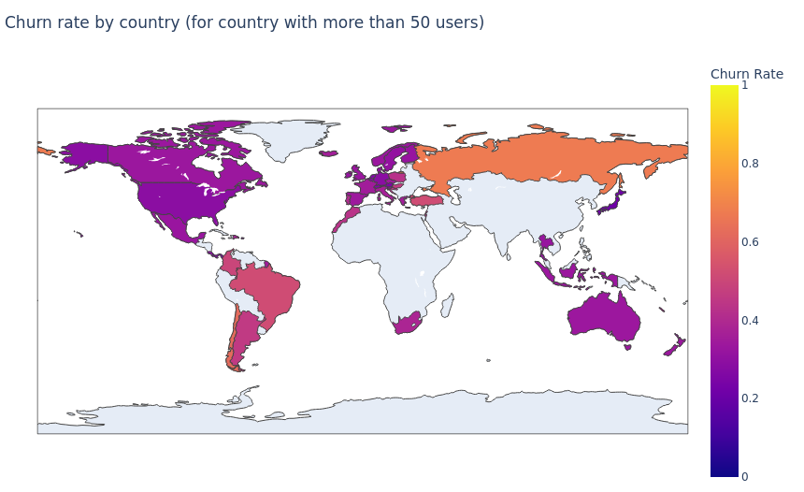
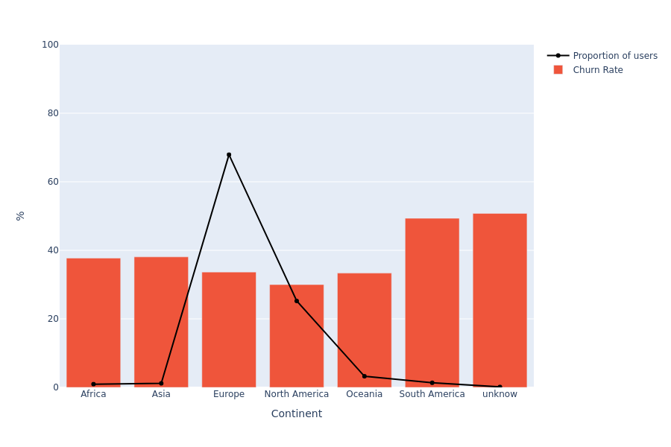
Localization of the user
North American users show a smaller churn rate that European

Slide 8
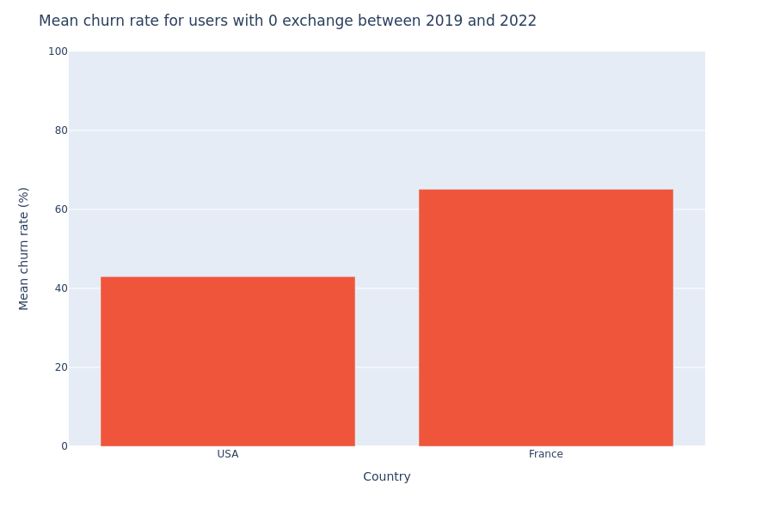
Localization of the user
The re-subscription rate among non-users of Home Exchange is higher for USA’s users compared to French users.

Slide 9
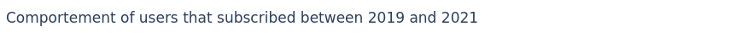
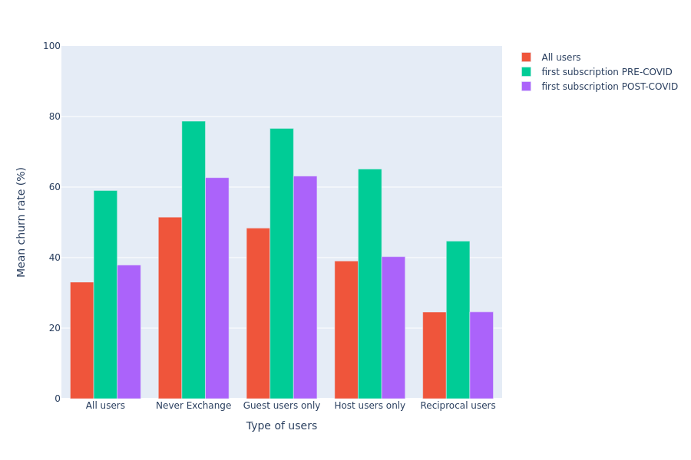

Type of users
Notes:
The use of Guest Point (guest only) does not allow to convince users to stay another year especially for first subscriber (even after COVID).
On the other hand, if users do exchange their houses, even for a first subscription, they have a much smaller churn rate!
This is the solution that is working !
Users that never exchanges and did less than 12 conversations have a largest churn rate than those who did more than 12 conversations. That behavior indicated that the churner are those who do not try a lot to find an exchange.
Maybye HomeExchange could try to motivate them with some e-mail or recommendation (for example improve quality of house picture or description, alert when users city is on the top research on the web site etc...)

Slide 10
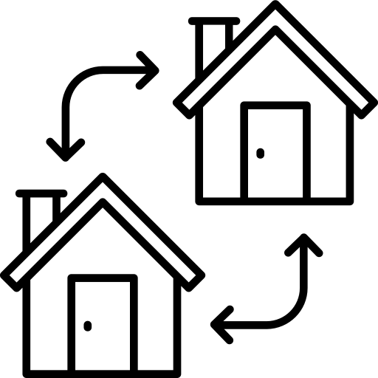
RECOMMENDATIONS
Enhancing Reciprocal Exchanges:
Encourage reciprocal exchanges by offering advantages or exclusive features to users participating in such exchanges.
Increase the visibility of reciprocal users by adding a badge to their profiles, attracting attention from new subscribers.

Slide 11

RECOMMENDATIONS
Identify highly active users to serve as ambassadors :
Enhance user profiles by including social media information.
Utilize ambassadors to promote the platform and engage with the community.
Recognize and reward users who successfully refer a significant number of new users.

Slide 12

RECOMMENDATIONS
Motivating Users with Limited Engagement:
Identify users with a small number of conversations or exchanges.
Reach out to them via email, providing tips and recommendations to help them find exchanges.
Suggestions may include improving the quality of house pictures or descriptions, receiving alerts when their city is highly searched on the website, and more.

Slide 13


RECOMMENDATIONS
Surveying Non-Exchanging Users:
If a user's subscription is nearly expired and they have not engaged in any exchanges, conduct a survey to understand their reasons.
Analyze the collected data to gain insights into the challenges faced by users in finding suitable exchanges and determine potential areas for improvement.

Slide 14

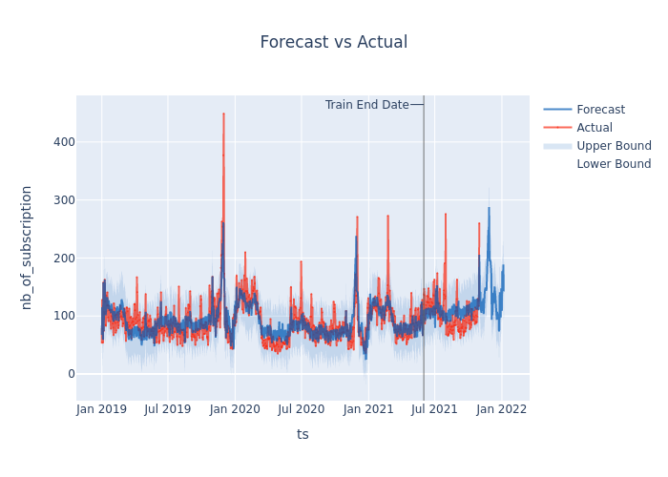
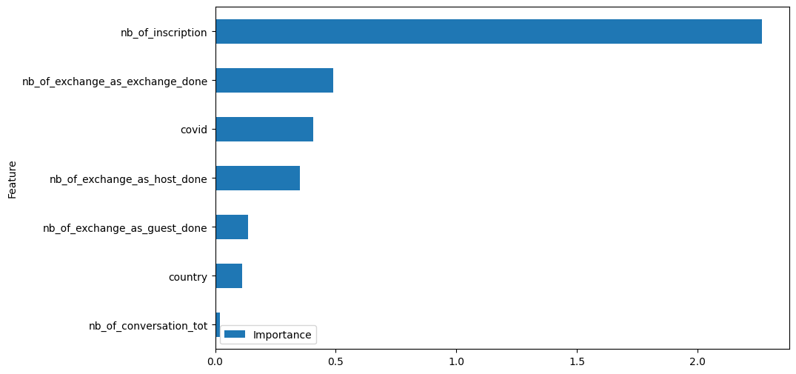
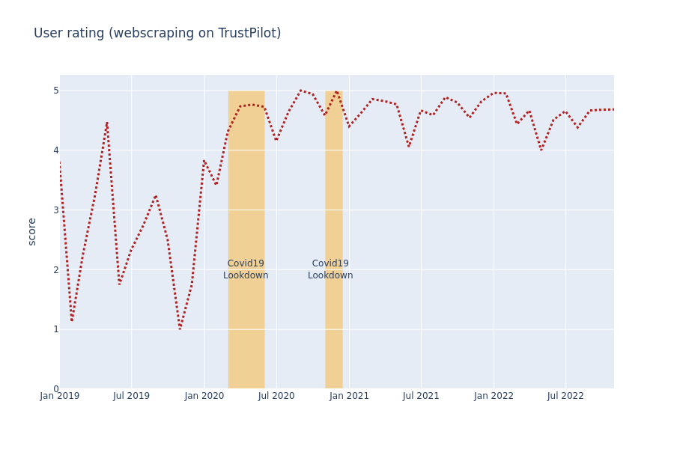
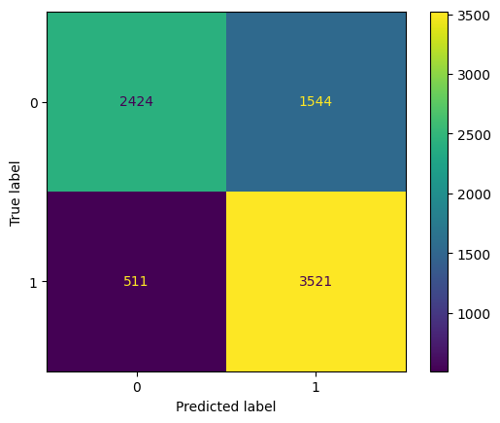
More to see on GitHub
https://github.com/ctherreau/HomeExchange
More parameters analysis
Statistical tests
Prediction of which users are highly likely to become churners
Prediction of the number of subscription for the following months

Slide 15
Demo Day #Batch 1203 Chloé Therreau
Thank you

