Slide 1
Embedded Audio Mixer
Chris Thomas
ECE 554 – Embedded Systems
Summer 2011
University of Michigan – Dearborn
2011/07/20

Slide 2
Contents
Introduction
Project Design
Results
Comparison
Demo
Conclusion

Slide 3
Introduction
Project Rationale:
  Implement multi-channel mixing of audio on an embedded device
  Use standard wireless connectivity to transmit data (WiFi versus a proprietary protocol)
  Offer good mixing performance with low system resource necessities
Project Outcome:
  ARM-based solution running embedded Linux with WiFi capable streaming and mixing

Slide 4
Contents
Introduction
Project Design
Results
Comparison
Demo
Conclusion

Slide 5
Project Design
Basic System Requirements:
  Allow for client connections that can stream data to the system
  Actively mix the content from the client streams into an output channel that is mixed in a manner that is nearly imperceptible to the human ear as digitally mixed
  Allow for wireless transmission of the data between client and server

Slide 6
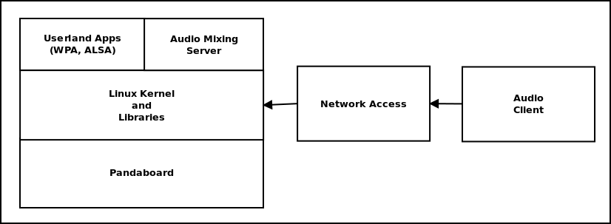
Project Design
High-Level System Architecture
Mixer/Client resides alongside linux running
on an ARM-based embedded target

Slide 7
Project Design
System operates on a PandaBoard with Linux
  Dual ARM Cortex A9's + TI DSP
  OMAP-compatible Ubuntu Linux Operating System
Two main facets to the system
  Audio Mixing Server: runs on the embedded device and handles client connections
  Audio Client: sends a stream of audio data to the device given an audio file and destination IP address and port

Slide 8
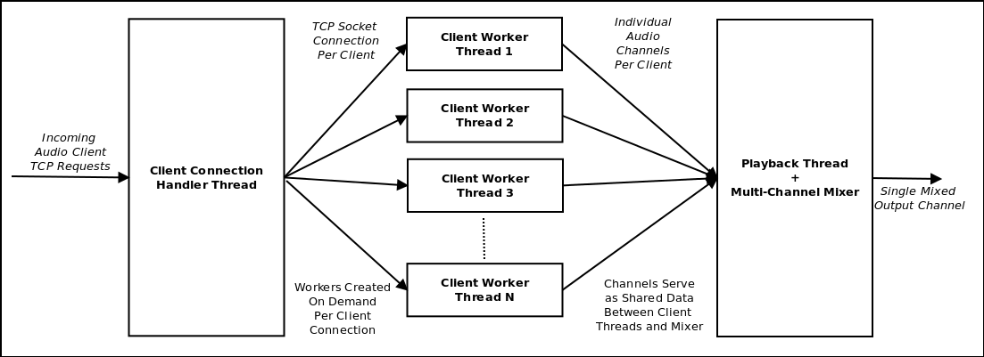
Project Design
Mixing Server

Slide 9
Project Design
Mixing Server:
  Multi-Threaded application that accepts connections from clients and actively mixes audio data from multiple clients into a single stream
  Utilizes shared data areas with mutexes and conditions to allow for sharing of data across threads
  Mixes only as much data as necessary to not starve the playback thread in order to minimize the amount of resources necessary to manage multiple streams of data

Slide 10
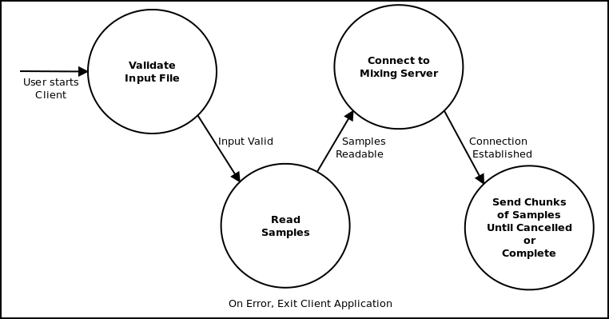
Project Design
Audio Client

Slide 11
Project Design
Client
  Opens a specified wav file and breaks it into multiple data blobs
  Utilizes TCP sockets to connect to a specified host and port and transmit blobs
  Expandable to allow for pre-processing of the audio data before transmission

Slide 12
Contents
Introduction
Project Design
Results
Comparison
Demo
Conclusion

Slide 13
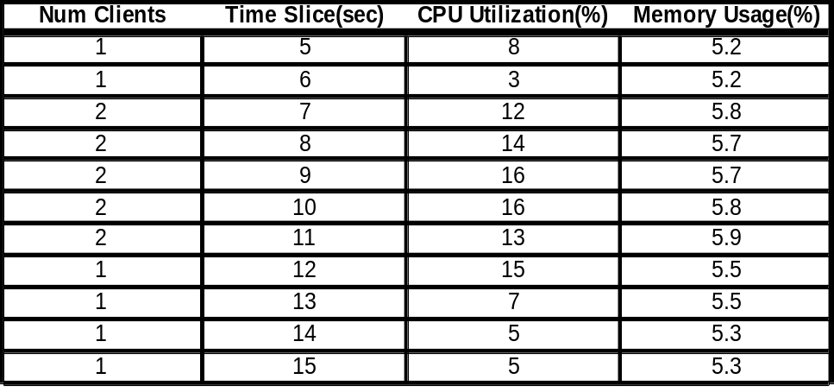
Results
System Performance
  The mixing server, over the course of many run-time tests, was minimally utilizing the hardware resources of the system in terms of processing cycles
  As with most wireless applications, the system is I/O bound on the wireless client connections

Slide 14
Results
Subjective Performance
  When the WiFi connectivity is having a high error rate, the observer can perceive imperfections in the output stream in the form of artifacts and discontinuities
  When the mixed streams mix down to an amplitude greater than the 16-bit bit-depth of the audio data, their is some clipping taking place that can be heard as artifacts

Slide 15
Results
Future Improvements
  Use target hardware that is better suited to this application(ie less powerful processor, utilize DSP, etc)
  Buffer more data before a stream is included in mixing to reduce perceptible artifacts
  Let the 16-bit client streams be mixed into a 32-bit output stream in order to avoid clipping

Slide 16
Contents
Introduction
Project Design
Results
Comparison
Demo
Conclusion

Slide 17
Comparison
Other systems similar to this:
  Sonos wireless audio systems
    Allows for single-client streaming of audio
    Proprietary transmission protocol (not WiFi)
  Apple Airplay
    Allows for streams to Apple devices (AppleTV, Airport Express)
    Couple many other features with audio streaming such as a wireless access point or set-top-box
  None allow multiple streams and active mixing

Slide 18
Contents
Introduction
Project Design
Results
Comparison
Demo
Conclusion

Slide 19
Demo
Please play the file, ECE554_Demo.mp4, which was submitted to VLT

Slide 20
Conclusion
A viable system was developed using an ARM development board and an open-source software based framework
With additional work, this could function as a portable PA system or the like
Gained much knowledge in this implementation about multi-threading, synchronization and performance trade-offs with embedded targets

Slide 21
Thank You!
Questions?
Contact: chrtho@umd.umich.edu for Answers!

