Slide 1

Laravel 4
Hand-Crafted Artisinal PHP, for web Artisans.

Slide 2
What is Laravel?!
“Laravel is a web application framework with expressive, elegant syntax. We believe development must be an enjoyable, creative experience to be truly fulfilling. Laravel attempts to take the pain out of development by easing common tasks used in the majority of web projects, such as authentication, routing, sessions, and caching.”
Awesome marketing lingo.

Slide 3
What is Laravel Really?!
Laravel is an MVC framework with an emphasis on elegant syntax, modular construction, and easy routing.
A good portion of its components are composer packages.
It uses Symfony 2 components as its kernel.
HttpKernel
Console
EventDispatcher
Routing
And More - http://symfony.com/projects/laravel
Has a strong and enthusiastic community.
Baked in IoC container for unit testing.

Slide 4
Some Server Requirements
PHP >= 5.4.0
Thank the gods, we need 5.3 to die.
I’d advise going straight to 5.5
The PHP mcrypt library.
You *might* need to install the php5-json package manually on ubuntu if you’re using 5.5 or higher.

Slide 5
Great, how do I get started?
Quickstart guide here: http://laravel.com/docs/quick
Get the installer composer package, and ensure that composer’s vendor directory is in your path
After that, you can just do `laravel new $projectname` to create a new project directory wherever you specify.
You can also do this without the installer via composer:

Slide 6
Building a Markdown Parser
Let’s do some Laravel-by-example. We’re going to build out a simple pastebin-like solution with a Markdown parser.
We’ll cover Routing, Controllers, Views, Database Migrations, and Using External composer packages.
Slight Plug: I did all of this originally in cloud 9 IDE : https://c9.io/

Slide 7
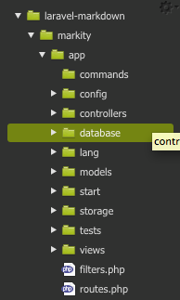
Create The Project
composer create-project laravel/laravel markity --prefer-dist
This generates all of the laravel core framework code in our markity directory
This shows the app directory. We’ll want to pay special attention to the controllers, database, config, models, and views directories to get started.

Slide 8
Test out your dev server
PHP 5.4 has a nifty built in development server (php –S) which laravel can run with a simple `php artisan serve`.
You should see a static homepage from the default laravel install. That’s how you know the sauce is working.

Slide 9
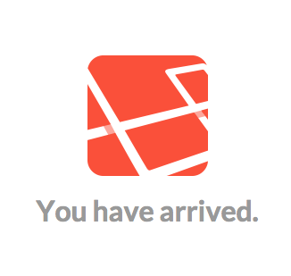

Slide 10
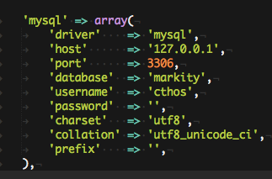
Configure the local DB
Application configuration is based in app/config (for generics and defaults), and app/config/{$env} (for environment specific information).
We’ll want to config the local env’s database.php file to include the configuration for a locally running database, like so:

Slide 11
Configure the local DB (cont)
The previous stanza is in the ‘connections’ section of the configuration array.
This connection will only apply to the local environment. You can define global database connections in app/config/databases.php, but I recommend keeping them in their environment directories.
A note about config files:
They are all just php arrays which are being returned from the scope file and as such are assigned with “require” or “include” statements.

Slide 12

Configure The Local Env
Laravel has a magical method for determining what environment you’re on based on the server’s host name. As such you might need to configure it in app/bootstrap/start.php
The method is $app->detectEnvironment, and there should already be a stub for the local environment.

Slide 13

Wire up a route!
Routes are defined in the application’s app/routes.php file.
There are several static methods you can use to define routes.
::get and ::resource being common.
http://laravel.com/docs/routing
Routes can be directed to controller methods, or they can be closures. Here’s a simple closure example:
The output from this is simply the string printed to the screen, as if you had echoed it.

Slide 14

Controllers: Betterness for all
Controllers hold the logic that will be sent to the view in order to render content to a page (or provide service output).
Laravel has the concept of RESTful controllers, as well as being able to tie those to a model for a “Resource” controller.
There’s a handy generator in the artisan script to handle this:
It also has --only and --except flags which can exclude various methods from the controller
Or you can delete them yourself, doesn’t really matter.

Slide 15


Creating the Note controller
Create the controller:
Wire it up to a route:
Stub out the create method:

Slide 16
Creating a view for “create”
Views are generally stored in the form app/views/{resourcename}/{action}.blade.php (or just .php)
Laravel knows whether or not to expect blade syntax based on this file extension.
So, we’ll start off by creating the folder for notes: app/views/notes, and then inside of that make create.blade.php

Slide 17
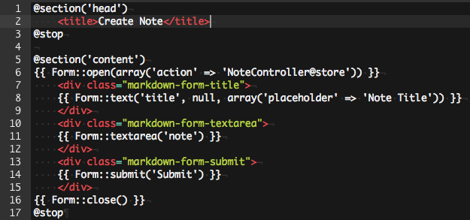
Contents of the “create” view

Slide 18
Blade template engine
http://laravel.com/docs/4.2/templates#blade-templating
Blade is an extensible templating language for Laravel, full of magic and glory.
Actually it’s pretty similar to most other templating languages.
Basics
{{{ $variable }}} – Echo, but escape first
{{ $variable }} – Echo without escaping
@if, @elseif, @else, @endif – If control blocks
@foreach, @endforeach; @for, @endfor;
@forelse and @empty – foreach else empty == awesomeness
@yield – display sub-template contents.

Slide 19
Form Helper
Laravel has a nifty Form helper which can help generate form markup.
Form::open opens the form and generates a CSRF token and automatically injects it into the form.
You can also bind its action to a controller route, which is what’s going on in that array('action' => 'NoteController@store') section
Form::text – Standard <input> element
Form::textarea - <textarea>
Form::submit – Submit button

Slide 20
Layouts
Another nifty feature of Laravel’s view system is the ability to have an over-arching layout (or sub-layout) for a given controller.
These can either be handled in php or via blade.
For this application, let’s take advantage of blade’s layout capabilities
Layouts are stored in app/views/layouts.
I’ve created a base.blade.php layout for us to work off of (containing basic wrapper html).

Slide 21
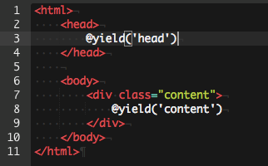
Base.blade.php

Slide 22
Yeah, not so much going on…
It’s a pretty basic layout. It only contains the basic tags we need to have a valid HTML base, and then provides two @yield blocks for which our sub templates can take over for.
The @yield(‘head’) section is designed for sub templates to be able to pass along extra header tags as necessary
My example is a bit of bad form, since the title should probably be handled by a controller variable, but eh, tomato tomato.
The @yield(‘content’) section is for the actual guts of the view.

Slide 23
Getting content into @yield
So! How the heck do we get the content to show up in the @yield sections?
This is the job for @section and @stop.
The @section(‘name’) syntax defines the given section you’re wanting to operate on.
The @stop directive closes out that section block.
Defining sections that aren’t in the layout will cause those sections to not be rendered at all.
AKA if there’s no @yield block for a corresponding @section block, it’s not going to show up.

Slide 24

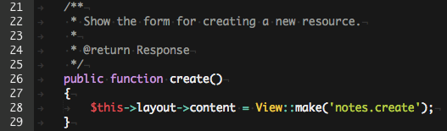
Great, how do I render that?
So, there are a couple of things we need to deal with in the controller.

Slide 25
Whoh, $this->layout?
Okay, that’s part of the view modeling fanciness.
It allows you to define what the layout is going to be.
You can then nest content using $this->layout->content
This tells the renderer to load the layout first, and then you can nest a sub template within it.
If there’s no $layout variable, you can just return View::make

Slide 26
View::make
This is a helper method that allows you to bind parameters to the view, so that you can render them to the page.
To do this, you can pass an array of variables as the second parameter.
It returns an object with various methods for doing this as well.
->with() takes 2 parameters, the variable name and its contents.
->with{$param} uses magic methods to unpack the variable name from the method, and only takes the data as a param.
Best practice is to not send a model directly, but instead to send a static representation of it to the view, that way it can’t be inadvertently saved or whatnot.

Slide 27

Nesting Views
In addition to the layout code demonstrated earlier, views can also be nested within each other.
This is done with the aptly-named “nest” method

Slide 28
View Composers
View composers are a nifty way to bind data to a view every time it is rendered.
You might do this on say a template that renders a user bar to render the user’s username and details when the view is rendered.
Additionally, you can bind the same composer to multiple views at the same time.
Composers have no convention to where they can be stored. So long as your composer.json’s autoloader rules can find them, they’ll be loaded.
View creators are essentially the same thing, but are loaded immediately when the view is instantiated.

Slide 29
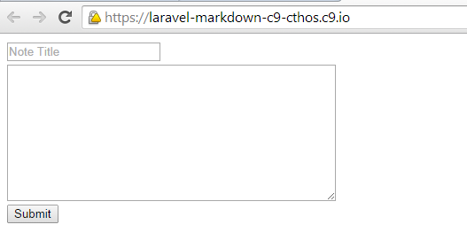
Alright, let’s check out the page

Slide 30
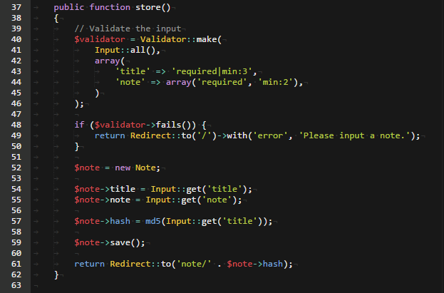
Dealing with note submission
We need to create the ->store method on the NoteController

Slide 31
Input validation
Validation is typically handled by the Validator class.
Validator::make takes 2 parameters, the first being the data to validate, and the second being the rule sets
Input::all() will generally get you what you want out of the post/get data.
The rules structure and list can be found here: http://laravel.com/docs/4.2/validation
Rules can be either pipe-delimited or an array of different rules.
This is demonstrated in the note’s create controls.

Slide 32
Redirects and Flash messages
The Redirect class handles returning various types of redirects.
It also has the ability to pass along flash messages.
These are stored in the session, and thus need to have a valid session store (defaults to phpsession).
You can pass some other parameters to ::to as well, to make the redirect status be a 302 instead of the standard 301
This is only documented in the code.
http://laravel.com/docs/4.2/responses#redirects

Slide 33

Note model
Now it’s time to create something that can store the note data in the database.
We need to make a file in app/models named Note.php
It contains:
Yep. The Eloquent controller uses the ActiveRecord pattern to figure out what parameters it has.

Slide 34
Database Migrations
Database migrations cover the situation where you need to alter the database at some point in time.
They live in app/database/migrations, and can be created with an artisan command
php artisan migrate:make {name of migration}
You may need to php artisan migrate:install to create the database tables where the current position of the database is stored
This is how you can rollback database changes

Slide 35
Note Database Migration
So we’ll create our stub with the following:
php artisan migration:make create_note_table
That will create a file prefixed with the date and time in the migrations folder.
A class is created automatically, with stubs for the up and down methods
These determine what happens during migrate and migrate:rollback

Slide 36
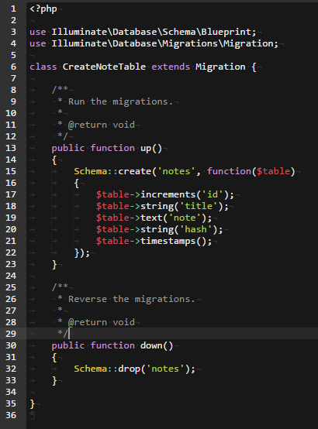
Note migration

Slide 37
Schema Class
This is a helper class which creates database-agnostic code to generate the appropriate tables.
Schema::create takes an anonymous function (or any other callable, really) and passes the $table class to it. On that, you may determine the appropriate columns.
Schema::drop drops the named table. Typically that is all your down method will contain, unless you’re doing alters.
Table alters are handled by Schema::table
You can drop columns, rename them, change the definitions, etc.
http://laravel.com/docs/4.2/schema

Slide 38
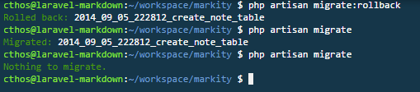
Note migration finished
Note that I do a rollback first, because I’d already run a migration for this previously.

Slide 39
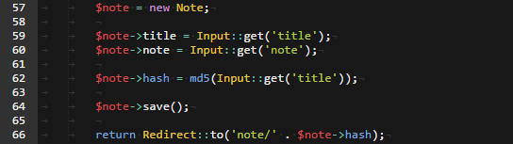
Create action reexamined
Let’s look at the note model creation bit again:
We create a new Note model by instantiating its class.
After that we can attach parameters to it directly.
It also supports mass assignment, but you have to do some extra hoops to make it secure: http://laravel.com/docs/4.2/eloquent#mass-assignment
Finally calling the ->save() method persists the model to the database. (Update if the primary key is assigned, otherwise Insert)

Slide 40
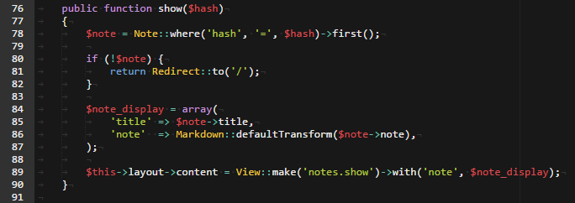
Creating the View Method
The ->show method takes a single parameter (usually the primary key) and can display data based on that.

Slide 41
Examining the Show Method
The first important bit is using the Note model itself to make a query against the database.
Most of the methods return a Fluent Query Builder object and can be used normally.
http://laravel.com/docs/4.2/queries
Second bit is binding the note parameters to an array which is then passed to the view.
Finally, I’m using a composer package to parse the Markdown into HTML. This is particularly important because it requires something special out of the view.

Slide 42
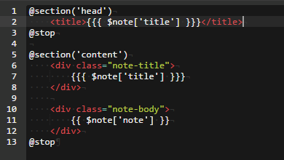
The Show view
The important bit to note here is that the $note[‘note’] renderer has to be
surrounded in {{ }} so that it won’t be escaped before it is rendered. This is
because the markdown processor is handling the conversion to HTML on its own

Slide 43
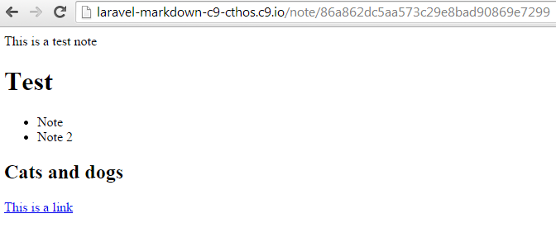
A view of a rendered note

Slide 44

Basics are done!
But this looks a little plain. Let’s handle adding some assets and styling.
Adding bootstrap to the header, loading it from a CDN is a good start.
Using the HTML class to render the proper html is handy, and a good idea most of the time.

Slide 45
Fin!
Questions?
Contacting me:
@cthos
http://alextheward.com
daginus@gmail.com

