Slide 1
Parallel Processing in Python
Weaving your Fate

Slide 2
Alright, what’s parallel processing?
“Parallel processing is the simultaneous use of more than one CPU or processor core to execute a program or multiple computational threads.”
Generally this can speed up the application because it can process multiple things at the same time.
In GUI applications, the GUI should be on one thread, while any tasks that could take a while should be done in another, so that the user interface does not hang. (Android is very explicit about this point, for example)

Slide 3
Why Python?
Python is awesome.
It has a bunch of different high and low level interfaces that we can play with in order to demonstrate various methods of parallel processing.
Easy to grok even if you’re not a Pythonista.
We’re at the first ever OKCPython meeting. WOOOO!

Slide 4
What are we going to cover?
Threading module
Multiprocessing module
Lower-level system operations. os.fork included.
All of this is Python 2.7
Just cause.

Slide 5
What we’re not going to cover
Mutexes. They’re deprecated as of 2.6 and have been removed as of Python 3
Semaphores
They’re like mutexes, but have an internal counter so you can say more than one thread can acquire the same one at a time.

Slide 6
Go go gadget threading
This is a high level wrapper around the lower-level thread module.
Due to historical madness, all of the methods on Thread are underscore delimited.
As of Python 2.6 there are also camelCased methods to comply with PEP 8.
All threads share the same memory space.
Threading is also subject to the CPython limitation around the GIL
We’ll get to that in a minute.

Slide 7
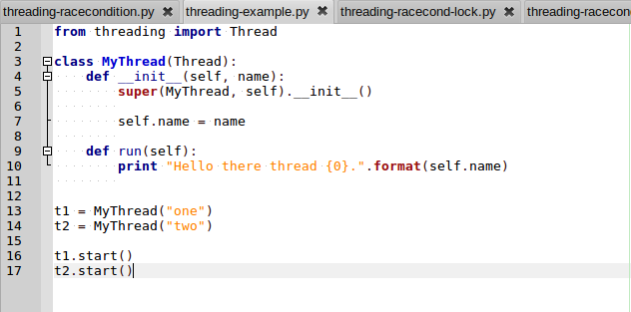
Diving right in – Code Example 1

Slide 8
Well that was boring.
Yep, all we’re doing back there is creating two threads, and having them print something.
Each execution, thread 1 or thread 2 might print its message first. Just depends on which thread gets access to the CPU first.

Slide 9
Race conditions are awesome
Let’s talk about race conditions for a bit.
Race conditions happen when more than one thread tries to access shared memory at the same time.
Weird things will definitely happen. So we’re going to make that happen.

Slide 10
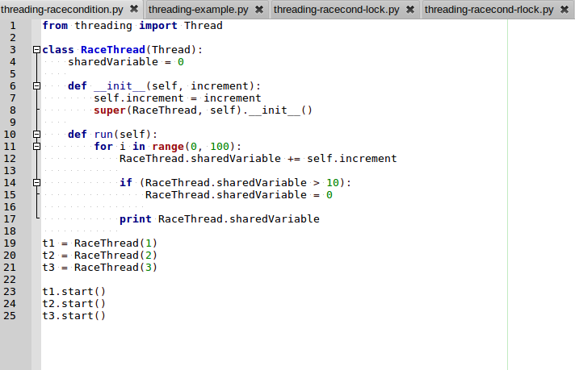
Do something better - Example 2

Slide 11
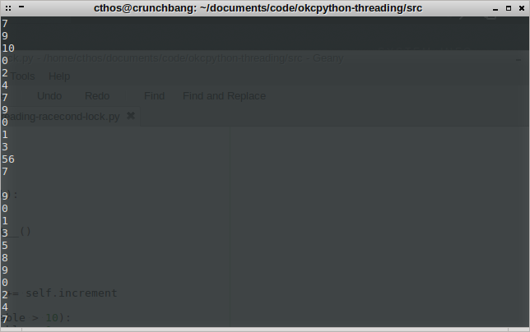
Output of race condition

Slide 12
What the heck happened?
We’ve got a bunch of weirdness happening in that screenshot
For one, we have one line that printed “54”, which is probably 2 threads trying to output at the same time (after the second thread had incremented the shared variable).
For two, we have a blank line after the 7
Why? I dunno, probably something borked with the memory when it was trying to increment or print.

Slide 13
Preventing Race conditions with Lock
There are a couple of ways we can deal with Race conditions. The first way we can deal with it is by acquiring a lock.
This is a shared variable which on a call to Lock.acquire() will block until a given thread is able to acquire a lock.
That’ll prevent the thread from doing any work until it can be sure it has exclusive access to whatever shared memory space it needs.

Slide 14
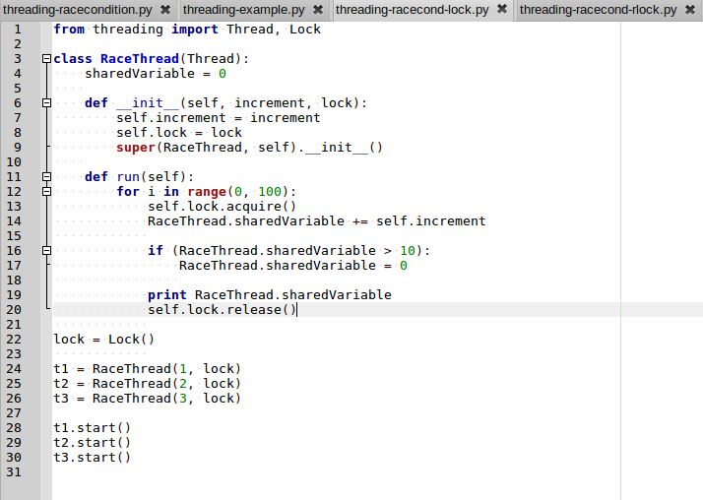
Locking! – Example 3

Slide 15
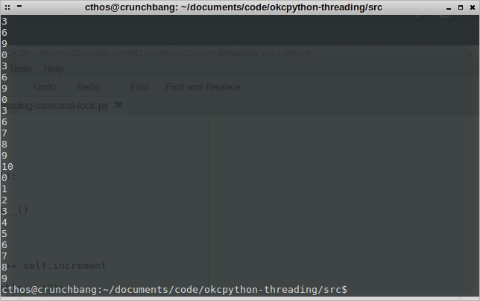
Output with locking

Slide 16
Much better!
As you can see in the output, we don’t have any more crazy memory anomalies.
There’s no guarantee which thread is going to acquire the lock at any given time, so you’ll note that there are several places where the same increment number happens in a row.

Slide 17
Re-entrant locks?
Put simply, a Re-entrant lock is a lock that a single thread can acquire more than once.
If no threads have acquired the RLock, that thread gains ownership of the RLock.
Afterwards, the same thread may re-acquire the RLock without the acquire() call blocking.
You have to release the lock the same number of times that you acquired it, otherwise no other thread can acquire it.
It does this with an internal recursion counter.

Slide 18
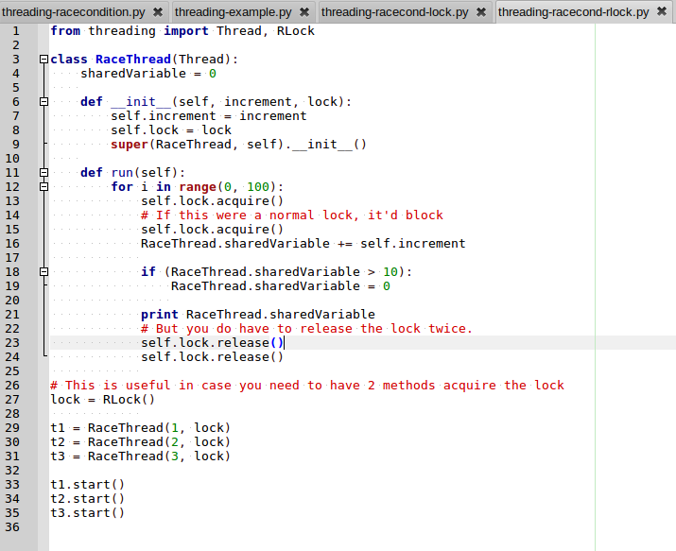
RLock – Example 4

Slide 19
What the heck, that was useless.
Okay, okay, that was a contrived example. Let’s try something a bit more useful.

Slide 20
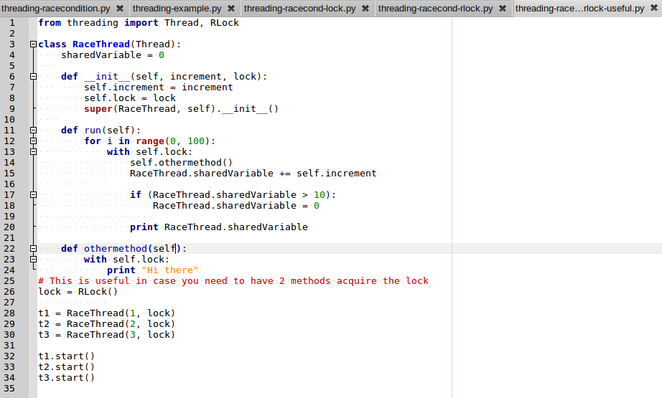
A Useful RLock – Example 5

Slide 21
That’s more like it!
Okay, that’s more like it.
We need to acquire a lock in more than one method (which may or may not get called), so we can do that without worrying about whether or not the lock has been acquired before doing processing.
This also makes use of the ‘with’ statement. That’ll acquire the lock at the beginning and automatically release it at the end.

Slide 22
Rock on, my application is fast now!
Not so fast, speed racer.
If you benchmark these examples, you’ll find that speed will actually not increase, and might even have a slight increase due to the overhead of creating the threads.
Why?!
There’s something called the GIL which I glossed over earlier.
Let’s talk about that now.

Slide 23
GIL – Global Interpreter Lock
The Global Interpreter Lock is something that is implemented in CPython (the default version of the interpreter you’re using when you type `python` on the command line) that prevents multiple threads from executing bytecode at the same time.
This prevents multiple threads from messing up Python’s memory management, because it isn’t thread safe.
That doesn’t protect you from race conditions, because it is only shields a single bytecode at a time. If an instruction takes more than one, well you’re in trouble.
So it’s not really doing 2 things at once?
Nope. Not really.

Slide 24
Multiprocessing
Multiprocessing is a module that supports spawning processes, similarly to threading, but with some important differences.
Processes created with multiprocessing do not share the same memory space, and thus cannot interact with each other directly.
It creates subprocesses to do its dirty work, so it doesn’t have to worry about the GIL.
Yep, we can actually process multiple things at the same time.

Slide 25
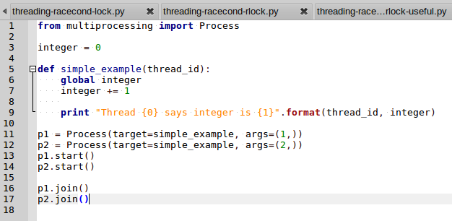
Multiprocessing – Example 5

Slide 26
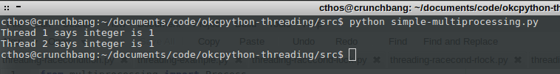
Multiprocessing output

Slide 27
What happened there?
This just shows that processes created by multiprocessing don’t share memory state.
They inherit the state of the parent process’s memory when they split off from it, but past that they do not share memory state.

Slide 28
So, uh, how can they talk to each other?
Glad you asked!
Multiprocessing comes with a couple of objects to help facilitate communication.
Queues are basically what you’d expect. You push stuff into a stack, and you pop stuff off of said stack. (Internally it uses a pipe and a few locks/semaphores to do its thread-safe madness)
Pipes open up between processes and allow for the sending of communications back and forth.
Value and Array can live in shared memory space.

Slide 29
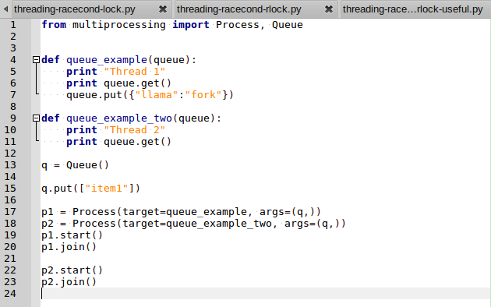
Multiprocess Queue – Example 6

Slide 30
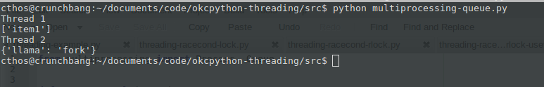
Queue Output

Slide 31
Queue?!
So you can push any python object into a queue (so long as you can pickle it).
Threads share queue. Both from parent to child and among children.

Slide 32
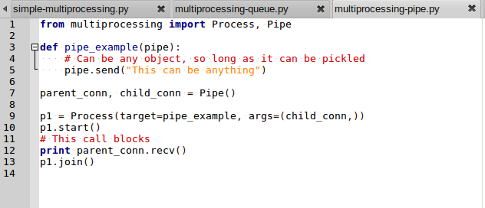
Multiprocessing Pipe – Example 7

Slide 33
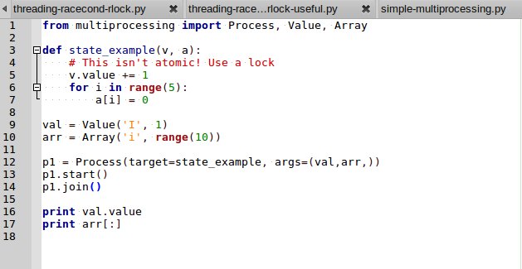
Shared Variables – Example 8

Slide 34

Shared Variable Output

Slide 35
Something something parent process
In that previous example, I didn’t have 2 child processes talking to one another, but instead the child process sharing variable state with its parent.

Slide 36
Let’s get lower level
Now we’re going to interact with the OS functions directly.
os.fork() spawns child processes much like the multiprocessing module.
It does not, however, have nice methods for dealing with child process management. You have to do that yourself.

Slide 37
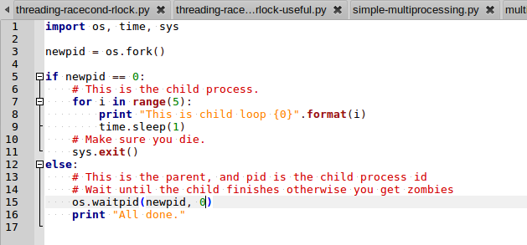
os.fork – Example 10

Slide 38
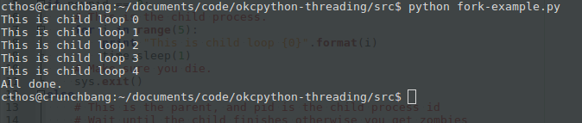
os.fork output

Slide 39
What just happened there?
os.fork has 2 possible return types. If you get a 0 back, you’re in the child process. If you get any other integer back, you’re in the parent, and that integer is the process id of the child.
Later, you can use os.waitpid() in order to watch for the child process to exit.
This is important. If you don’t pay attention to the child process’s death, you can easily wind up with a zombie process.
It desires brains, so you need to reap it to ensure it doesn’t hang around longer than it should.
Be very very careful not to fork-bomb the server you’re on. It’s pretty easy to do if you aren’t careful.

Slide 40
Questions?
http://alextheward.com
@cthos
http://github.com/cthos
All the source for this presentation can be found at https://github.com/cthos/okcpython-threading

