Slide 1
♪
GigTrack
A live-music discovery, ticketing and memory companion
INF2003 Database Systems, Final Presentation
Group GXX Member 1 (lead) · Member 2 · Member 3 · Member 4 · Member 5 · Member 6
[ Replace GXX and names; put each presenter's name and SIT email on their slides. ]
Notes:
Under 10 minutes, all 6 members present, real voices.
Each member has 2+ slides: how it works, then why we chose it (with a performance graph).
Member F runs one live demo of everything, then shows the results and pros.

Slide 2
Run of show
Speaker
Covers
A
Member A
Background, the problem, and the four-store stack
2 slides
B
Member B
The datasets and the data model (ER)
2 slides
C
Member C
Relational database (MySQL): how it works, and why
2 slides
D
Member D
Documents and media (MongoDB, MinIO): how, and why
2 slides
E
Member E
Speed, sessions, security (Redis): how, and why
2 slides
F
Member F
One live demo of everything, then the results
3 slides
Every database part explains how it works, then why we chose it with the speed numbers. One live demo shows it all.
Notes:
Pre-recording: docker compose up, app on http://localhost:5001 with images.
Terminals ready for the demo: mysql, mongosh, redis-cli (MONITOR), MinIO console.
Keep each explainer tight so the live demo has room. Stay under 10:00.

Slide 3
1
Background and the problem
Member A
Fans use a dozen apps to find gigs, lose their tickets, and forget the setlist.
GigTrack is one home for the whole journey: discover, book, and remember.
Two kinds of user: customers who browse and book, and admins who run the catalogue.
Goal: build a real product on a sensible mix of databases, and back every choice with numbers.
1. Discover
browse and filter gigs by city, genre and date
▼
2. Book
buy tickets safely, up to six per show
▼
3. Remember
setlists, reviews and photos after the show
[ Member A - Full Name - name@sit.singaporetech.edu.sg ]
Notes:
Sell it as a product. Hook: fans juggle apps, lose tickets, forget setlists.
Value: one home for the journey. Two roles: customers and admins.
Set up the next slide: the journey needs different kinds of data, so we use four stores.

Slide 4
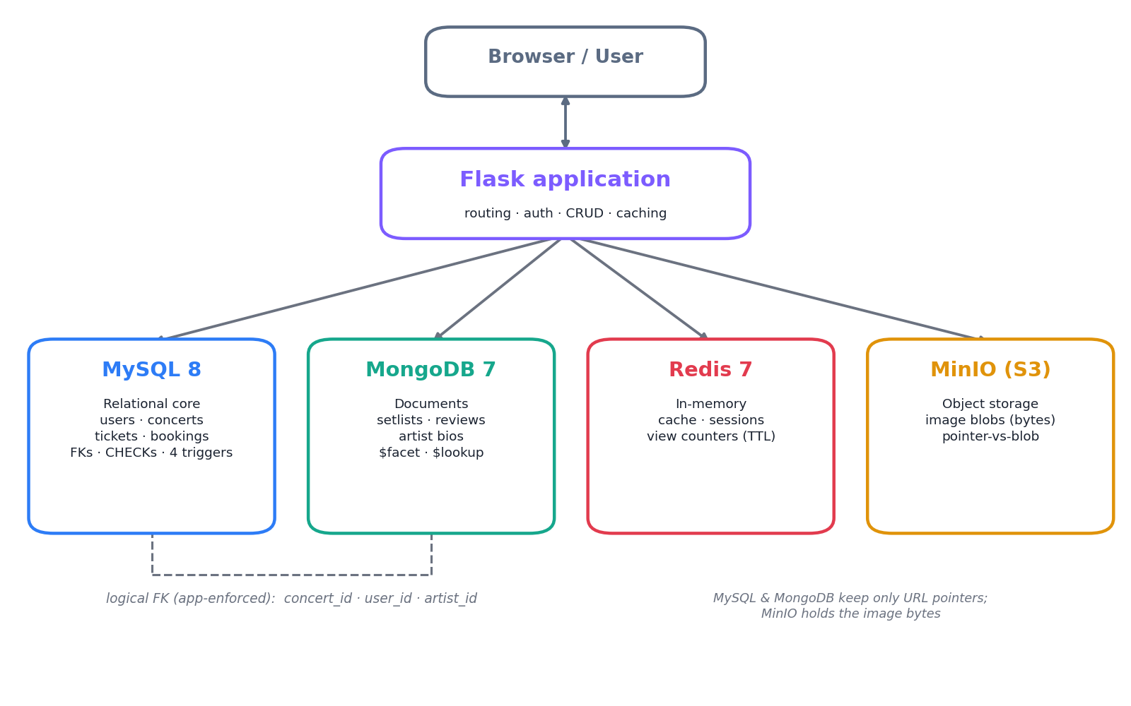
2
The four-store stack
Member A
Each kind of data goes to the store that handles it best, instead of forcing one database to do everything.
The app ties them together and keeps them consistent.
MySQL for the core records, MongoDB for flexible content, Redis for speed, MinIO for image files.
This 'polyglot' approach is a standard pattern in real systems, and each store can scale on its own.
Four datastores, connected through the app.
[ Member A - Full Name - name@sit.singaporetech.edu.sg ]
Notes:
Point at the picture: the app talks to four stores, each chosen for a reason.
Name the reason for each in one line; the next speakers go deeper.
Mention 'polyglot persistence' is normal in industry; each store scales independently. Hand to B.

Slide 5
3
The data and datasets
Member B
A realistic catalogue, generated to a fixed recipe so everyone gets the exact same data.
It already respects the rules: no oversold seats, VIP pricing, and the six-ticket limit.
Real artist photos are stored as files, with only a link kept in the database.
Easy to swap in a real public dataset later (Kaggle, Setlist.fm, data.gov.sg) through the same pipeline.
21
50
users
concerts
116
220
ticket tiers
reviews
[ Member B - Full Name - name@sit.singaporetech.edu.sg ]
Notes:
Synthetic but realistic and rule-respecting; deterministic so markers reseed identical data.
Also: 30 artists, 15 venues, ~176 bookings, 220 follows, ~25 setlists, 30 bios.
Set up the model on the next slide. Hand within B.

Slide 6
4
How the data is modelled
Member B
Three kinds of link: one-to-many (a venue has many concerts), many-to-many (line-ups and follows), and a link from the document side back to the main records.
A mix of data types: text, whole numbers, money, dates, and yes/no flags.
The tables are normalised, so each fact is stored once with no duplication.
The document side references the main records by id, kept consistent by the app.
▢ FLOW CHART
ER diagram (docs/er_diagram.mermaid)
Export er_diagram.mermaid at mermaid.live, paste the picture here.
[ Member B - Full Name - name@sit.singaporetech.edu.sg ]
Notes:
Walk the ER diagram: show the one-to-many, the two many-to-many junctions, and the link to documents.
Note 3NF normalisation and the data-type variety the brief asks for. Hand to C.

Slide 7
5
Relational database (MySQL): how it works
Member C
8 tables hold the core facts: users, artists, venues, concerts, tickets, bookings, follows and line-ups.
The database enforces the rules itself: foreign keys, value checks, and 4 triggers.
Seats can never be oversold, and a VIP tier can never be cheaper than a normal one.
Buying is safe even if two people click at once: the check and the save happen in one locked step.
Built-in reports, like a revenue ranking per city.
▢ FLOW CHART
Booking and seat trigger (flow_diagrams.md §2)
Export §2 at mermaid.live, paste the flow chart here.
[ Member C - Full Name - name@sit.singaporetech.edu.sg ]
Notes:
Why relational: bookings and money need strict correctness (ACID).
The triggers are the core integrity guarantee; the seat trigger makes overselling impossible.
The flow chart shows the booking path: quota check + insert + trigger in one transaction. Why-slide next.

Slide 8
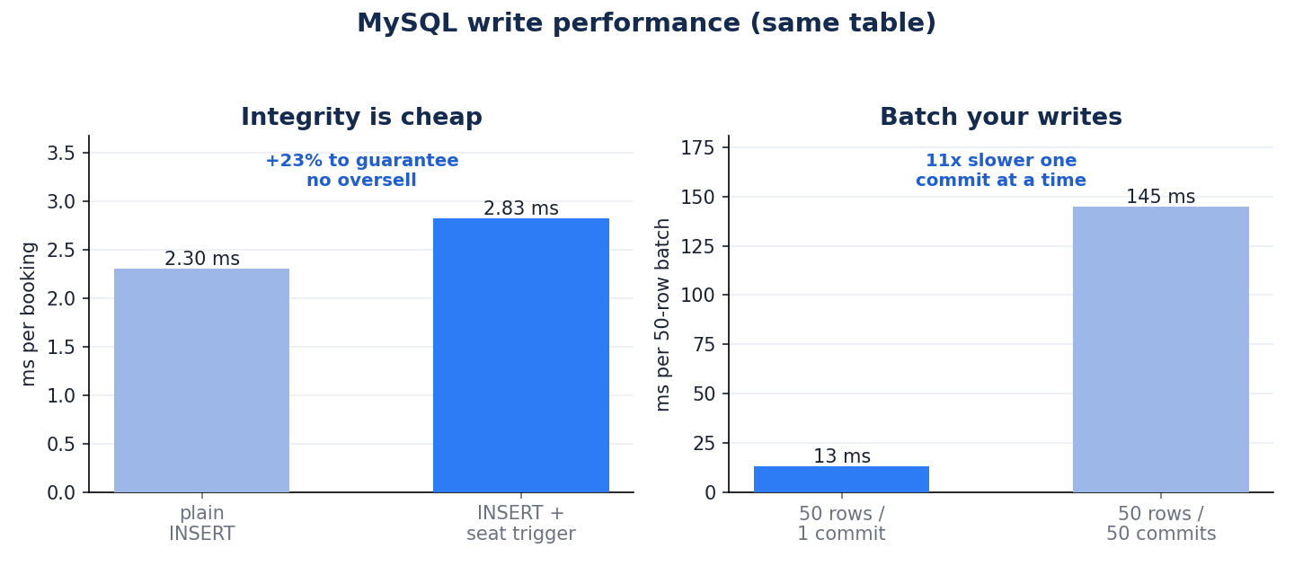
6
Why MySQL
Member C
✓ Rock-solid for money and inventory (ACID transactions).
✓ Business rules live in the database itself (triggers and checks).
✓ Stays correct even when many people book at once.
In a real production deployment
Runs as a primary with read replicas, so reads scale out and writes stay consistent.
A connection pool removes the per-request connection cost we measured.
Automated backups and point-in-time recovery protect the data.
Integrity adds about 23% per booking; batching writes is about 11x faster.
[ Member C - Full Name - name@sit.singaporetech.edu.sg ]
Notes:
Explain the graph: the seat trigger guarantees no oversell for only ~23% more time per booking.
Right panel: committing in batches is ~11x faster than one commit per row (durability cost).
Production: a connection pool would erase most of the ~8 ms read floor we saw (connect-per-call). Hand to D.

Slide 9
7
Documents and media (MongoDB, MinIO): how it works
Member D
Reviews and setlists vary a lot (tags, photos, 10 to 40 songs), so we store them as flexible documents with no empty columns.
Likes are stored as a set, so liking twice still counts once.
Photos: the picture file lives in storage (MinIO); the database keeps only a link.
Built-in analytics: a ratings dashboard and a join, done inside the database.
▢ FLOW CHART
Review with photo: pointer vs blob (flow_diagrams.md §3)
Export §3 at mermaid.live, paste the flow chart here.
[ Member D - Full Name - name@sit.singaporetech.edu.sg ]
Notes:
Why documents: variable shape would need many sparse tables and joins in SQL; a document is read as one unit.
Why object storage: documents have a 16 MB cap and image bytes bloat backups; storage is built for blobs.
The flow chart shows bytes going to MinIO while the database keeps the pointer. Why-slide next.

Slide 10
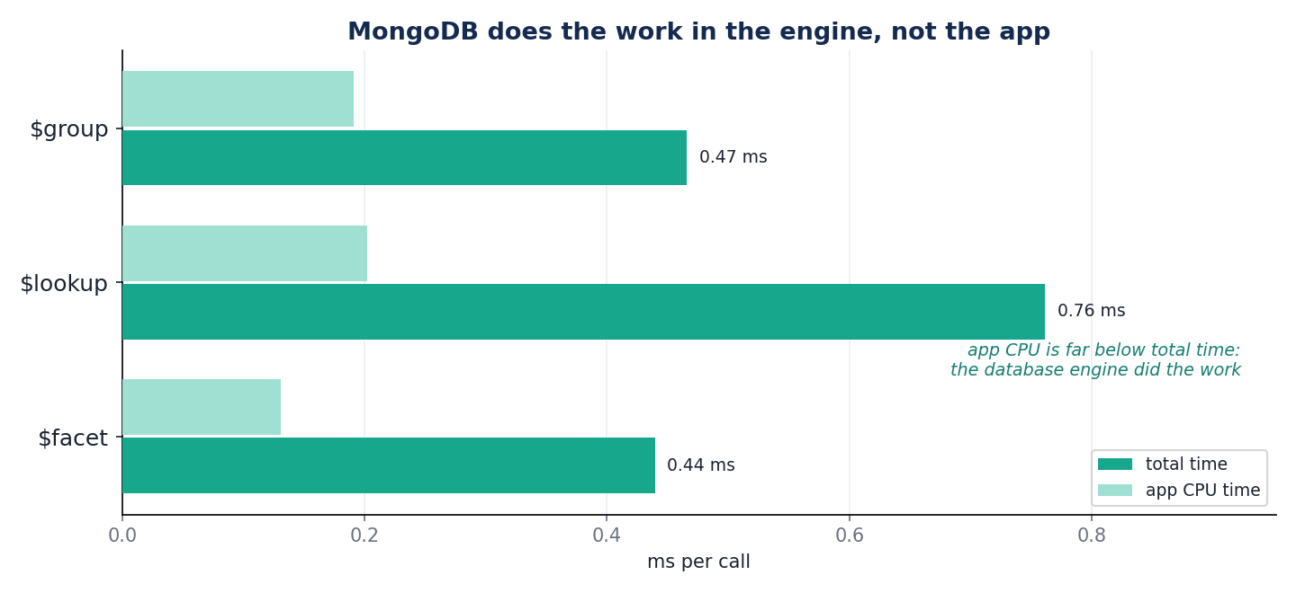
8
Why MongoDB and MinIO
Member D
✓ Flexible shape for reviews and setlists, with no empty columns.
✓ Analytics (dashboards, joins) run inside the database.
✓ Image files never bloat the database; object storage is built for them.
In a real production deployment
MongoDB runs as a replica set for high availability, and shards to scale out.
Object storage scales without limit and is served through a CDN.
Swap MinIO for AWS S3 or Cloudflare R2 by changing only the endpoint.
Aggregations run server-side in about half a millisecond.
[ Member D - Full Name - name@sit.singaporetech.edu.sg ]
Notes:
Explain the graph: the app's own CPU time is far below the total time, so the database engine did the work.
That means analytics scale with the database, not the app process.
Production: replica set for failover, sharding for scale, object storage behind a CDN. Hand to E.

Slide 11
9
Speed, sessions and security (Redis): how it works
Member E
Popular pages are cached, so they load instantly, and the cache refreshes itself.
Login sessions live in memory and expire on their own (auto logout after 30 minutes).
View counts are tallied in memory and saved to the database in the background.
Security in plain terms: passwords are scrambled, forms are protected, cookies are locked down, and admins cannot buy tickets.
▢ FLOW CHART
Browse caching and view counters (flow_diagrams.md §4)
Export §4 at mermaid.live, paste the flow chart here.
[ Member E - Full Name - name@sit.singaporetech.edu.sg ]
Notes:
Why a cache: hot listing pages and sessions belong in memory, not a fresh query each time.
Cache-aside for listings; write-behind for view counts; sessions slide on each request.
Security one line: parameterised SQL, bcrypt, CSRF tokens, hardened cookies, admins can't buy. Why-slide next.

Slide 12
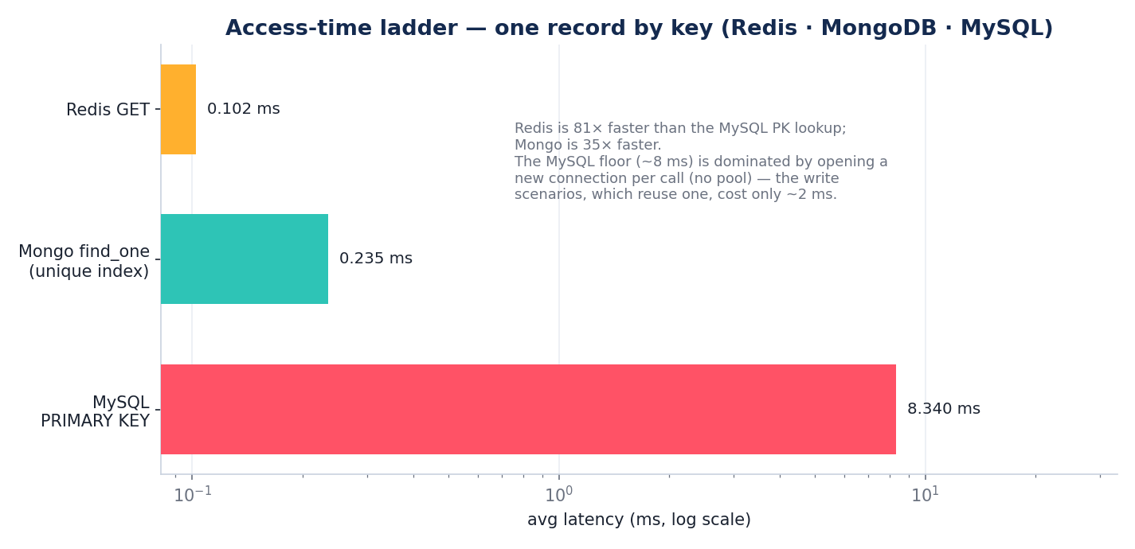
10
Why Redis
Member E
✓ Makes popular pages and logins feel instant.
✓ Takes heavy read load off the database.
✓ Sessions and caches expire on their own (TTLs).
In a real production deployment
Runs as a cluster for high availability and to spread keys across nodes.
Optional persistence (snapshots or an append-log) so data survives restarts.
Memory is capped with eviction; one shared session store across many app servers.
Fetching one item by its key: Redis vs MongoDB vs MySQL.
[ Member E - Full Name - name@sit.singaporetech.edu.sg ]
Notes:
Explain the graph: a key lookup from Redis is about 80x faster than from MySQL; cached pages ~67x faster.
Redis still beats the others per call even under load; it just does not scale with Python threads.
Production: Redis Cluster for HA, persistence for durability, eviction to cap memory. Hand to F for the demo.

Slide 13
● LIVE DEMO
Live demo
The whole app, end to end, on screen.
Everything the last five parts described, working together.
[ Member F - Full Name - name@sit.singaporetech.edu.sg ]
Notes:
Member F drives one screen recording that touches every feature and all four stores.
Keep the four terminals visible so the audience sees the data change live.
Next slide is the run sheet.

Slide 14
Live demo: one run, every feature
Member F
● LIVE DEMO
1
Sign up and log in
A session appears in the cache; the password is stored scrambled, not as text.
4
Review with a photo
The photo is saved to storage; like it twice and it still counts once.
2
Browse and filter
Open the page again and it loads instantly from the cache.
5
Follow and cancel
Follow an artist; cancel a booking and the seat is returned automatically.
3
Book tickets
Try to overbook, or buy more than six: both are blocked on the spot.
6
Admin tools
Create a concert (new act and venue in one go); delete one and its reviews and photos are cleaned up everywhere.
[ Member F - Full Name - name@sit.singaporetech.edu.sg ]
Notes:
LIVE run sheet (docs/demo_cli.md). Keep mysql, mongosh, redis-cli MONITOR and MinIO visible.
1) Sign up + log in: KEYS session:* shows a token, TTL ~1800; users.password_hash is bcrypt.
2) Load /concerts, reload: MONITOR shows a cache hit, no MySQL query the second time.
3) Book; attempt an oversell (trigger blocks it); attempt a 7th ticket (quota blocks it).
4) Post a review with a photo: new MongoDB doc photos:[{url,key}], object in MinIO; like twice, unchanged.
5) Follow an artist; cancel a booking, available_seats restored by the trigger.
6) Admin: create a concert with a new artist+venue (one transaction); delete a booking-free concert, Mongo + MinIO cascaded away.
Then the results summary.

Slide 15
The results, and why it works
Same job done two ways. Bigger means faster.
67x
80x
11x
0
faster to load the
concerts list from the
cache vs the database
faster to fetch one item
by its key from the
cache vs the database
faster to save many
bookings at once vs
one at a time
tickets can ever be
oversold, the database
guarantees it
Why GigTrack works
✓ One home for the whole journey: discover, book, remember.
✓ Each datastore used for what it does best.
✓ Bookings are never oversold and stay safe under load.
✓ Fast pages and protected accounts.
Measured on the running app over 300 repeats. Cache = Redis, database = MySQL.
[ Member F - Full Name - name@sit.singaporetech.edu.sg ]
Notes:
Big-number recap, plain language.
67x: serving the same list from Redis vs running the 3-table MySQL query.
80x: one record by key, Redis GET vs MySQL primary-key lookup (access time).
11x: 50 bookings in one transaction vs one commit each. 0 oversells: the seat trigger.
Close on the pros, then the contact slide.

Slide 16
Thank you
GigTrack: one home for the live-music journey: discover, book, remember.
What's next: a real public dataset, payments, mobile, recommendations.
Point of contact (team lead):
[ Member 1 - Full Name ]
[ teamlead-name@sit.singaporetech.edu.sg ]
Group GXX · INF2003 Database Systems
Notes:
Last slide lists the team lead / point-of-contact email (required).
Recap the value in one sentence, thank the markers, keep under 10:00.

