Slide 1
Razor
Taking the ASP out of ASP.NET.

Slide 2
Contact Info
ctigeek@gmail.com
@ctigeek on twitter
Deck and code:
github.com/ctigeek/razor

Slide 3
Who has worked with Razor? How about MVC?

Slide 4
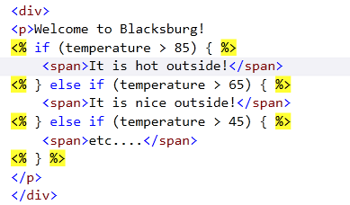
Quick Review of ASP
ASP and ASPX pages support server-side processing to generate dynamic content. This is done using special delimiter tokens to define the boundaries of the server-side code.

Slide 5
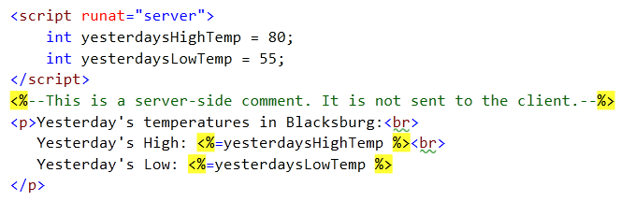
ASP: Variables and Expressions
Stand-alone server-side code has to be in script tags. Variables can be used using a special version of the token.

Slide 6
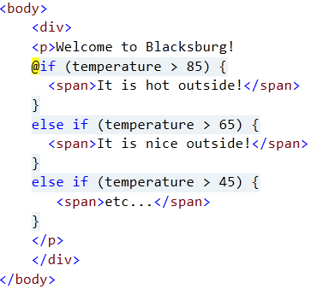
Razor View Engine
Razor is a new view engine released with MVC 3 and updated for MVC 4. It uses a more intelligent marking and parsing system.

Slide 7
Razor is…
Easy to write.
Easy to read - flows with the page.
Consistent syntax; doesn’t mix webforms with asp mark-up.
Extendable using @helper functions and inline templates.
Easier to debug.
Pages can be compiled and tested.
Partial view functionality is compatible with ASPX.
Applicable outside of web apps.

Slide 8
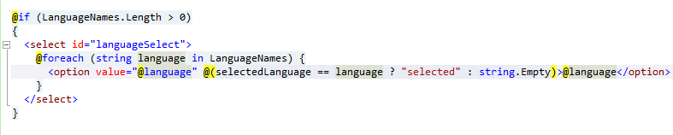
Language Statements
You can use any c# statement by simply adding the “@” sign in front of it. While using c#, you can seamlessly switch back to HTML tags.

Slide 9
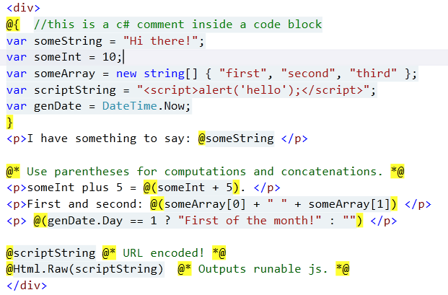
Using Variables

Slide 10
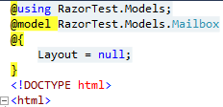
Specifying model and namespace.
You specify the model type by using the Razor specific @model keyword.
You can also add ‘using’ statements for any namespaces that will be referenced.

Slide 11
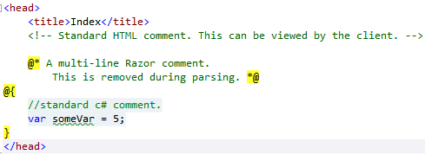
Comments
There are standard HTML and c# comments, plus a new razor comment method.

Slide 12
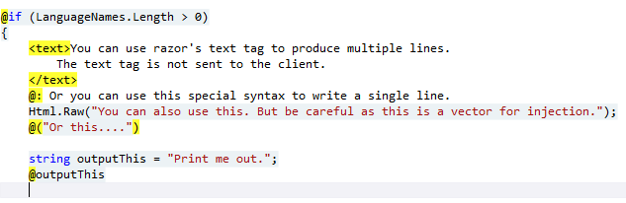
Text inside c#
If you’re in a c# context and you need to output text without tags, you have several options.

Slide 13
Context Switching
The @ sign semantically means multiple things depending on context
@ + c# keyword == “switch to c# context”
@ + variable or expression == “send value to output”
value + @ + value == “by pass parser, probably an email address”
@ + razor keyword (or ‘*’ or ‘:’) == “special functionality (helpers, etc.).”
@ + HTML tags == “Build a template for helper function parameter.”

Slide 14
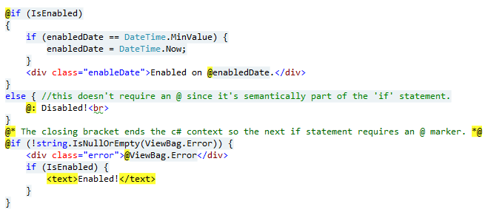
Context Switching - Examples

Slide 15
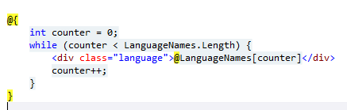
So when do I need semicolons?
You use semicolons on lines of c# that normally require semicolons, but don’t have an @ sign or HTML tags in them.

Slide 16
Razor’s “@”-ables
c# keywords
@if
@for
@foreach
@while
@do
@switch
@try
@using (Namespace)
@using (IDisposable)
@lock
@case
@default
Tokens specific to Razor:
@functions
@helper
@section
@item
@model
@ { }
@* *@
@:
<text> </text>
Future use:
@namespace
@class
@layout

Slide 17
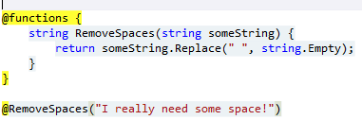
Declaring c# Functions on the Page
You can declare functions inside your page using the ‘@functions’ keyword.
Only use this space for declaring functions. Put variables in a separate block.
You cannot put HTML tags or use “global” variables inside a function.

Slide 18
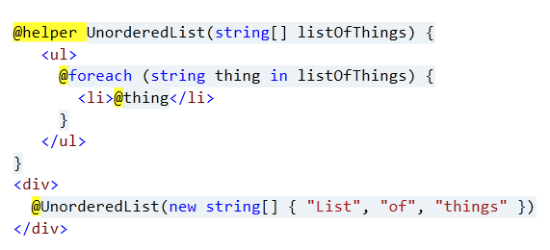
Helpers - Parameterized Razor Functions
Helpers can be in a view page or in a stand-alone page located in the App_Code folder. They always return a HelperResult object.

Slide 19
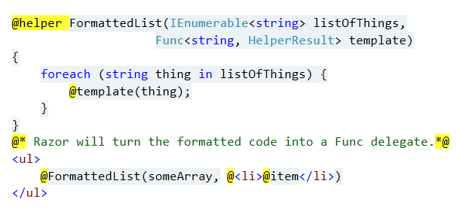
Helpers with Inline Templates
You can add a Func<> delegate to a helper parameter to pass in custom HTML formatting.

Slide 20
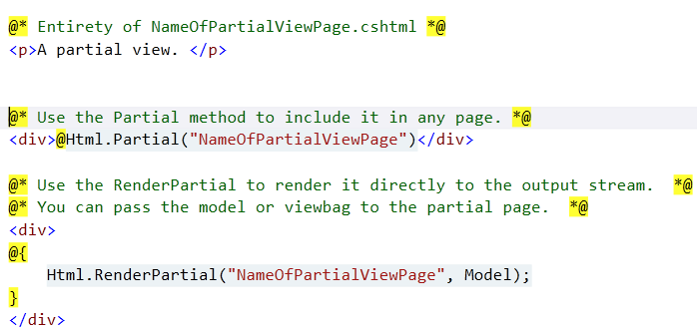
Partial Views
A partial view is an HTML+Razor snippet in its own page. (Code below is from two different .cshtml pages.)

Slide 21
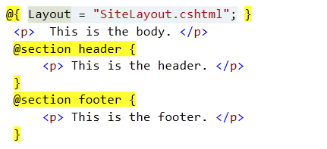
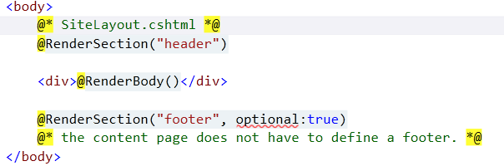
Layout Pages

Slide 22
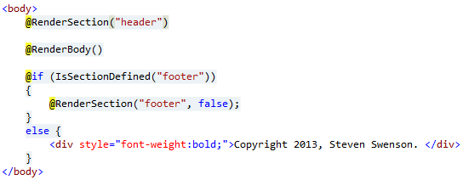
Layout Pages with Default Content
The layout page can provide default content that can be overridden by the content page. You check for a section using ‘IsSectionDefined’ method.

Slide 23
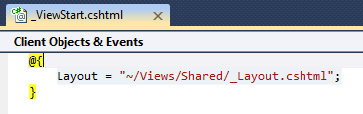
_ViewStart.cshtml Page
_ViewStart is a hardcoded page name in the Razor engine. The code inside _ViewStart is added to each view when it is compiled. There can be a _ViewStart file in each folder.

Slide 24
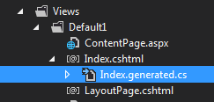
Razor Generator
http://razorgenerator.codeplex.com/
Razor Generator dynamically compiles each cshtml page into a .cs page that can be debugged and unit tested.

Slide 25
Razor – V2
V2 of Razor was almost entirely internal changes to make it more compatible with HTML5.
Overview of small changes in version 2 of Razor:
http://vibrantcode.com/blog/2012/4/10/whats-new-in-razor-v2.html/
http://vibrantcode.com/blog/2012/4/13/what-else-is-new-in-razor-v2.html/

Slide 26
Using Razor outside of WebApps
Razor can now be applied to anything that requires templating using Razor Engine.
https://github.com/Antaris/RazorEngine

Slide 27
Other helpful links
Introduction to Razor on asp.net
Troubleshooting Razor pages
Razor API Quick Reference
Good article on Partial Views in Razor
Using Razor with Web API
Using Razor template engine with stand-alone Web API
Article about the release of Razor source code
Razor Engine – parsing templates outside of ASP
Another article about Razor Engine from the author

Slide 28


RACKSPACE® HOSTING | 5000 WALZEM ROAD | SAN ANTONIO, TX 78218
US SALES: 1-800-961-2888 | US SUPPORT: 1-800-961-4454 | WWW.RACKSPACE.COM
RACKSPACE® HOSTING | © RACKSPACE US, INC. | RACKSPACE® AND FANATICAL SUPPORT® ARE SERVICE MARKS OF RACKSPACE US, INC. REGISTERED IN THE UNITED STATES AND OTHER COUNTRIES. | WWW.RACKSPACE.COM

