Slide 1

Jackals
Dogaru Constantin 333CC
Gherghina Cristian-Catalin 333CC
Macarie Roxana Georgiana 333CB
Manciu Stefan 333CC

Slide 2
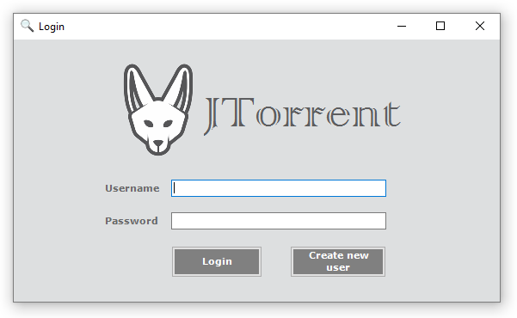

Slide 3
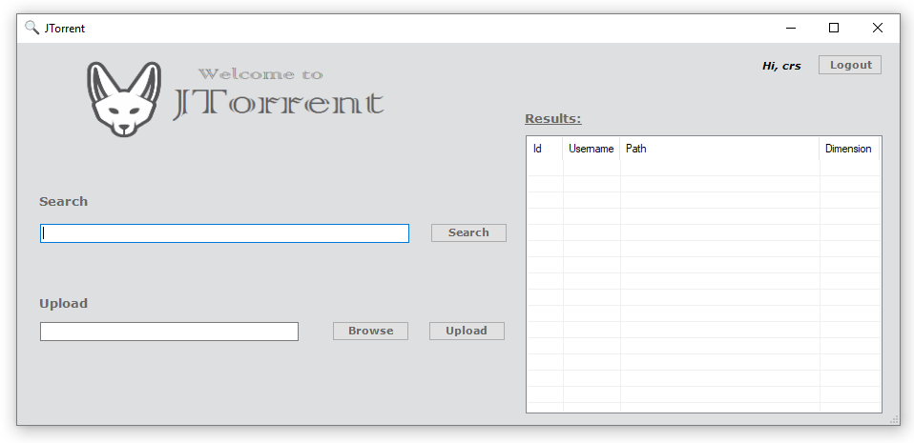

Slide 4


Slide 5
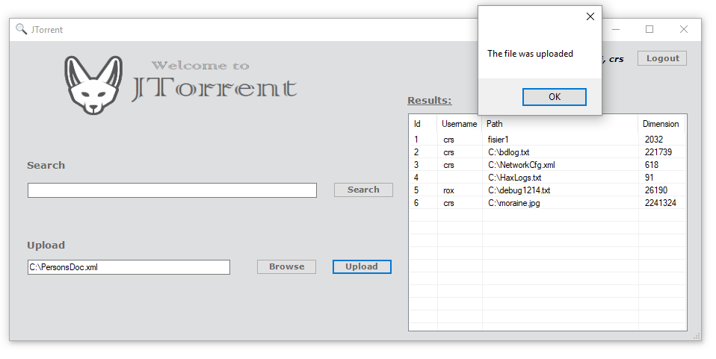

Slide 6
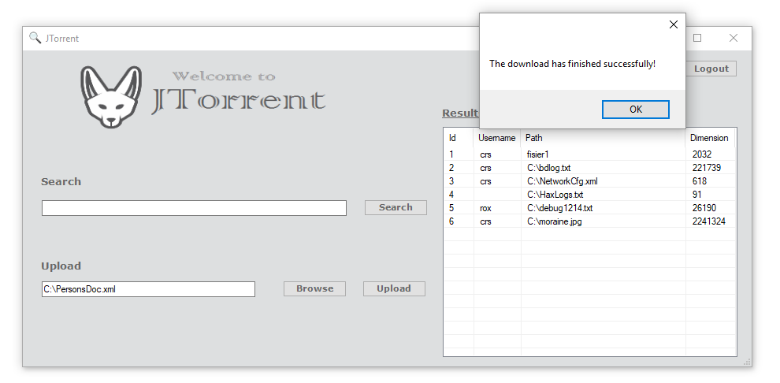

Slide 7


