Slide 1
Research hand-off
HybridCache: AI-Assisted Cloud-RAN Caching with Reduced In-Network Content Redundancy
- Chittibabu Tirupathi

Slide 2
Agenda
Data set
Data processing
LSTM Predictor
Hybrid Cache Simulation

Slide 3
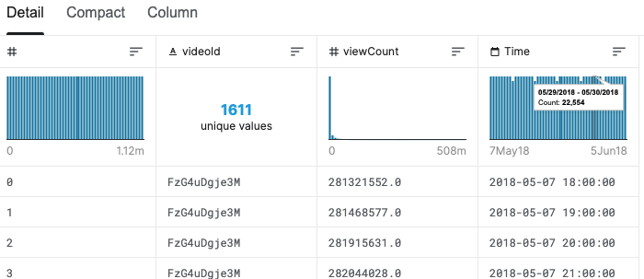
Dataset
YouTube videos View Count every hour.
Dataset with 1611 unique videos with view count over a period of time.
Ref: https://www.kaggle.com/nnqkfdjq/statistics-observation-of-random-youtube-video#count_observation_upload.csv

Slide 4
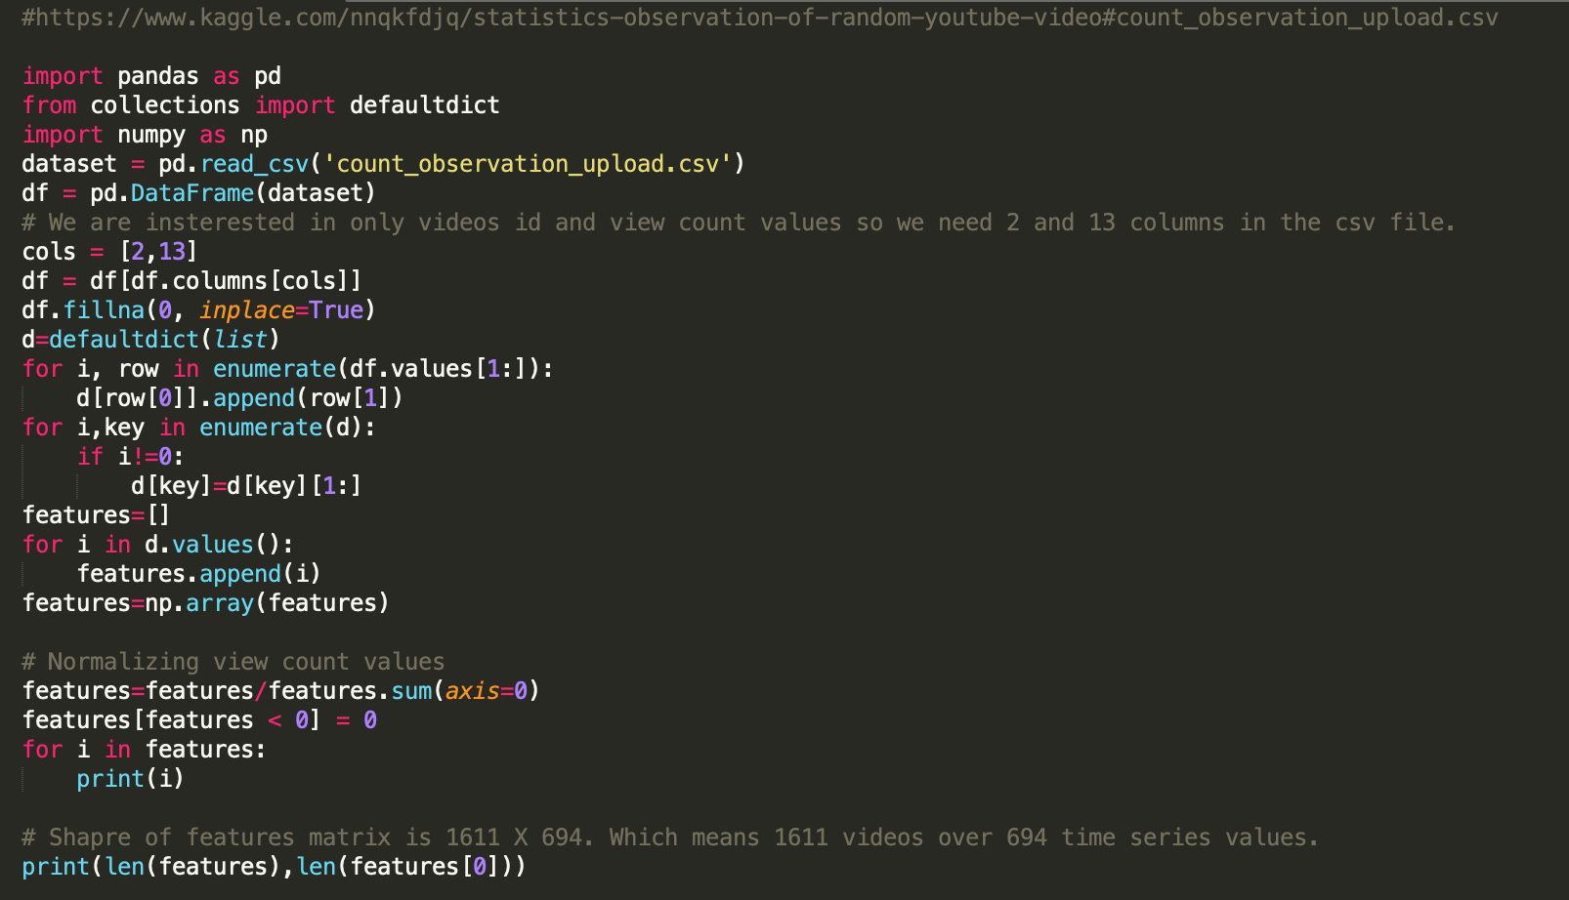
Data Processing

Slide 5
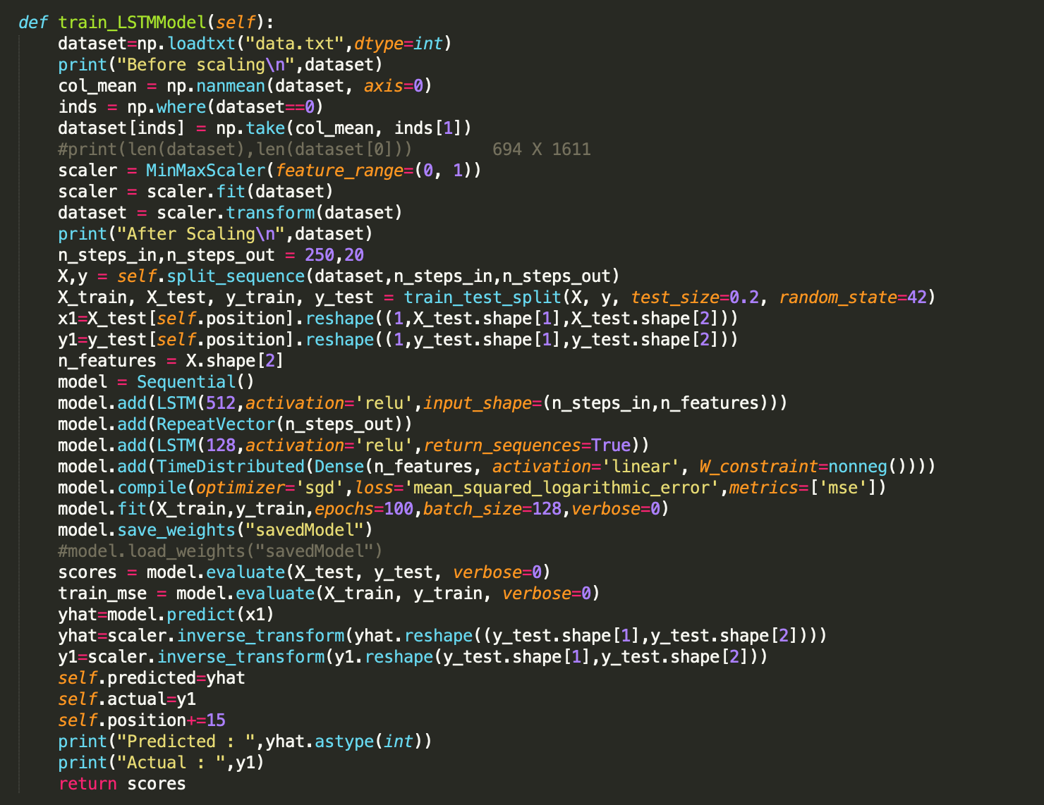
LSTM Predictor

