Slide 1


Slide 2

Goal
Good User Experience
Recognize a movement e.g. pull up,…
Give feed back to the movement
Visual
Audio

Slide 3
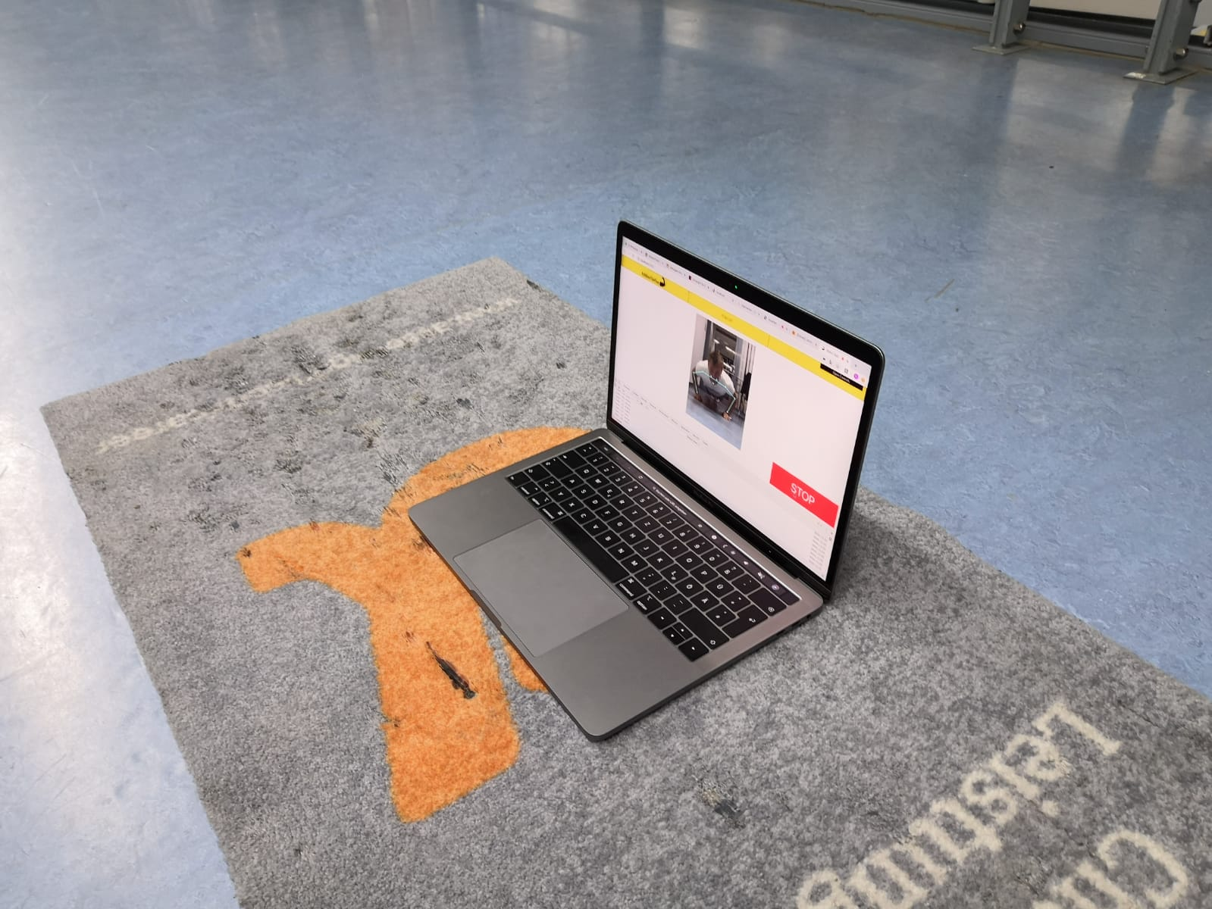
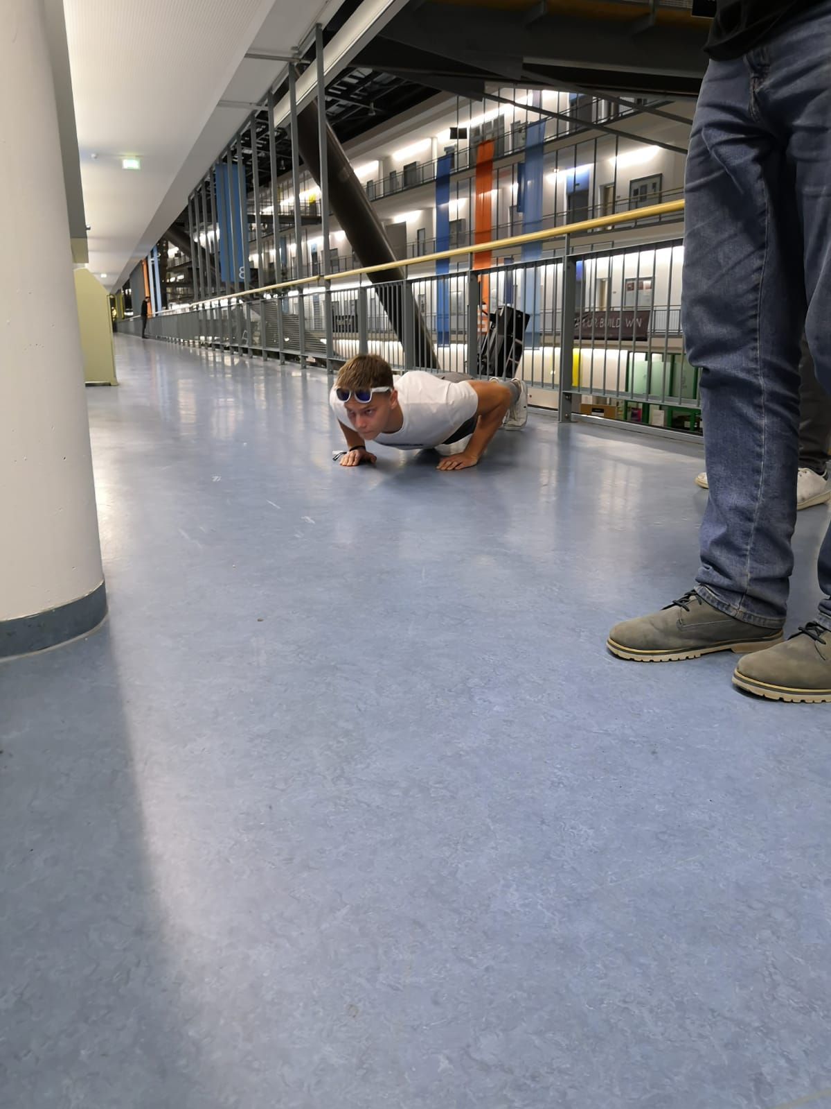
Vorlage

Slide 4
Vorlage
Vorlage

Slide 5
Vorlage

