Slide 1
CSC 230
WiFi Control
Patrick Dunlavey, Craig Knappenberger, Jai Mistry, Jeremy Seidner

Slide 2



About the project
In this project we will be controlling a servo using an Arduino Uno that is connected to a Raspberry Pi. The Raspberry Pi will be hosting a server that accepts HTTP requests over an established network (wifi). The reason we need the Raspberry Pi and Arduino is so we can write all of our logic in a language called JavaScript. How we will be doing this is by using NodeJs, ExpressJs and Johnny-five.

Slide 3
System Block Diagram
Front Servo
Turn Steering motor
PWM
Android Device
Raspberry Pi
Arduino Uno
Http Req
Johnny 5
USB
PWM
Back Servo
USB Battery
Turn Drive motor

Slide 4
System Block Diagram Breakdown (Servos)
ESC stands for Electronic speed controller. ESC regulates PWM
Arduino Uno
ESC
Front Servo
Back Servo
NiCad Battery
Notes:
ESC - Electronic Speed Controller microchip

Slide 5
Functional Requirements
Ability to control RC car using an Android Device over WiFi.
The Android application receives user inputs and converts them to http requests sent over the network.
The Raspberry Pi uses a NodeJs server using Express.js to establish an easily routable network. The NodeJs server accepts those http requests and uses another Library called Johnny-Five to convert the JSON objects into Firmata.
The Firmata is then sent to the Arduino Uno that interprets the Firmata and turns two servos using Pulse Width Modulation (PWM).

Slide 6
Development Platform Description
Android Tablet
Nexus 7
Android Studio
Java
Raspberry Pi
Raspbian Jessie
Javascript
Johnny-Five
Express.js
Arduino
Firmata
C
RC Car Servo Motors

Slide 7
Control Flow Chart (Android)
User Physical Input on Android Device
If brake is on just keep checking itself
Brake
User Inputs:
SeekBar: Speed
Button 1: Brake
Button 2: Forward/Reverse
Gyroscope: Turn Degree
setOnCheckedChangeListener
SeekBar
Gyro Scope
Forward/Reverse
Send Speed Http
Send Turn Direction http
Send Drive Direction http

Slide 8
Control Flow Chart (AndroidTablet.js)
Http Request from Android
Http Request:
‘Right’,’Left’,’
Forward’,’Reverse
Routing to correct Url
Changing Direction based on button http request
Changing Speed based on Seekbar http request
Changing Turn based on Gyroscope http request
Sends PWM to Arduino to change direction
Sends PWM to Arduino to change speed
Sends PWM to Arduino to change turn radius

Slide 9
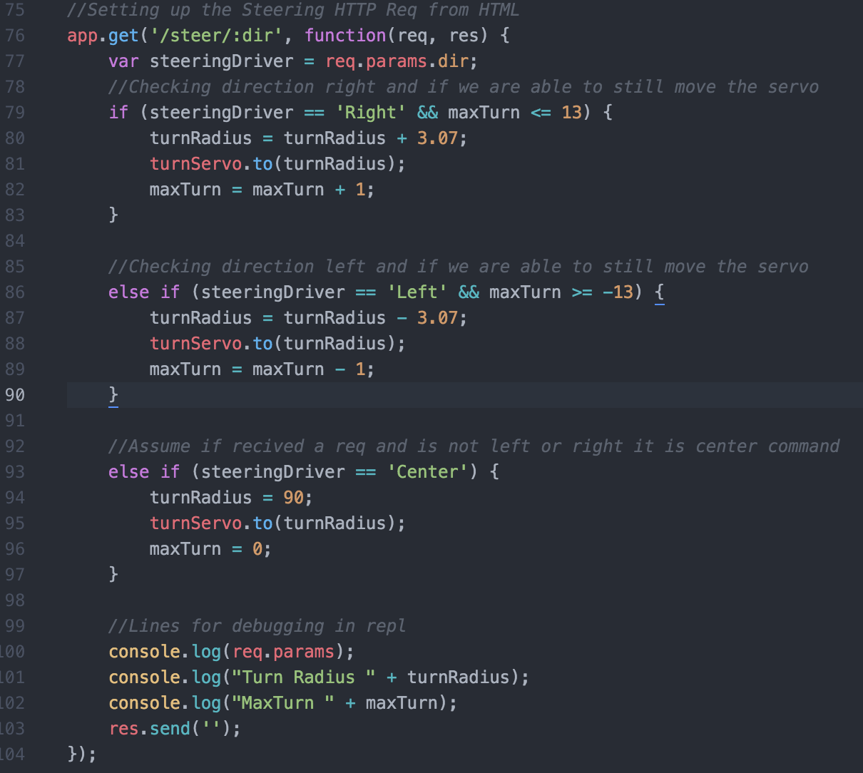
Sample Code
Sample of Steering Logic in AndroidTablet.js

Slide 10
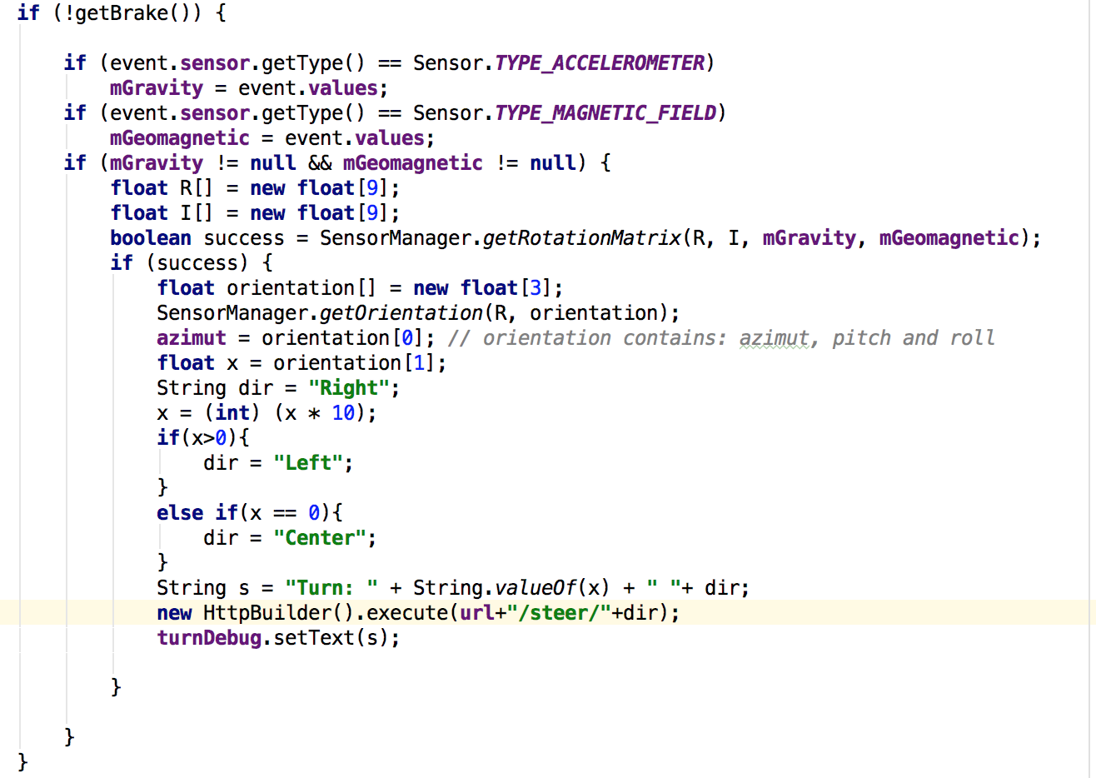
Sample Code
Sample of software-defined sensor for gyroscope in MainActivity.java

Slide 11
Problems - Solutions
Hardware/Software: The team needed to buy a separate piece of hardware for the Arduino to have access to wifi. To save money, the group had a Raspberry Pi control the wifi and communicate that information to the Arduino. If the team solely used the Raspberry Pi, it would’ve required more time to research and install PWM controls. To save time and money, the team decided to use the Raspberry Pi to control the wifi, then communicate that information to the Arduino which would control the servo motors.
Learning multiple softwares: Some of the team members weren’t familiar with some of the software. The team conducted a sit-in where one person walked the others through installing and setting up the platforms so they could start learning via tutorials.
Gyroscope: used a default that was initially inaccurate due to Earth’s gravity and rotation. The team built a software-defined sensor using an accelerometer and magnetometer.

Slide 12
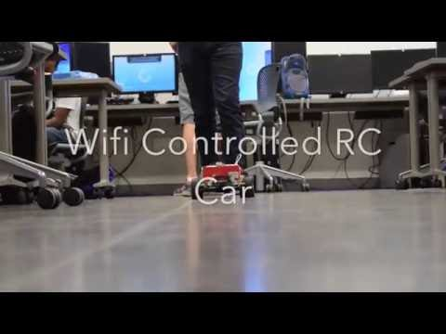
Demo Video

Slide 13
Developer’s Notes
Complete Project Tutorial

Slide 14
Sources:
http://media.idownloadblog.com/wp-content/uploads/2016/02/wifi-icon.png
http://www.clipartkid.com/images/20/people-clipart-7FoHas-clipart.gif
http://cdn.grid.fotosearch.com/CSP/CSP683/k34733171.jpg

