Slide 1
Steel Industry Data Exploration
A Quick EDA and Model Building

Slide 2
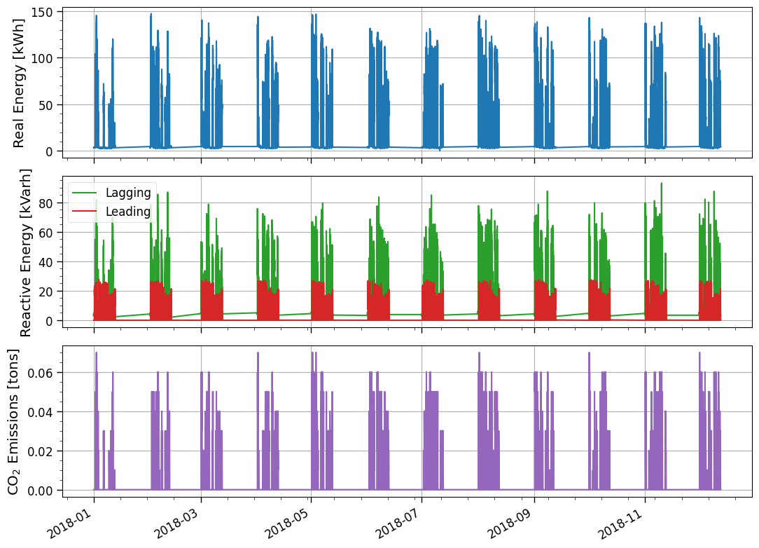
Time-Series - Full Data Set
A comprehensive time-series analysis covers the entire observation period, with a detailed view of 2018 segmented into two-week intervals, alternating with data gaps.
The units provided in the data set are units of energy (kWh and kVarh), from which the power is simply given from dividing by the integrated time of each measurement.

Slide 3
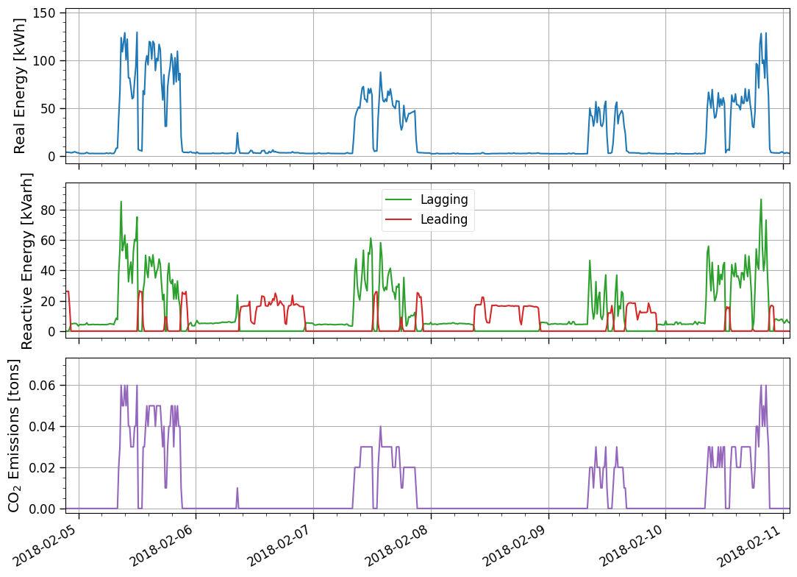
Time Series - One Week
Focusing on the week of February 2, 2018, clear correlations emerge between real energy usage, reactive energy lagging, and CO₂ emissions.
This motivates further examination of CO₂ emissions in the space of Real Vs. Reactive Lagging Energy…

Slide 4
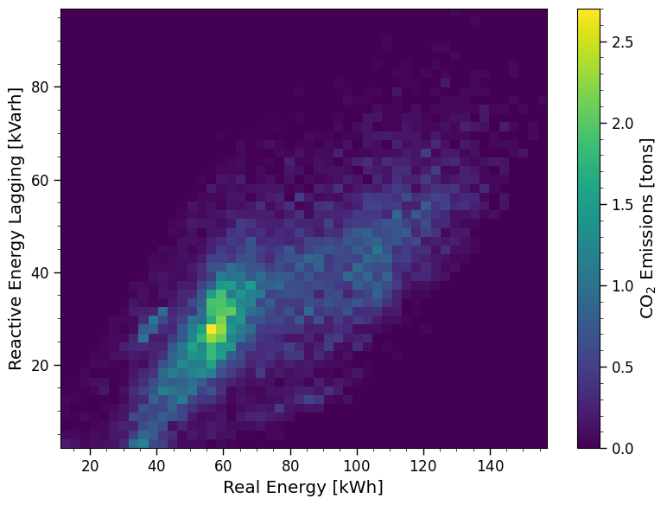
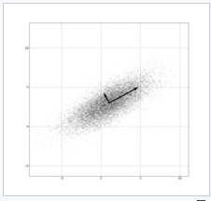
Modeling CO₂ Emissions from Power
While other 2d spaces were also explored, the space of real vs. reactive lagging energies did prove to be the most revealing of the distribution of CO₂ emission.
The CO₂ emission may potentially be modeled as a function by the real power P and the reactive lagging power Q_{L}.
At a first glance, the data seem to reflect a Bivariate Gaussian distribution, though there is certainly more structure.
from Wikipedia

