Slide 1
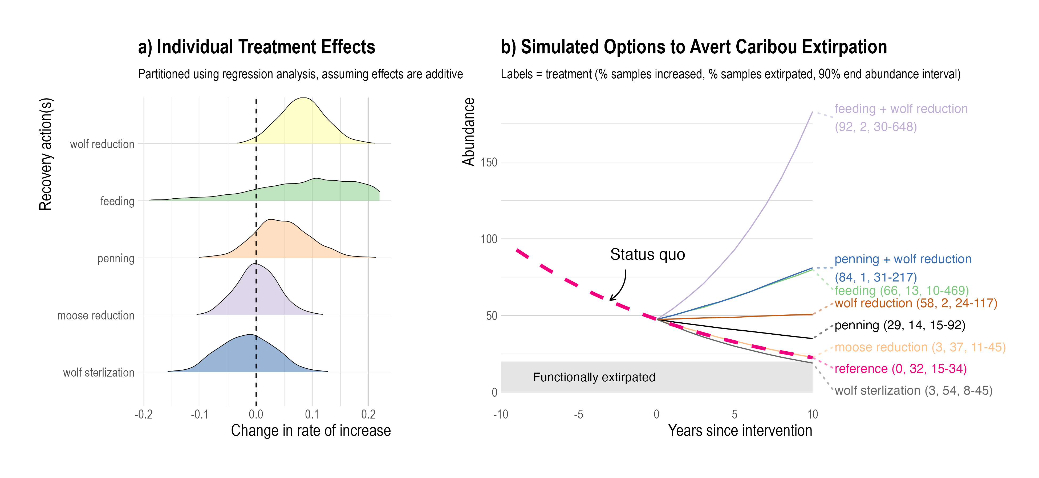
Similar outcomes, more uncertainty in feeding effectiveness
High probability of increase, low probability of extirpation
Low probability of increase, high probability of extirpation

