Slide 1
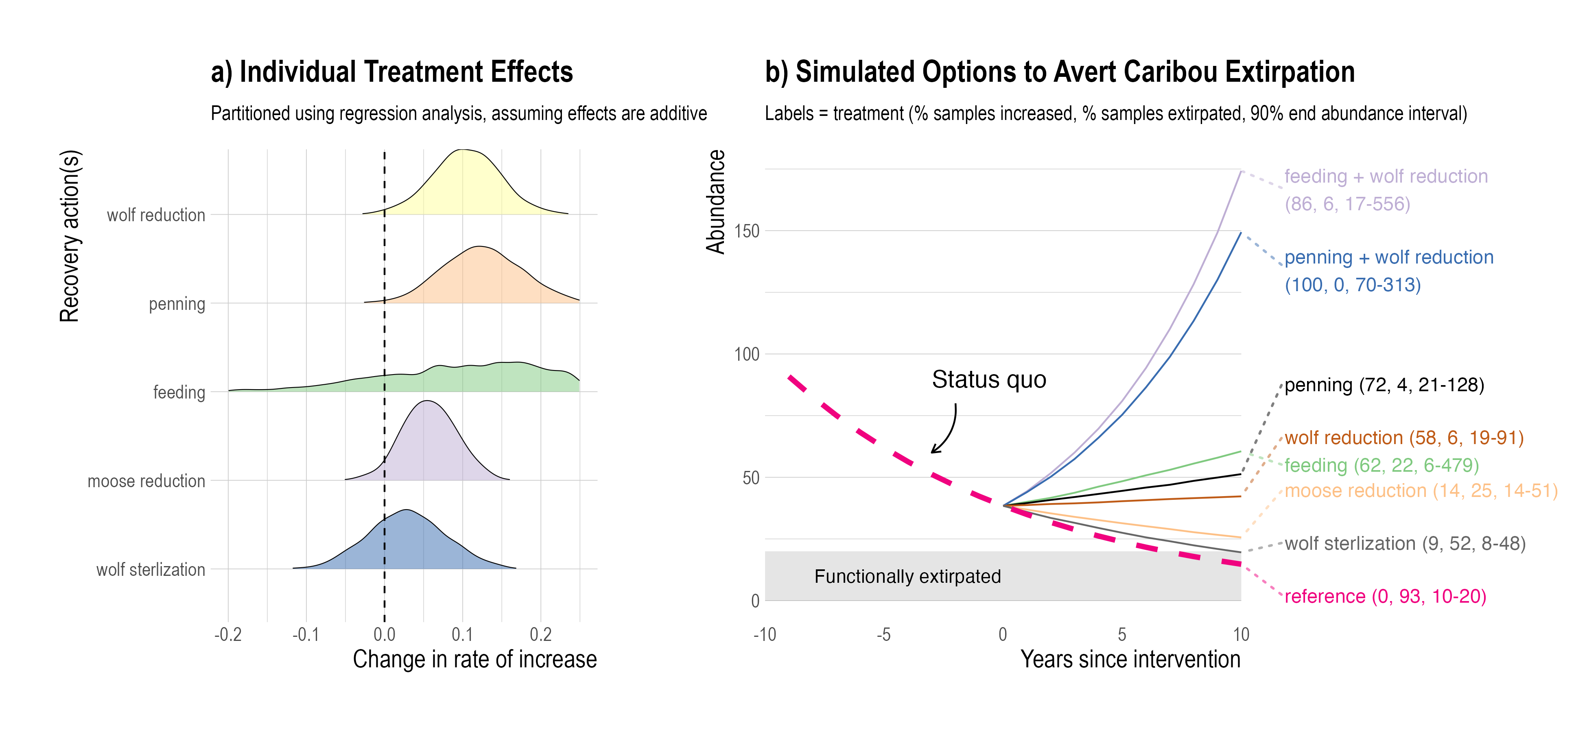
High probability of increase, low probability of extirpation
Low probability of increase, high probability of extirpation

