Slide 1

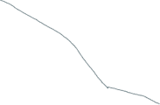
Model
An Example: Klinse-Za caribou and WMFN + SFN
”a sea of caribou”
Indigenous hunting voluntarily ended (>300)
Culturally-defined recovery (548)
Treaty ensuring Indigenous way of life and subsistence hunting signed
200
Species recommended* as Endangered (36)
Population size
100
Indigenous led-recovery begins (36)
non-Indigenous hunting ended (100)
Considered partially recovered under SARA
Time immemorial
Colonization
1970
1990
2000
2010
2020
Year

