Slide 1
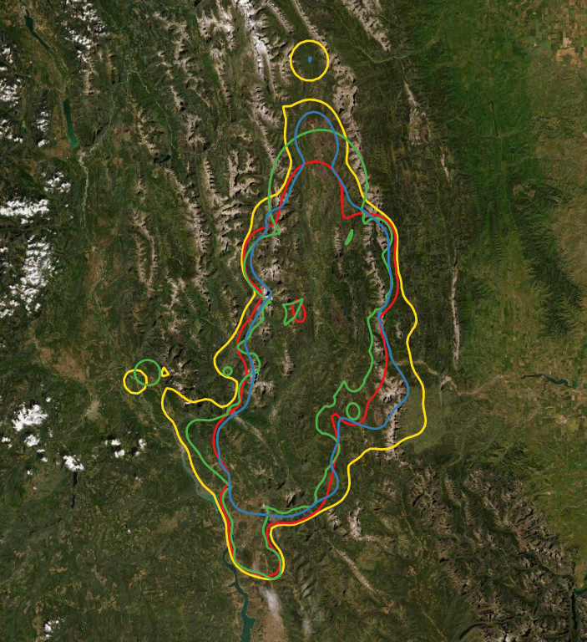
95% UD of all telem
Area: 3,327 sq.km
DNA individuals: 305
Lambda: 1.006
99% UD of all F telem
Area: 3,443 sq.km
DNA individuals: 299
Lambda: 0.9997
CURRENT:
99% UD of all telem
Area: 5,073 sq.km
DNA individuals: 406
Lambda: 1.002
Composite 95% F hr’s
Area: 3,492 sq.km
DNA individuals: 326
Lambda: 1.002

