Slide 1
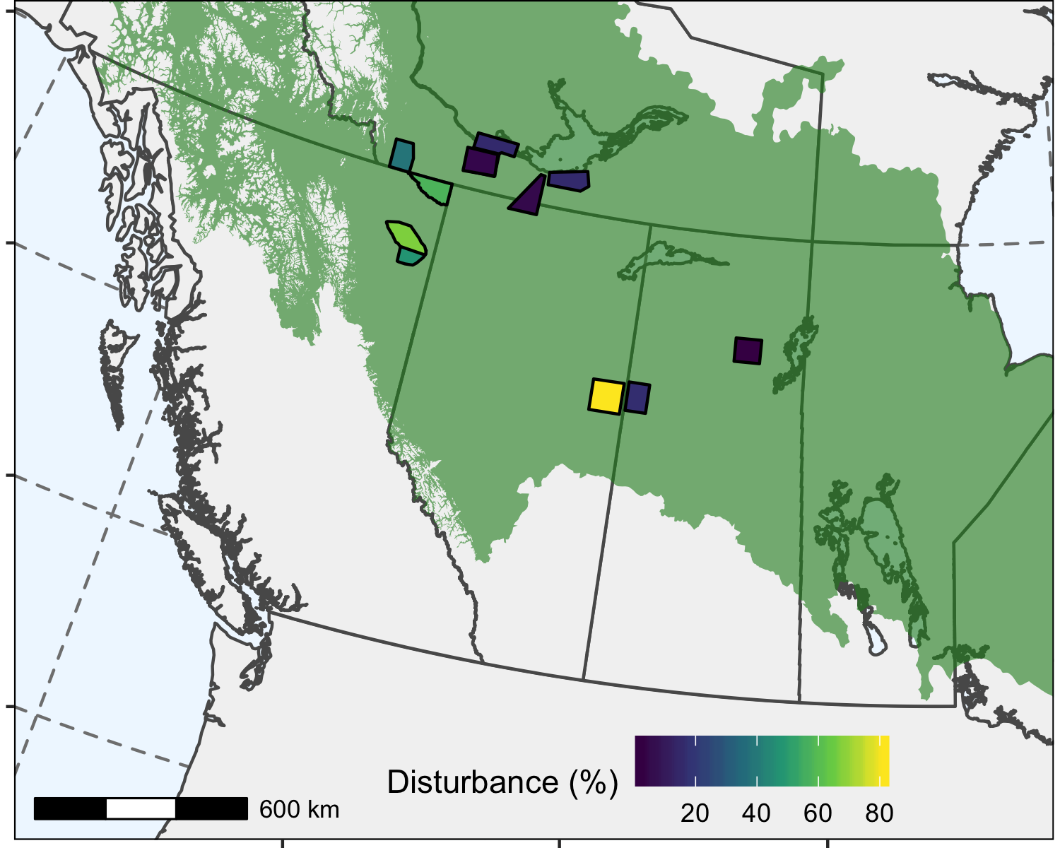
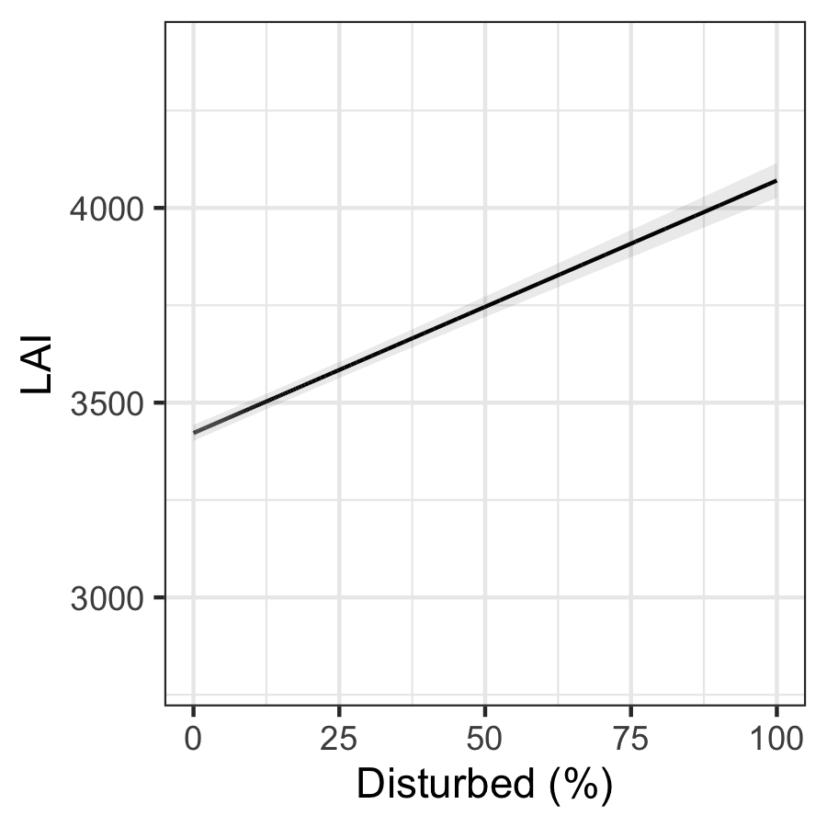
A
Disturbance can increase habitat productivity
B: spatial comparison across region
C: temporal pattern after disturbance (state area)
Craig add temporal LAI figure

