Slide 1
Smarter
•
@EnableAutoConfiguration
Review
Tuning Demystifying Writing our own
•
•
•

Slide 2

Spring Framework is highly configurable
Web?
Front end?
Data access?
Security?

Slide 3
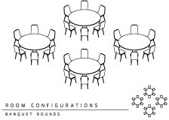
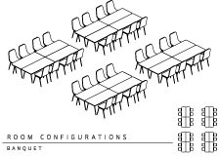
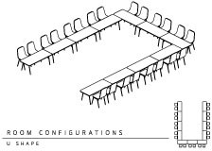
Decisions. So many decisions.
Banquet Style Round
Banquet Style Square
U Shape Configuration

Slide 4

@EnableAutoConfiguration is like having
your own opinionated event planner.

Slide 5
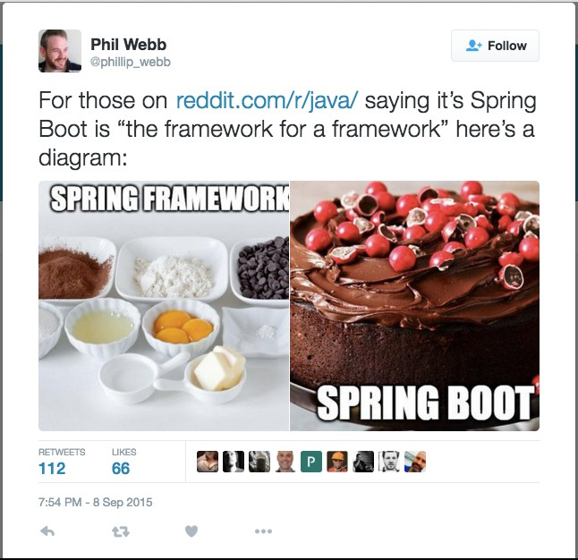

Slide 6
Spring Boot is not Spring Boot without Auto Configurations!

Slide 7

package schultz.dustin.io
Package has significance
@EnableAutoConfiguration public class Foo {
...
}
Intelligent and seemingly “magical” annotation that enables features and configures functionality

Slide 8
package schultz.dustin.io
@Configuration @ComponentScan @EnableAutoConfiguration public class Foo {
...
}
}
3 very common annotations in Spring Boot apps

Slide 9
package schultz.dustin.io
@SpringBootApplication public class Foo {
...
}
Introduced in Spring Boot 1.2. Really three annotations in one.

Slide 10
Tuning your Auto Configuration

Slide 11





Intelligent Decision Making Based on Conditions
Presence/ Absence of Jar
Presence/ Absence of Bean
Presence/Absence of Property
Many More!

Slide 12
=========================
AUTO-CONFIGURATION REPORT
=========================

Slide 13

Positive matches:
-----------------
EmbeddedServletContainerAutoConfiguration matched
- found web application StandardServletEnvironment (OnWebApplicationCondition)
...

Slide 14

Negative matches:
————————
CassandraAutoConfiguration did not match
- required @ConditionalOnClass classes not found: com.datastax.driver.core.Cluster (OnClassCondition)
...

Slide 15

Exclusions:
-----------
org.springframework.boot.autoconfigure. jdbc.DataSourceAutoConfiguration

Slide 16

Unconditional classes:
———————————
org.springframework.boot.autoconfigure. PropertyPlaceholderAutoConfiguration
...

Slide 17


Enabling the Auto Configuration Report
--debug
cmd line arg
-Ddebug
VM arg
export DEBUG=true
Environment var
debug=true
application.properties
logging.level.=debug
application.properties
Many more!

Slide 18
When in doubt, always check the Spring Documentation first

Slide 19
Using the @ConditionalOn… Annotations

Slide 20
Spring 4 Conditional Configuration
A single condition that must be matched in order for a component to be registered.

Slide 21


Presence or Absence of Class on Classpath
@ConditionalOnClass
@ConditionalOnMissingClass
 | Attributes
 | [] | name = { "a.b.c.Foo" }
 | [] | value = { Foo.class }
 | Attributes
 | [] | name = { "a.b.c.Foo" }
 | [] | value = { Foo.class }

Slide 22


Presence or Absence of Defined Bean
@ConditionalOnBean @ConditionalOnMissingBean
 | Attributes
 | [] | name = { “dataSource” }
 | [] | value = { Foo.class }
 | [] | type = { “a.b.c.Foo” }
 | [] | annotation = { Foo.class }
 | enum | search = { ALL }
 | [] | ignored = { “a.b.c.Foo” }
 | [] | ignoredType = { Foo.class }
 | Attributes
 | [] | name = { “dataSource” }
 | [] | value = { Foo.class }
 | enum | type = { “a.b.c.Foo” }
 | [] | annotation = { Foo.class }
 | [] | search = { ALL }
 | [] | ignored = { “a.b.c.Foo” }
 | [] | ignoredType = { Foo.class }

Slide 23

Presence or Absence of a Property Having Value
@ConditionalOnProperty
 | Attributes
 | [] | name = { “my-property” }
 | [] | value = { “my-property” }
 | String | havingValue = “foo”
 | [] | prefix = { “some.prefix” }
 | boolean | matchIfMissing = false
 | boolean | relaxedNames = true

Slide 24
@ConditionalOnJava
@ConditionalOnJndi
@ConditionalOnResource
@ConditionlOnExpression
@ConditionlOnWebApplication
@ConditionalOnNotWebApplication
Don’t be afraid to mix and match!
Additional Conditions

Slide 25
Writing Our First Auto Configuration

Slide 26
@EnableAutoConfiguration Unveiled
@EnableAutoConfiguration
@Import(EnableAutoConfigurationImportSelector.class) SpringFactoriesLoader.loadFactoryNames(...)
/META-INF/spring.factories
o.s.b.a.EnableAutoConfiguration = o.s.b.a.SomeAutoConfig, ...

Slide 27
Auto configuration report
•
Module in Review
Tuning auto configuration
@ConditionalOn… annotations
Writing our own custom auto configurations
•
•

