Slide 1
Microservices Architecture
Introduction
Rajesh Meena
Rajesh.meena@centurylink.com

Slide 2
Microservices
What is a Service? | Introduction | The Monolithic

Slide 3

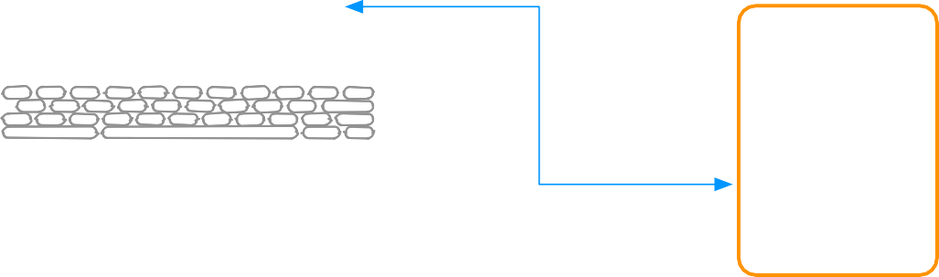


Microservices: What is a Service?
Account
Orders
Offers
Basket
Shopping website
Website
Account
Service
Database
Mobile App
Desktop App
Network

Slide 4


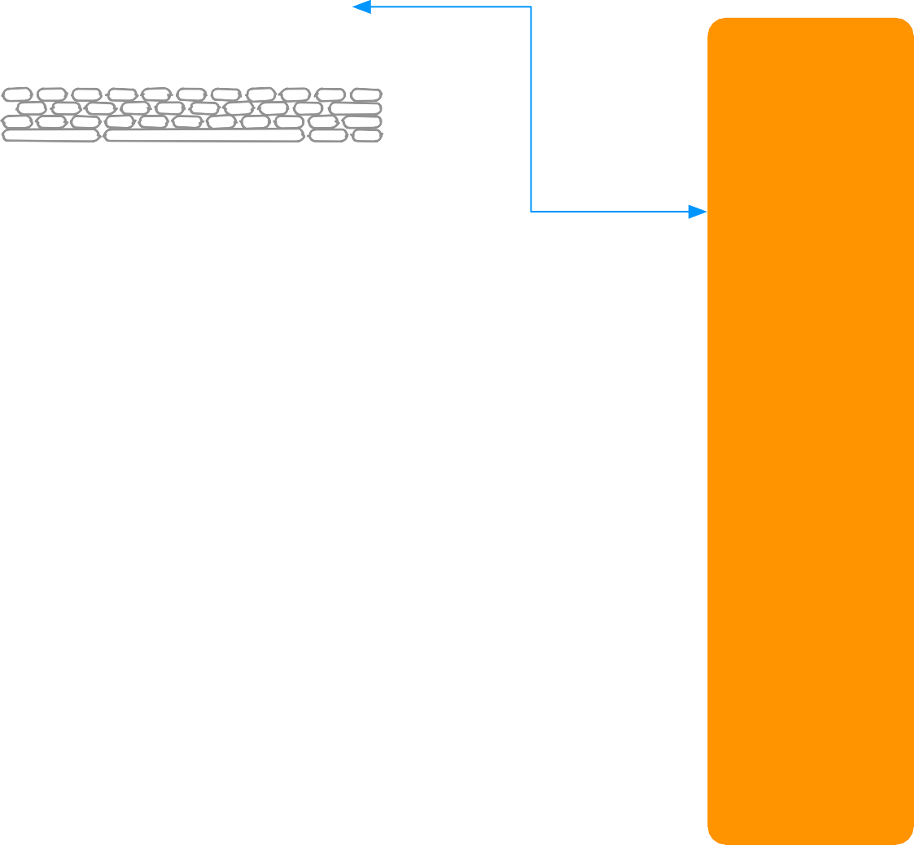










Microservices: What is a Service?
Account
Orders
Offers
Basket
Website
Server 1
Account
Load Balancer
Mobile App
Database Server
Server 2
Server 3
Desktop App
Network

Slide 5
Microservices: Introduction
SOA done well
Knowing how to size a service
Traditional SOA resulted in monolithic services
Micro sized services provide
UI
Service
Service
Eﬃciently scalable applications
Flexible applications
High performance applications
Application(s) powered by multiple services
Small service with a single focus
Lightweight communication mechanism
Both client to service and service to service
Technology agnostic API
Independent data storage
Independently changeable
Independently deployable
Distributed transactions
Centralized tooling for management
Client
Service
Service

Slide 6


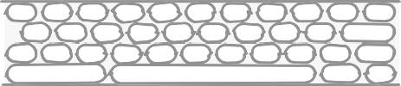
Microservices: Introduction
Shopping
Accounts Service
website
Promotions Service
Orders Service
Account
Orders
Internal Support website
Inventory Service
Offers
Basket
Products Service
Client
Internet
API
Gateway

Slide 7
Microservices
What is a Service? | Introduction | The Monolithic

Slide 8

Microservices: The Monolithic
Typical enterprise application
No restriction on size
Large codebase
Longer development times
Challenging deployment
Inaccessible features
Fixed technology stack
High levels of coupling
Between modules
Between services
Failure could aﬀect whole system
Scaling requires duplication of the whole
Single service on server
Minor change could result in complete rebuild
Easy to replicate environment
Accounts
Shopping website
Account
Orders
Orders
Offers
Basket
Service
Promotions
Data Access
Database
Customer
Internal Support website
Inventory
Products
Internet

Slide 9
Emergence of Microservices
Why Now? | Benefits

Slide 10



Emergence of Microservices : Why Now?
Need to respond to change quickly
Need for reliability
Business domain-driven design
Automated test tools
Release and deployment tools
On-demand hosting technology
On-line cloud services
Need to embrace new technology
Asynchronous communication technology
Simpler server side and client side technology
Shopping
Accounts Service
website
Promotions Service
Orders Service
Account
Orders
Internal Support website
Inventory Service
Offers
Basket
Products Service
Client
Internet
API
Gateway

Slide 11



Emergence of Microservices : Benefits
Shorter development times
Reliable and faster deployment
Enables frequent updates
Decouple the changeable parts
Security
Increased uptime
Fast issue resolution
Highly scalable and better performance
Better ownership and knowledge
Right technology
Enables distributed teams
Shopping
Accounts Service
website
Promotions Service
Orders Service
Account
Orders
Internal Support website
Inventory Service
Offers
Basket
Products Service
Client
Internet
API
Gateway

Slide 12
Microservices Design Principles
Introduction | Principles | Summary

Slide 13
Microservices Design Principles: Introduction
High Cohesion
Autonomous
Business Domain Centric
Resilience
Observable
Automation

Slide 14
Microservices Design Principles: High Cohesion
Single focus
Accounts Service
Single responsibility
SOLID principle
Only change for one reason
Reason represents
A business function
A business domain
Encapsulation principle
OOP principle
Easily rewritable code
Why
Scalability
Flexibility
Reliability
Postage Service
Orders Service
Stock Service
Products Service

Slide 15
Microservices Design Principles: Autonomous
Loose coupling
Accounts
Honor contracts and interfaces
Stateless
Independently changeable Independently deployable Backwards compatible Concurrent development
Service
V1
Postage Service V6
Orders Service V3
Stock Service V4
Products Service V2

Slide 16












Design Principles: Business Domain Centric
Service represents business function
Accounts Department
Postage calculator
Scope of service
Bounded context from DDD
Identify boundaries\seams
Shuﬄe code if required
Group related code into a service
Aim for high cohesion
Responsive to business change
Accounts Service
Accounts Department
Orders Service
Orders Department
Products Service
Stock Department

Slide 17


Microservices Design Principles: Resilience
Embrace failure
Another service
Specific connection
Accounts Service
Third-party system
Degrade functionality
Default functionality
Multiple instances
Register on startup
Deregister on failure
Types of failure
Exceptions\Errors
Delays
Unavailability
Network issues
Delay
Unavailability
Validate input
Service to service
Client to service
!
Postage Service
Orders Service
Stock Service
Products Service

Slide 18
Microservices Design Principles: Observable
System Health
Status
Logs
Errors
Centralized monitoring
Centralized logging
Why
Distributed transactions
Quick problem solving
Quick deployment requires feedback
Data used for capacity planning
Data used for scaling
Whats actually used
Monitor business data
Central Monitoring
Central Logging

Slide 19
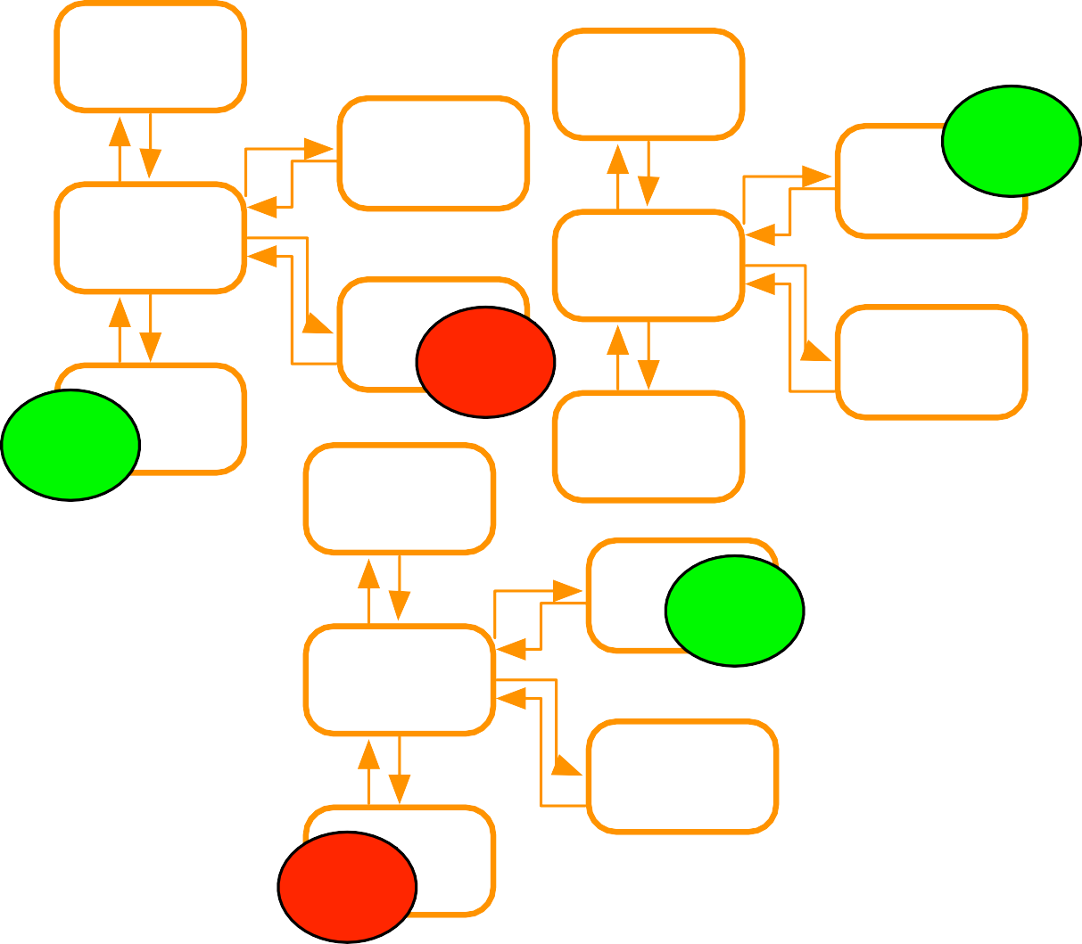
Microservices Design Principles: Automation
Tools to reduce testing
Manual regression testing
Time taken on testing integration
Environment setup for testing
✓
Tools to provide quick feedback
Integration feedback on check in
Continous Integration
Tools to provide quick deployment
Pipeline to deployment
Deployment ready status Automated deployment
•
Reliable deployment
Continuous Deployment
Why
•
Distributed system
Multiple instances of services
Manual integration testing too time consuming
Manual deployment time consuming and unreliable
X
✓
✓
X

Slide 20

Summary
Microservices
Service
Introduction
The Monolithic
Emergence of Microservices
Why Now?
Benefits
Microservices Design Principles
High Cohesion
Autonomous
Business Domain Centric
Resilience
Observable
Automation

