Slide 1
Technology for Microservices
Rajesh Meena
Rajesh.meena@centurylink.com

Slide 2

TOPICS
Communication Hosting Platforms
Observable Microservices Performance
Automation Tools

Slide 3
Communication: Synchronous
Request response communication
Client to service
Service to service
Service to external
HTTP Verbs: POST PUT
GET DELETE
Remote procedure call
Sensitive to change
HTTP
Work across the internet
Firewall friendly
REST
CRUD using HTTP verbs
Natural decoupling
Open communication protocol
REST with HATEOS
Synchronous issues
Both parties have to be available
Performance subject to network quality
Clients must know location of service (host\port)
Make call
Wait…
Response received
http://Service/Account/23
JSON/XML
Service One
Service Two

Slide 4

Communication: Asynchronous
Event based
Mitigates the need of client and service availability
Decouples client and service
Message queueing protocol
Message Brokers
Subscriber and publisher are decoupled
Microsoft message queuing (MSMQ)
RabbitMQ
ATOM (HTTP to propagate events)
Asynchronous challenge
Complicated
Reliance on message broker
Visibility of the transaction
Managing the messaging queue
Real world systems
Would use both synchronous and asynchronous
Accounts Service
Shopping website
Promotions Service
Orders Service
Place Order
Internal Support website
Inventory Service
Client
Products Service
Internet
API
Gateway
Message Broker

Slide 5
Hosting Platforms
Virtualization | Containers | Self Hosting | Registry and Discovery

Slide 6
Hosting Platforms: Virtualization
A virtual machine as a host
Foundation of cloud platforms
Platform as a service (PAAS)
Microsoft Azure
Amazon web services
Your own cloud (for example vSphere)
Could be more eﬃcient
Takes time to setup
Takes time to load
Take quite a bit of resource
Unique features
Take snapshot
Clone instances
Standardised and mature
Service One
VM
VM
VM
Host
Service Two
Service Three

Slide 7
Hosting Platforms: Containers
Type of virtualization
Isolate services from each other
Single service per container
Diﬀerent to a virtual machine
Use less resource than VM
Faster than VM
Quicker to create new instances
Future of hosted apps
Cloud platform support growing
Mainly Linux based
Not as established as virtual machines
Not standardised
Limited features and tooling
Infrastructure support in its infancy
Complex to setup
Examples
Docker
Rocker
Glassware
Container
Service One
Container
Container
Host
Service Two
Service Three

Slide 8





Hosting Platforms: Self Hosting
Implement your own cloud
_{V}•
irtualization platform
I• mplement containers
Use of physical machines
Single service on a server
Multiple services on a server
Challenges
Long-term maintenance
Need for technicians
Training
Need for space
Scaling is not as immediate

Slide 9





Hosting Platforms: Registration and Discovery
Where?
Host, port and version
Service registry database
Register on startup
Deregister service on failure
Cloud platforms make it easy
Local platform registration options
Self registration
Third-party registration
Local platform discovery options
Client-side discovery
Server-side discovery
Shopping
Accounts Service
website
Promotions Service
Orders Service
Account
Orders
Internal Support website
Inventory Service
Offers
Basket
Products Service
Client
Internet
API
Gateway

Slide 10
Observable Microservices
Monitoring Tech | Logging Tech

Slide 11
Observable Microservices: Monitoring Tech
Centralised tools
Nagios
PRTG
Load balancers
New Relic
Desired features
Metrics across servers
Automatic or minimal configuration
Client libraries to send metrics
Test transactions support
Alerting
Network monitoring
Standardise monitoring
Central tool
Preconfigured virtual machines or containers
Real-time monitoring
Central Monitoring

Slide 12
Observable Microservices
Monitoring Tech | Logging Tech

Slide 13

Observable Microservices: Logging Tech
Portal for centralised logging data
Elastic log
Log stash
Splunk
Kibana
Graphite
Client logging libraries
Serilog
and many more…
Desired features
Structured logging
Logging across servers
Automatic or minimal configuration
Correlation\Context ID for transactions
Standardise logging
Central tool
Template for client library
Central Logging

Slide 14
Microservices Performance
Scaling | Caching | API Gateway

Slide 15
Microservices Performance: Scaling
How
Creating multiple instances of service
Adding resource to existing service
1₁
1₁
Automated or on-demand
PAAS auto scaling options
Virtualization and containers
Physical host servers
4
2
5
3
66
6
Load balancers
API Gateway
When to scale up
Performance issues
Monitoring data
Capacity planning
9
7
10
8

Slide 16
Microservices Performance: Caching
Caching to reduce
Client calls to services
Service calls to databases
Service to service calls
API Gateway\Proxy level
Client side
Service level
Considerations
Simple to setup and manage
Data leaks
Accounts Service
API Gateway / Proxy Server

Slide 17




Microservices Performance: API Gateway
Help with performance
Load balancing
Caching
Help with
Creating central entry point
Exposing services to clients
One interface to many services
Dynamic location of services
Routing to specific instance of service
Service registry database
Security
API Gateway
Dedicated security service
Central security vs service level
Shopping
Accounts Service
website
Promotions Service
Orders Service
Account
Orders
Internal Support website
Inventory Service
Offers
Basket
Products Service
Client
Internet
API
Gateway

Slide 18
Automation Tools
Continuous Integration | Continuous Deployment

Slide 19
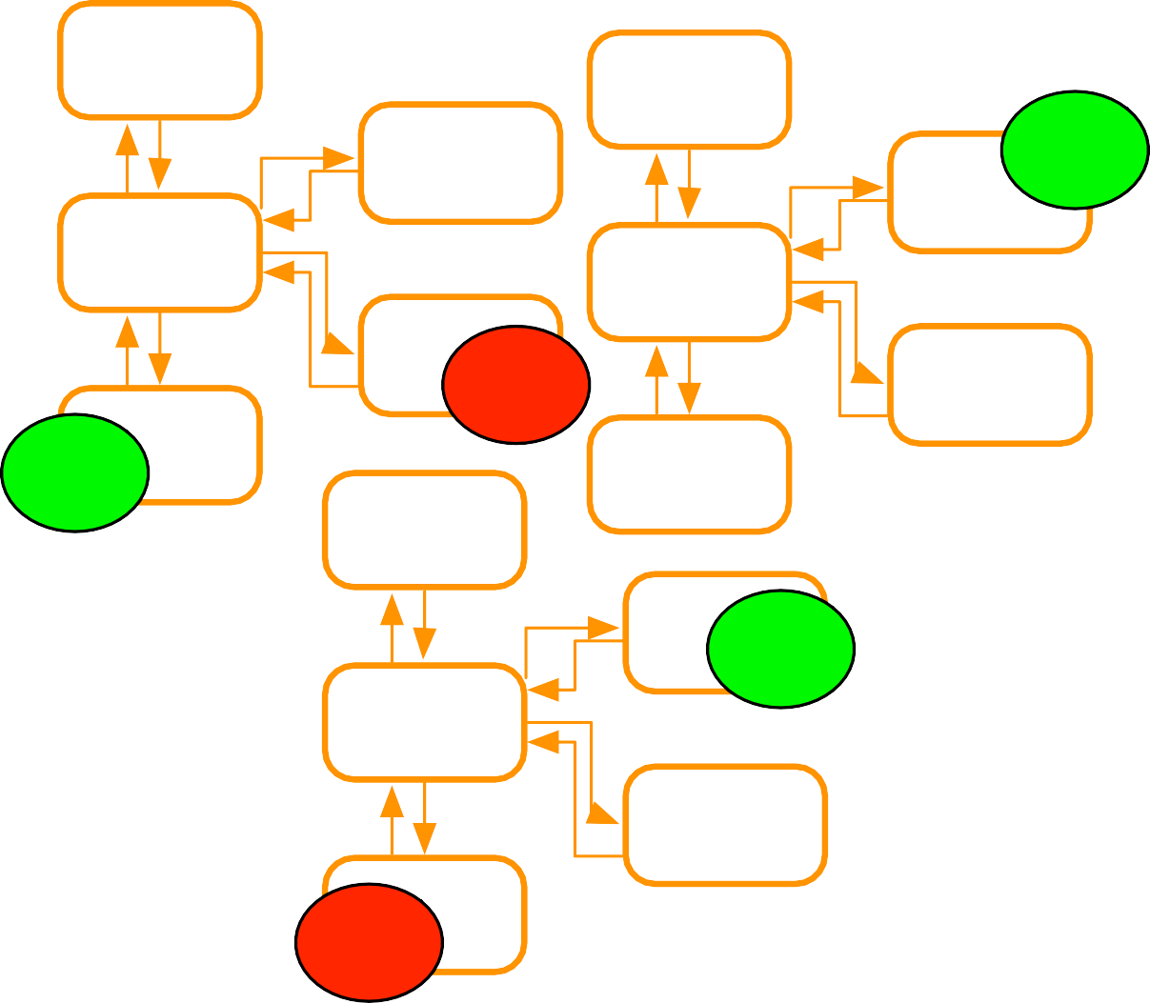
Automation Tools: Continuous Integration
Many CI tools
GO/CD
Jenkins
✓
Many more!
Desired features
Cross platform
Windows builders, Java builders and others
Source control integration
Notifications
IDE Integration (optional)
Map a microservice to a CI build
Code change triggers build of specific service
Feedback just received on that service
Builds and tests run quicker
Separate code repository for service
End product is in one place
CI builds to test database changes
Both microservice build and database upgrade are ready
Avoid one CI build for all services
X
✓
✓
X

Slide 20






Automation Tools: Continuous Deployment
Many CD tools
Aim for cross platform tools
Desired features
Central control panel
Simple to add deployment targets
Support for scripting
Support for build statuses
Integration with CI tool
Support for multiple environments
Support for PAAS
Accounts Service
✓
Server 1
GO
Continous Deployment Tool
Orders Service
✓
Server 2
✓
Products Service
Server 3

Slide 21
Module Summary
Communication
Synchronous
Asynchronous
Hosting Platforms
Virtualization
Containers
Self Hosting
Registry and Discovery
Observable Microservices
Monitoring Tech
Logging Tech
Performance
Scaling
Caching
API Gateway
Automation Tools
Continuous Integration
Continuous Deployment

