Slide 1
Microservice coordination with Spring cloud

Slide 2
Why are Microservices Architectures Popular ?
Desire for faster changes
Need for greater availability
Motivation for fine-grained scaling
Compatible with a DevOps mindset

Slide 3
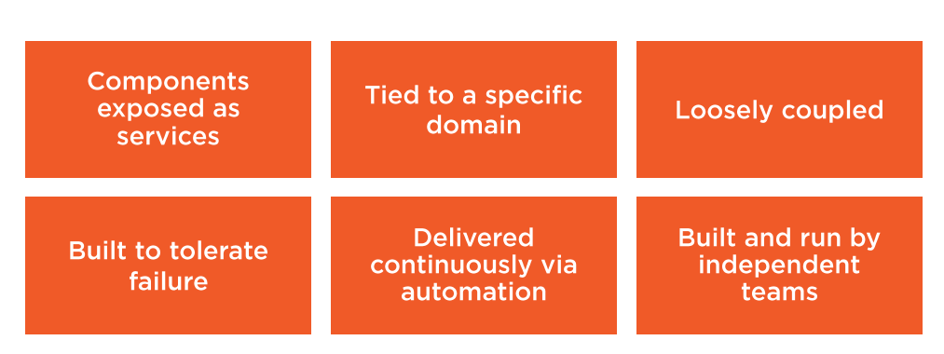
Core Characteristics of Microservices

Slide 4
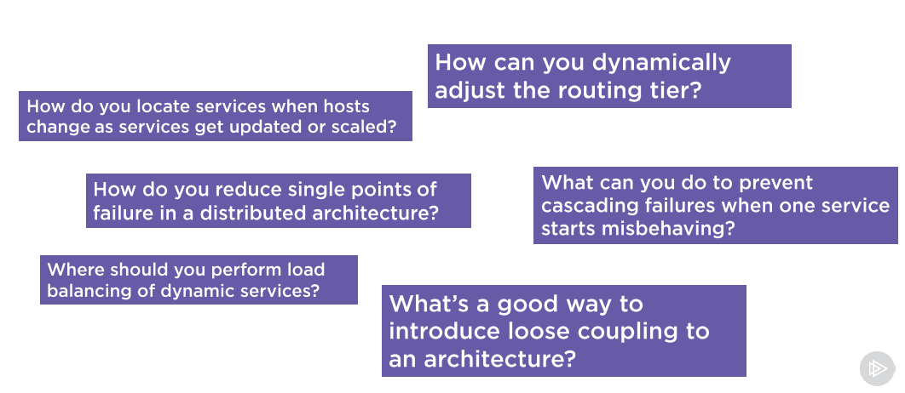
Coordination Challenges that Emerge with Microservices

Slide 5
Spring Cloud Project featured in this course
Spring Cloud Eureka
Spring Cloud Ribbon
Spring Cloud Hystrix
Spring Cloud Zuul

Slide 6
Customer Details UI
Customer MS
Account MS

Slide 7
Locating Services at Runtime using Service Discovery
Role of Service Discovery in microservices
Problem with status quo
Describing Spring Cloud Eureka
Creating a Eureka Server
Registering services with Eureka
Discovering services with Eureka
Configuring health information
Reviewing the high availability setup
Option for advanced configuration

Slide 8
The Role of Service Discovery in Microservices
Recognize the Dynamic environment
Have a live view of healthy services
Avoid hard-coded references to service location(IP/Port)
Centralized list of available Services

Slide 9
Problem with Status Quo
Outdated configuration management DBs
Simplistic HTTP 200 health check
Limited load balancing for middle-tier
DNS is insufficient for microservices
Registries can be single points of failure

Slide 10
Spring Cloud Eureka - History
First released by Netflix OSS team in 2012
Used for middle-tier load balancing
Integrated into many other Netflix projects

Slide 11
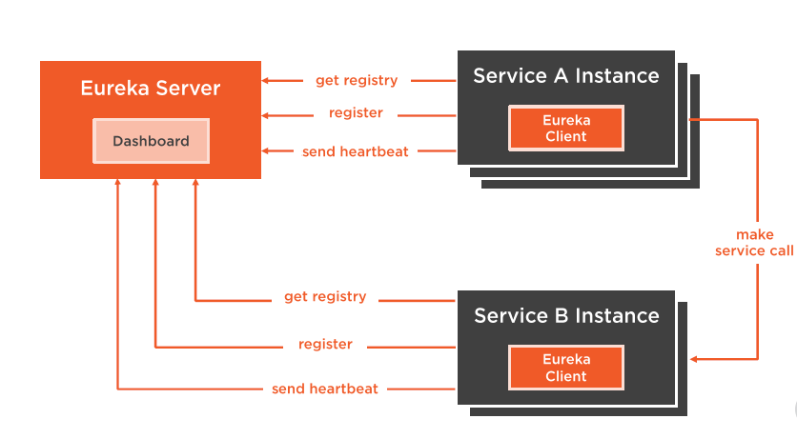
Components of a Eureka Environment

Slide 12
Creating a Eureka Server
Add spring-cloud-starter-eureka-server
Standalone or clustered configuration
Enable @EurekaServer Server annotation
Multiple configuration options

Slide 13
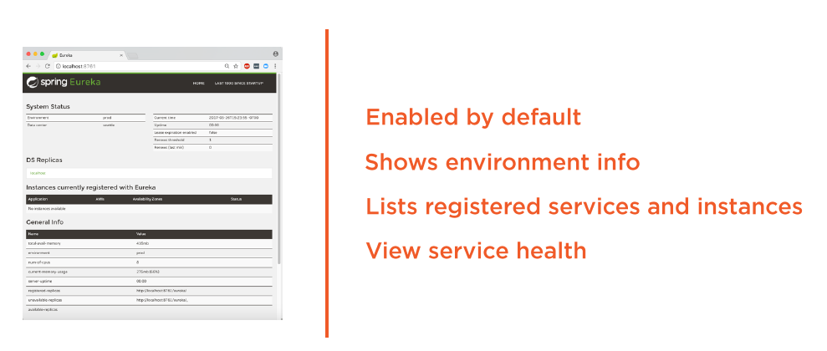
Using the Eureka Dashboard

Slide 14
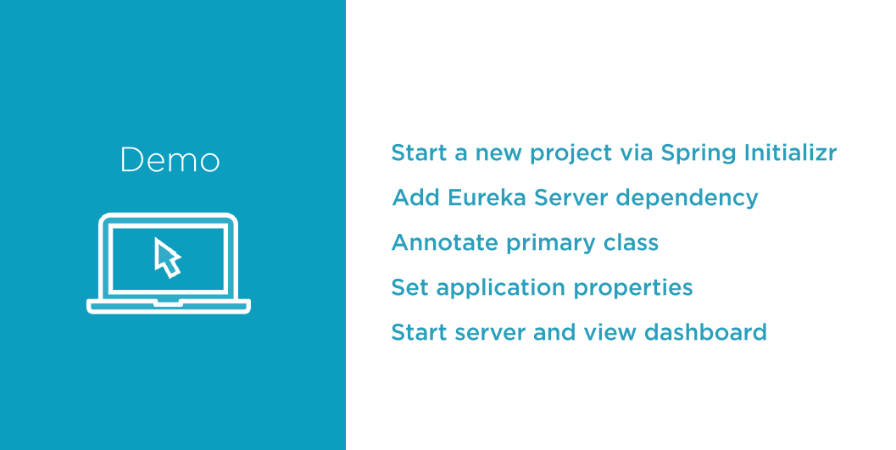

Slide 15
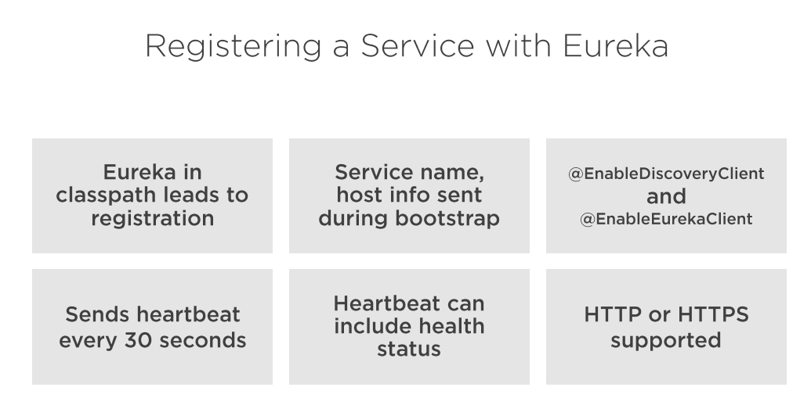

Slide 16
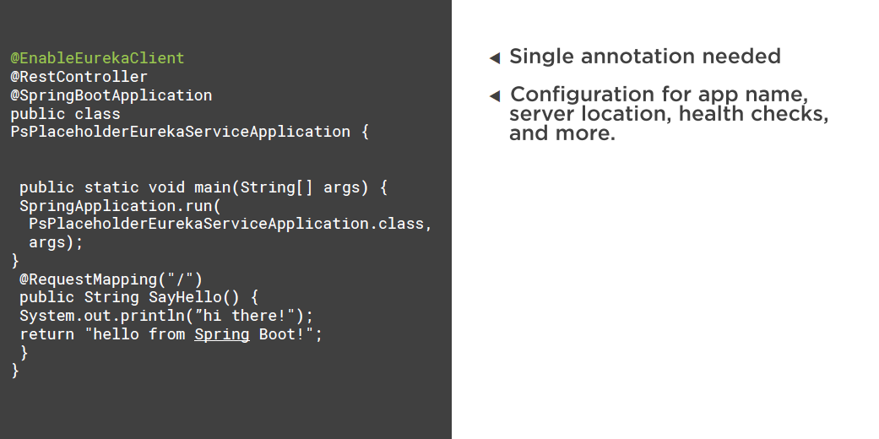

Slide 17

Open existing service
Add project dependency on Eureka
Annotate primary class
Add bootstrap and application properties
Startup Microservices and see in registry
Start a second instance
Same with another service

Slide 18
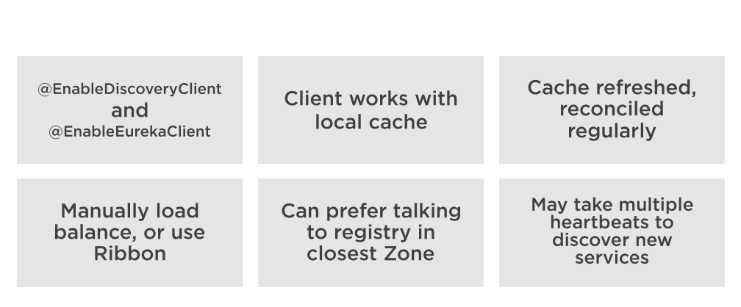
Discovering a Service with Eureka

Slide 19
Open application
Add dependency of Eureka
Update application properties
Annotate primary class
Add Load Balanced RestTemplate
Replace hard-coded URL with registry lookup
Test application

Slide 20
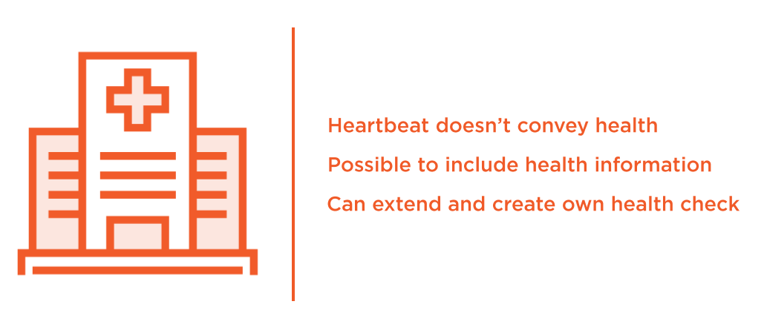
Configuring Service Health Information

Slide 21
Add a custom health check
Start up microservice and wait for error
See service taken out of rotation by Eureka

Slide 22
Advanced Configuration Options
Dozen and Dozens of configuration flags
Set cache refresh internal
Set timeouts
Set connection limits
Override default service, health endpoints
Define replication limits, timeout, retries..
etc …

Slide 23


