Slide 1
Protecting Systems with Circuit Breaker

Slide 2
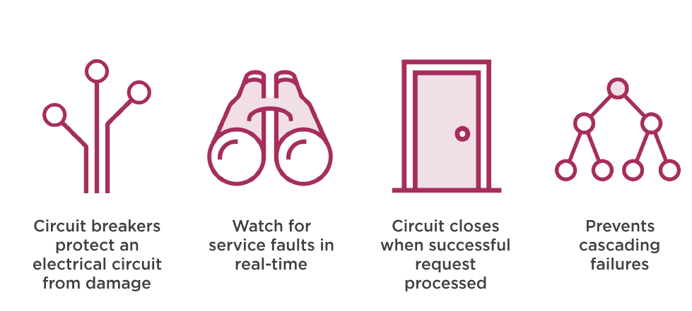
The Role of Circuit Breakers in Microservices

Slide 3
Problem with Status Quo
Major dependence on server to be resilient
Load balancers are network call too
Hard to detect and “recover” via automation
Solution can be intrusive to code base or add significant over head
Resilience engineering often not part of logic or behavior

Slide 4
Spring Cloud Hystrix
Library for enabling resilience in Microservices

Slide 5
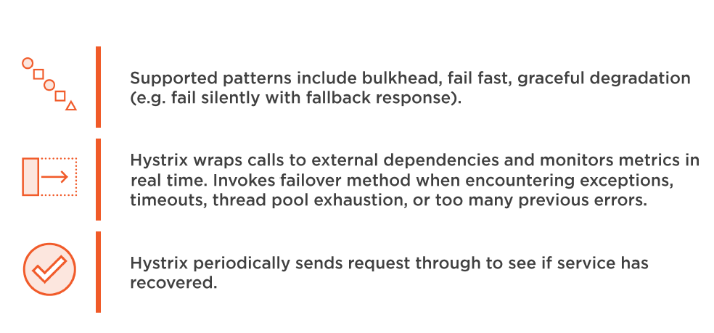
What Hystrix Does

Slide 6
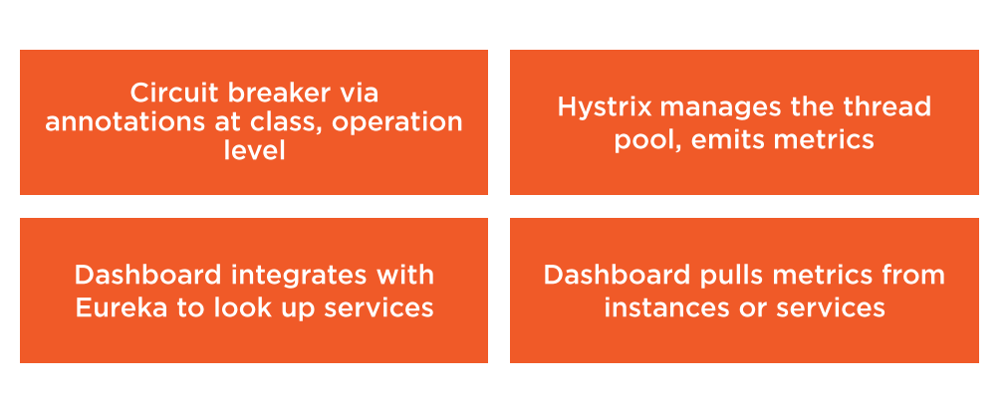
How Spring Cloud Hystrix Works

Slide 7
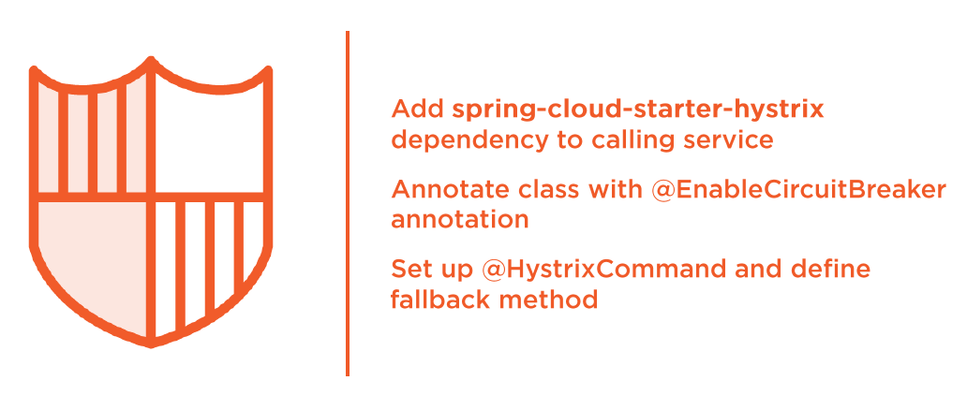
Creating a Hystrix-protected Service

Slide 8
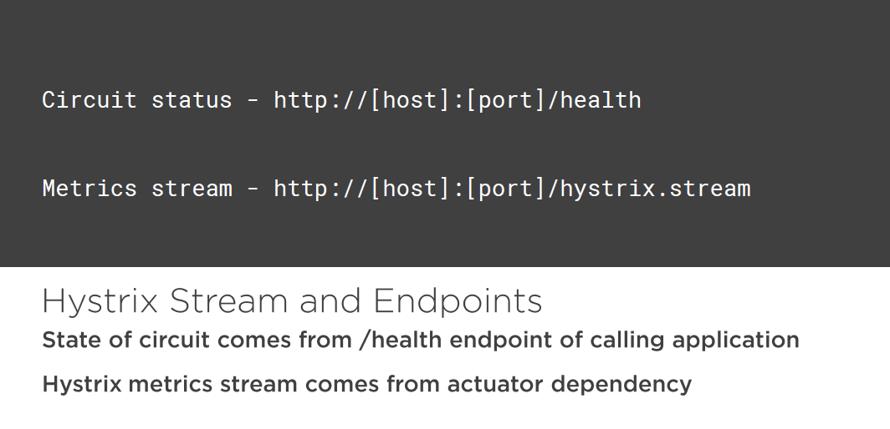

Slide 9

Open client application
Add hystrix dependency to project
Introduce Circuit Breaker to code
Start up and call client applications
Review circuit and metrics endpoints

Slide 10
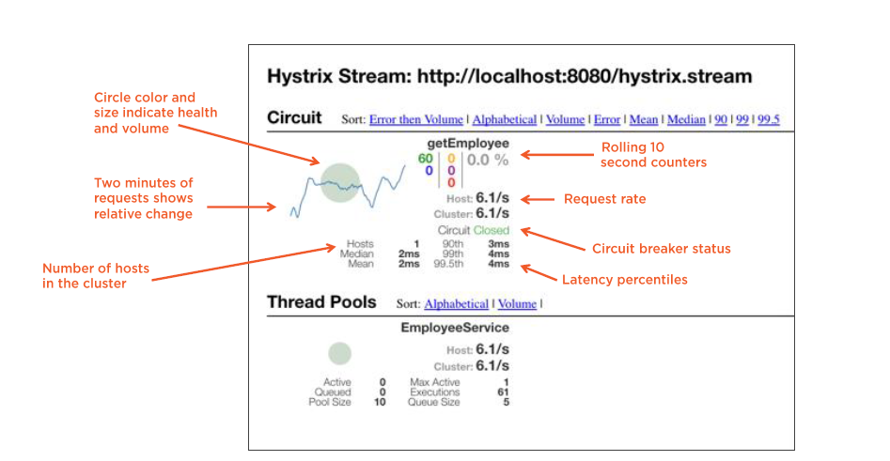
What’s visible on the Hystrix Dashboard

Slide 11
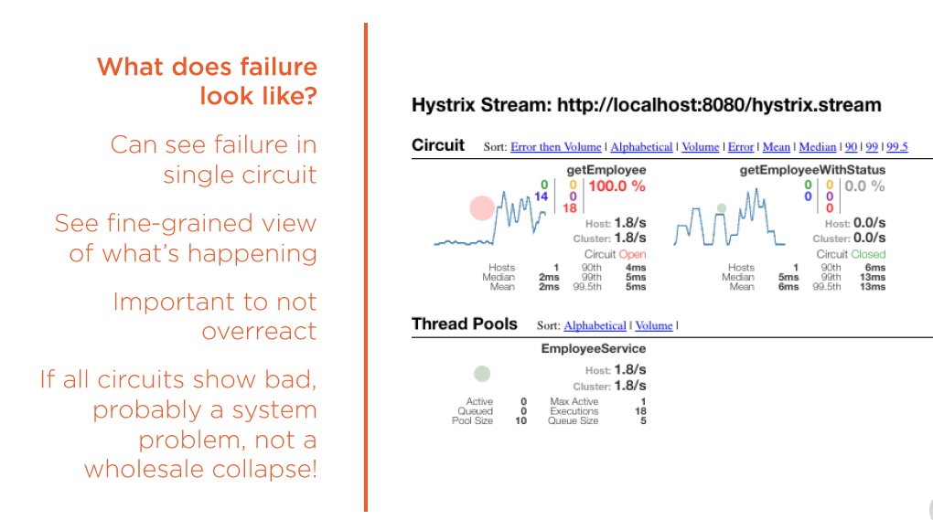

Slide 12
Create a new project from spring initilizer
Choose Hystrix dashboard dependency
Annotate main class
Startup dashboard
Load streams for services

Slide 13
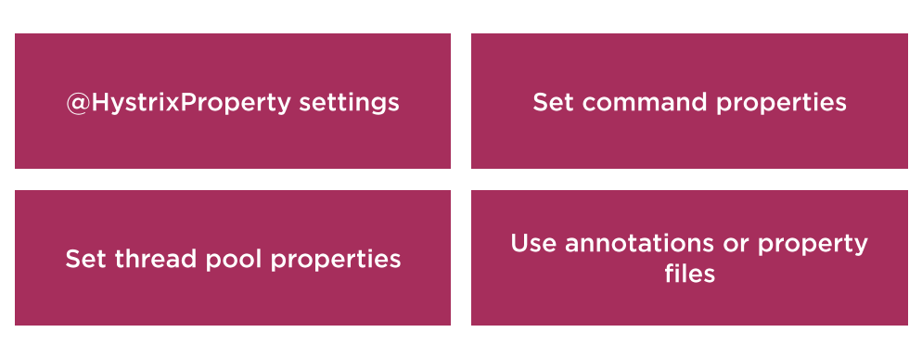
Advanced Hystrix Configuration

Slide 14


