Slide 1
Routing your Microservices traffic

Slide 2
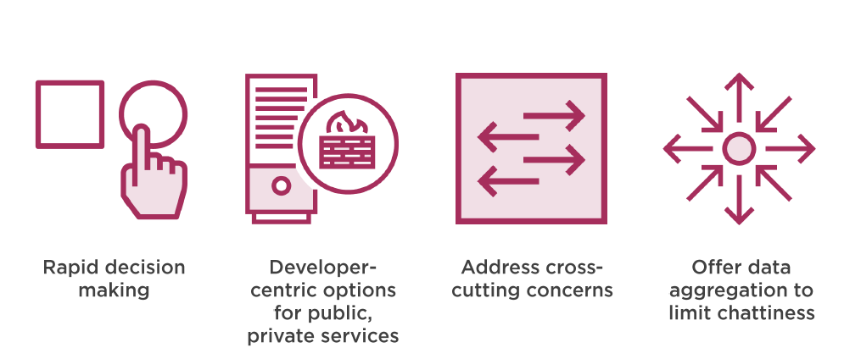
The Role of Routing in Microservices

Slide 3
Problem with Status Quo
Centralized load balancer, API gateways
Routing tech focused on public services
API granularity often at odds with client demands
Different performance needs for different clients
Tools that don’t account for constant change

Slide 4
Spring Cloud Ribbon
Client-Side software load balancer

Slide 5
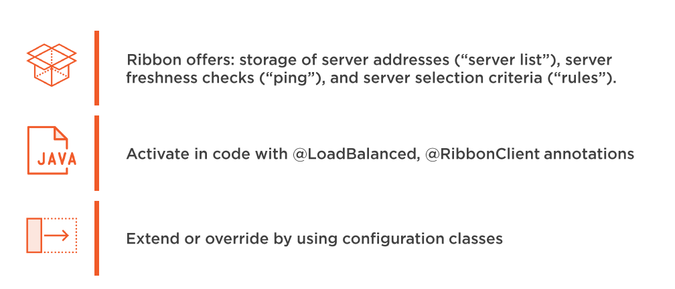
Key Concepts

Slide 6
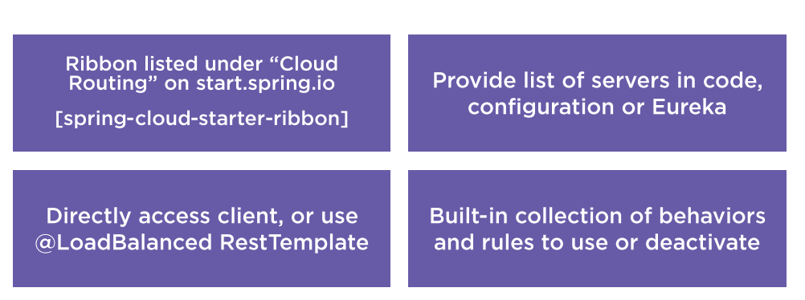
Configuring Ribbon in Applications

Slide 7

Open Client application and see Ribbon dependency
Disable existing Eureka Configuration
Add list of target servers to property file
Add RibbonClient annotation
Run client application and see load balancing occur

Slide 8
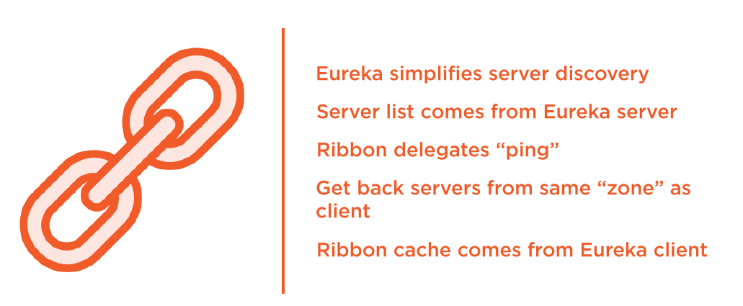
How Ribbon and Eureka Work Together

Slide 9
Re-enable Eureka in client application
Update annotation
Test application

Slide 10
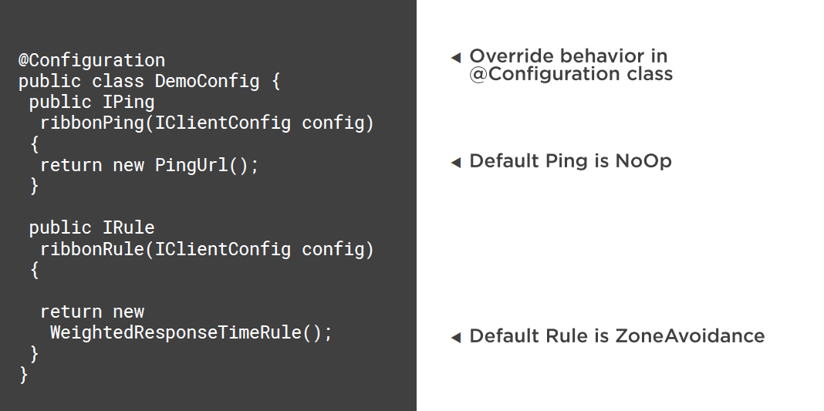

Slide 11
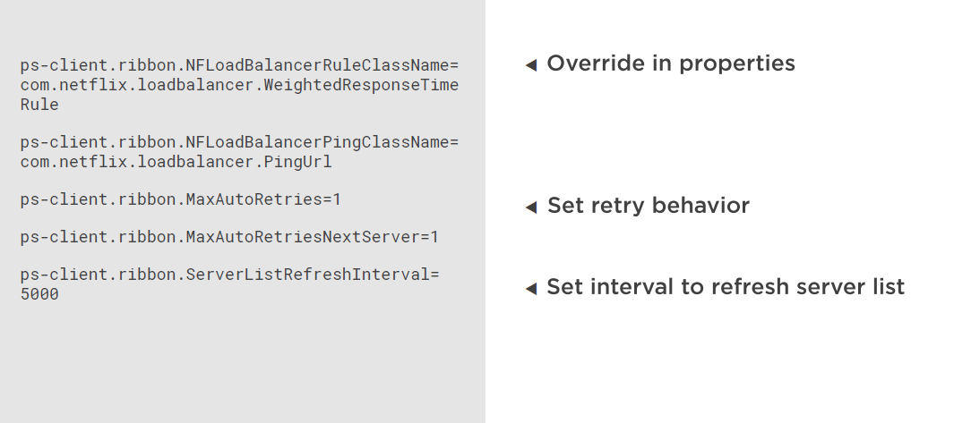

Slide 12
Add Ribbon configuration to properties file of client application
Observe behavior of running application
Add class that changes ping and routing rules
Update RibbonClient annotation
Observe behavior of running application

Slide 13
Spring Cloud Zuul
Embedded proxy for routing traffic in a Microservices Architecture

Slide 14
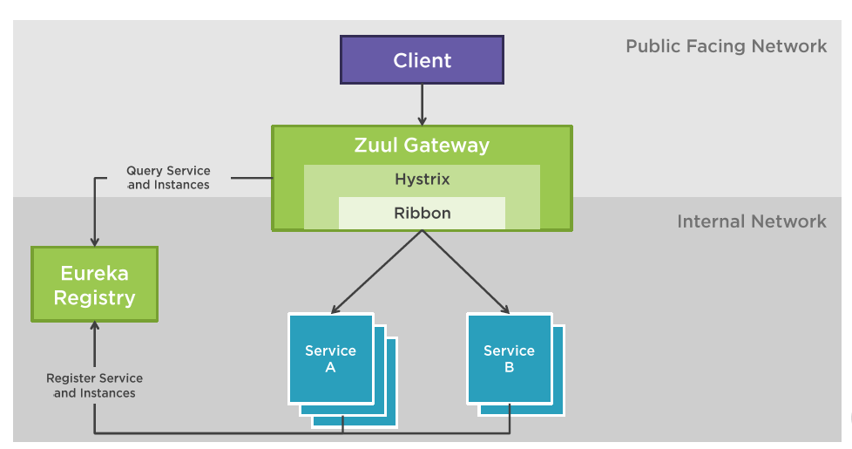
How Zuul Works

Slide 15
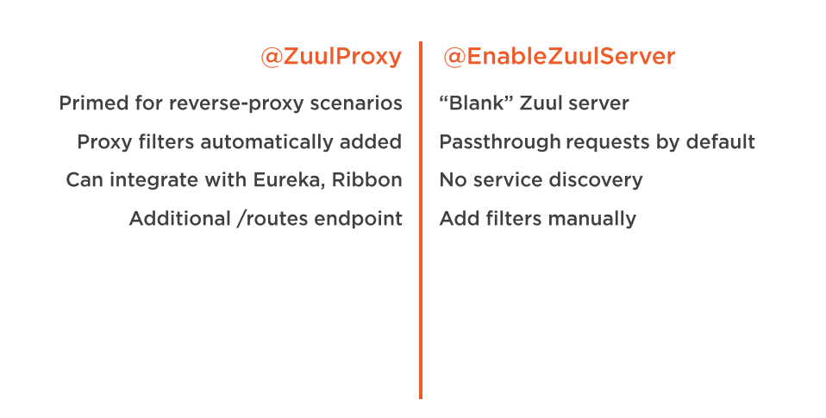
Choosing a Spring Cloud Model

Slide 16
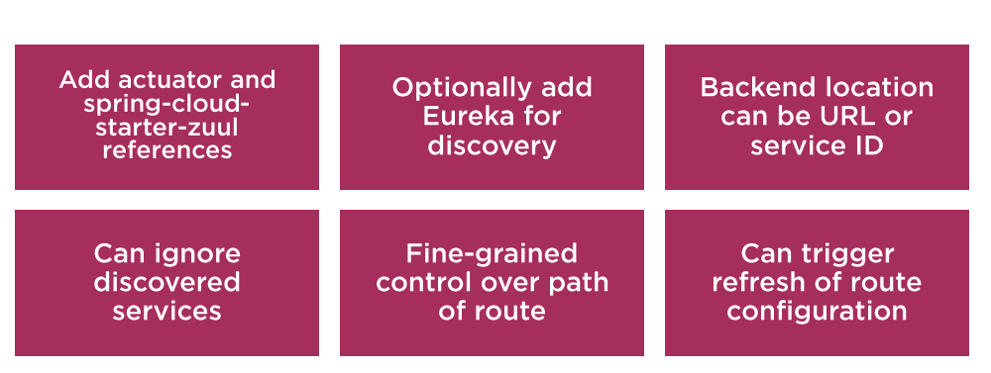
Creating a Zuul Proxy with configurable Routes

Slide 17
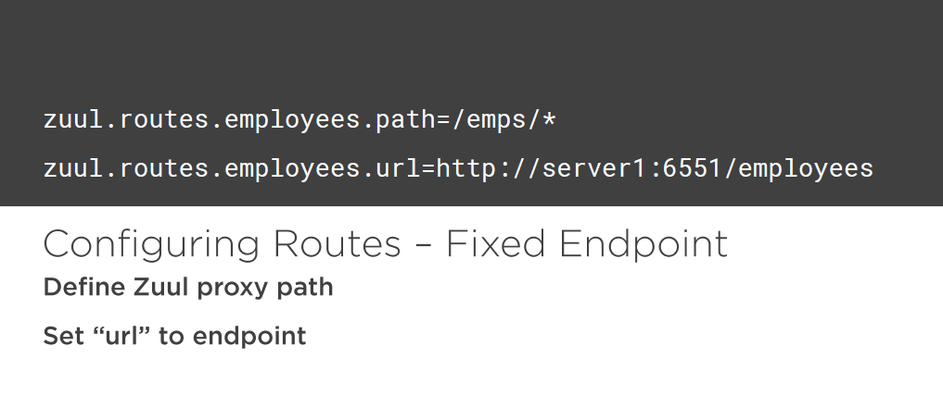

Slide 18
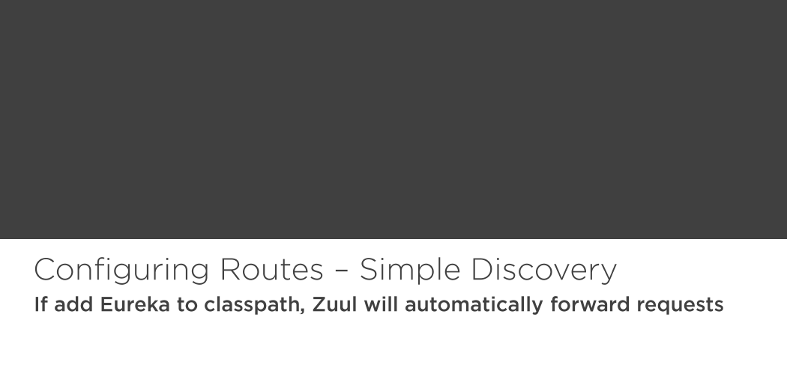

Slide 19
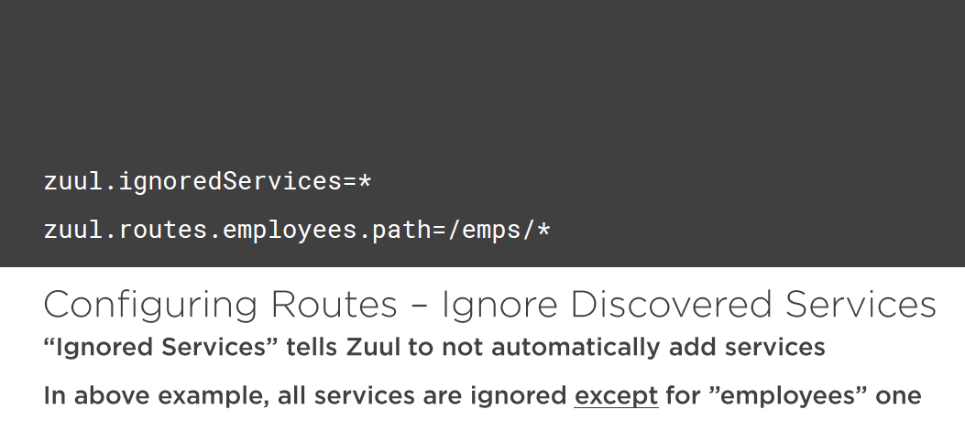

Slide 20
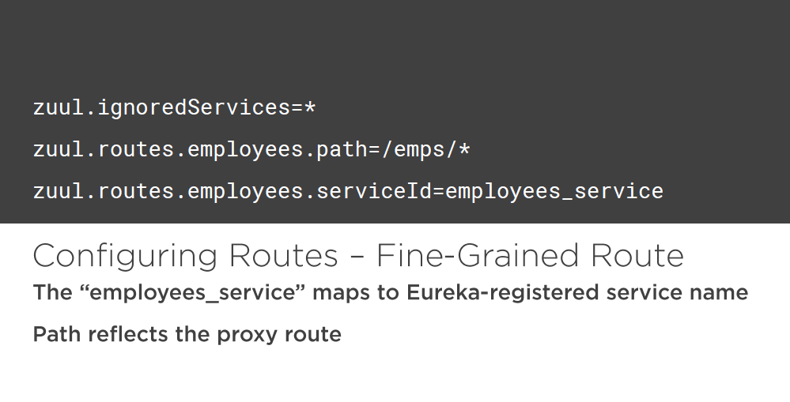

Slide 21
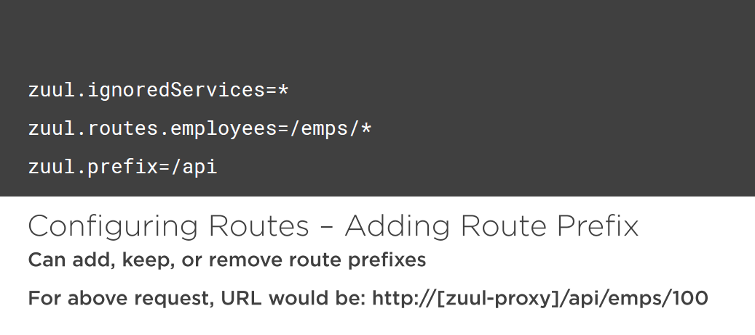

Slide 22
Create a new project from spring initializer
Annotate class to turn into Zuul proxy
Set up with local URLs, no Eureka
Add Eureka with no whitelisting
Lock down allowable services (like exclude admin page)
Introduce prefix handling

Slide 23
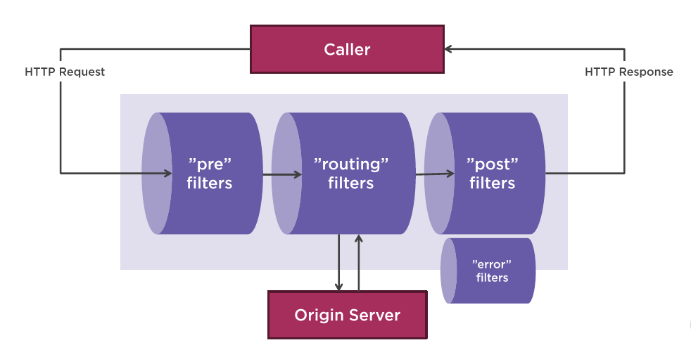
About Zuul Filters and Stages

Slide 24
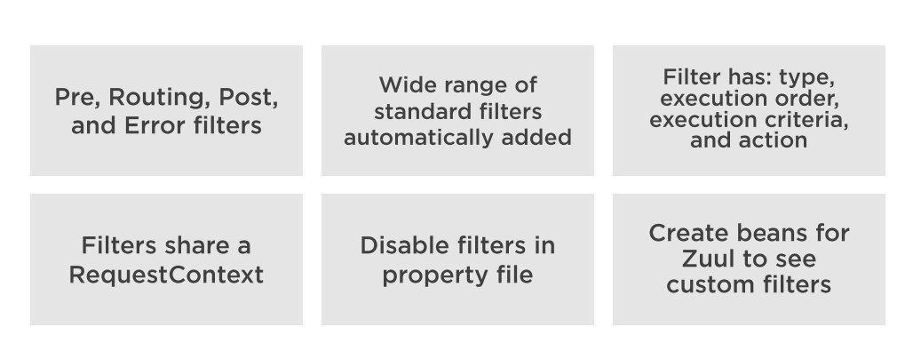
Working with Zuul Filters

Slide 25
Create “pre” filter that logs request from specific caller
Create “pre” filter which adds “startTime” to RequestContext
Create “post” filter that checks “startTime” and logs call duration
Add Filter beans to Zuul proxy

Slide 26


