Slide 1
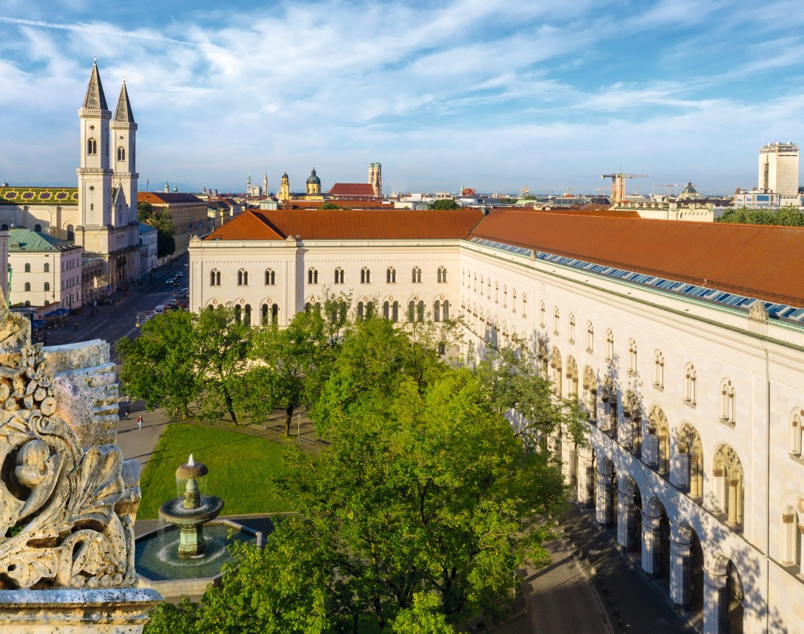
X and H
Quantum Operations
Minh Chung, MNM Team
Note - Documentation - Summary

Slide 2
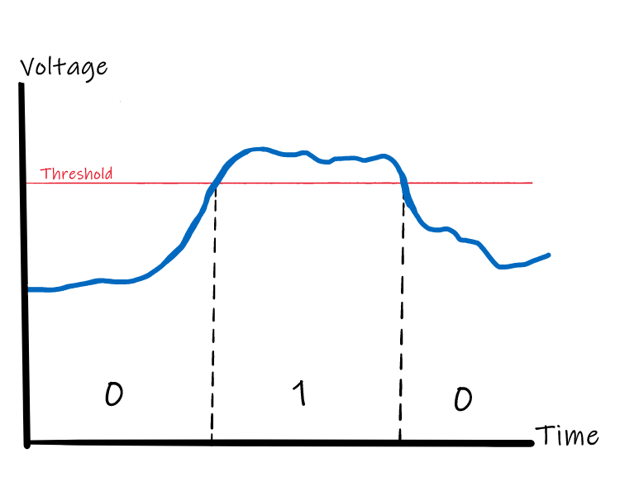
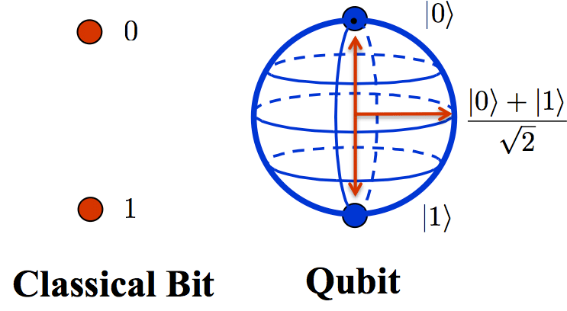
Describing Quantum Operations
Classical computers vs. Quantum computers
source: https://codebook.xanadu.ai/I.1
source: Bennett et al., Strengths and Weaknesses of Quantum Computing, SIAM Journal on Computing, 1997
A bit is a binary value, 0 or 1
A bit is associated to something physical, 2 different states
E.g., a voltage passing through an electronic component regulates bits.
Quantum bits/qubits also correspond to something physical, but focusing on the theory from a software/algorithm perspective
Quantum computing is the manipulation of qubits to solve problems
A qubit’s state can be either 0, 1, or a quatum superposition of 0 and 1

Slide 3







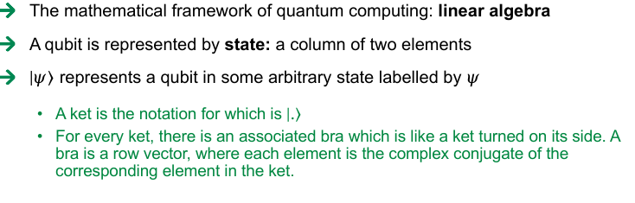
Mathematical Representation of Qubits
Qubits - mathematical representation
Dirac notation
(bra-ket notation)
The mathematical framework of quantum computing: linear algebra
A qubit is represented by state: a column of two elements
$\left|\left.ψ\right\rangle \right.$ represents a qubit in some arbitrary state labelled by $ψ$
A ket is the notation for which is $\left|\left..\right\rangle \right.$
For every ket, there is an associated bra which is like a ket turned on its side. A bra is a row vector, where each element is the complex conjugate of the corresponding element in the ket.
$$state 0 =\left({1 \atop 0}\right)$$
$$\left|\left.0\right\rangle \right. =\left({1 \atop 0}\right)$$
$$state 1 =\left({0 \atop 1}\right)$$
$$\left|\left.1\right\rangle \right. =\left({0 \atop 1}\right)$$
$$\left.\left\langle 0\right.\right| =\left(\begin{matrix}1 & 0\end{matrix}\right)$$
$$\left.\left\langle 1\right.\right| =\left(\begin{matrix}0 & 1\end{matrix}\right)$$
form the basis
Inner product:
bases consist of independent vectors
$$\left.\left\langle 1\right.\right|\left|\left.0\right\rangle \right. =\left.\left\langle 1\right.\right|\left.0\right\rangle =\left(\begin{matrix}0 & 1\end{matrix}\right).\left({1 \atop 0}\right)=0.1 + 1.0 = 0$$
a special case of orthogonal (can be checked by inner product)

Slide 4


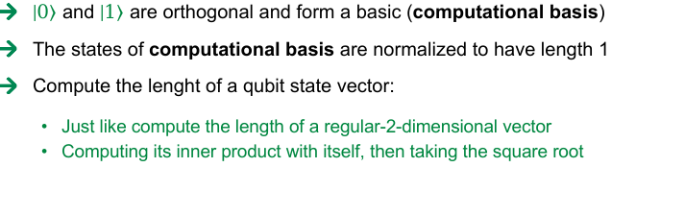

Mathematical Representation of Qubits
Qubits - $\left|\left.0\right\rangle \right.$ and $\left|\left.1\right\rangle \right.$
$\left|\left.0\right\rangle \right.$ and $\left|\left.1\right\rangle \right.$ are orthogonal and form a basic (computational basis)
The states of computational basis are normalized to have length 1
Compute the lenght of a qubit state vector:
Just like compute the length of a regular-2-dimensional vector
Computing its inner product with itself, then taking the square root
When a basis consists of two normalized, orthogonal vectors, it is called an orthonormal basis
$$\sqrt{\left\langle \left.1\right|\right.\left.1\right\rangle }=\sqrt{\left(\begin{matrix}0 & 1\end{matrix}\right)\left({0 \atop 1}\right)}$$
$$=\sqrt{0.0+1.1}=0$$

Slide 5






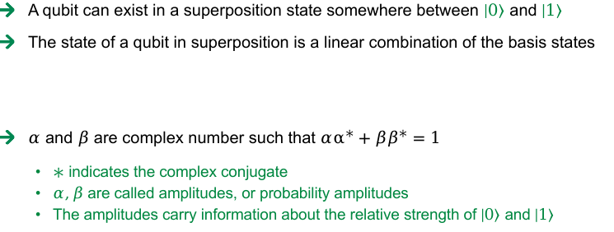

Mathematical Representation of Qubits
Superposition
A qubit can exist in a superposition state somewhere between $\left|\left.0\right\rangle \right.$ and $\left|\left.1\right\rangle \right.$
The state of a qubit in superposition is a linear combination of the basis states
$α$ and $β$ are complex number such that $αα^{∗}+ββ^{∗}=1$
$∗$ indicates the complex conjugate
$α,β$ are called amplitudes, or probability amplitudes
The amplitudes carry information about the relative strength of $\left|\left.0\right\rangle \right.$ and $\left|\left.1\right\rangle \right.$
Suppose we have two states:
The inner product between $\left|\left.ψ\right\rangle \right.$ and $\left|\left.φ\right\rangle \right.$
where, the bra of $\left|\left.φ\right\rangle \right.$ is calculated by taking the conjugate of the amplitudes
$$\left|\left.ψ\right\rangle \right.=α\left|\left.0\right\rangle \right.+β\left|\left.1\right\rangle \right.$$
$$\left|\left.φ\right\rangle \right.=γ\left|\left.0\right\rangle \right.+δ\left|\left.1\right\rangle \right.$$
$$\left|\left.ψ\right\rangle \right.=α\left|\left.0\right\rangle \right.+β\left|\left.1\right\rangle \right.=\left({α \atop β}\right)$$
$$\left.\left\langle φ\right.\right|\left.ψ\right\rangle =\left(\begin{matrix}γ^{∗} & δ^{∗}\end{matrix}\right)\left({α \atop β}\right)$$
$$\left.\left\langle φ\right.\right| =γ^{∗}\left.\left\langle 0\right.\right|+δ^{∗}\left.\left\langle 1\right.\right|=\left(\begin{matrix}γ^{∗} & δ^{∗}\end{matrix}\right)$$
$$\left.\left\langle φ\right.\right|\left.ψ\right\rangle =(γ^{∗}\left.\left\langle 0\right.\right|+δ^{∗}\left.\left\langle 1\right.\right|).(α\left|\left.0\right\rangle \right.+β\left|\left.1\right\rangle \right.)$$
$$=γ^{∗}α\left.\left\langle 0\right.\right|\left.0\right\rangle +δ^{∗}α\left.\left\langle 1\right.\right|\left.0\right\rangle +γ^{∗}β\left.\left\langle 0\right.\right|\left.1\right\rangle +δ^{∗}β\left.\left\langle 1\right.\right|\left.1\right\rangle$$
$$=γ^{∗}α\left.\left\langle 0\right.\right|\left.0\right\rangle +δ^{∗}β\left.\left\langle 1\right.\right|\left.1\right\rangle$$

Slide 6


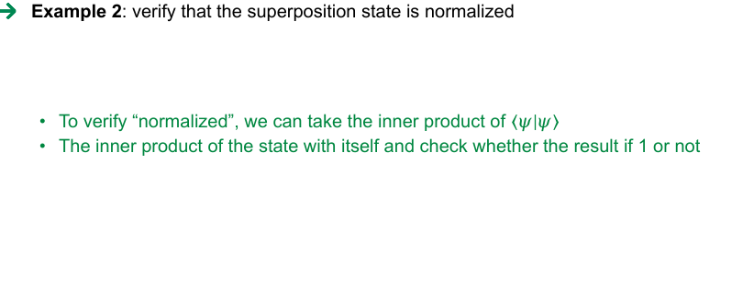

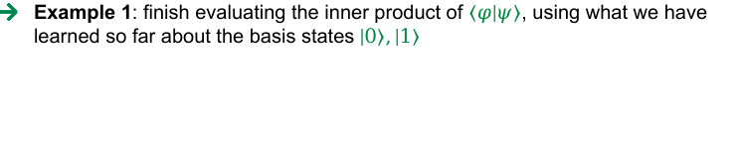
Mathematical Representation of Qubits
Superposition
Example 1: finish evaluating the inner product of $\left.\left\langle φ\right.\right|\left.ψ\right\rangle$, using what we have learned so far about the basis states $\left|\left.0\right\rangle \right.,\left|\left.1\right\rangle \right.$
$$\left.\left\langle φ\right.\right|\left.ψ\right\rangle =\left(\begin{matrix}γ^{∗} & δ^{∗}\end{matrix}\right)\left({α \atop β}\right)$$
$$=γ^{∗}α+δ^{∗}β$$
Example 2: verify that the superposition state is normalized
To verify “normalized”, we can take the inner product of $\left.\left\langle ψ\right.\right|\left.ψ\right\rangle$
The inner product of the state with itself and check whether the result if 1 or not
$$|\left.ψ\right\rangle =\frac{3}{5}\left|\left.0\right\rangle \right.−{\frac{4}{5}}^{e^{{πi}/6}}\left|\left.1\right\rangle \right.$$
$$\left.\left\langle ψ\right.\right|\left.ψ\right\rangle =\left(\frac{3}{5}\left\langle 0\right.|−{\frac{4}{5}}^{e^{−{πi}/6}}\left\langle 1|\right.\right)\left(\frac{3}{5}\left|\left.0\right\rangle \right.−{\frac{4}{5}}^{e^{{πi}/6}}\left|\left.1\right\rangle \right.\right)=\frac{9}{25}+\frac{16}{25}=1$$

Slide 7




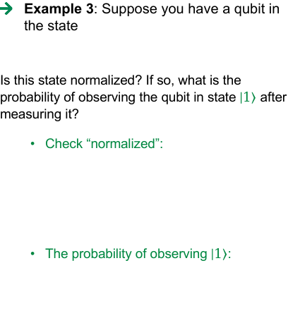


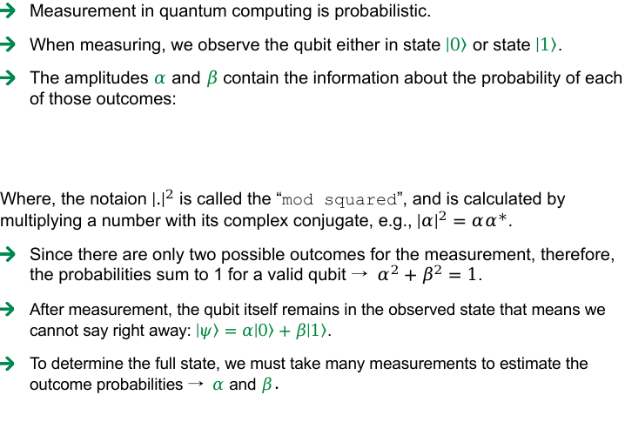
Mathematical Representation of Qubits
Measurement outcome probabilities
Measurement in quantum computing is probabilistic.
When measuring, we observe the qubit either in state $\left|\left.0\right\rangle \right.$ or state $\left|\left.1\right\rangle \right.$.
The amplitudes $α$ and $β$ contain the information about the probability of each of those outcomes:
Where, the notaion ${\left|.\right|}^{2}$ is called the “mod squared”, and is calculated by multiplying a number with its complex conjugate, e.g., ${\left|α\right|}^{2}=αα^{∗}$.
Since there are only two possible outcomes for the measurement, therefore, the probabilities sum to 1 for a valid qubit → $α^{2}+β^{2}=1$.
After measurement, the qubit itself remains in the observed state that means we cannot say right away: $\left|\left.ψ\right\rangle \right.=α\left|\left.0\right\rangle \right.+β\left|\left.1\right\rangle \right.$.
To determine the full state, we must take many measurements to estimate the outcome probabilities → $α$ and $β$.
Example 3: Suppose you have a qubit in the state
Is this state normalized? If so, what is the probability of observing the qubit in state $\left|\left.1\right\rangle \right.$ after measuring it?
Check “normalized”:
The probability of observing $\left|\left.1\right\rangle \right.$:
$$|\left.ψ\right\rangle =\frac{1}{2}\left|\left.0\right\rangle \right.−\frac{\sqrt{3}i}{2}\left|\left.1\right\rangle \right.$$
Prob(measure and observe $\left|\left.0\right\rangle \right.$) = ${\left|α\right|}^{2},$
Prob(measure and observe $\left|\left.1\right\rangle \right.$) = ${\left|β\right|}^{2},$
$$\left.\left\langle ψ\right.\right|\left.ψ\right\rangle =\left(\frac{1}{2}\left\langle 0\right.|+\frac{\sqrt{3}i}{2}\left\langle 1|\right.\right)\left(\frac{1}{2}\left|\left.0\right\rangle \right.−\frac{\sqrt{3}i}{2}\left|\left.1\right\rangle \right.\right)$$
$$=\frac{1}{4}+\frac{3}{4}=1$$
$$−\frac{\sqrt{3}i}{2}×\frac{\sqrt{3}i}{2}=\frac{3}{4}$$

Slide 8






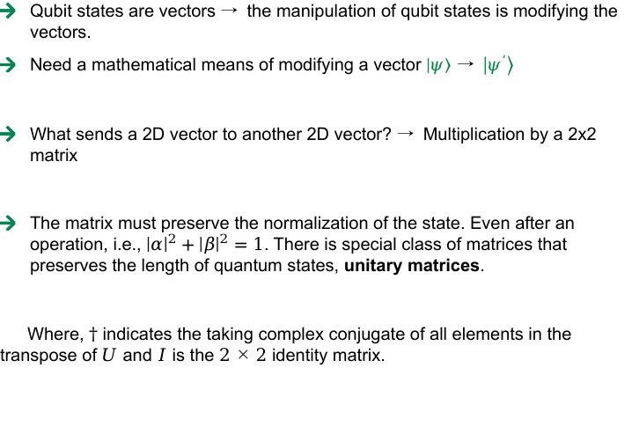

Mathematical Representation of Qubits
Operations on qubit states
Qubit states are vectors → the manipulation of qubit states is modifying the vectors.
Need a mathematical means of modifying a vector $\left|\left.ψ\right\rangle \right.$ → $\left|\left.ψ^{’}\right\rangle \right.$
What sends a 2D vector to another 2D vector? → Multiplication by a 2x2 matrix
The matrix must preserve the normalization of the state. Even after an operation, i.e., ${\left|α\right|}^{2}+{\left|β\right|}^{2}=1$. There is special class of matrices that preserves the length of quantum states, unitary matrices.
Where, $†$ indicates the taking complex conjugate of all elements in the transpose of $U$ and $I$ is the $2×2$ identity matrix.
Example 4: Suppose you have a qubit in the state
and we want to apply the operation
Compute the state of the qubit after applying $U$
$$|\left.ψ\right\rangle =\frac{1}{2}\left|\left.0\right\rangle \right.−\frac{\sqrt{3}i}{2}\left|\left.1\right\rangle \right.$$
$$\left|\left.ψ\right\rangle \right.=α\left|\left.0\right\rangle \right.+β\left|\left.1\right\rangle \right.→\left|\left.ψ^{’}\right\rangle \right.=α^{’}\left|\left.0\right\rangle \right.+β^{’}\left|\left.1\right\rangle \right.$$
$$U =\left(\begin{matrix}0 & i \\ −i & 0\end{matrix}\right)$$
$$\left|\left.ψ^{’}\right\rangle \right.=U\left|\left.ψ\right\rangle \right.$$
$$\left|\left.ψ^{’}\right\rangle \right.=U\left|\left.ψ\right\rangle \right.=\left(\begin{matrix}0 & i \\ −i & 0\end{matrix}\right)\left(\begin{matrix}\frac{1}{2} \\ \frac{−\sqrt{3}i}{2}\end{matrix}\right)$$
$$UU^{†}=I$$
$$=\left(\begin{matrix}\frac{\sqrt{3}}{2} \\ \frac{−i}{2}\end{matrix}\right)=\frac{\sqrt{3}}{2}\left|\left.0\right\rangle \right.−\frac{i}{2}\left|\left.1\right\rangle \right.$$

Slide 9
Ludwig-Maximilians-Universität München, MNM-Team
Oettingenstr. 67
80538 Munich
https://www.nm.ifi.lmu.de/

