Slide 1

2d shooter implementation and progress
Christian Moden

Slide 2
Overview
Software Assets
High Level Goal Review
Design Architecture
Obstacles

Slide 3



Software assets
Visual Studio Monogame Framework
Adobe Photoshop
OpenGameArt.com
https://www.wikidata.org/wiki/Q13218967
https://logos-world.net/photoshop-logo/
https://www.ilovefreesoftware.com/07/webware/download-artwork-and-music-to-design-games-opengameart.html

Slide 4
Goals Overview
Monogame framework used to create game world
Monogame holds all content and architecture
Allows for game-specific program driver
Create 2-3 levels of gameplay
Use Photoshop to create/modify sprites/animation

Slide 5

Design Architecture Game Loop
Process Input
Update
Render

Slide 6
Design Architecture
Program Driver (Game Controller) heart of game
Initializes all sprite assets
Processes input
Renders all sprites
Sprites (Helicopter, missile, etc) all have their own mini game loops, all owned by the Game Controller
Particle systems for some sprites (ie bullets): save memory/processing time for large number of sprites

Slide 7
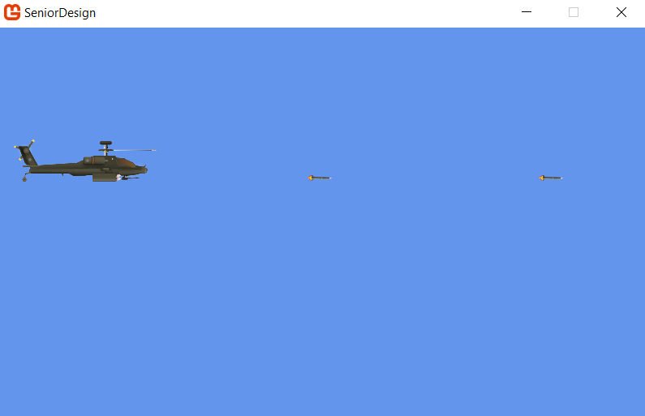
Example gameplay

Slide 8
classes
GameController
BulletParticleSystem
Bullet
MissileSprite
ChopperSprite
Constants
(Coming soon) Antagonist1
(Coming soon) Antagonist2

Slide 9
Obstacles/Next Features
Finish implementing particle system
Shifting architecture to support multiple levels
Continue working on AI for antagonists

Slide 10

Thank You

