Slide 1
Cis 598 2d shooter game
Christian Moden

Slide 2
overview
Requirements
Assets
Timeline
Design
Progress

Slide 3
Requirements
Functioning 2D shooter game, Console-based
User can navigate their sprite through >=2 levels
1 protagonist sprite, ~4+ antagonist boss sprites
Each level has new bosses, each level with an increased difficulty
Level One has one boss
Level 2/3 has 2-3 bosses
Each boss shoots back randomly at first, aims at protagonist in higher levels
Scrum/Agile Methodology

Slide 4
Requirements 2
User can fire multiple types of munitions
City background, parallax scrolling
Stretch goals/requirements
Guided munitions
Sound effects
Varying levels of difficulty in game setup
Powerups to replenish ammo, health

Slide 5



assets
Visual Studio Monogame Framework (C#)
Physics engine? TBD
Adobe Photoshop for Sprite animation
OpenGameArt.org
https://www.wikidata.org/wiki/Q13218967
https://logos-world.net/photoshop-logo/
https://www.ilovefreesoftware.com/07/webware/download-artwork-and-music-to-design-games-opengameart.html

Slide 6
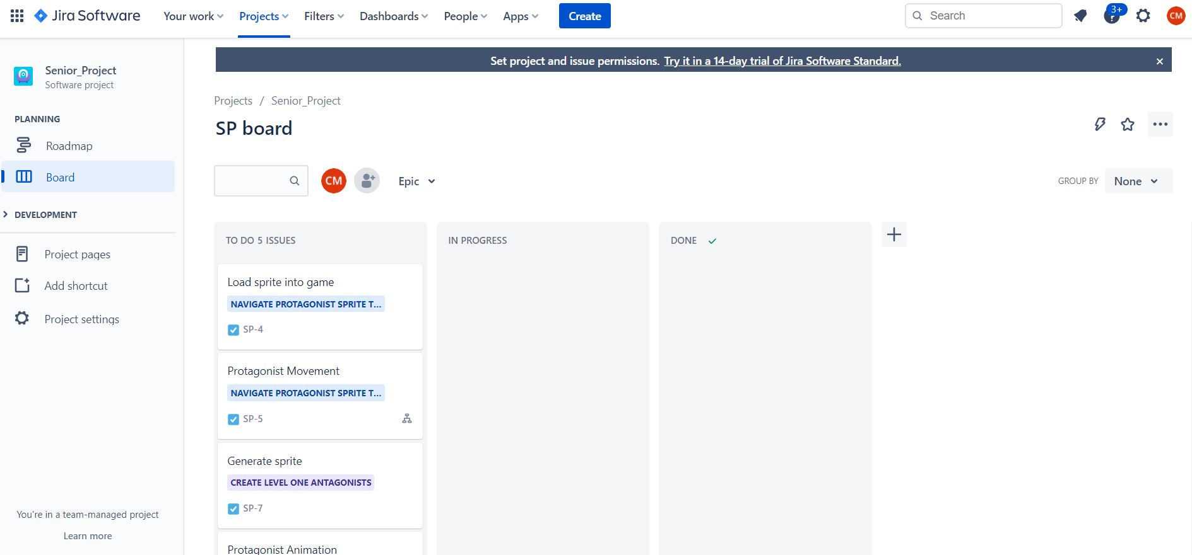
Assets
Jira Software from Atlassian (Atlassian.com)
Sprint dev manager

Slide 7
Timeline
First 3 sprints: Protagonist movement and munitions, start antagonist
Sprints 3-6: Finish Antagonist Sprites and upgrade first antagonists from first three sprints, test at each level
Sprints 6-9: Continue AI of antagonists and added graphics, start testing

Slide 8
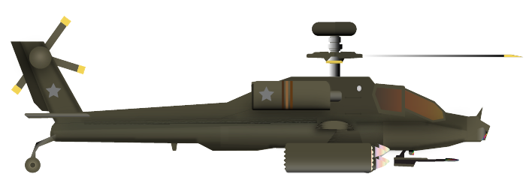

design
https://opengameart.org/content/war-pack

Slide 9
Questions?

